Slide 1
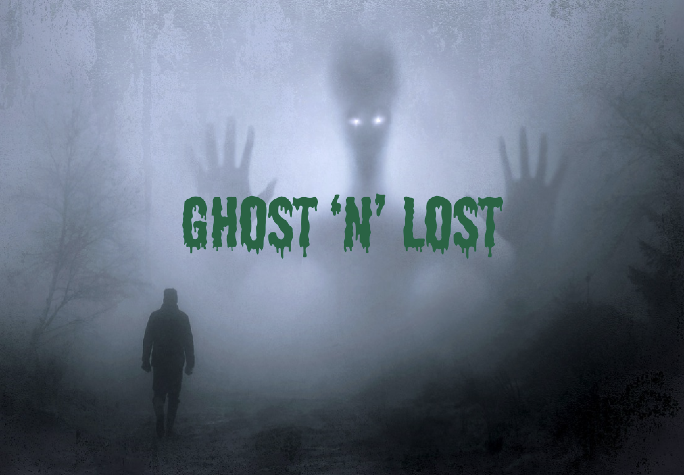

Slide 2
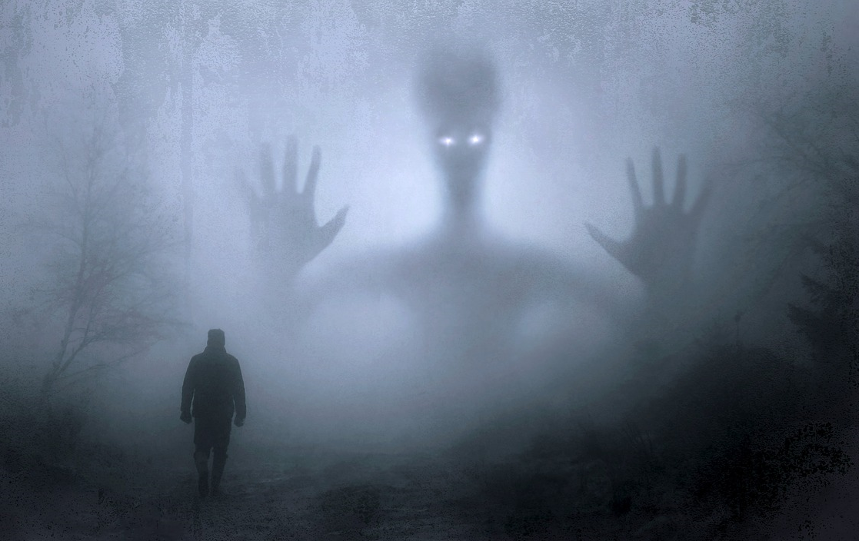
CONTENTS
Purpose
Game Idea
Game Story
Trasmission
Structure of the game
Conclusions
Demo

Slide 3
Purpose
3D
Switch first/third person
Scene graph transformations
Static and dynamic objects, interactions among objects
Material, textures
Audio effects, sounds
AI (NPC, enemies, ...)
Tutorial
Initial menu screen
Levels
Game over / victory screen

Slide 4
Game Idea
3D game
Impersonate a ghost
Travels through two dimensions
Search his material body.

Slide 5
Game Story
You are a researcher
Small town declared uninhabitable
Wake up as a ghost
48H Time
Find your body

Slide 6
Trasmission
Ghost to pass between dimensions
‘Re-transmit' the soul back to life.

Slide 7
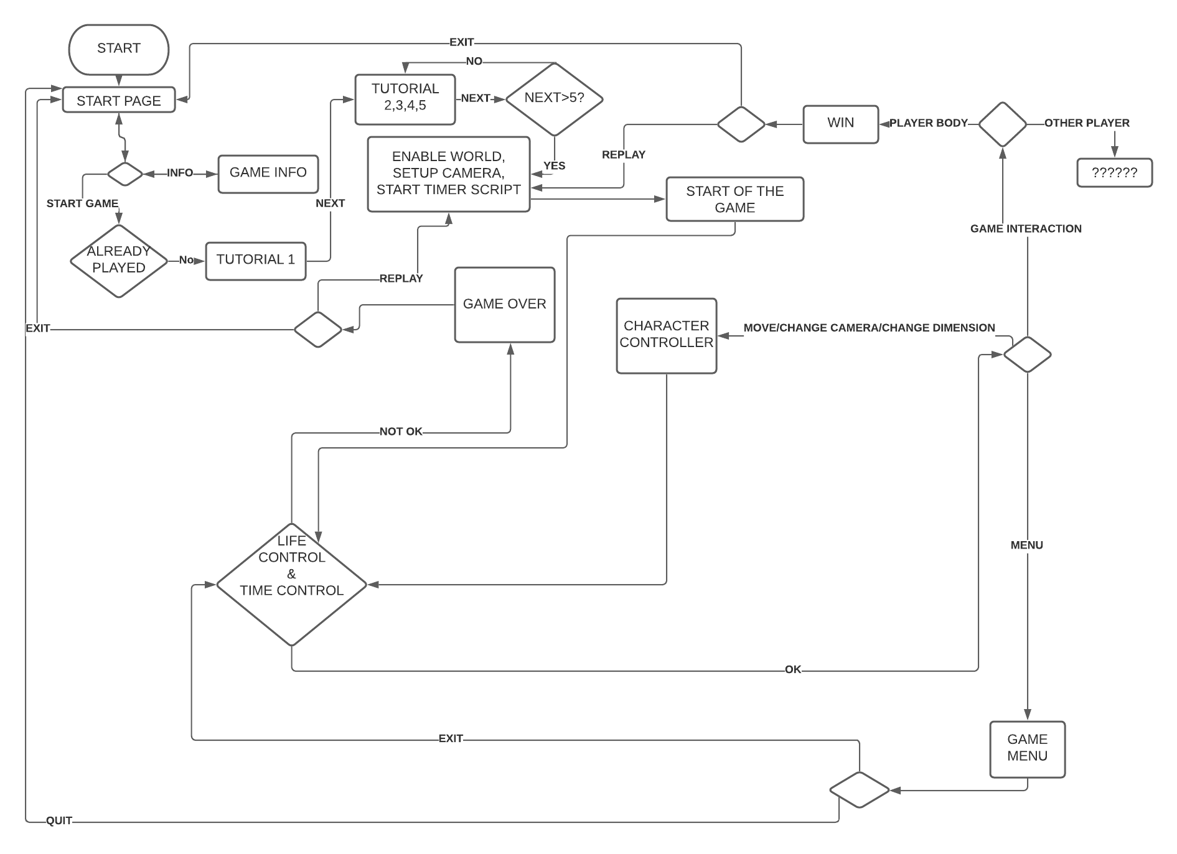
Structure of the game

Slide 8
Conclusions

Slide 9
