Slide 1

Los Angeles & Chicago
Homicide Crime Analysis
By:
Blanco, Andrea
Kawashima, Keith
Macias, Jennifer
Najera, Jose
Nguon, Chiv
Haghnazarian, Osheen

Slide 2
DATA SOURCE
Los Angeles Crime Data
https://catalog.data.gov/dataset/crime-data-from-2010-to-present
Chicago Crime Data
https://catalog.data.gov/dataset/crimes-2001-to-present-398a4

Slide 3
Purpose of analysis
New Insight for Crime Decreasing and Increasing
Information can be Utilized by the Chicago & Los Angeles Police Department & homeowners.

Slide 4
DATA SIZE
Data Set Size:
Combined equals approximately
1.7 GB of Data
Entries:
(Set 1CHI): 65,535 (Set 2LA).1,033,099

Slide 5
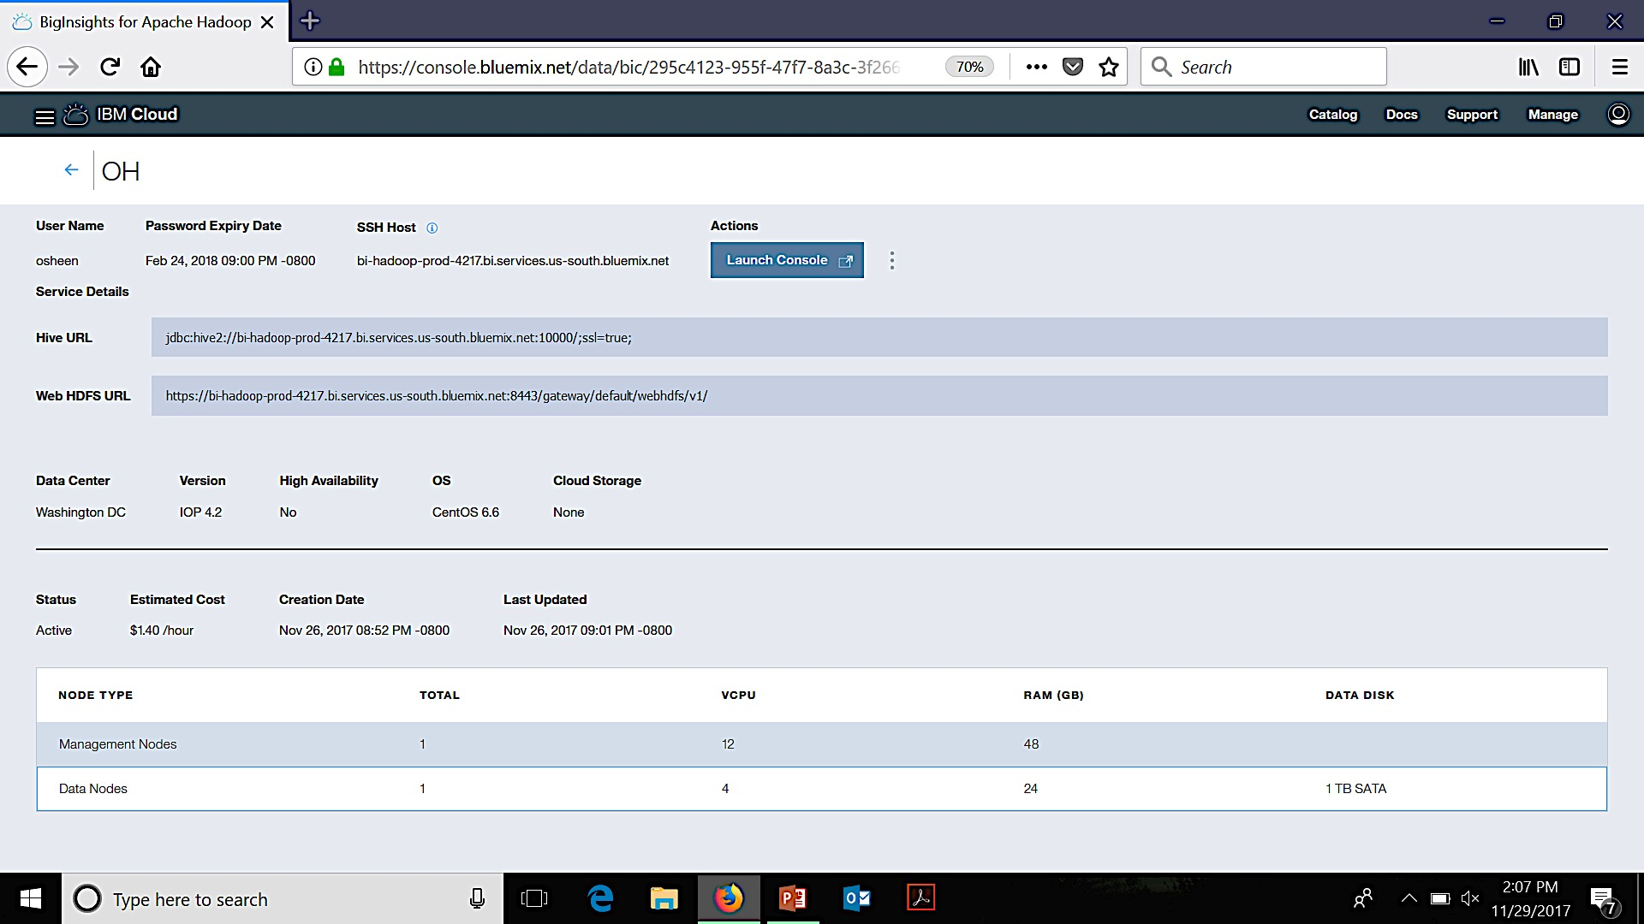
EXPERIMENTAL EXPECIFICATIONS
Cluster version:
IOP 4.2
Cluster number of nodes:
1 Data node
1 Management node

Slide 6
OBJECTIVE
We will analyze both data sets using Hive to see if crime rate has increased or decreased each year between both cities and compare which city has the most criminal homicide by location.
We will visualize the data on a geolocatin and graphs comparing by year the amount of crime.

Slide 7
HDFS & HIVE

Slide 8
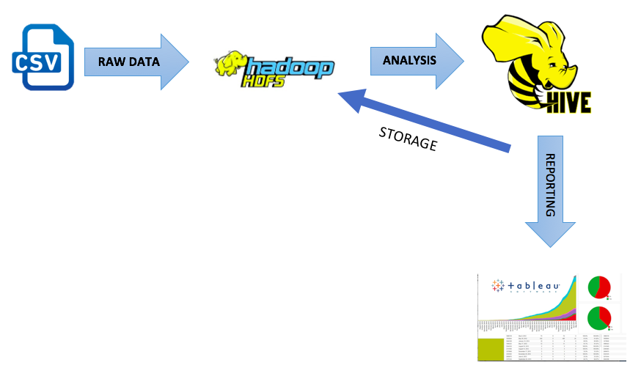
FLOWCHART OF DATA ANALYSIS

Slide 9
HDFS
(Los Angeles)
wget -O Crime_Data_from_2010_to_Present.csv
https://3-us-west-1.amazonaws.com/dreab/Crime_Data_from_2010_to_Present.csv
(Chicago)
wget -O Crimes_-_2001_to_present.cs
https://s3-us-west-1.amazonaws.com/dreab/Crimes_-_2001_to_present-2.csv

Slide 10
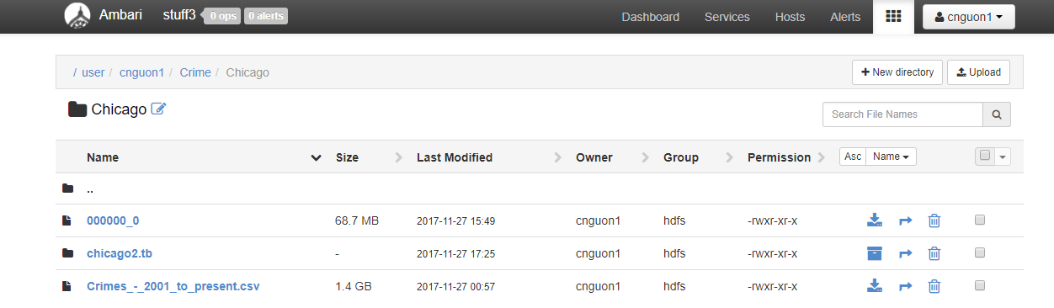
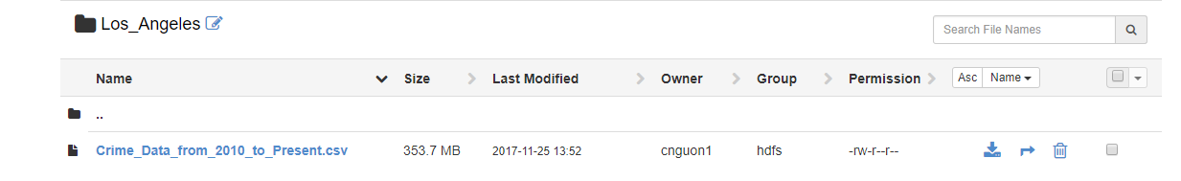
AMBARI – FILE BROWSER

Slide 11
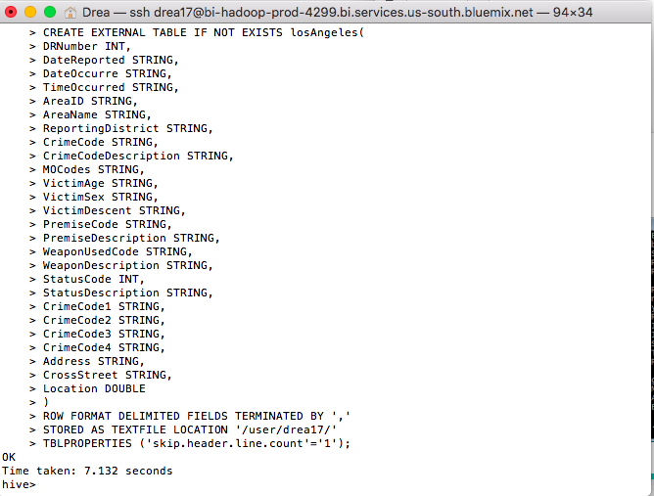
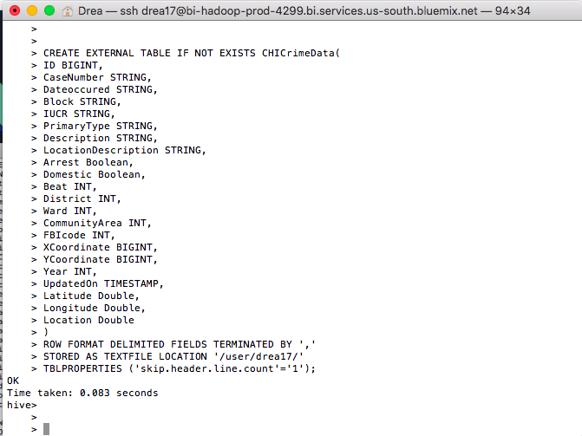
HIVE

Slide 12
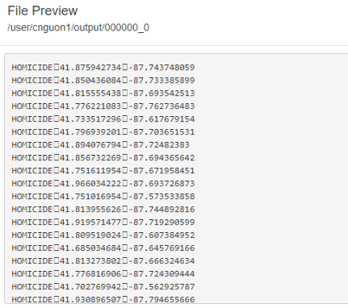
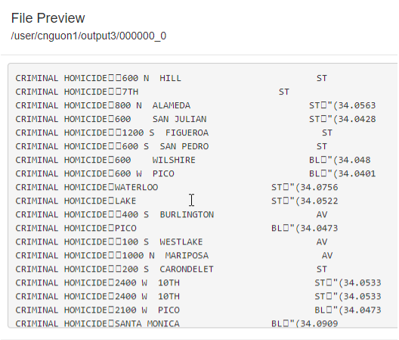
AMBARI – FILE BROWSWER
CHICAGO
LOS ANGEALES

Slide 13
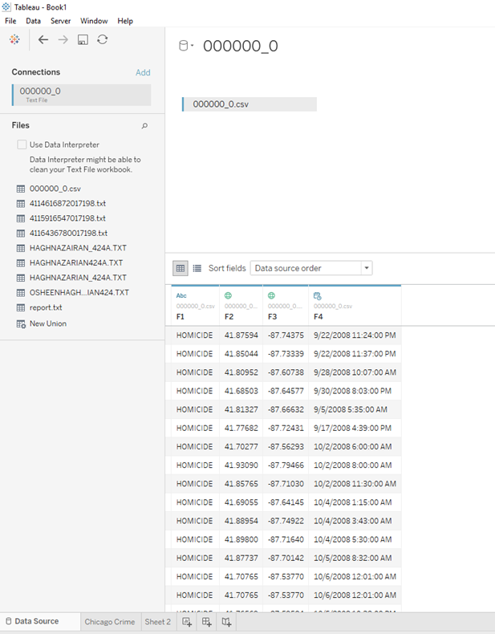
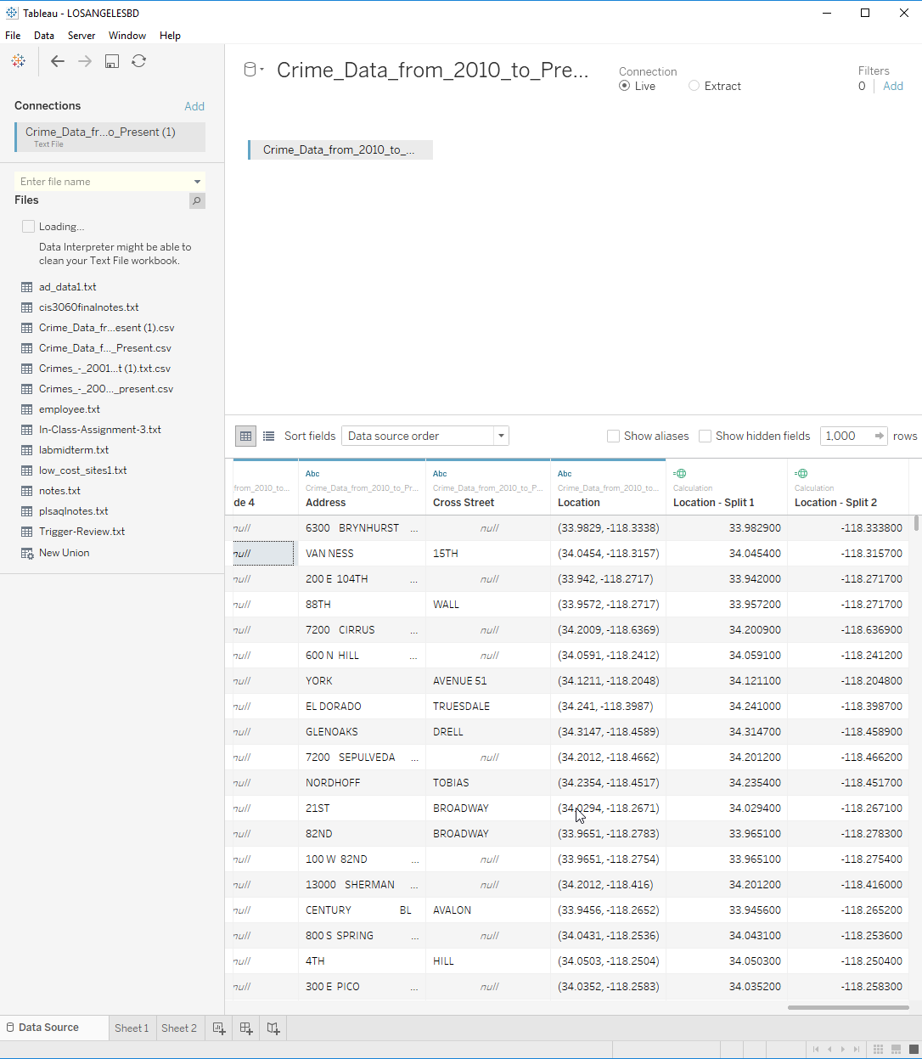
tableau
CHICAGO
LOS ANGEALES

Slide 14
VISUALIZATION

Slide 15
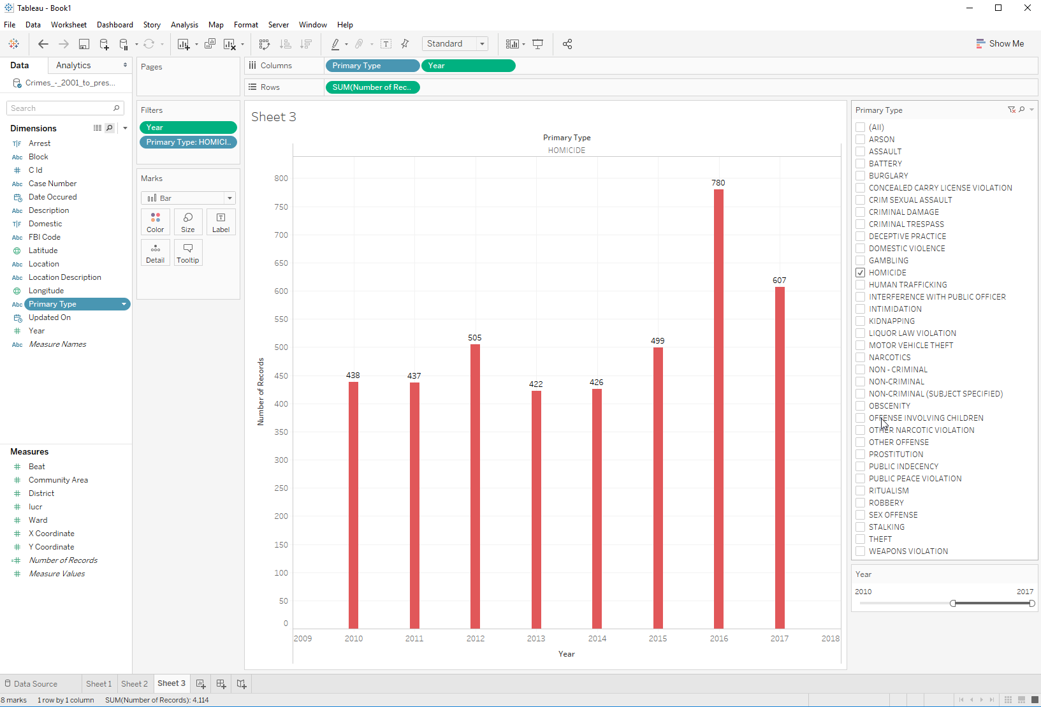
Chicago HOMICIDE CRIME Chart - 2010-2017

Slide 16
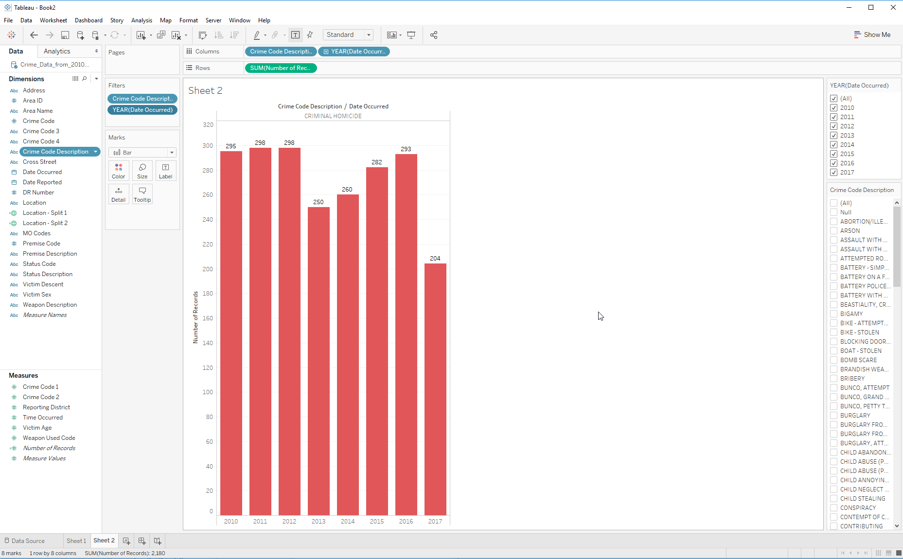
LA HOMICIDE CRIME Chart - 2010-2017

Slide 17
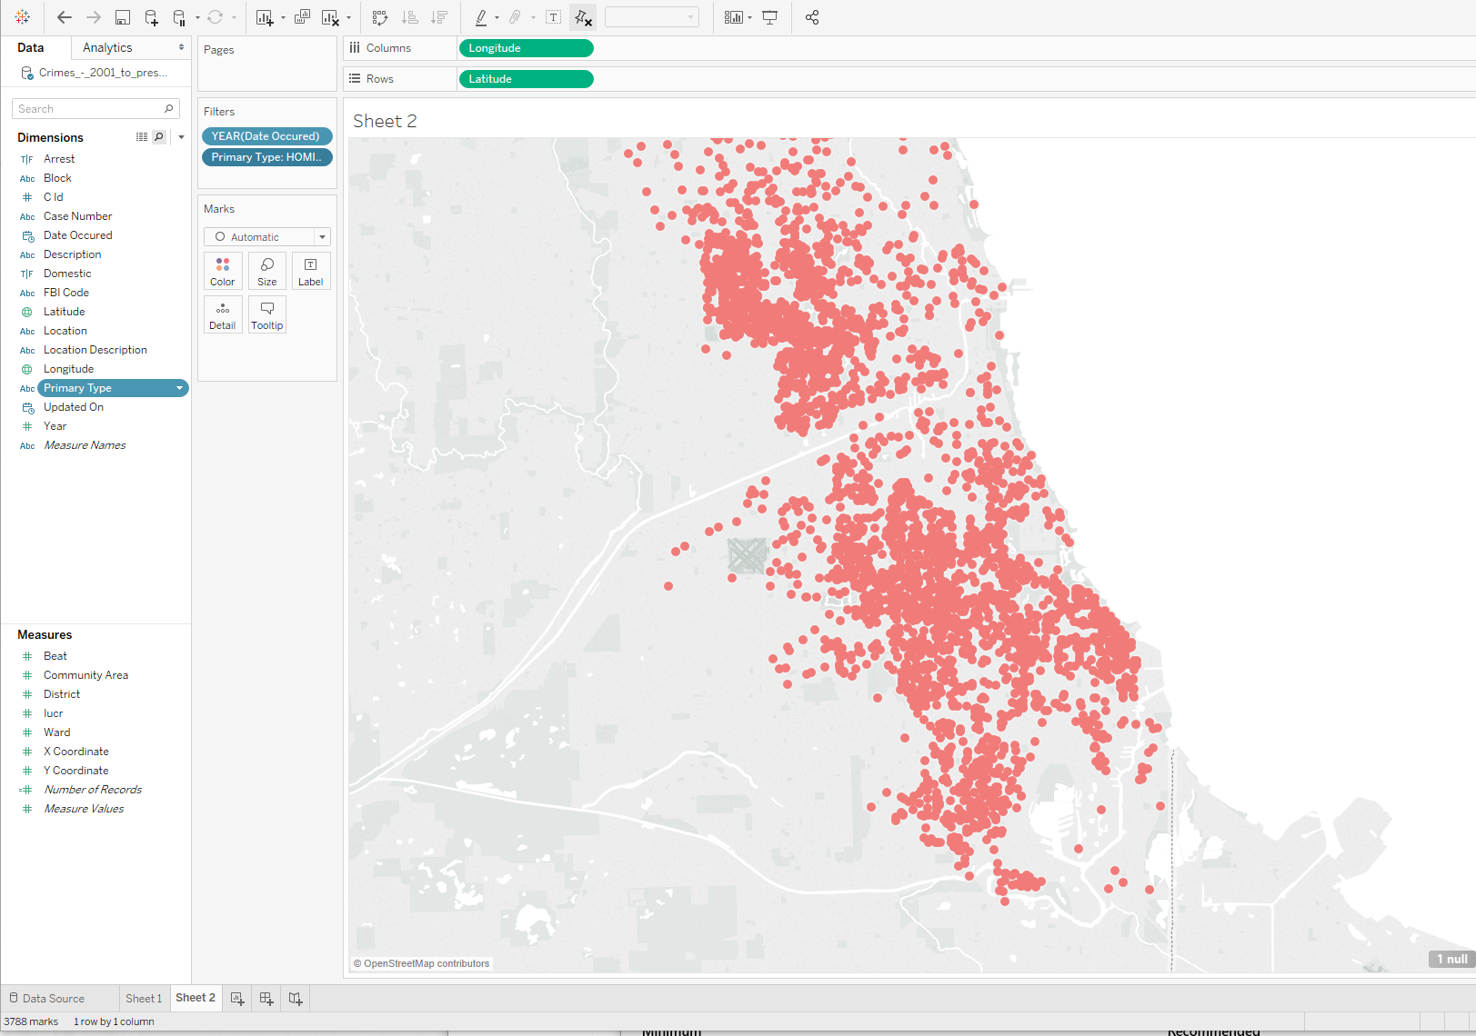
HOMICIDE CRIME BY LOCATION - CHICAGO

Slide 18
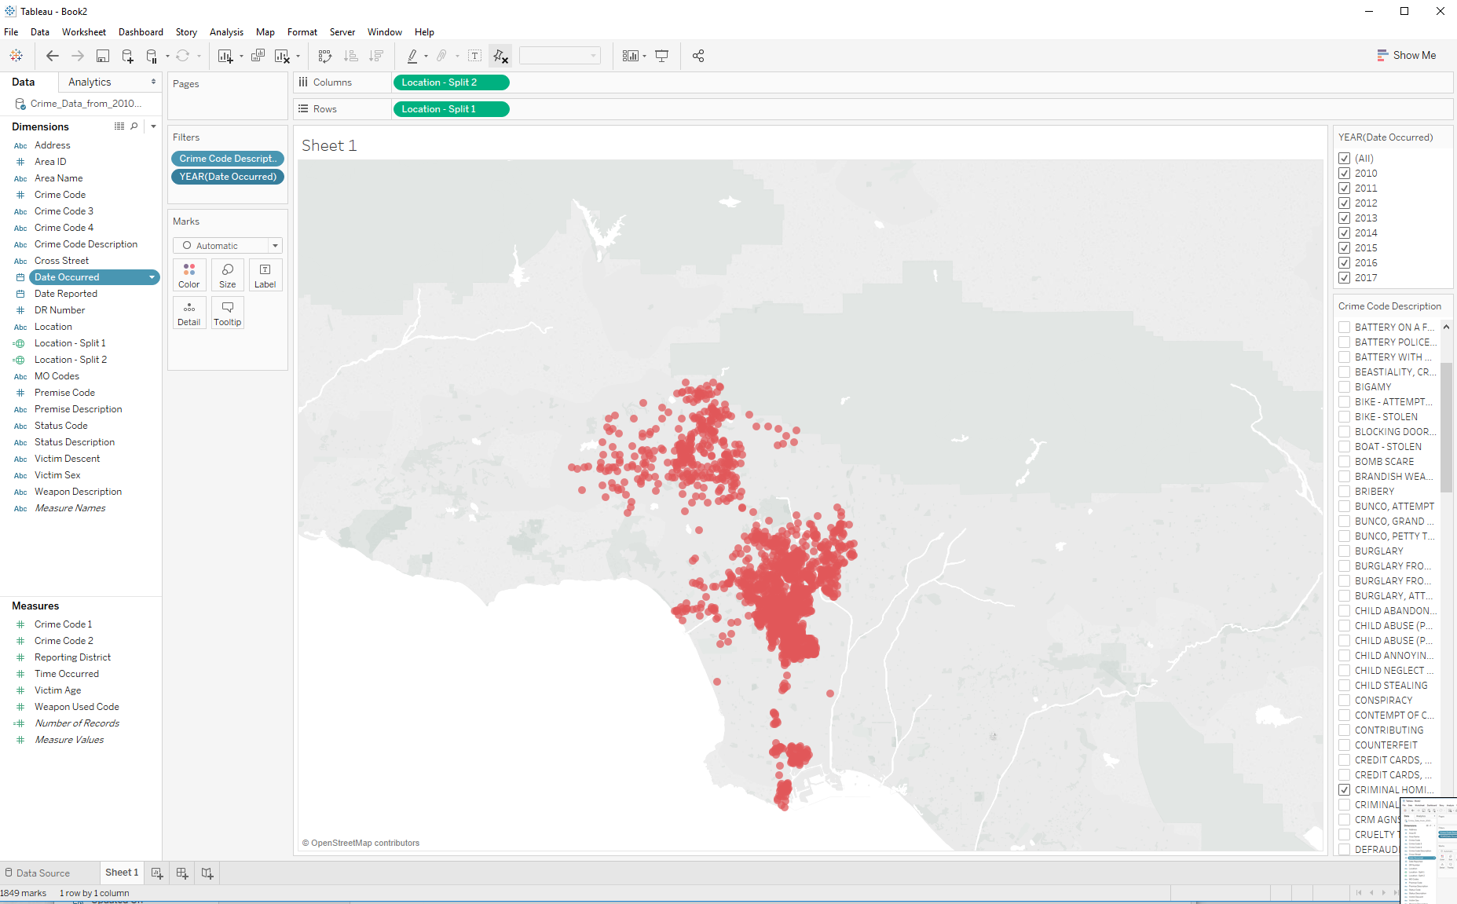
HOMICIDE CRIME BY LOCATION – LOS ANGELES

Slide 19
INTERESTING FACTS

Slide 20

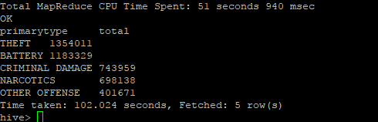
TOP 5 CRIMES PER CITY
LOS ANGELES
Battery
Burglary – From Vehicle
Vehicle – Stolen
Burglary
Theft Plain
CHICAGO
Theft
Battery
Criminal Damage
Narcotics
Other

Slide 21


The most frequent crime in 5 locations
LOS ANGELES
Battery
CHICAGO
Theft

Slide 22

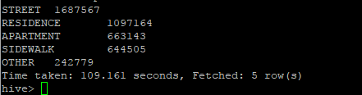
TOP 5 Premises where crimes are most committed
LOS ANGELES
Street
Single Family Dwelling
Multi-unit Dwelling
Parking Lot
Sidewalk
CHICAGO
Street
Residence
Apartment
Sidewalk
Other

Slide 23

QUESTIONS?

