Slide 1





Point-Spread Function Simulator for Fluorescence Microscopy
Fernando Caprile Andrea Bassi Fernando Stefani Luciano Masullo

Slide 2
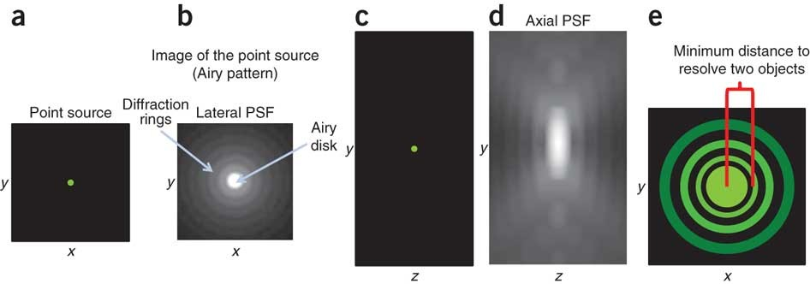
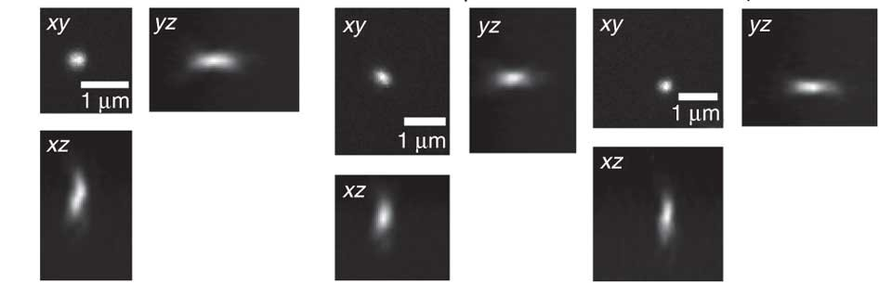
Why is the Point Spread Function important?
R. Cole et al, Nature Protocols 6, 1929–1941 (2011)

Slide 3
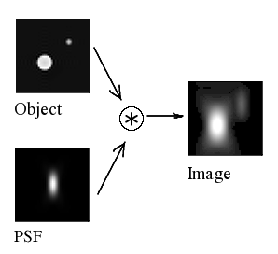
Why is the Point Spread Function important?
It directly determines the quality of the microscope image (resolution, contrast, etc)
R. Cole et al, Nature Protocols 6, 1929–1941 (2011)

Slide 4
Why is the Point Spread Function important?
It directly determines the quality of the microscope image (resolution, contrast, etc)
It can be engineered and used for super-resolution microscopy
R. Cole et al, Nature Protocols 6, 1929–1941 (2011)

Slide 5
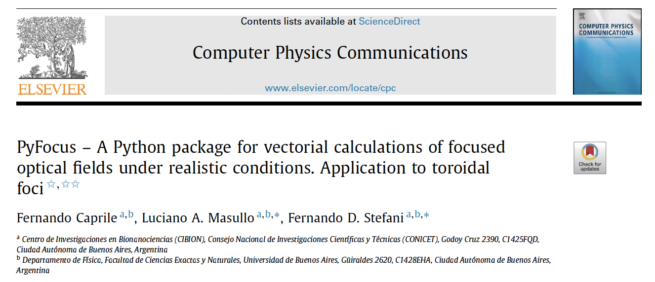

The PyFocus software package
https://pyfocus.readthedocs.io/en/latest/

Slide 6
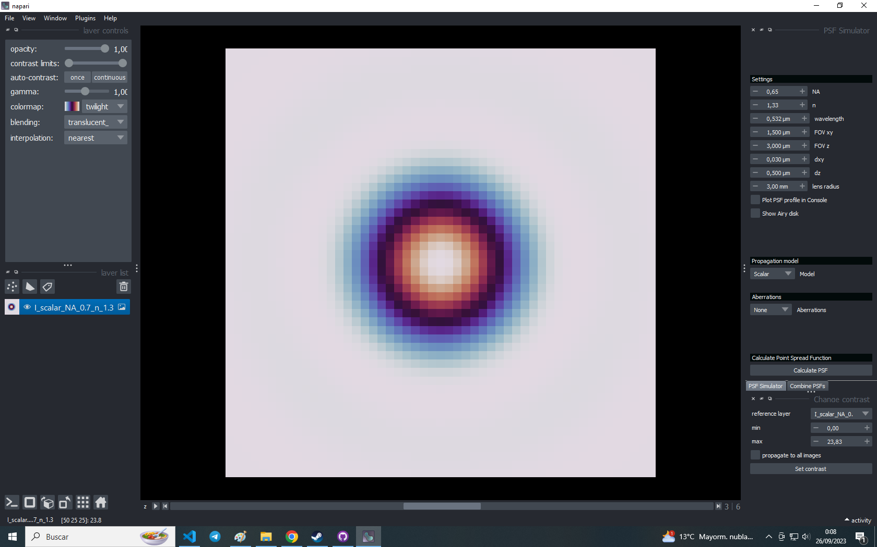
Simulator of focused fields (including PSF)

Slide 7
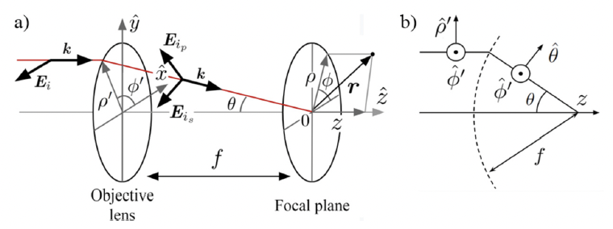
Simulator of focused fields (including PSF)
F. Caprile, L.A. Masullo and F.D. Stefani Computer Physics Communications 275 (2022) 108315

Slide 8
Simulator of focused fields (including PSF)
Two models:
F. Caprile, L.A. Masullo and F.D. Stefani Computer Physics Communications 275 (2022) 108315

Slide 9
Simulator of focused fields (including PSF)
Two models:
Scalar:
- Faster calculation (Fourier transform)
- Works well only for low NA
- Neglects polarization
F. Caprile, L.A. Masullo and F.D. Stefani Computer Physics Communications 275 (2022) 108315

Slide 10
Simulator of focused fields (including PSF)
Two models:
Scalar:
- Faster calculation (Fourier transform)
- Works well only for low NA
- Neglects polarization
Vectorial:
- Slower calculation (full field propagation)
- Works well for high NA
- Takes into account polarization
F. Caprile, L.A. Masullo and F.D. Stefani Computer Physics Communications 275 (2022) 108315

Slide 11
Applications in (super-resolution) fluorescence microscopy
High resolution confocal microscopy
PSF is critical

Slide 12
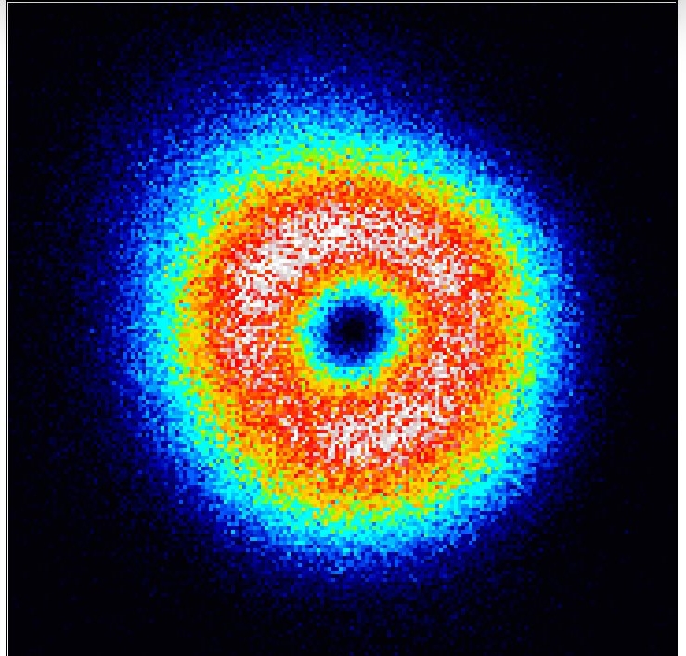
Applications in (super-resolution) fluorescence microscopy
High resolution confocal microscopy
STED microscopy
MINFLUX microscopy
PSF is critical
Doughnut-shaped beams, PSF is critical

Slide 13
Applications in (super-resolution) fluorescence microscopy
High resolution confocal microscopy
STED microscopy
MINFLUX microscopy
Image Scanning Microscopy (ISM)
PSF is critical
Doughnut-shaped beams, PSF is critical
PSF is critical, engineered PSF

Slide 14
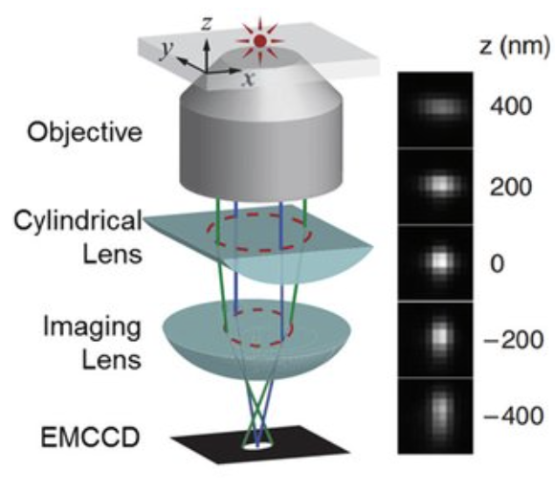
Applications in (super-resolution) fluorescence microscopy
High resolution confocal microscopy
STED microscopy
MINFLUX microscopy
Image Scanning Microscopy (ISM)
Single-molecule localization microscopy
PSF is critical
Doughnut-shaped beams, PSF is critical
PSF is critical, engineered PSF
Engineered PSF
Huang et al, Science (2008)

Slide 15
Unexpected applications!

Slide 16
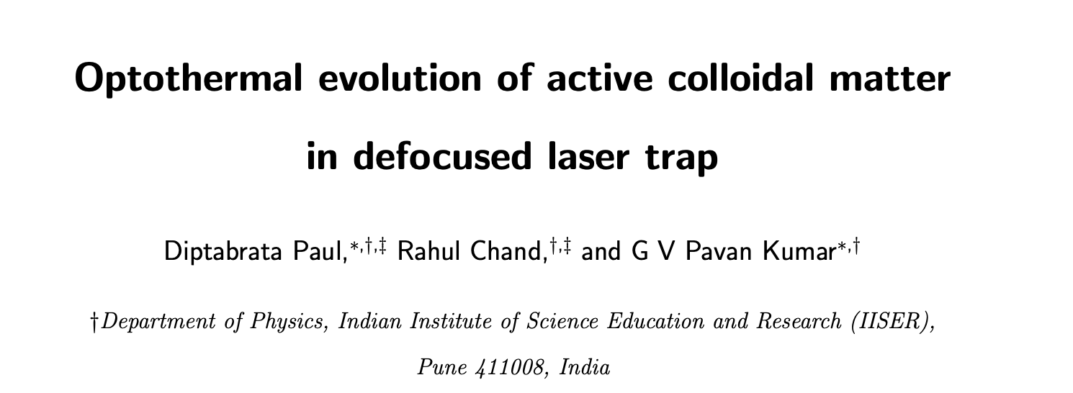
Unexpected applications!

Slide 17
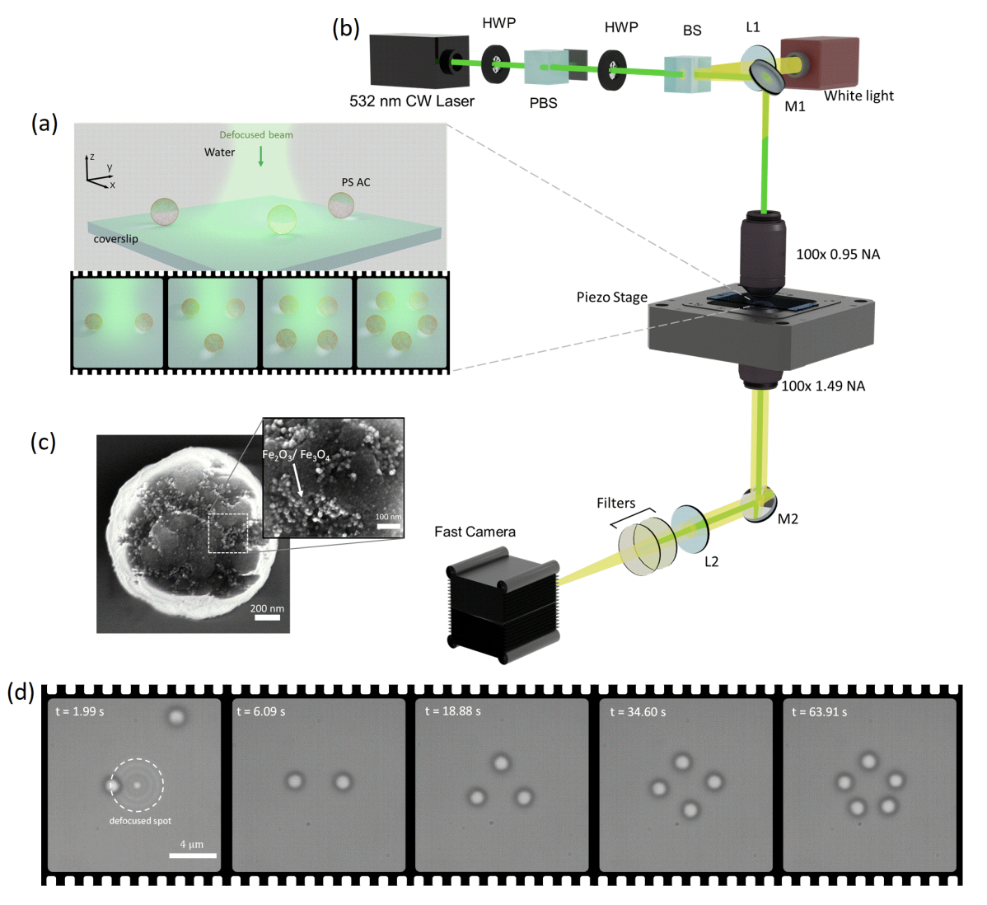
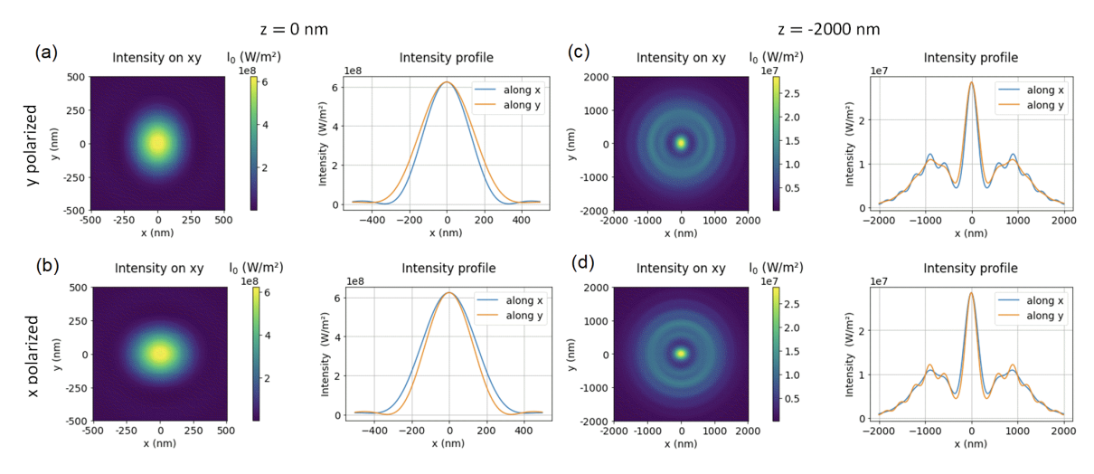
Unexpected applications!

