Slide 1
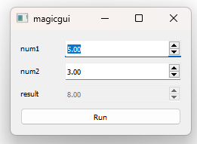
Exercise 1: create a magicgui function that sums two input float numbers
and shows the result on the UI as a third float number when you press “Run”
Bonus point if you remove the arrows
https://github.com/andreabassi78/napari_workshop_milan/tree/main/day1/bassi_napari_intro

Slide 2
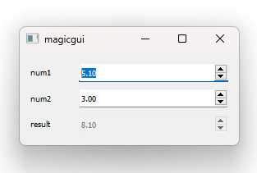
Exercise 1b: repeat the previous exercise, removing the “Run” button
and updating the result in the event of a change of the input value num1
https://github.com/andreabassi78/napari_workshop_milan/tree/main/day1/bassi_napari_intro

Slide 3
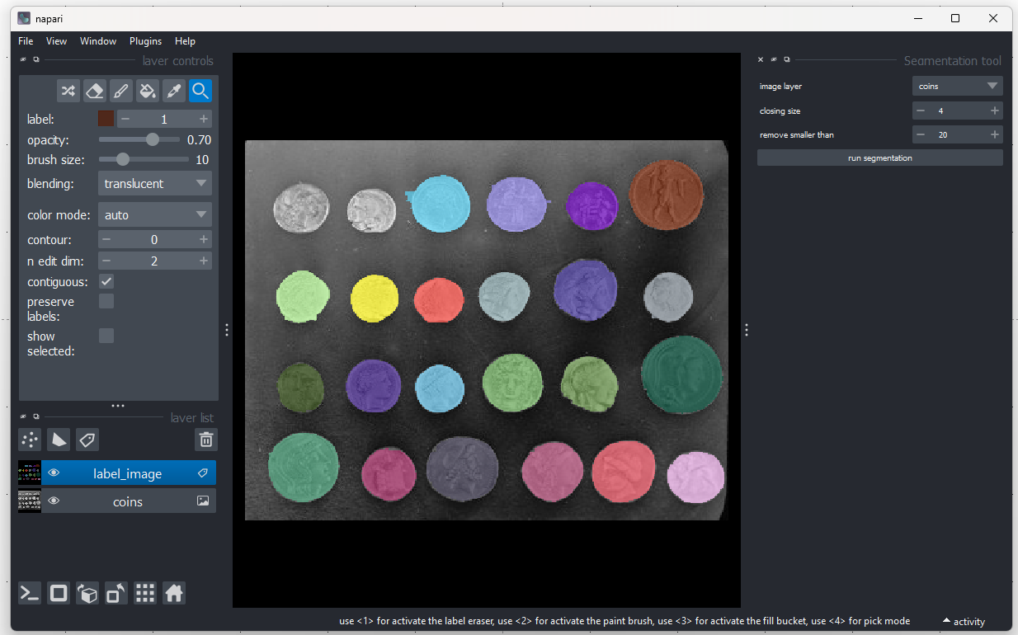
Exercise 2: create a segmentation widget that takes an image-layer, and returns a segmentation label-layer
Bonus point if you improve the quality of the segmentation
Coins image available on the GitHub repository
https://github.com/andreabassi78/napari_workshop_milan/tree/main/day1/bassi_napari_intro

Slide 4
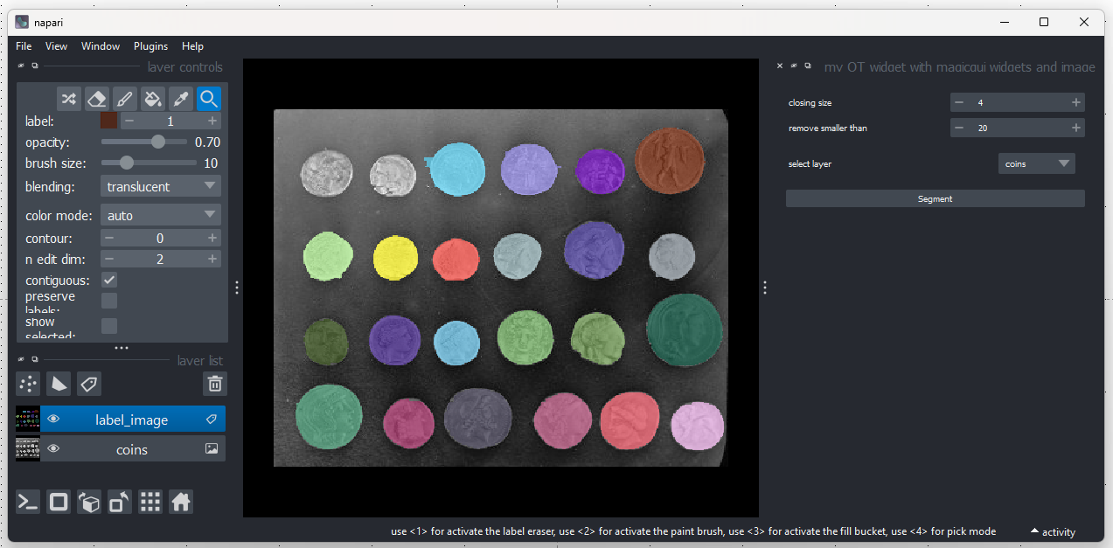
Exercise 3: create a QT widget with a “magicgui-like” combo box for the image layer selection
https://github.com/andreabassi78/napari_workshop_milan/tree/main/day1/bassi_napari_intro

Slide 5
Exercise 4: create a code for generating a random image pixel-by-pixel,
using the threadworker
https://napari.org/stable/guides/threading.html
https://github.com/andreabassi78/napari_workshop_milan/tree/main/day1/bassi_napari_intro

Slide 6
Exercise 4b: create a code for generating a random image pixel-by-pixel,
using the threadworker, yielding instead of returning
https://napari.org/stable/guides/threading.html
https://github.com/andreabassi78/napari_workshop_milan/tree/main/day1/bassi_napari_intro

