Slide 1



Slide 2
TIDY DATA
Notes:
‹#›

Slide 3
TIDY DATA
Notes:
‹#›

Slide 4
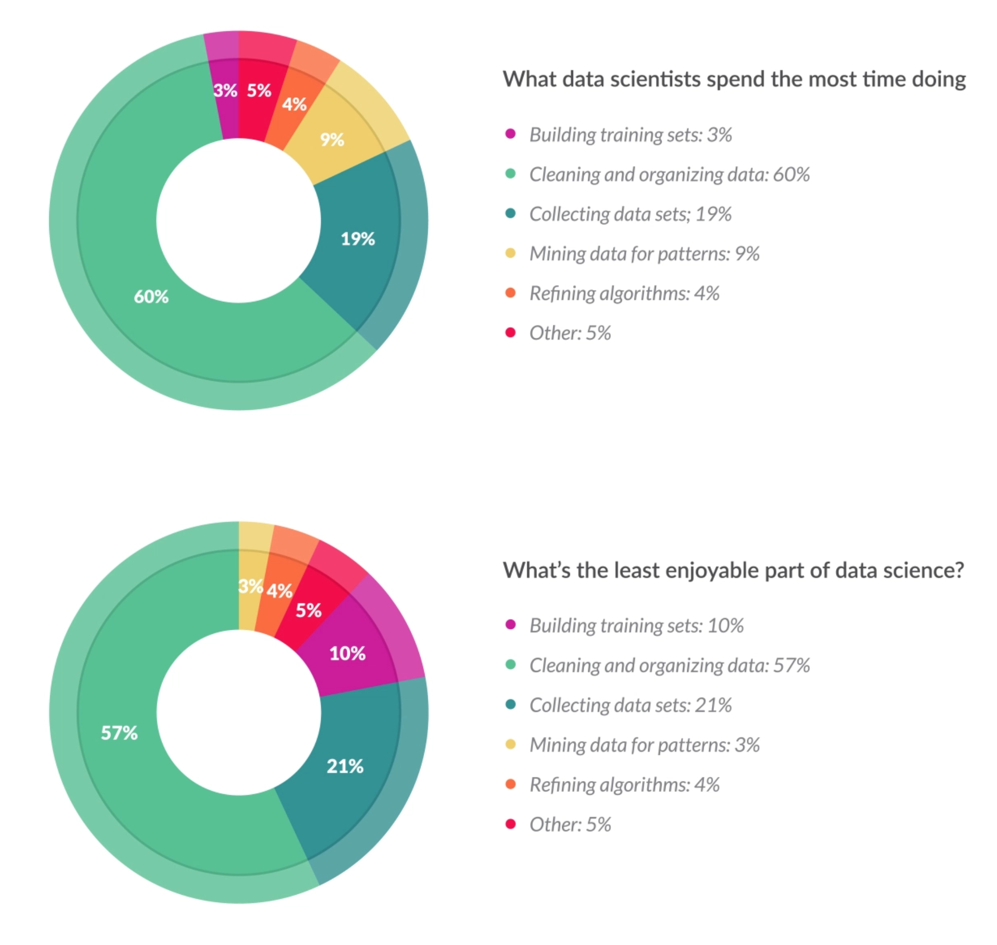
TIDY DATA
https://whatsthebigdata.com/2016/05/01/data-scientists-spend-most-of-their-time-cleaning-data/
Notes:
‹#›

Slide 5
TIDY DATA
https://whatsthebigdata.com/2016/05/01/data-scientists-spend-most-of-their-time-cleaning-data/
Notes:
‹#›

Slide 6
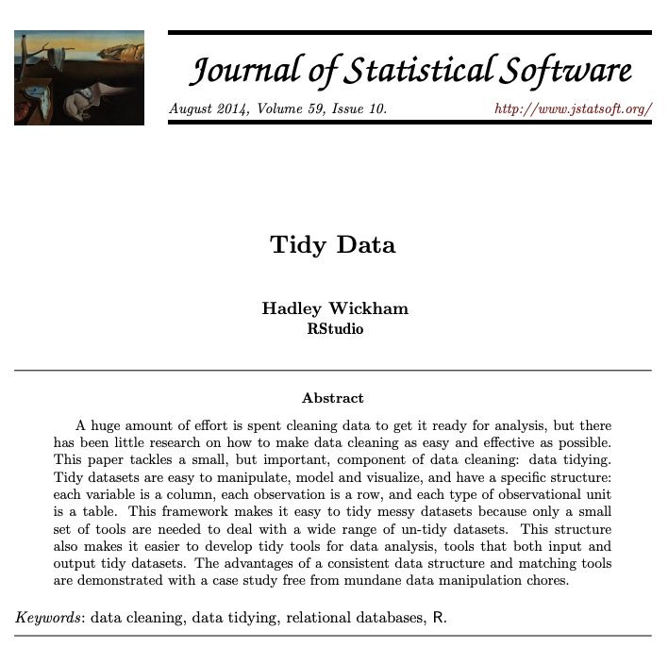
TIDY DATA
REFERENCES
AI
ML
DL
Notes:
‹#›

Slide 7
TIDY DATA
WHY?
WHY TIDY DATA?
real world dataset are not tidy.
‘tidy datasets are all alike but every messy dataset is messy in its own way’.(Hadley Wickham, Tidy Data).
Tidy data manifesto:
each variable forms a column
each observation forms a row
each type of observational unit form a table
AI
ML
DL
Notes:
‹#›

Slide 8
TIDY DATA
JARGON
JARGON
a dataset is a set of related tables
a table is a collection of values sorted in column and rows
a value
can be quantitative (numeric) or qualitative (character)
belongs to a variable and a observation
a variable contains all values that measure the same underlying attribute (like height, temperature, duration)
an observation contains all values measures on the same unit (like a person, a day or a city) across attributes
there should be a table for each kind of variable to avoid storing duplicate values
AI
ML
DL
Notes:
‹#›

Slide 9
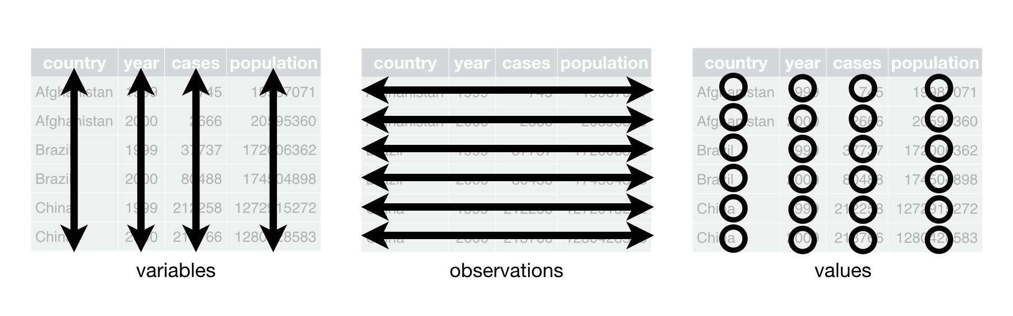
TIDY DATA
REFERENCES
AI
ML
DL
Notes:
‹#›

Slide 10
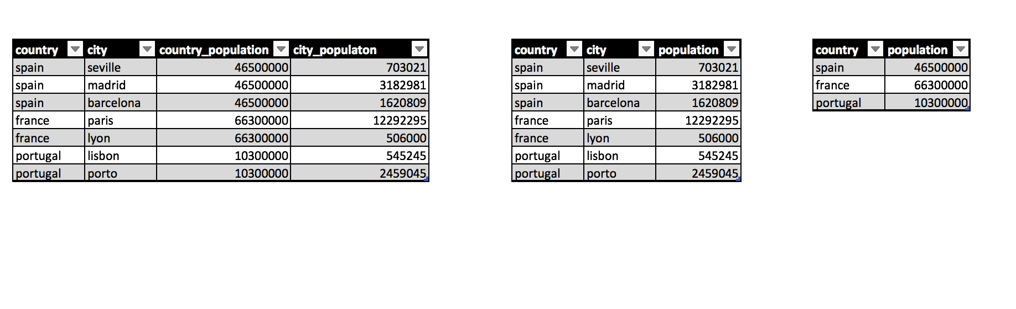
TIDY DATA
QUIZ
DL
Notes:
‹#›

Slide 11
TIDY DATA
QUIZ
DL
Notes:
‹#›

Slide 12
TIDY DATA
QUIZ
DL
Notes:
‹#›

Slide 13
TIDY DATA
UNDER THE HOOD
DL
it is easier to describe functional relationships between variables than between rows
it is easier to make comparisons between groups of observations than between groups of columns.
Notes:
‹#›

Slide 14
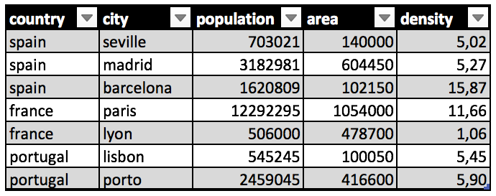
TIDY DATA
UNDER THE HOOD
DL
it is easier to describe functional relationships between variables than between rows
it is easier to make comparisons between groups of observations than between groups of columns.
columns work better to describe functional relationships
rows work better
to make comparisons
Notes:
‹#›

Slide 15
TIDY DATA
MAIN PROBLEMS
Real datasets can, and often do, violate the three precepts of tidy data in almost every way imaginable.
The five most common problems with messy datasets
column headers are values, not variable names.
multiple variables are stored in one column.
variables are stored in both rows and columns.
multiple types of observational units are stored in the same table.
a single observational unit is stored in multiple tables.
DL
Notes:
‹#›

Slide 16
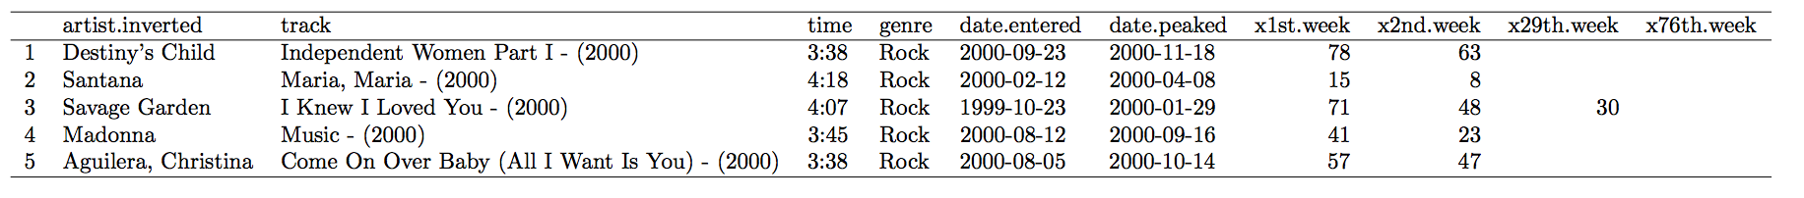
TIDY DATA
MAIN PROBLEMS
COLUMNS HEADER ARE VALUES
DL
Notes:
‹#›

Slide 17
TIDY DATA
MAIN PROBLEMS
COLUMNS HEADER ARE VALUES
DL
The Billboard dataset records the date of a song first entered the Billboard Top 100.
It has the variables of the year, the artist the name of the track, the duration, the date when the song enter the list and the position in the list the first week, the second week, an so on until the week 76.
In case the song skips the top 100 list in less than 76 weeks the remaining week will be filled with NAs
Notes:
‹#›

Slide 18
TIDY DATA
MAIN PROBLEMS
COLUMNS HEADER ARE VALUES
DL
The Billboard dataset records the date of a song first entered the Billboard Top 100.
It has the variables of the year, the artist the name of the track, the duration, the date when the song enter the list and the position in the list the first week, the second week, an so on until the week 76.
In case the song skips the top 100 list in less than 76 weeks the remaining week will be filled with NAs
Notes:
‹#›

Slide 19
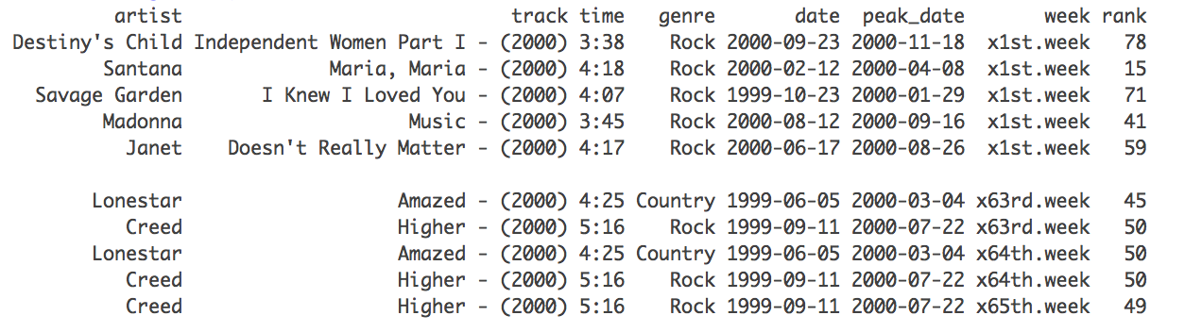
TIDY DATA
MAIN PROBLEMS
MULTIPLE VARIABLES STORED IN ONE COLUMN
DL
Notes:
‹#›

Slide 20
TIDY DATA
MAIN PROBLEMS
MULTIPLE VARIABLES STORED IN ONE COLUMN
DL
Notes:
‹#›

Slide 21
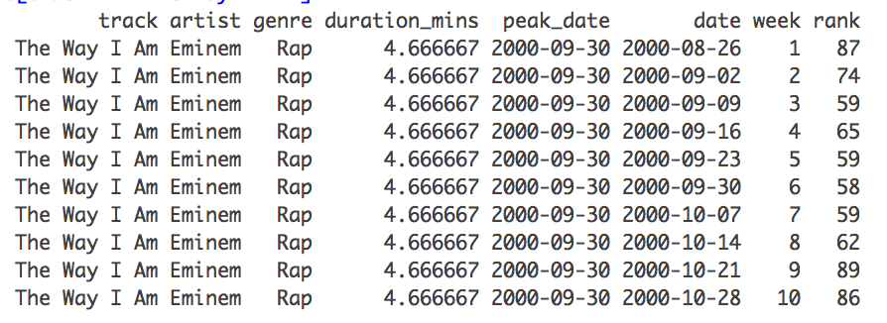
TIDY DATA
MAIN PROBLEMS
MORE THAN ONE OBSERVATIONAL UNIT IN ONE TABLE
DL
Notes:
‹#›

Slide 22
TIDY DATA
MAIN PROBLEMS
MORE THAN ONE OBSERVATIONAL UNIT IN ONE TABLE
DL
Notes:
‹#›

Slide 23
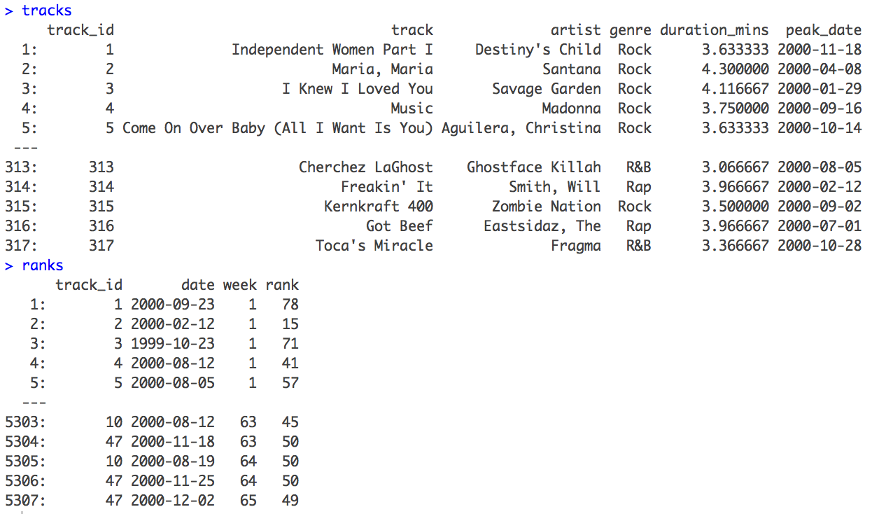
TIDY DATA
MAIN PROBLEMS
MORE THAN ONE OBSERVATIONAL UNIT IN ONE TABLE
DL
Notes:
‹#›

Slide 24
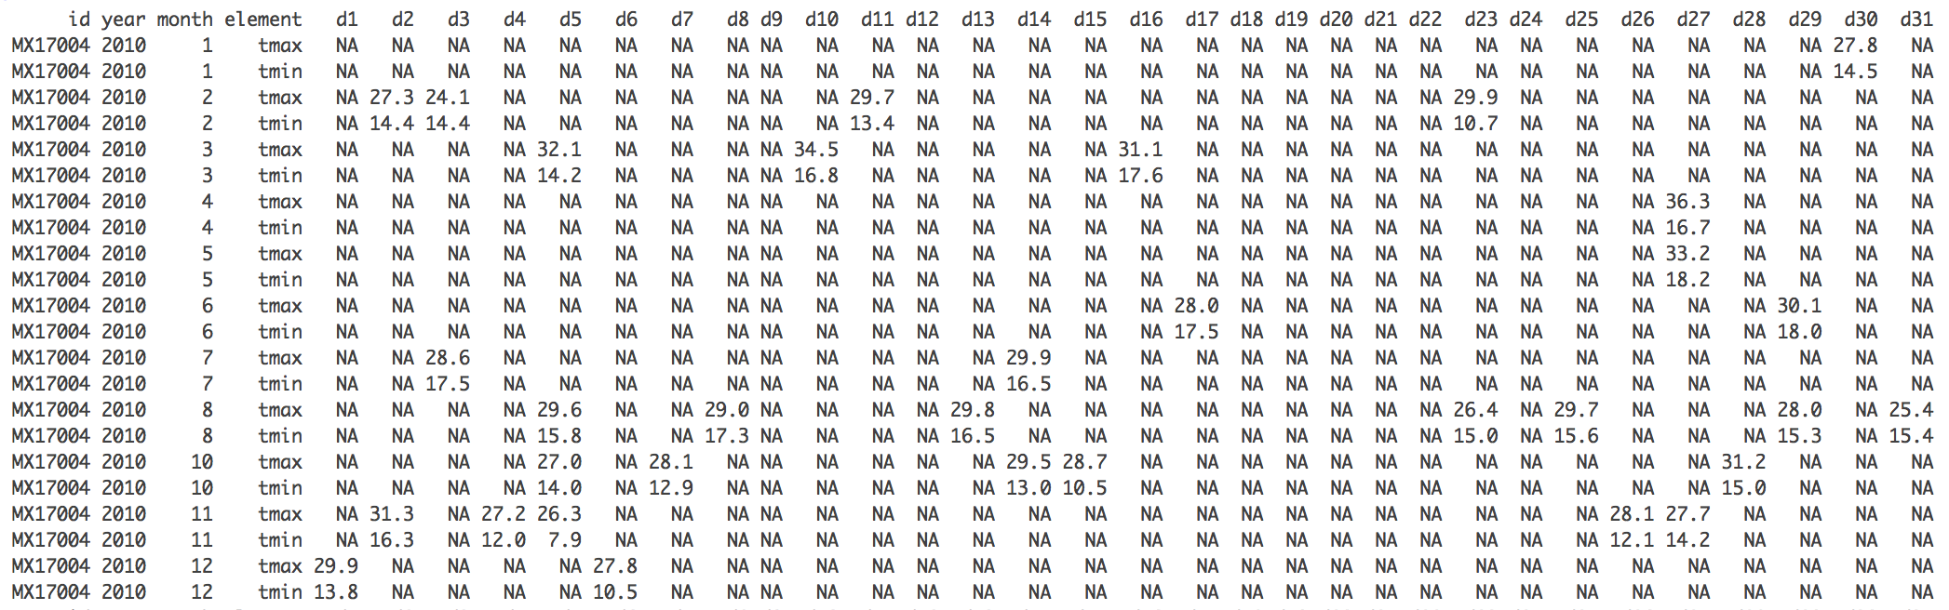
TIDY DATA
MAIN PROBLEMS
VARIABLES STORED IN BOTH ROWS AND COLUMNS
Weather temperature. Maximum temp and minimum temp per day
Notes:
‹#›

Slide 25
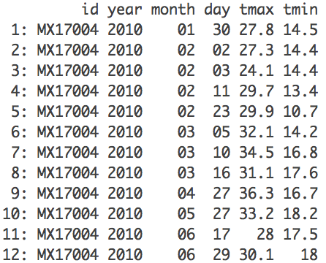
TIDY DATA
MAIN PROBLEMS
VARIABLES STORED IN BOTH ROWS AND COLUMNS
Weather temperature. Maximum temp and minimum temp per day
Notes:
‹#›

Slide 26
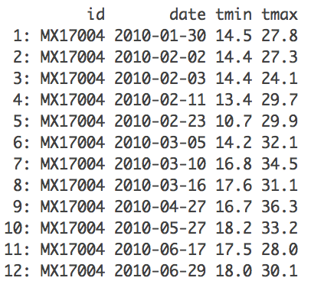
TIDY DATA
MAIN PROBLEMS
VARIABLES STORED IN BOTH ROWS AND COLUMNS
Weather temperature. Maximum temp and minimum temp per day
Notes:
‹#›

Slide 27


