Slide 1



Slide 2
principal components analysis
Notes:
‹#›

Slide 3
Notes:
‹#›

Slide 4

pca
references
Section 10.2
An Introduction to Statistical Learning
by Gareth James, et al.
https://www-bcf.usc.edu/~gareth/ISL/ISLR%20Seventh%20Printing.pdf
Notes:
‹#›

Slide 5
pca
theory
It is not a machine learning algorithm!
It is an unsupervised statistical technique used to examine the interrelation among a set of variables in order to identify the underlying structure of those variables
It is also known in general terms as factor analysis
Notes:
‹#›

Slide 6
pca
theory
where regression determines a line of best fit to a data set, factor analysis determines several orthogonal lines of best fit to the data set.
Orthogonal means “at right angles”.
Actually the lines are perpendicular to each other in n-dimensional space
n-Dimensional Space is the variable sample space
There are as many dimensions as there are variable, so in a dataset with 4 variables the sample space has 4 dimensions
Notes:
‹#›

Slide 7
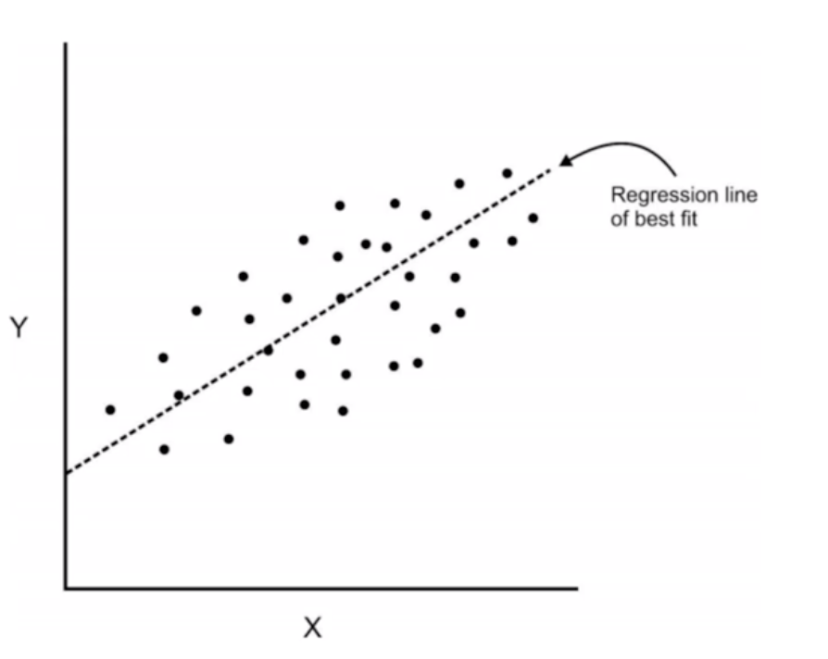
pca
theory
here we have some data plotted along two features, x and y
Notes:
‹#›

Slide 8
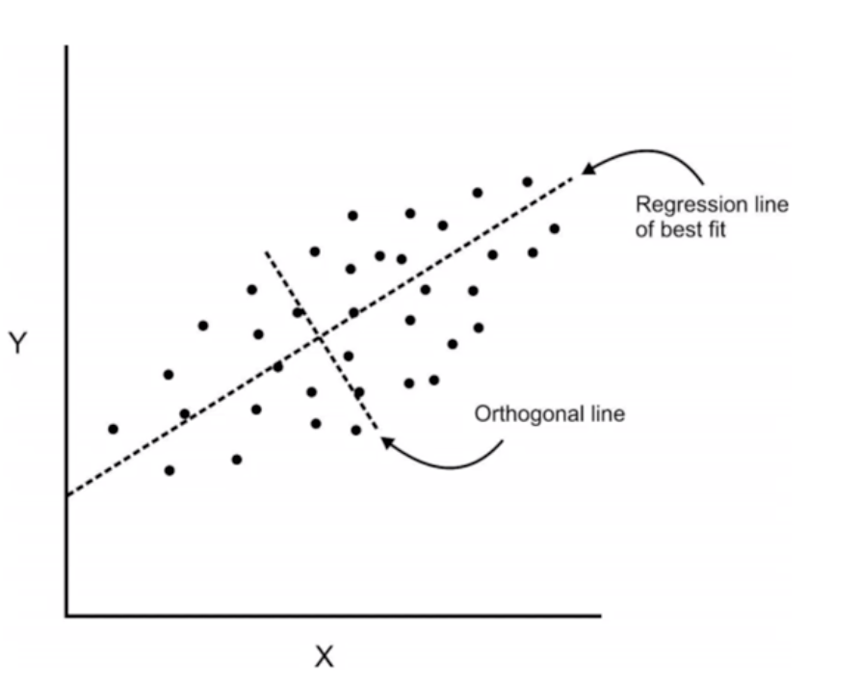
pca
theory
here we have some data plotted along two features, x and y
we can add an orthogonal line
Now we can begin to understand the components!
Notes:
‹#›

Slide 9
pca
theory
Components are a linear transformation that choose a variable system for the dataset such that the greatest variance of the dataset comes to lie on the first axis
Notes:
‹#›

Slide 10
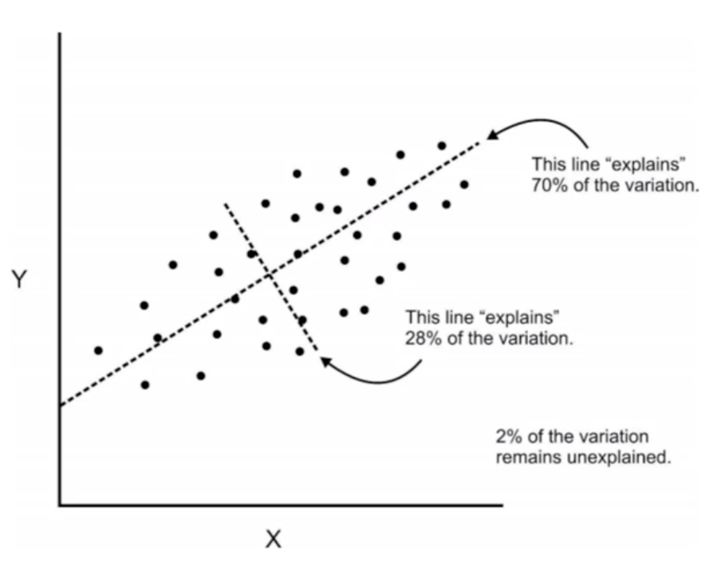
pca
theory
The second greatest variance on the second axis and so on..
this process allows us to reduce the number of variables used in a analysis.
Notes:
‹#›

Slide 11
pca
theory
note that components are uncorrelated since in the same space the are orthogonal to each other
Notes:
‹#›

Slide 12
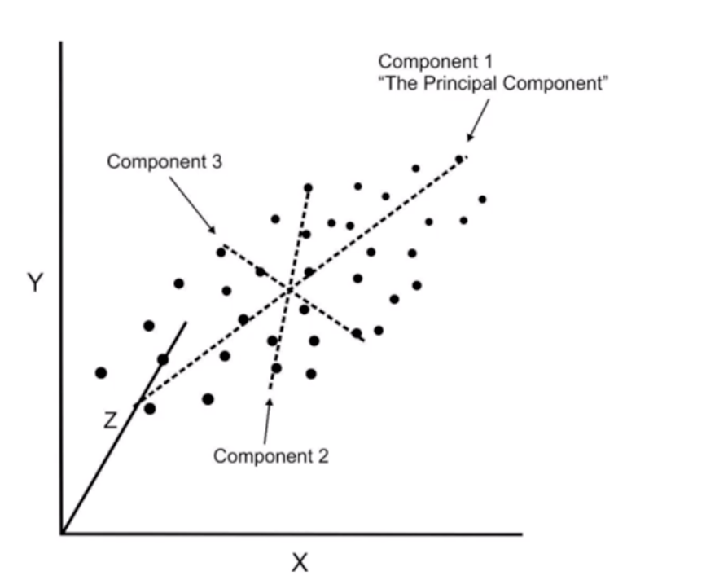
pca
theory
we can continue this analysis into higher dimensions
Notes:
‹#›

Slide 13
pca
analogy
we can continue this analysis into higher dimensions
Notes:
‹#›

Slide 14
pca
theory
we can continue this analysis into higher dimensions
Notes:
‹#›

Slide 15
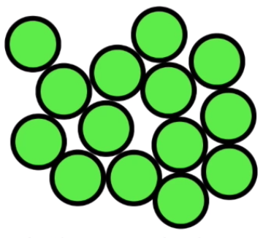
pca
analogy
Notes:
‹#›

Slide 16
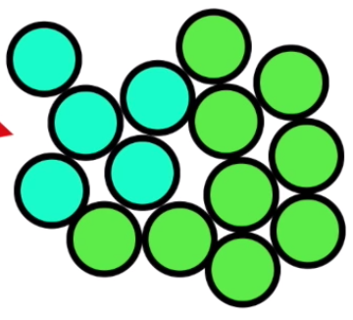
pca
analogy
Notes:
‹#›

Slide 17
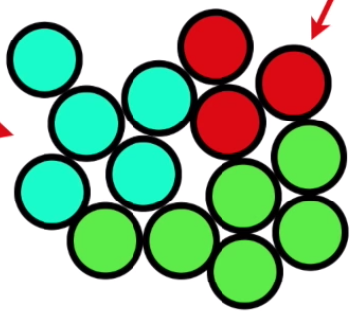
pca
analogy
Notes:
‹#›

Slide 18
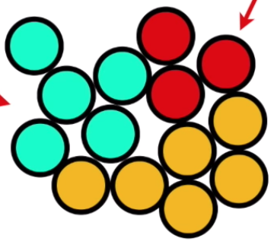
pca
analogy
Notes:
‹#›

Slide 19
pca
analogy
we know the cells are different but we can not observe differences from the outside
Notes:
‹#›

Slide 20
pca
analogy
we know the cells are different but we can not observe differences from the outside
so we sequence the mRNA in each cell to identify which genes are active. This tell us what the cell is doing
Notes:
‹#›

Slide 21
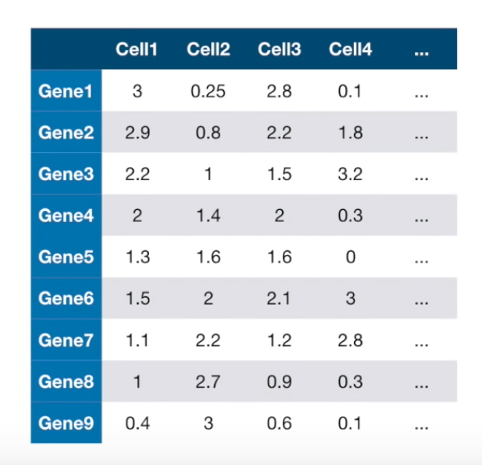
pca
analogy
we know the cells are different but we can not observe differences from the outside
so we sequence the mRNA in each cell to identify which genes are active. This tell us what the cell is doing
Notes:
‹#›

Slide 22
pca
analogy
each column show how much each gene is transcribed in each cell
Notes:
‹#›

Slide 23
pca
analogy
each column show how much each gene is transcribed in each cell
let’s imagine there were only 2 cells
Notes:
‹#›

Slide 24
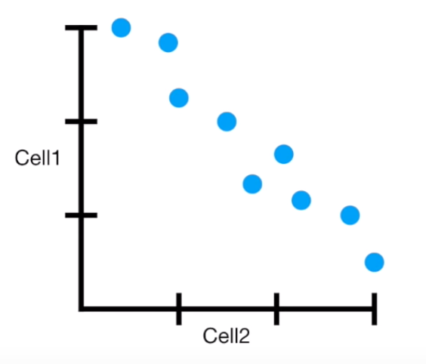
pca
analogy
gene 1 is highly transcribed in cell1 and lowly transcribed in cell2
Notes:
‹#›

Slide 25
pca
analogy
gene 9 is lowly transcribed in cell1 and highly transcribed in cell2
Notes:
‹#›

Slide 26
pca
analogy
cell1 and cell2 have a clear inverse correlations
Notes:
‹#›

Slide 27
pca
analogy
This may means that they are probably two different types of cells using different genes
Notes:
‹#›

Slide 28
pca
analogy
Notes:
‹#›

Slide 29
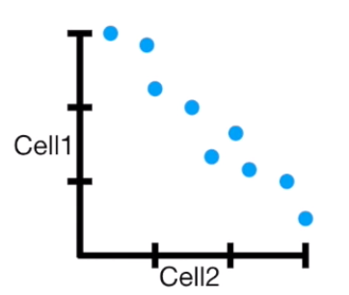
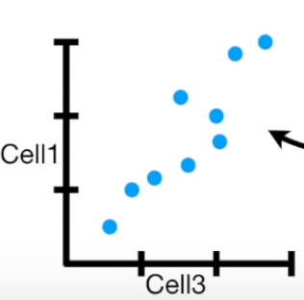
pca
analogy
Notes:
‹#›

Slide 30
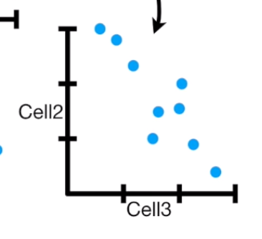
pca
analogy
Notes:
‹#›

Slide 31
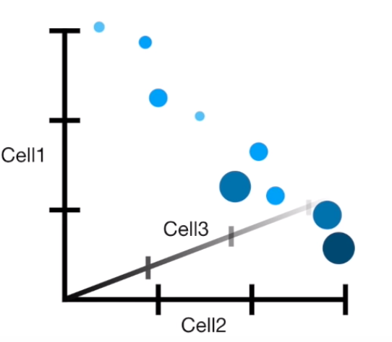
pca
analogy
Notes:
‹#›

Slide 32
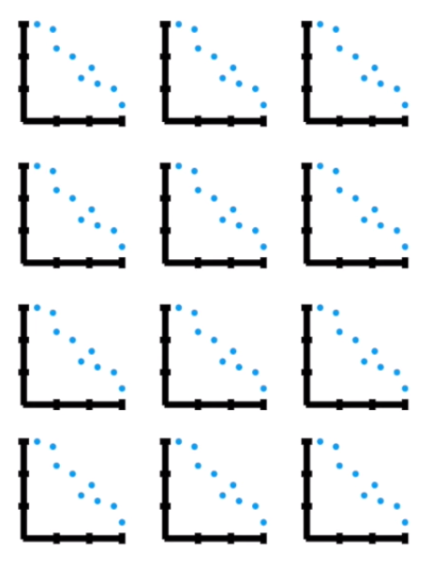
pca
analogy
Notes:
‹#›

Slide 33
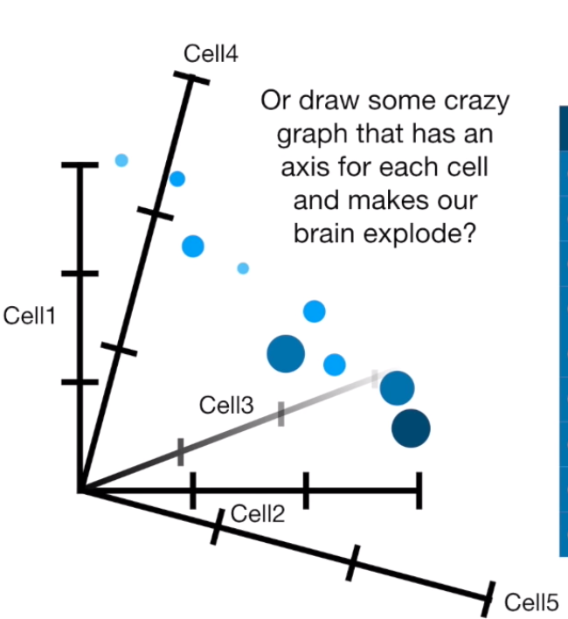
pca
analogy
Notes:
‹#›

Slide 34
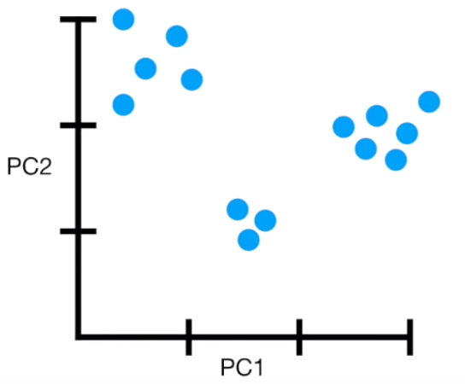
pca
analogy
Notes:
‹#›

Slide 35
pca
analogy
a pca plot converts the correlation among all the cells (features) into 2-D graph
cells highly correlated forms clusters
Notes:
‹#›

Slide 36
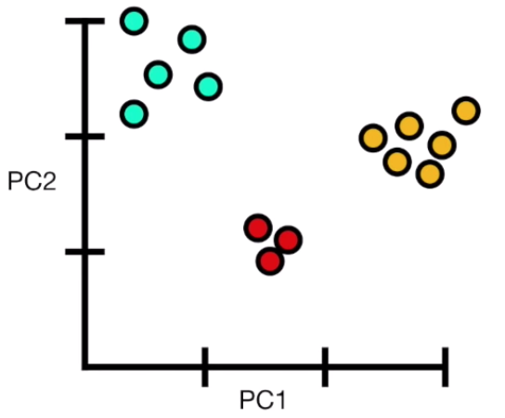
pca
analogy
Notes:
‹#›

Slide 37
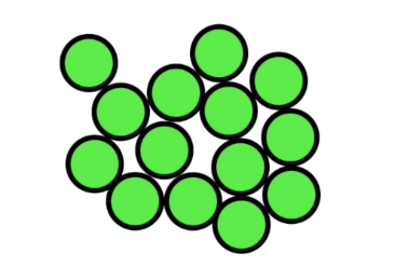
pca
analogy
Notes:
‹#›

Slide 38
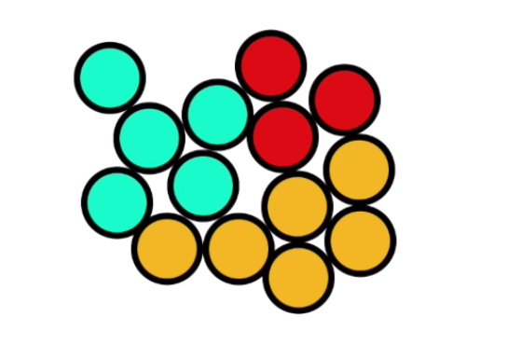
pca
analogy
Notes:
‹#›

Slide 39
pca
analogy
we have to take in mind that the axes are ranked in order of importance
Difference between clusters among the first principal component (PC1) are morE important than differences among PC2
Notes:
‹#›

Slide 40

pca
practice
Notes:
‹#›

Slide 41


