Slide 1

HATE SPEECH CLASSIFICATION
Andrea Beretta, 27201A

Slide 2
WHAT DO WE WANT TO ACHIEVE?
Building a model that classifies text of tweets as hate speech, offensive language or neither of the two.
Understand what words are relevant in determining the tweet label

Slide 3
WHAT IS HATE SPEECH
There is no unique shared definition
As a reference we are gonna take :
“language that is used to expresses hatred towards a
targeted group or is intended to be derogatory, to humiliate, or to insult the members of the group”

Slide 4
STATE-OF-THE-ART
Best-in-class models usually reveal their weaknesses when they are asked to generalize on unseen data:
Difficult task per se
Methodology issues and data set biases
Lack of explainability

Slide 5
THE DATA SET
not easy to find the right data set:
Hate Speech is not the same for everyone, a lot of variability in the definition of the target variable
I decided to go for a popular one, because it is possible to compare the results with the related paper

Slide 6
THE DATA SET
The dataset contains tweets in english
24k tweets, 3 labels:
Hate speech
Offensive speech
Neither of the two
There is a strong class imbalance, respectively 1430, 19190 and 4163 occurences

Slide 7
PREPROCESSING
Fundamental part to obtain high-quality results, i’ve been guided by the indications found in the paper
Lowercase conversion
Hashtags handling
URLs handling
Mentions handling -> tokenization
Digits handling -> conversion to words

Slide 8
TEXT PREPROCESSING
6. Punctuation and special characters removal -> emojis and emoticons
Character repetitions removal ( if >2 )
Contractions expansion
Tokenization
Stopwords removal -> not always recommended
Stemming vs lemmatization

Slide 9
MACHINE LEARNING
Now data are optimal to implement Machine Learning
Train and test set split -> only then, undersampling of the majority class
Pipeline choice: TF-IDF + XGBoost
common approach
Deep Learning approaches do not always perform better
less computationally intensive
more explicable

Slide 10
TF-IDF
Method that is used to measure the importance of a word to a document in a collection
Algorithm:
Construction of the vocabulary by identifying unique words
IDF computation: how common or rare is a word in the corpus
TF computation

Slide 11
TF-IDF
ML application:
Cannot be implemented on the whole data set -> data leakage
Should not be implemented separately on train and test, otherwise the outcome is also a measure of the goodness of the method + test smaller so worse estimate
Solution: implemented on the train and the resulting vocabulary and IDF estimates are used also for the test -> consistent evaluation of the model but if a word is present only in the test is not considered
+ cut-off (0.1%)

Slide 12
THE MODEL
XGBoost: ML algorithm based on decision trees that implements Gradient Boosting -> ensemble method, combines many models one after another where each new one is trained on the residuals of the previous
Definition of a custom function to maximize F1 Score (harmonic mean of precision and recall) for the class «hate»

Slide 13
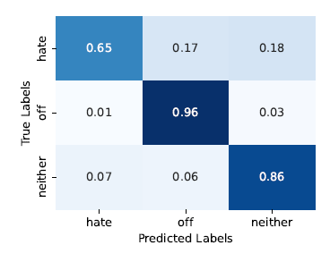
RESULTS
Better results, worse mistakes

Slide 14
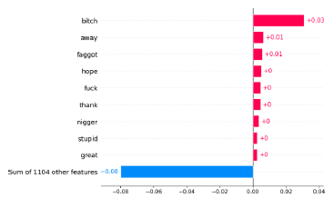
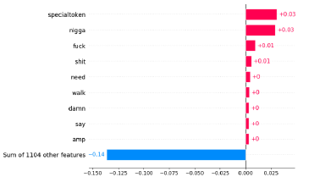
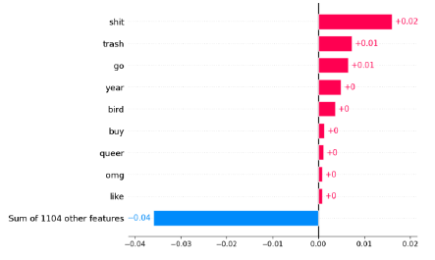
RELEVANT TERMINOLOGY #1
Hate speech
Offensive speech
Neither of the two

Slide 15
RELEVANT TERMINOLOGY
There are words that are noisy and words in unexpected positions (b*tch, queer)
Hate: harsh insults that target specific categories: women, black people, LGBT community
Offensive: 3 interesting insights
dichotomy n*gga vs n*gger
vulgar expressions but no targeting insults
mentions
Normal speech: there is only a vulgar expression not always associated with the purpose of offending (sh*t)

Slide 16
RELEVANT TERMINOLOGY
The lexicon extracted seems to depict a sort of pyramid of words of hate speech, where, from the top to the bottom, the degree of hate fades, still keeping in mind that a word can be associated with more than one kind of speech
Harsh insults with a target, usually minorities or women (e.g. f*ggot)
Vulgar expressions that can be directed at someone (e.g. f*ck)
Vulgar expressions (e.g. sh*t)

Slide 17
THANK YOU!

