Slide 1

Apache Avro Case
Recruiting process for Data Scientist position at ENEL
Andrea Bragantini

Slide 2
Summary of Contents
Research question
Exploratory Univariate Analysis
Pre-processing Data
Bivariate Analysis
One-hot Encoding
Model Design: Multivariate Linear Regression
Model Design: Regression Tree
Model Design: Random Forest Regression
Conclusions
Predicting Tasks
Improving models with further information

Slide 3
Research Question
It is required to develop a data science model with the given data file to predict the required time to resolve an alert, based on its characteristics
The first thing is to is to start exploring the available dataset to understand the shape, type and distribution of the different variables
The target variable “required time to resolve an alert” is not present in the dataset and therefore must be derived from available data
Let’s proceed with the univariate analysis

Slide 4
Exploratory Analysis
Categorical variables
Status
Priority
Issue_type
Resolution
Numerical variables
Vote_count
Comment_count
Watch_count
Description_length
Summary_length
DateTime variables
Created
Updated
Resolution_date
RangeIndex: 1458 entries, 0 to 1457
Data columns (total 17 columns):
status 1458 non-null object
priority 1458 non-null object
updated 1458 non-null object
issue_type 1458 non-null object
reporter 1458 non-null object
created 1458 non-null object
resolutiondate 1134 non-null object
vote_count 1458 non-null int64
project 1458 non-null object
assignee 1063 non-null object
comment_count 1458 non-null int64
key 1458 non-null object
description_length 1388 non-null float64
summary_length 1458 non-null int64
watch_count 1458 non-null int64
resolution 1134 non-null object
days_in_current_status 1458 non-null float64
dtypes: float64(2), int64(4), object(11)
memory usage: 193.7+ KB

Slide 5
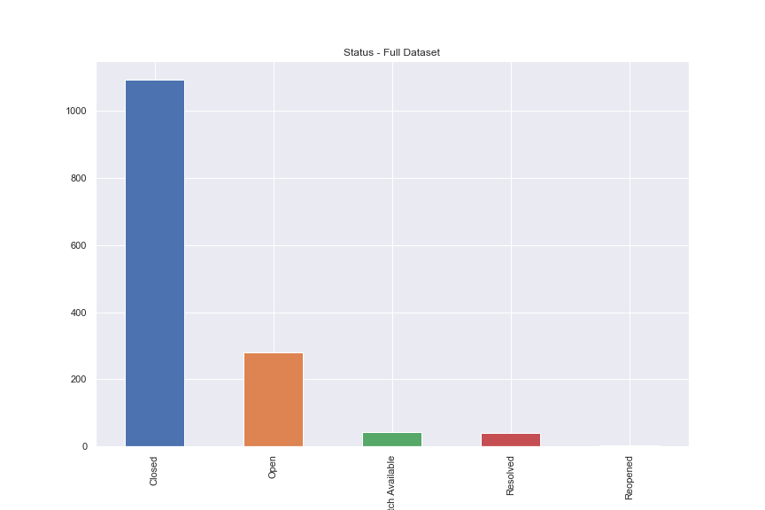
Categorical Variable: Status
The large majority of alerts present in the dataset are «closed».
«Closed» and «Resolved» alerts can be considered finished tasks and posses a valid «resolution_date» variable.
«Open», «PatchAvailable» and «Reopened» are instead out-standing tasks waited to be treated.

Slide 6
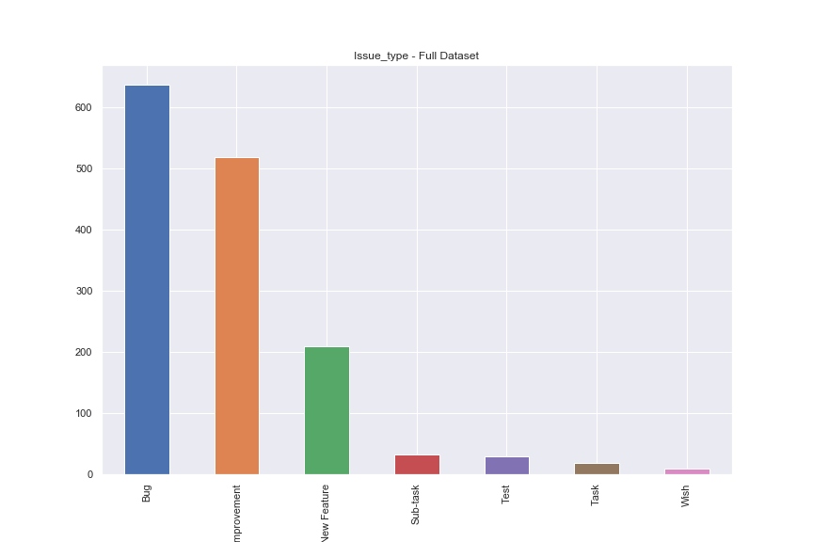
Categorical Variable: Issue_type
This variable describes the type of alerts. Dataset is mainly composed by «Bug», «Improvement» and «NewFeature»

Slide 7
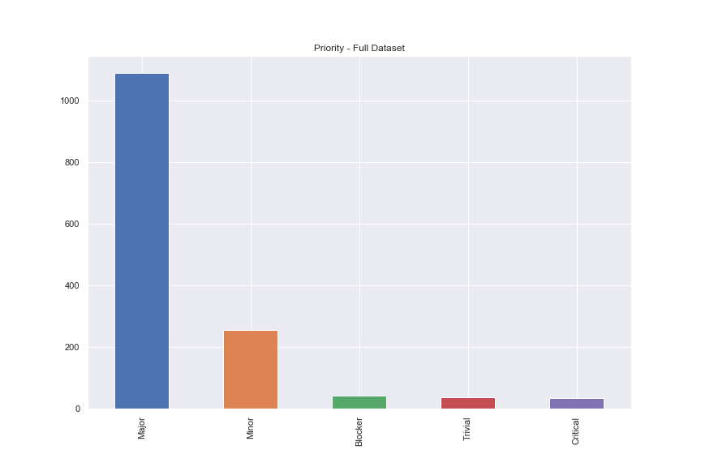
Categorical Variable: Priority
Intuitively this variable should be very descriptive in defining the amount of time that it takes for an alert to be solved.
It is easy to think how «Major», «Blocker» and «Critical» issues will be processed quicker than «Minor» or «Trivial» issues. Let’s see whether data reflects this intuition later.

Slide 8
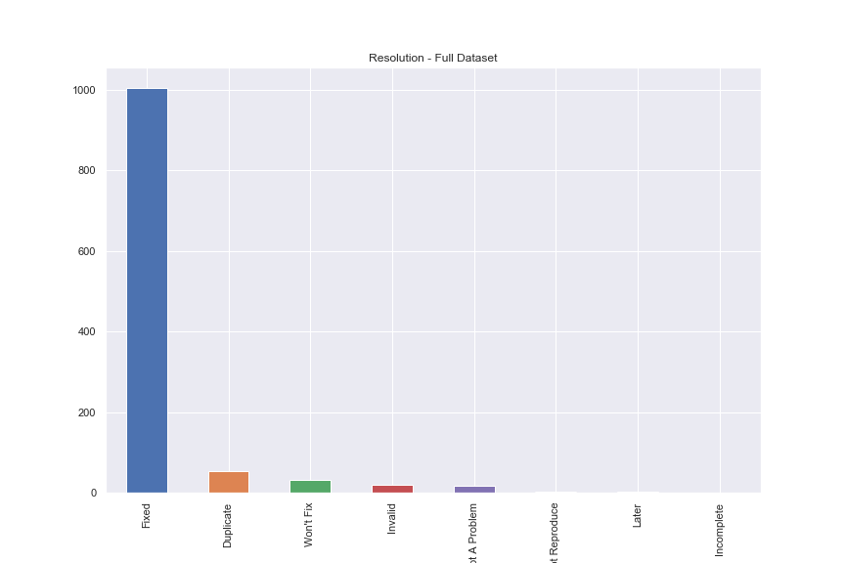
Categorical Variable: Priority
This is the resolution state of already closed alerts.
We can simply model this with a Binary Variable as «Fixed» and «NotFixed».

Slide 9
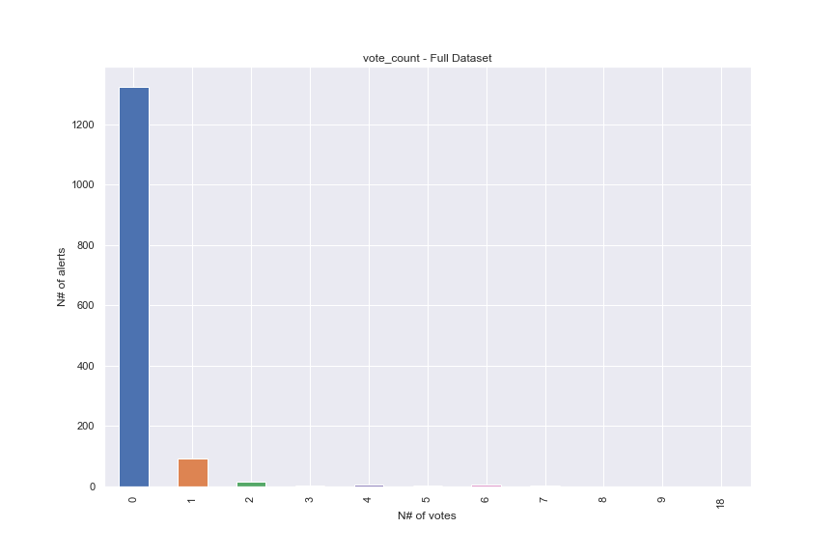
Numerical Variable: vote_count
The distribution is highly skewed to the left. It might require a proper transformation.

Slide 10
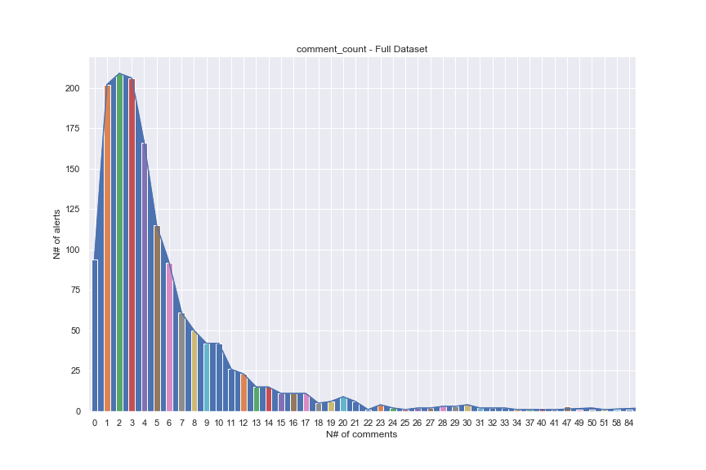
Numerical Variable: comment_count
The distribution is highly skewed to the left. It might require a proper transformation.

Slide 11
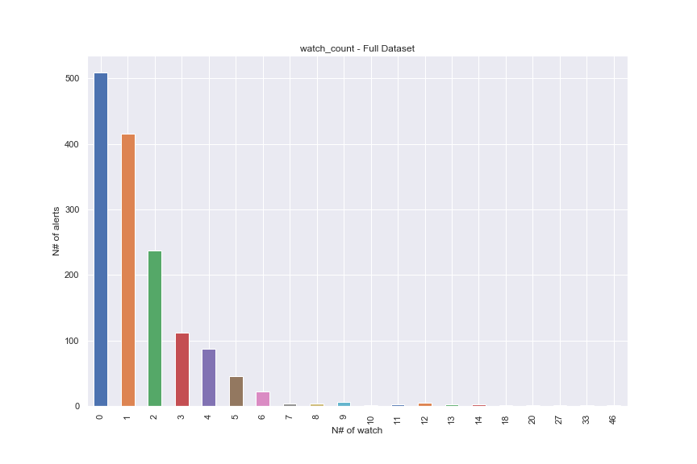
Numerical Variable: watch_count
The distribution is highly skewed to the left. It might require a proper transformation.

Slide 12
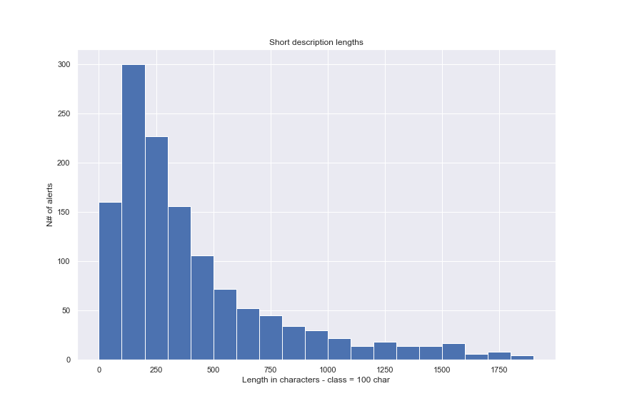
Numerical Variable: description_ length
The distribution is highly skewed to the left. It might require a proper transformation.
There are a few outliers with very long descriptions.
In the chart only short description are considered for sake of simplicity of visualization

Slide 13
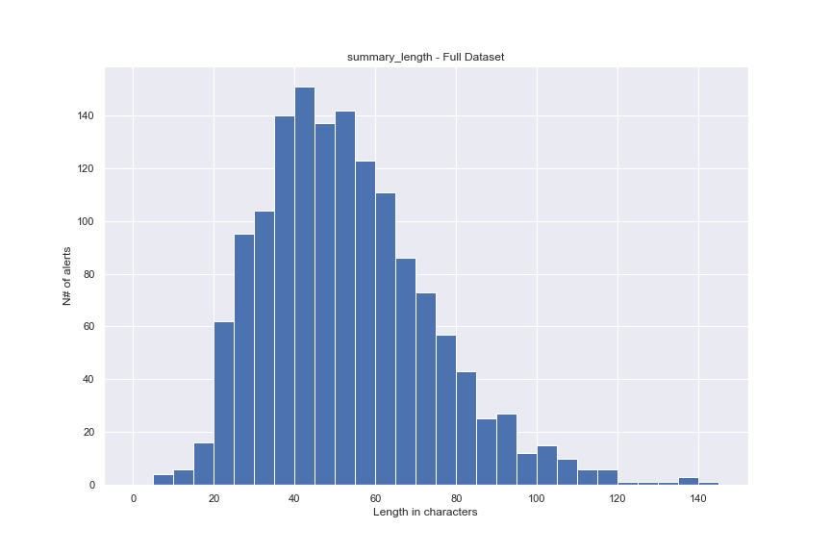
Numerical Variable: summary_ length
The distribution of this variable is different from the others and may look gaussian, even though test denies this assumption.
Shapiro Test outcome:
Statistics=0.965, p=0.000
Sample does not look Gaussian (reject H0)

Slide 14
Pre-processing
Split Training and Validation sets
Look only at successfully solved alerts in the available dataset
1st approach: select only “Closed“/”Resolved alerts.
2nd approach: select all alerts that has a resolution date
Decision: 2nd approach because it returns a larger dataset
The Validation set is instead composed by all those alerts that have not been closed yet, namely do not have a resolution date.
Target Variable: Duration
Convert all datetime data
Looking at created times and resolution dates, it is possible to derive the duration of finished tasks.
$$duration = resolutiondate − created$$
Notes:
Subtracting 2 datetime datatype we obtain a new datatype called «timedelta64» which can easily be converted to float64 for further analysis

Slide 15
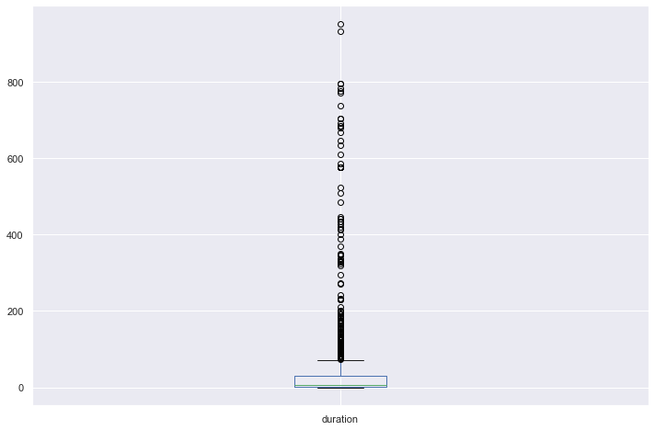
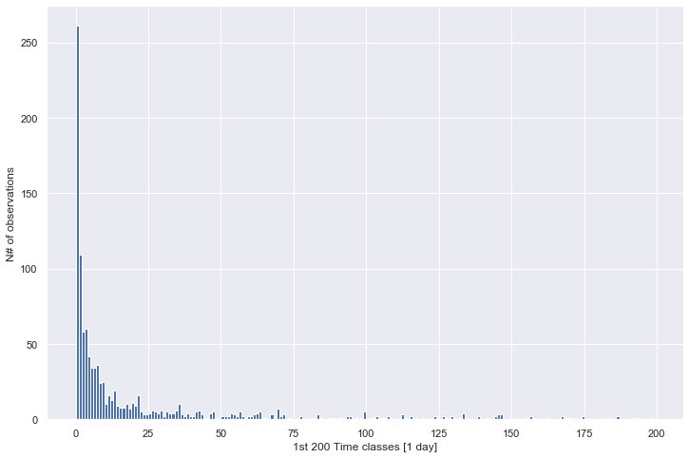
Target Variable: duration
Almost all the observations are characterized by small resolution times [min, hours..].
The distribution is highly skewed to the left and there are lots of outliers with very "high" resolution times [months, years...]

Slide 16
Pre-processing Useless variables
Drop from the dataset useless predictors, as do not offer useful information.
project : same for all
updated : updates are after the resolution date
resolutiondate : already used for determining duration
created : already used for determining duration
key : different for all
days_in_current_status : difficult to be included in the model

Slide 17
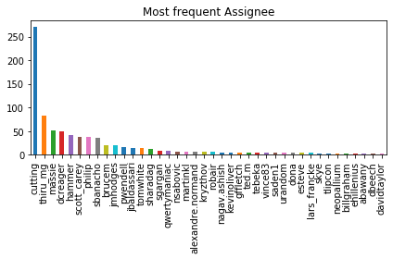
Pre-processing Reporter VS Assignee
It has been observed that generally relevant reporters assign the issue themselves to be solved.
Also minor reporters assign the reported issue themselves.
Cutting is the main contributor and solves self-reported issues and reported issues by minor contributors and other relevant contributors

Slide 18
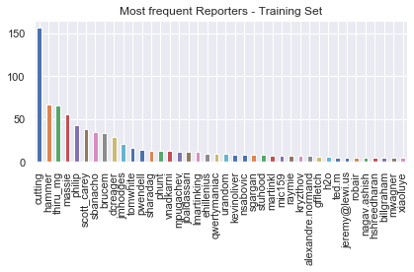
Pre-processing Reporter VS Assignee
With a very rough assumption we can say that all the reporters assign the issues to themselves.
I prefer to take reporters as cat var because it is always present, even in new alerts to be forecasted. While sometimes happens that some alerts are not assigned.
CONCLUSION: remove “assignee”

Slide 19
Pre-processing Status VS Resolution
Actual training set considers all alerts that have been closed/resolved for which it is possible to determine the duration.
Var "status" somehow determines the split in training/test sets.
At the same time, "resolution" levels have a value only for closed/resolved alerts.
New alerts cannot have these feature.
We should remove "status" and "resolution" predictors.
Notes:
Ideally, a new alert would have a "status" var that can assume the following: Open, PatchAvailable, Reopened, but NEVER Closed or Resolved.
These last 2 classes belongs in fact to an "already resolved" alert.

Slide 20
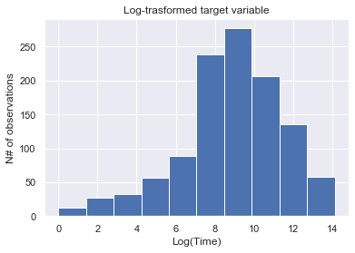
Pre-processing Logarithmic Transform
All numerical variables in the dataset present highly skewed distribution towards left.
Logarithmic transformation is necessary to try to turn variables to «something closer» to a Gaussian distribution.
Variable trasformed:
Vote_count
Comment_count
Watch_count
Description_length
Duration (target)
Log-Log trasformation

Slide 21
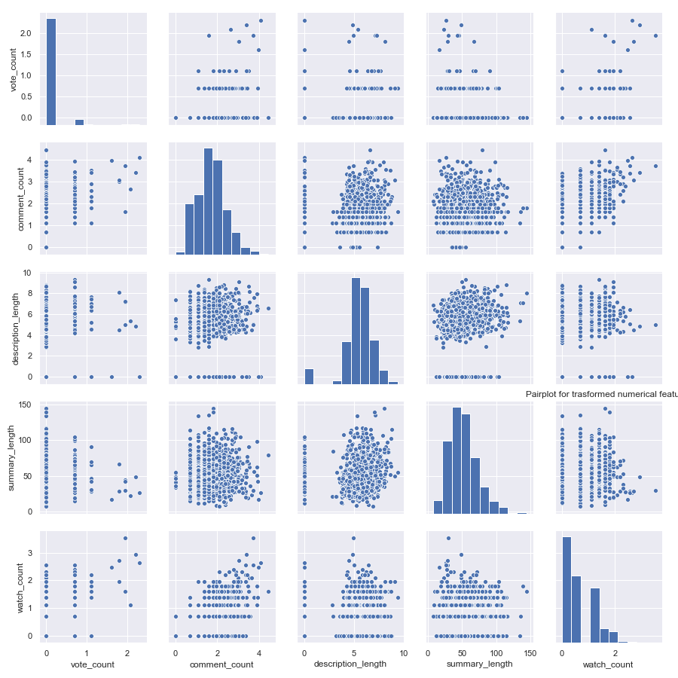
Pre-processing Logarithmic Transform
Summary pairplot of all the numerical variables after log trasformation

Slide 22
Bivariate Analysis
Let’s focus on the relation between our target variable "duration" and its numerical or categorical predictors.
NB: We are looking at our new processed dataset of closed/resolved issues for the training phase
Target Variable VS Categorical Predictors – Full Levels
Priority
Issue_type
Reporter
Target Variable VS Categorical Predictors – Reduced Levels
I tried to use combine methods to reduce the levels for each var
Target Variable VS Numerical Predictors
vote_count
comment_count
description_length
summary_length
watch_count

Slide 23
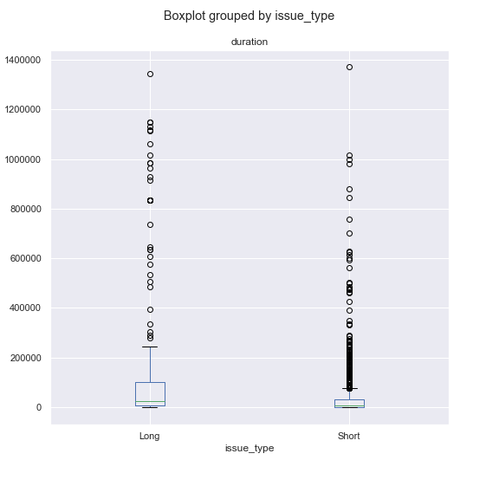
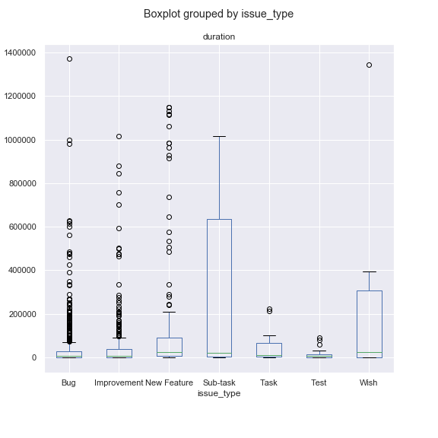
Bivariate Analysis: duration VS issue_type
It has been observed in Bivariate Analysis with Full Levels (right) that on average issue_type leves as Bug, Improvement, Task, Test tend to have SHORTER resolution times.
On the other hand, levels as NewFeature, Subtask and Wish tend to have LONGER resolution times.
Therefore we encoded this two different groups.
Combined
Original
Notes:
Here I did not include the charts with respect to the TRASFORMED target variable because they were not showing anything relevant or different than that.
You could have also encoded issue type with 3 new levels as New Feature and Task seem to show medium resolution times with respect to others

Slide 24
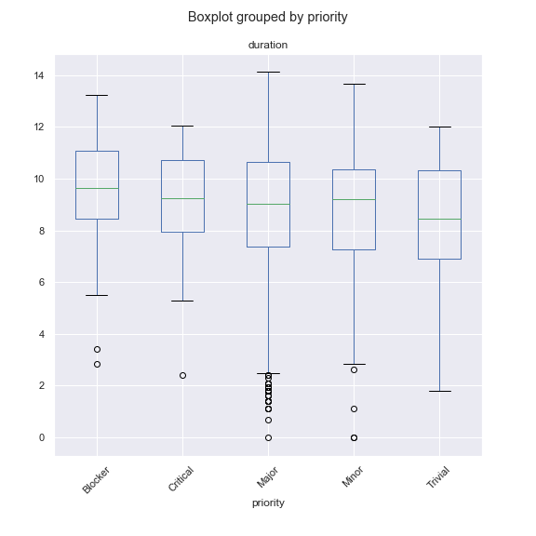
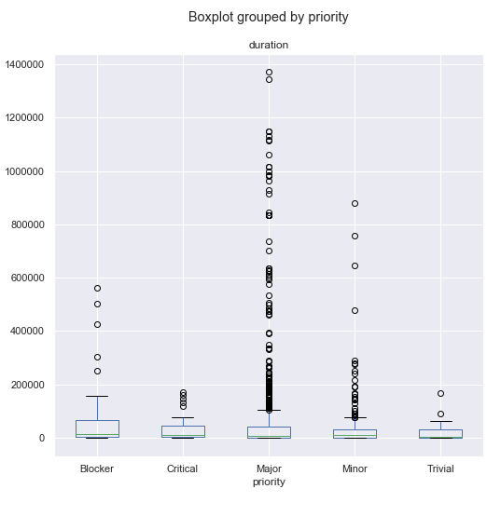
Bivariate Analysis: duration VS priority
Priority is a very difficult predictor to analyze. Intuitively it seems very descriptive but unfortunately data show the contrary.
In both transformed and original, variability of priority levels seems not to impact duration outcome relevantly.
Just note presence of many outliers in “Major” class as it is very numerous class.
Trasformed
Original

Slide 25
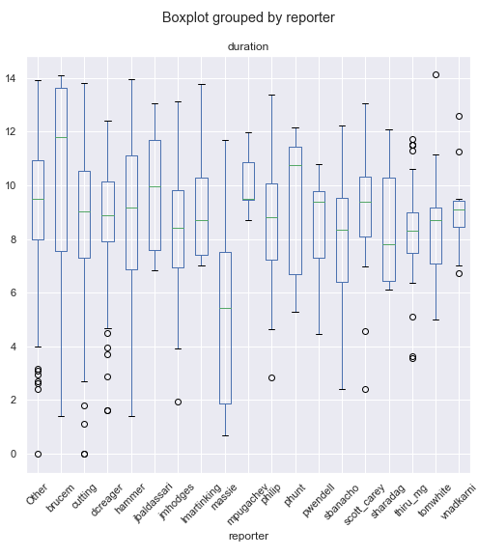
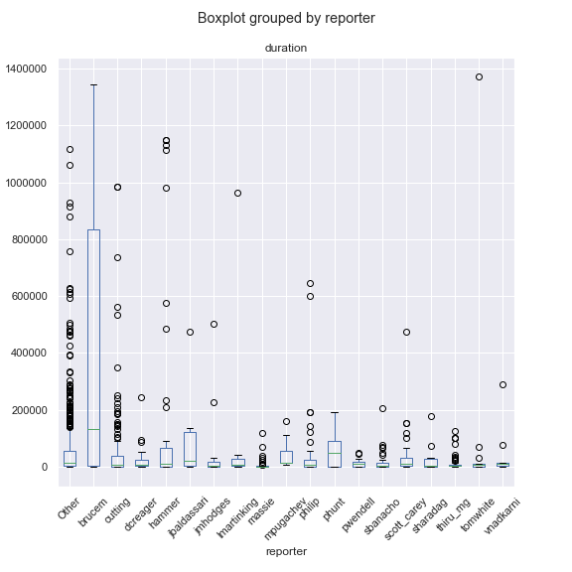
Bivariate Analysis: duration VS reporter
Reporter is a very numerous class and must be reduced to be treated
I decided to include in the inference study only those reporters that appears more than 10 times
Trasformed
Original

Slide 26
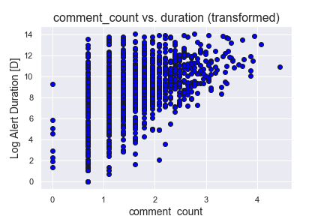
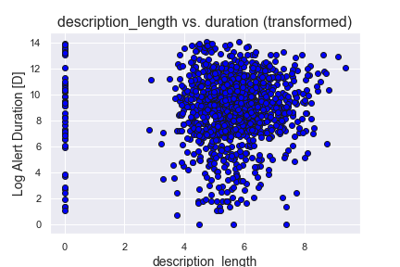
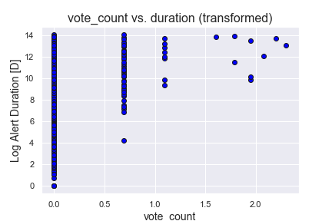
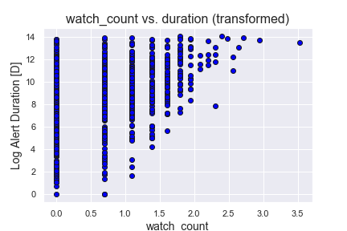
Bivariate Analysis: numerical variables
It is evident how the transformation did not improved much the distribution of numerical variables.
Nevertheless it is worth to note a sort of similar behaviour between all «counts» variables.
A somewhat «linear relation» can be found with respect to the target.

Slide 27
One-hot-Encoding
'issue_type_Short’,
'priority_Critical',
'priority_Major',
'priority_Minor',
'priority_Trivial’,
'reporter_brucem',
'reporter_cutting',
'reporter_dcreager',
'reporter_hammer',
'reporter_jbaldassari',
'reporter_jmhodges',
'reporter_lmartinking',
'reporter_massie',
'reporter_mpugachev',
'reporter_philip',
'reporter_phunt',
'reporter_pwendell',
'reporter_sbanacho',
'reporter_scott_carey',
'reporter_sharadag',
'reporter_thiru_mg',
'reporter_tomwhite',
'reporter_vnadkarni'
Being a Regression problem, enconding is necessary to consider categorical variables in the problems
I decided to use the well-established method of one-hot-encoding
The following categorical variables have been encoded:
Reporter: 19 levels -> 18 bin var
Issue_type: 2 levels -> 1 bin var
Priority: 5 levels -> 4 bin var
Total number of variables:
Target + 5 num vars + (18+1+4) bin vars = 29

Slide 28

Model Design: Multivariate Linear Regression
Supervised Learning Method
Good practice to fit a regression model and see how it behaves.
Build up a benchmark model
Need to one-hot-encode categorial variables
Assumptions for regression analysis are NOT fully respected:
Linearity: The relationship between X and the mean of Y is linear.
Homoscedasticity: The variance of residuals is the same for any value of X.
Independence: Observations are independent of each other.
Normality: For any fixed value of X, Y is normally distributed.

Slide 29
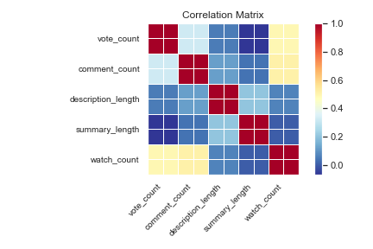
Potential collinearity between numerical predictors ?
A little correlation between «counts» variables was already clear from previous charts
Only watch_count presents relevant collinearity with vote_count and comment_count, even though not strong.

Slide 30
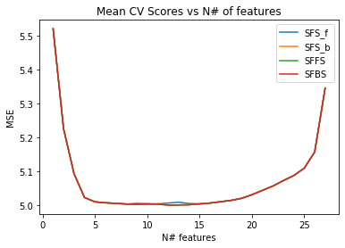
Features Selection
Reduce complexity, overfitting
Improve interpretability
 | SFS_F | SFS_B | SFFS | SFBS
reporter_sharadag | 0 | 0 | 1 | 0
reporter_sbanacho | 1 | 1 | 1 | 1
reporter_dcreager | 1 | 1 | 1 | 1
issue_type_Short | 1 | 1 | 1 | 1
reporter_vnadkarni | 0 | 0 | 1 | 0
reporter_scott_carey | 0 | 0 | 1 | 0
priority_Minor | 0 | 1 | 0 | 1
reporter_hammer | 0 | 1 | 0 | 1
reporter_massie | 1 | 1 | 1 | 1
reporter_tomwhite | 1 | 1 | 1 | 1
vote_count | 1 | 1 | 1 | 1
comment_count | 1 | 1 | 1 | 1
reporter_cutting | 0 | 1 | 0 | 1
watch_count | 1 | 1 | 1 | 1
4 different algorithms:
Sequential Forward Search
Sequential Backward Search
Sequential Floating Forward Search
Sequential Floating Backward Search

Slide 31
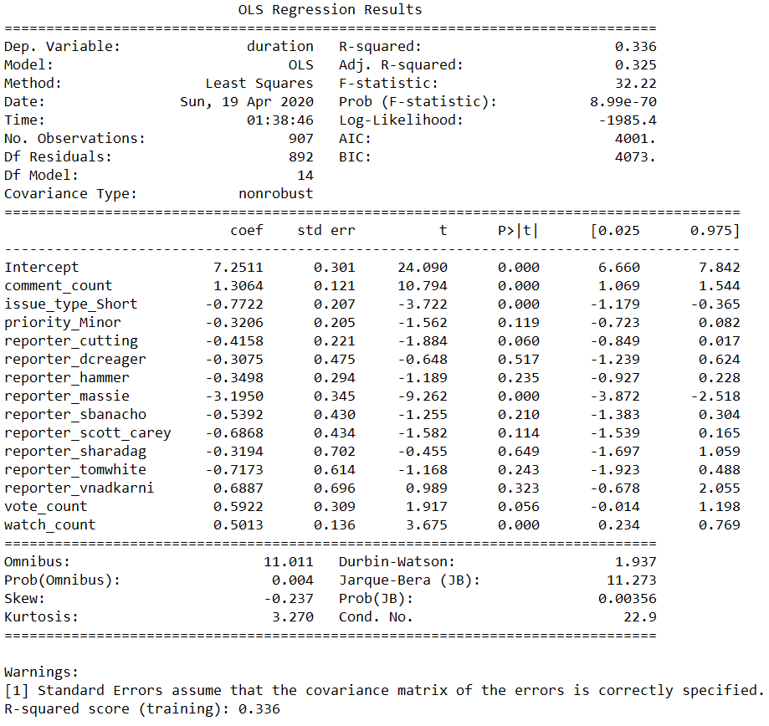
Model Design: Multivariate Linear Regression

Slide 32
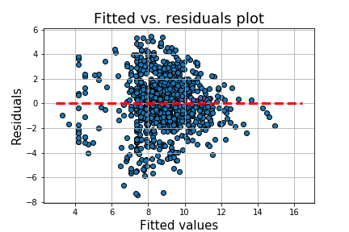
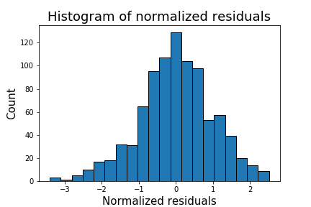
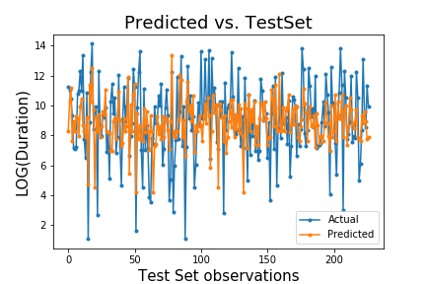
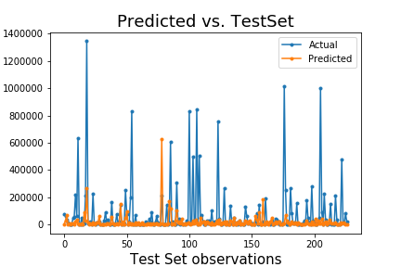
Model Design: Multivariate Linear Regression

Slide 33

Model Design: Regression Tree
Tree-based approach
Easier to perform/understand
Particularly suitable with dataset with lots of categorical and numerical variables together
Easy calculation of «variable importance»
Trial and Error approach for parameter tuning
Possibility to explore more power ML algorithm: Random Forest

Slide 34
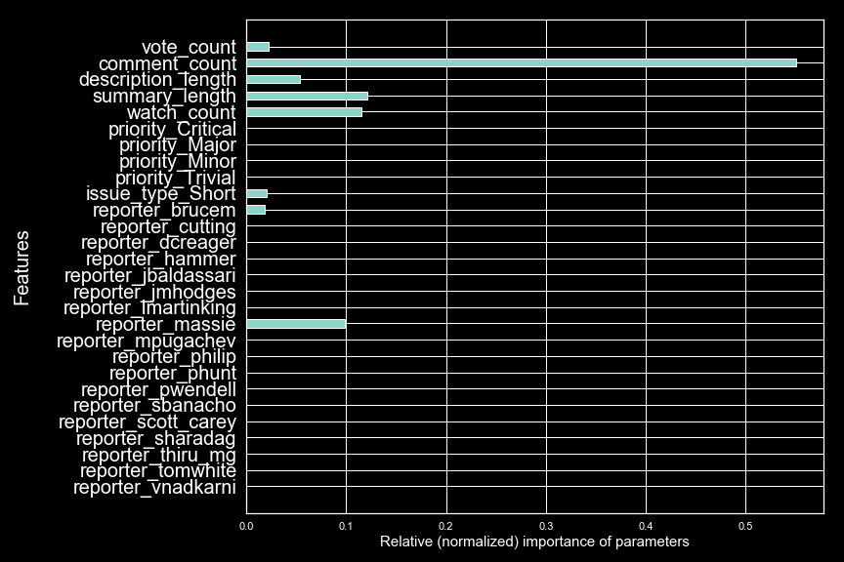
Regression Tree
criterion='mse’,
max_depth=5, max_features=None,
max_leaf_nodes=35, min_impurity_decrease=0.0,
min_impurity_split=None, min_samples_leaf=1,
min_samples_split=2, min_weight_fraction_leaf=0.0,
random_state=0, splitter='best'

Slide 35
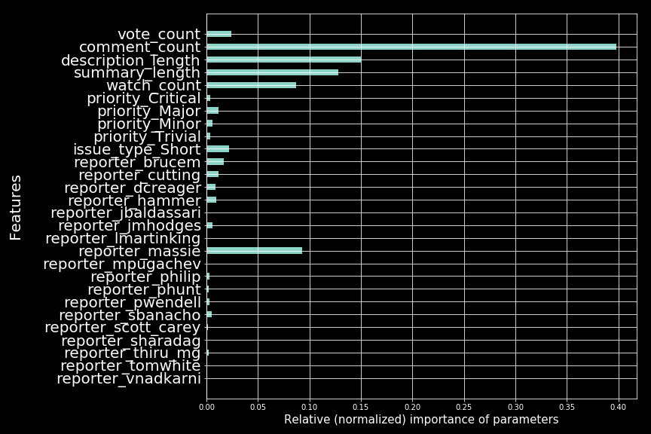
Random Forest Regression
bootstrap=True,
criterion='mse’,
max_depth=50,
max_features='auto', max_leaf_nodes=50,
min_impurity_decrease=0.0, min_impurity_split=None,
min_samples_leaf=1, min_samples_split=2,
min_weight_fraction_leaf=0.0
n_estimators=100,
random_state=0, warm_start=False

Slide 36
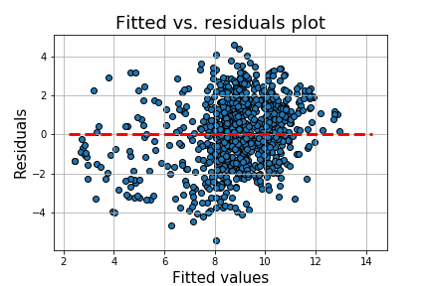
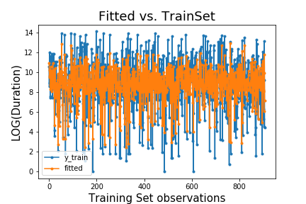
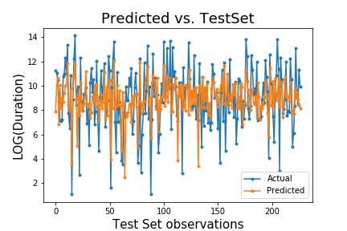
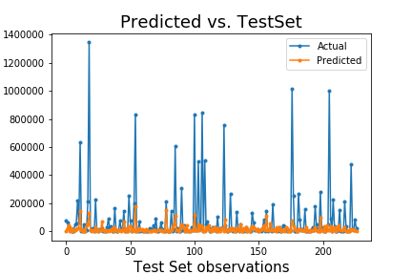
Random Forest Regression

Slide 37
Conclusions
 | MultiLinearReg | Regression Tree | Random Forest
MAE | 1.7439 | 1.6775 | 1.6722
MSE | 4.8953 | 4.7905 | 4.4933
RMSE | 2.2125 | 2.1887 | 2.1197
R^2 train | 0.336 | 0.445 | 0.600
R^2 test | 0.245 | 0.261 | 0.307
Linear Regression model underfits the data
Regression Tree techniques have better performances but still struggle to explain variability of target variable
Given dataset is full of heavy outliers
Simply too much to be removed
Models fail in predicting those outliers with large duration times

Slide 38
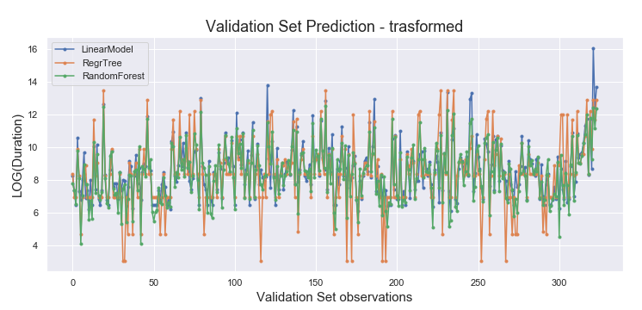
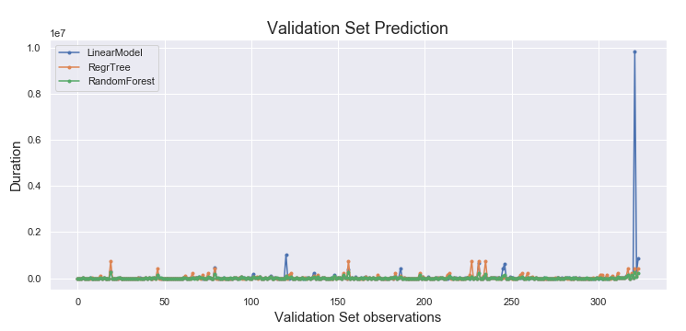
Predictions

Slide 39
Predictions

Slide 40
Predictions: 3 interesting cases
Status: Open
Priority: Major
Issue_type: New Feature
Index | LinReg | RegTree | RF
321 | 6836 days 01:35:33 | 286 days 03:56:24 | 177 days 19:13:03
Features indicates that issue is going to last long
Tree-based model returns quite high resolution times
Linear regression returns «inflated» resolution times
Capability of spotting potential outliers
Index | LinReg | RegTree | RF
120 | 711 days 13:59:55 | 77 days 00:48:05 | 73 days 19:42:33
Status: Patch Available
Priority: Major
Issue_type: New Feature
Not assigned.
Popular thread on the website but issue «stuck» for years
Features might indicate different behaviours
Same predicting behavior as before
Index | LinReg | RegTree | RF
113 | 4 days 23:47:08 | 2 days 23:53:08 | 3 days 22:20:25
Status: Patch Available
Priority: Major
Issue_type: Bug
Assigned, same contributor.
A solution is available. Status has recently changed
Possible sign of quick resolution
All models correctly predict quite low resolution times

Slide 41
Question 3
How to best exploit information from categorical variable?
In particualar «Status» and «Day_in_current_status»
Need for tracking the «history» of the alert untill completion
Required information: Transitions available on website

Slide 42
Question 4
JSON file contains 1458 dictionaries. One for each issues.
Transitions is between the available keys
Transitions unfortunately contains only empty list
After the exploration of the JSON file in all its fields I could not find any new relevant information for my task.
Whole conversations between contributors where available but not showing to me any potential source of useful information

Slide 43
THE END
Thank you for your attention

