Slide 1
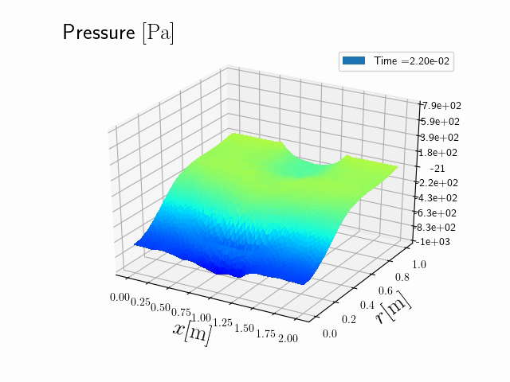
Partitioned finite element method for structured discretization with mixed boundary conditions
Andrea Brugnoli¹, Flávio Luiz Cardoso-Ribeiro², Ghislain Haine¹ Paul Kotyczka³
¹ ISAE-Supaero
² Instituto Tecnológico de Aeronáutica
³ Chair of Automatic Control, Technical University of Munich
We propose a methodology to consistently discretize boundary control systems in 2D and 3D.
Two different approaches are presented and compared.
The proposed method is used to simulate a vibroacoustic application with impedance damping.

