Slide 1
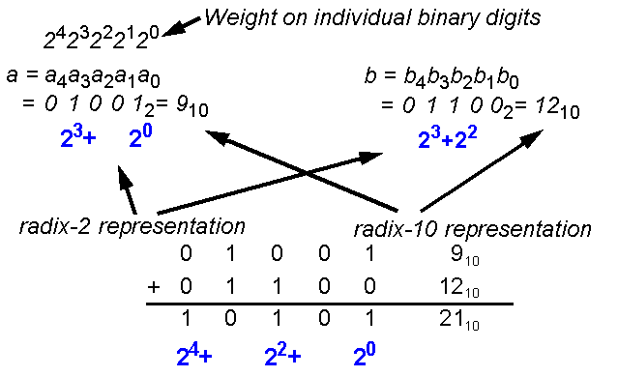
Basic Integer Arithmetic Building Block
Binary digit or radix-2 representation was chosen for computer hardware due to its simple and one-to-one mapping to VLSI logic circuits.
An integer number can be represented in n-bits or n binary digits.

Slide 2
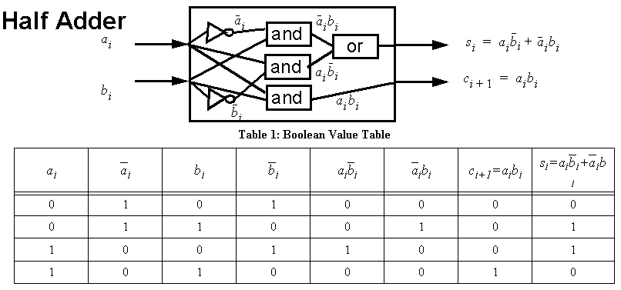
Half Adder & Full Adder
Half Adder and Full Adder are devices that compute the sum and carry bits of individual bits of two numbers .

Slide 3
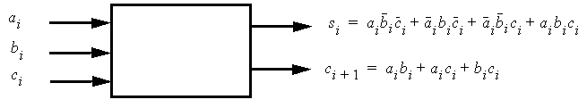
Full Adder

Slide 4
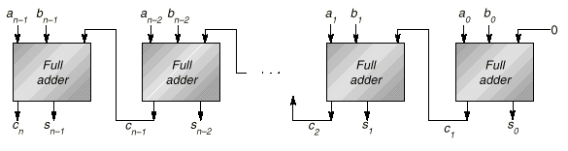
Ripple-carry Adder
In worst case, the carry signal Cn will go through 2n logical levels.
For 32-bit integer number, n=32.
For IEEE double precision FP number, the fraction part is 53 bits, n=53.

Slide 5
Radix-2 Unsigned Multiplication
Use a single n-bit adder, three registers (P, A, B), and a testing circuit for A₀
Initialization: Place the unsigned numbers in registers A and B. Set P to zero.
1: If A₀ is 1,
then register B, containing b_{n-1}b_{n-2}...b₀ is added to P;
otherwise 00...00 (nothing) is added to P. The sum is placed back into P.
2. Shift register pair (P, A) one bit right.
The last bit of A is shifted out (not used).

Slide 6
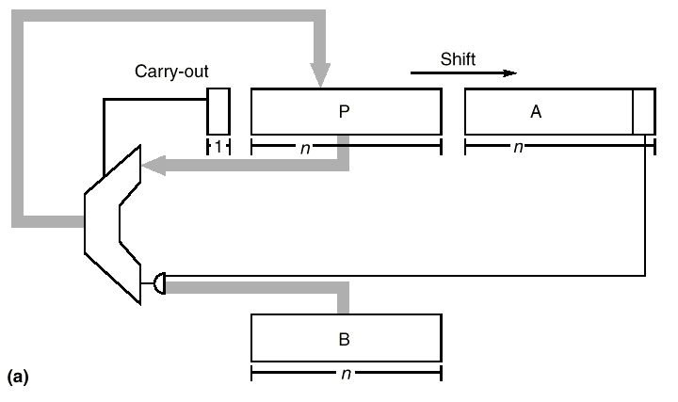
Radix-2 Unsigned Multiplication
(2)
A₀
(1)

Slide 7
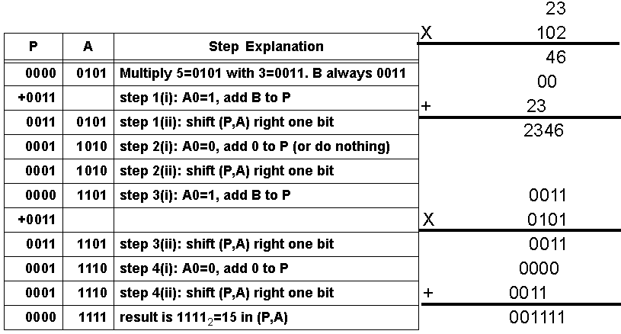
Numeric Example of Unsigned Multiplication (1)

Slide 8
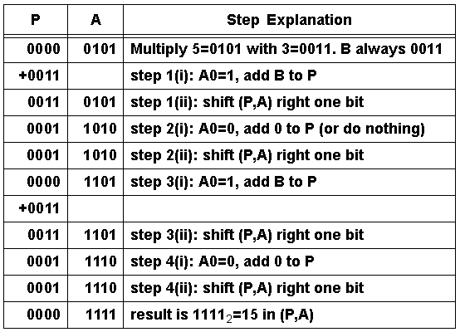
Numeric Example of Unsigned Multiplication (2)

Slide 9
Radix-2 Division
To compute a/b, put a in register A, b in register B, 0 in register P.
1. Shift the register pair (P, A) one bit left.
2. Subtract the content of Register B from register P.
3. If the result of step 2 is negative, set the A₀ to 0,
otherwise to 1.
4. if the result of step 2 is negative, restore the old value of P by adding the contents of register B back into P.
after repeat n times, register A will have quotient and register P with reminder.

Slide 10
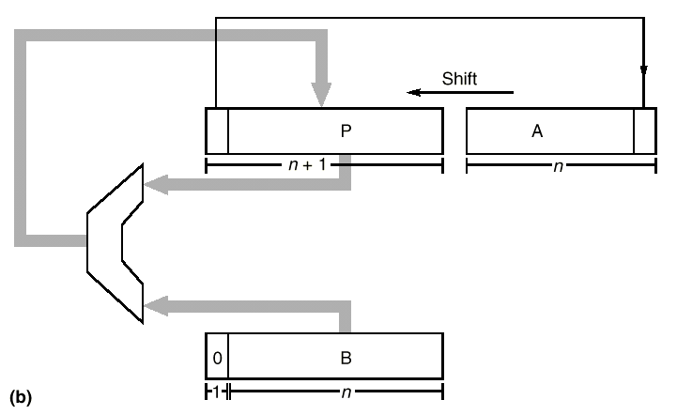
Radix-2 Division Block Diagram
Similar hardware for Multiplication
(1)
(3) Test P; set A₀
(2) P-B
(4) If (2) is negative, P+B

Slide 11
Radix-2 Division using nonrestoring algorithm
Idea: Eliminate the step 4 (restoring old value of P).
Let r the content of register pair (P,A) with the binary point between P₀ and A_{n}.
Restoring method:
Steps 1-3 compute 2r -b.
Step 4 add back b (giving 2r).
next round steps 1-3 shifting (giving 4r) and subtracting (giving 4r-b)
Nonrestoring method:
Skip Step 4, in next round step 1 shifting (giving 4r-2b), step 2 instead of subtracting adding b (giving 4r-b).
Notes:
Nonrestoring method:

Slide 12
Nonrestoring Algorithm
If P is negative,
1a. Shift (P,A) one bit left.
2a. Add the content of register B to P.
else
1b. Shift (P,A) one bit left.
2b. Subtract the contents of register B from P.
3. If P is negative, set the low-order bit of A to 0, otherwise set it to 1.
Repeat n time.

Slide 13
Representing Sign Numbers
Sign magnitude: The high order bit is the sign bit, the rest is the magnitude of the number. -3 =1011₂
Two’s complement: the number and its negative add up to 2^{n}.
0011₂+1101₂=2³=8, so -3=1101₂.
Most widely used: since since addition is extremely simple: simply discard the carry out from the high order bit
One’s complement: the negative of a number is obtained by complementing each bit. -0011=1100.
Biased: a fixed bias is picked so that the sum of the bias and the number being represented will always be non-negative. A number is presented by adding the bias and then encoding the sum as an ordinary number.
Using a bias of 8, 3 is represented by 1011, and -3 by 0101.
It is used in the exponent part of the IEEE floating point number.

Slide 14
Overflow
It occurs when the result of the operation can not fit in the representation being used.
e.g. use 4 bit to represent unsigned number. 0110+1011=10001 → overflow.
For two’s complement, it is trickier to detect:
It occurs when the carry into the high order bit is different from the carry out of the high order bit. 5+(-2) with both 1 carried in and out of the leftmost bit. It is not an overflow.
00101 (5) 10000 (-16)
+11110 (-2) +11110 (-2)
00011 (3) 01110 (overflow with carryout=1 carryin=0)
Negation involves complementing each bit and then add 1. That is why we need a full adder in the ripple-carry adder Figure A.1. (Set the C0 to be 1.)

Slide 15
Two’s Complement Number Multiplication
Bruce force method:
converting both operands to nonnegative,
do an unsigned multiplication,
if the original operands were of opposite signs, negate the result.
Booth recoding method:
Use similar multiplier in A.2.a.
If the content of is a_{n-1}a_{n-2}...a_{0,}at the ith step, the lower order bit of A is a_{i}
1. If a_{i}=0 and a_{i-1}=0 then add 0.
2. If a_{i}=0 and a_{i-1}=1 then add B.
3. If a_{i}=1 and a_{i-1}=0 then subtract B.
4. If a_{i}=1 and a_{i-1}=1 then add 0.
For the first step, when i=0, take a_{i-1} to be 0.

Slide 16
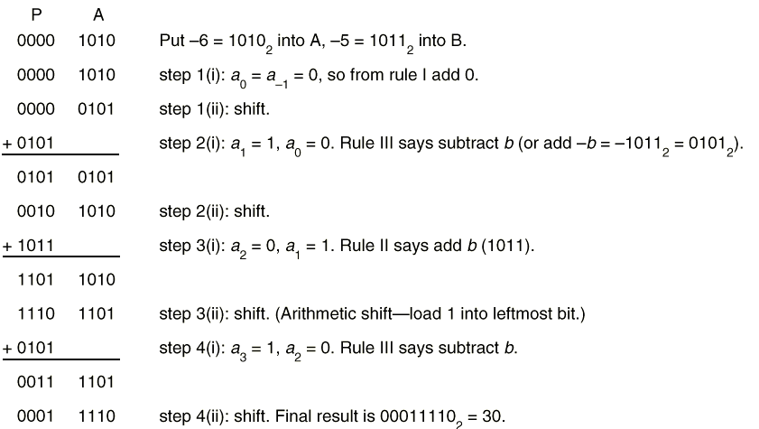
Apply Booth Recoding Method
Use original A for interpreting a_{i} value

Slide 17
Representing Non-Integer Numbers
Fixed point number
-e.g. Assume 32 bit number with the binary point fixed and between bit 16 and 15.
0000000000000001.1100000000000000
=1+1/2+1/4=1.75
Weights after binary point are ½, ¼, 1/8, ….
Use two numbers (a, b) to represent fraction a/b.
Disadvantage of the above representations: range of values too narrow.

Slide 18
Floating point representation
A floating point number is represented in two parts: exponent, e, and significant (or called mantissa), m.
They represent a number with value=m*r^{e}
where r is the known radix (base)
For radix 10, m=1.5, e=3, the value is 1.5*10⁻³=0.0015.
Note that the exponent indicates that the decimal point is actually three digits to the left of the significant and the decimal point is floating from number to number indicated by their exponent parts.
With the same number of bits (digits), floating point can represent larger value range.

Slide 19
IEEE Floating Point Standard 754-1985
It specifies four precisions: single, single extended, double, double extended.
Single precision are represented using 32 bits:
  1 sign bit, 8 exponent bits, 23 fraction bits.
  about 7 decimal digit accuracy.
  exponent is a biased-signed number with a bias of 127.
  value 0 is encoded as 127; value -3 is encoded as 124
  Reason: Nonnegative numbers ordered in the same way as integer→fast comparison.
  The fraction field represents a number less than one, with first bit has a weight of 1/2, 2nd bit 1/4, etc.
  The significant value = 1.f with an implicit one not encoded.

Slide 20
IEEE Floating Point Standard 754-1985
Single precision are represented using 32 bits:
The single precision number
1 10000001 010000000000000000000000
with exponent field 129 -> exponent value=129-127=2
with fraction field=.01₂=.25 -> significant=1.f=1.25
It represents -1.25*2² = -5
10 is represented in single precision as
0 10000010 0100....
because 10₁₀=1010₂=1.010*2³
  exponent is 3. With bias of 127, exponent field=127+3=130=10000010
  significant is 1.010->fraction=s-1=1.010-1=0.010...

Slide 21
IEEE 754
Exercise: Verify yourself that 10.5 is 0 10000010 0101000...
and 0.1 is 0 01111011 1001100110011.....
Single
Double
P(bits of precision)
24
53
Emax
127
1023
Emin
-126
-1022
Exponent bias
127
1023

Slide 22

Special Values
The range of exponents for single precision is -126 to 127
→ exponent field from 1 to 254.
Exponent field=255 and fraction field=0 represents ∞.
Exponent field=255 and fraction field≠0 represent Not a Numbers (NaNs)
NaN op NaN is NaN. This allows fast computing involved with exception.
  Square root of a negative number
Note that 3/0=+∞, not a NaN
1/∞=0

Slide 23
Denormals
Exponent field=0 and fraction field=0 represents 0.
Exponent field=0 and fraction field≠0 represent 0.fx2^{Emin} These numbers are called denormal or subnormal numbers. They are less than 1.0x2^{Emin}
Let x=1.234x2^{Emin}, x/10 causes gradual underflow yields a number smaller than 1.0x2^{Emin}

Slide 24
Drawbacks of IEEE754
Originally designed for μps, not for high performance implementations.
Contains optional parts
Gradual underflow are very slow than flush to zero. Many disable it.
No industrial strength, public-domain, IEEE floating point test suite.(ftp:\\ftp.intel.com/pub/PcandNetworkSupport/OverDrive+Math_Coprocessor/ MDIAG.EXE for Intel’s Math CoProcessor Advanced Diagnostics Test)
IEEE 754 did not ratify or refine any existing system.
It says nothing about integer arithmetic or about transcendental functions (sin, cos, exp,...). In particular, no mention about the accuracy that transcendentals should have. Buggy Pentiums fail in intel transcendental test

Slide 25
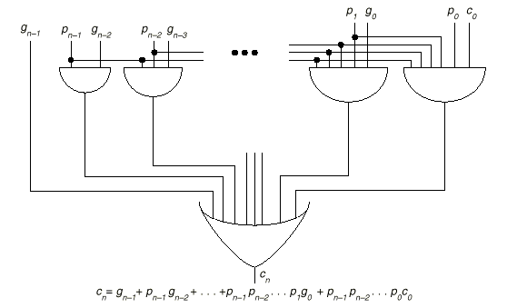
Speed up Integer Addition
Carry-Lookahead circuit
Carry bit could ripple through n bits → slow.
Generate Cn carry bit in 5 logical levels instead of 2n.
g_{i}=a_{i}b_{i} (generate bit which generate carry bit), p_{i}=a_{i}+b_{i} (propagation bit, if true, carry bit c_{i-1} will be propagate through this i bit position)
The circuit requires a fan-in of n+1 at the OR gate.
And gate
Or gate

Slide 26

Sweeney, Robertson, Tocher (SRT) Division
Observation: operations for leading zeros in divisor can be skipped.
a/b with n-bit
Load a and b into A and B registers (Figure A.2)
If B has k leading zero, shift B and (P,A) left k bits
For I=0, n-1,
  If top 3 bits of P are equal, set qi=0 and shift (P,A) one bit left.
  If top 3 bits of P are not equal and P is negative, set q_{i}=-1 (write as ) shift (P,A) one bit left, add B.
  Otherwise, set q_{i}=1, shift (P,A) one bit left, sub B.
If final remainder is negative, correct the remainder by adding B; correct the quotient by subtracting 1 from q₀.
Shift remainder k bits right.

Slide 27
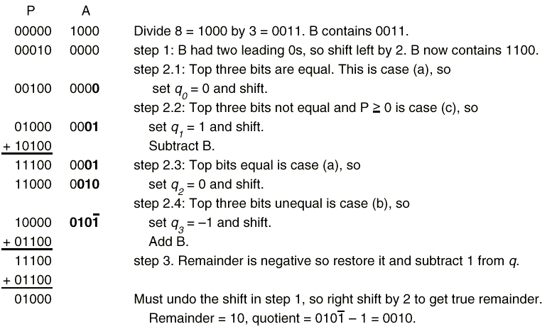
SRT Division Example

Slide 28
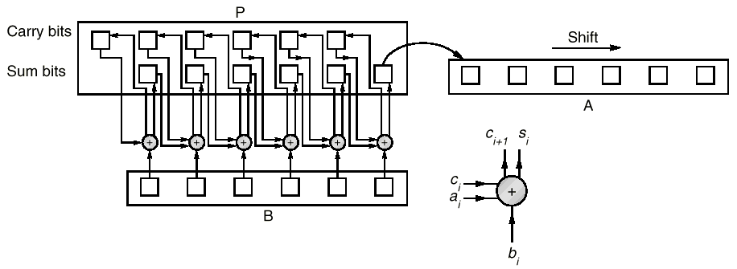
Speed Up Multiplication with a Single Adder
Carry-Save Adder (CSA)
Idea: save carry bits in P registers since we need to perform multiple time in multiplications, at the end use an ordinary adder to combine the sum and carry part.

Slide 29
Radix-k Multiplication
Idea: examine log k bits of register each time, and last bit shifted out, decide multiple of b to add or subtract, and shift log k bits at a time.
Low-order bits of A
Last bit shifted out
Multiple
2i+1
2i
2i-1
0
0
0
0
0
0
1
+b
0
1
0
+b
0
1
1
+2b
1
0
0
-2b
1
0
1
-b
1
1
0
-b
1
1
1
0

Slide 30
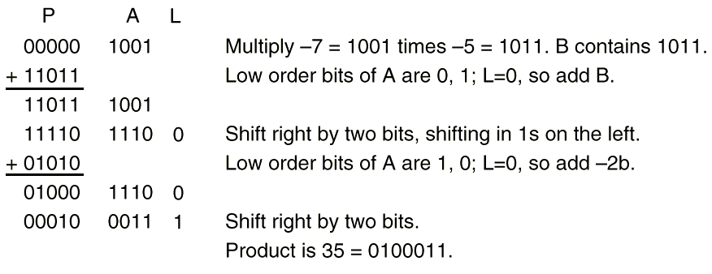
Radix-4 Multiplication Example

Slide 31
Radix-4 SRT Division
a/b with n-bit
Load a and b into A and B registers (Figure A.2)
If B has k leading zero, shift B and (P,A) left k bits. Choose 4 bit of B as b. use b to select quotient in the table.
For I=0, ceil((n-1)/2),
  Based on top 6 bits of P and b, from table A.34 select q_{i} , shift left two bits, subtract q_{i}*b to P.
  Note that q_{i} could be negative.
If final remainder is negative, correct the remainder by adding B; correct the quotient by subtracting 1 from q₀.
Shift remainder k bits right.

Slide 32
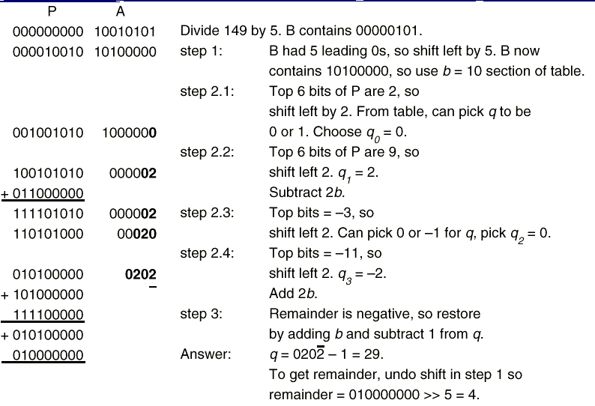
Example of radix-4 SRT divisioin
149/5

Slide 33
Table for Selecting Quotient Digits
Since b=10, we only show the b=10 section of the table.
Note that for some range values, there are multiple choices. This results from the redundant representation of the quotient.
b
Range of P
q
10
-15 -9
-2
10
-8 -3
-1
10
-3 2
0
10
2 7
1
10
8 14
2

Slide 34
Homework #2
Prob 1. Repeat nonrestoring division for 7/2 and show steps similar to Figure A.3b.
Prob 2. IEEE Floating Point
What is the decimal value of the IEEE single precision number with 0x41000000 as bit pattern?
How –0.25 is represented as IEEE single precison number? (describe the bit pattern)
Prob 3. Repeat radix-4 SRT division for 36/11 and show steps similar to Figure A.35.

Slide 35
Puzzle with NonRestoring Division
Here are the sequence using sign magnitude representation for P.
P
A
Step
Explanation
00000
1110
init
Divide 14=1110₂ by 3=11₂. B=0011₂
00001
110
1(i-b)
P positive; Shift (P, A) left one bit
- 00011
1(ii-b)
Subtract B, P=P – B; 1-3=-2
- 00010
1100
1(iii)
Result is negative; set A₀=0
- 00101?
100
2(i-a)
P negative; shift (P, A) left one bit
+00011
Add B, P=P+B; -5+3=-2
- 00010
1000
Result is negative; set A₀=0! Incorrect!
What went wrong?

Slide 36
Problem
After step 1(i-b), P=1 A=1100
If we consider a binary point between registers P and B. (P,A) represents 1.110₂=1+ ½+ ¼ =1.75
Note that after step 1(ii) P=-2 (-00010₂) become negative, but A is still a positive number, .11₂=½+ ¼ =0.75
The remainder value should be –2+0.75=-1.25
If we perform a logic left shift, the remainder value should multiply by 2. Since P=-00101₂=-5 A=(.10₂)=0.5
the remainder (P,A) becomes –5+0.5=-4.5
which is not the same as –1.25 *2=-2.5. Inconsistency!
Problem: The above treats A as a positive number.

Slide 37
Solutions
When performs the subtraction, work on (P,A) as a whole number, (not including the Quotient bits).
Treat P and A as independent numbers with their own sign (A always positive). Modify the “logical shift”
Use 2’s complement!
Why restoring division algorithm does not have problem?
→ P is restored and always non-negative. When P is positive, logical shift left preserve the value.

Slide 38
Solution 1 (a)
P
A
Step
Explanation
00000
1110
init
Divide 14=1110₂ by 3=11₂. B=0011₂
00001
110
1(i-b)
P positive; Shift (P, A) left one bit
- 00011
1(ii-b)
Subtract B, PA=PA – B; 1.75-3= -1.25
- 00001
0100
1(iii)
Result is negative; set A₀=0
- 00010
100
2(i-a)
P negative; shift (P, A) left one bit PA= -2.5
+00011
2(ii-a)
Add B, PA=PA+B; -2.5+3=0.5
00000
1001
2(iii)
Result is positive; set A₀=1
00001
001
3(i-b)
P positive, Shift (P,A) left one bit
- 00011
3(ii-b)
Subtract B, PA=PA-B; 1.0-3=-2

Slide 39
Solution 1 (b)
P
A
Step
Explanation
- 00010
0010
3(iii)
Result is negative; set A₀=0
- 00100
010
4(ia)
P negative; shift PA left one bit PA=-4
+00011
4(iia)
Add B; PA=PA+B=-4+3=-1
- 00001
0100
4(iii)
Result is negative; set A0=0
+00011
0100
Remainder is negative, do final restoration
00010
The quotient is 0100₂, remainder=00010₂
Problem with this approach: need a bigger
Adder. (8 bit).

Slide 40
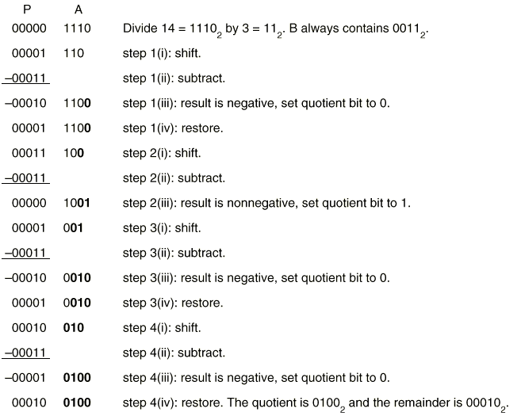
Restoring Division

Slide 41
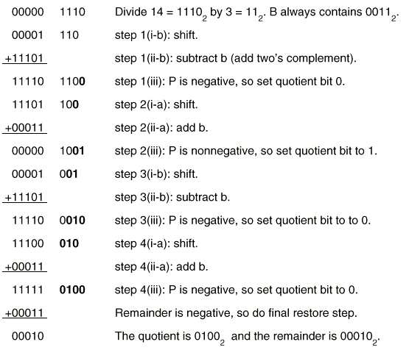
Non-restoring Division

