Slide 1

UNIVERSITY OF MASSACHUSETTS
Dept. of Electrical & Computer Engineering
Digital Computer Arithmetic
ECE 666
Part 7c
Fast Division - III
Israel Koren
Spring 2008

Slide 2
Speeding Up the Division Process
Unlike multiplication - steps of division are serial
Division step consists of selecting quotient digit and calculating new partial remainder
Two ways to speed up division:
(1) Overlapping full-precision calculation of partial remainder in step i with selecting quotient digit in step i+1
  Possible since not all bits of new partial remainder must be known to select next quotient digit
(2) Replacing carry-propagate add/subtract operation for calculating new partial remainder by carry-save operation

Slide 3
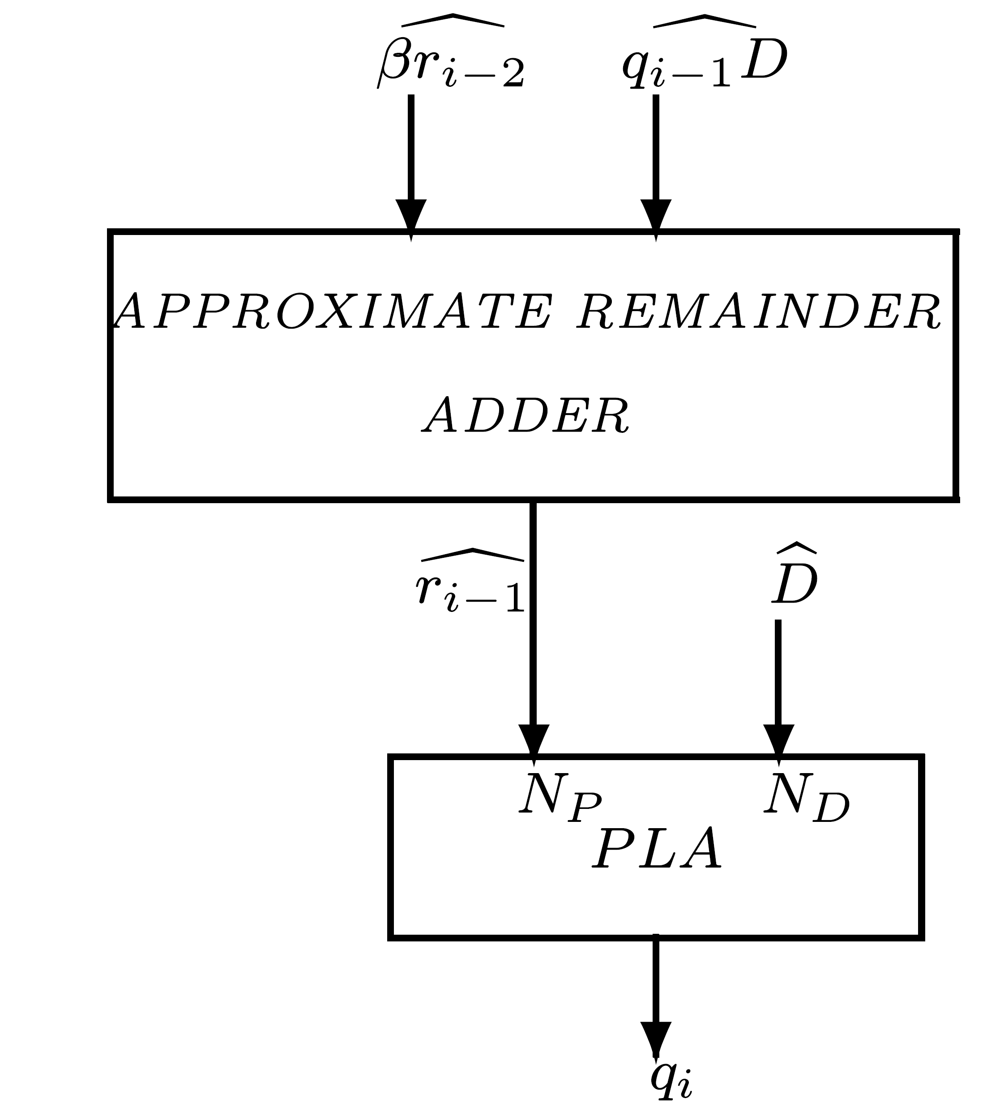
First Speed-Up Method
Truncated approximation of new partial remainder calculated in parallel to full-precision calculation of partial remainder - can be done at high speed
  Quotient digit determined before current step completed
Instead of: (1) Calculate ri-1 (with carry propagation) in step i-1 & (2) input NP most significant bits to PLA to determine qi
Use a small adder with inputs: most significant bits of previous partial remainder, βri-2, and most significant bits of corresponding multiple of divisor, qi-1D
Approximate Partial Remainder (APR) adder

Slide 4
Approximate Partial Remainder Adder
Produces approximation of NP most significant bits of partial remainder, ri-1, before full-precision add/sub operation (ri-1=βri-2-qi-1D) is completed
Allows to perform look-ahead selection of qi in parallel with calculation of ri-1
Size of APR adder determined so that sufficiently accurate NP bits generated
Uncertainty in result of this adder larger than of truncated previous partial remainder βri-2 - may need additional inputs for quotient look-up table
8-bit APR adder sufficient to generate necessary inputs to PLA for β=4, α=2

Slide 5
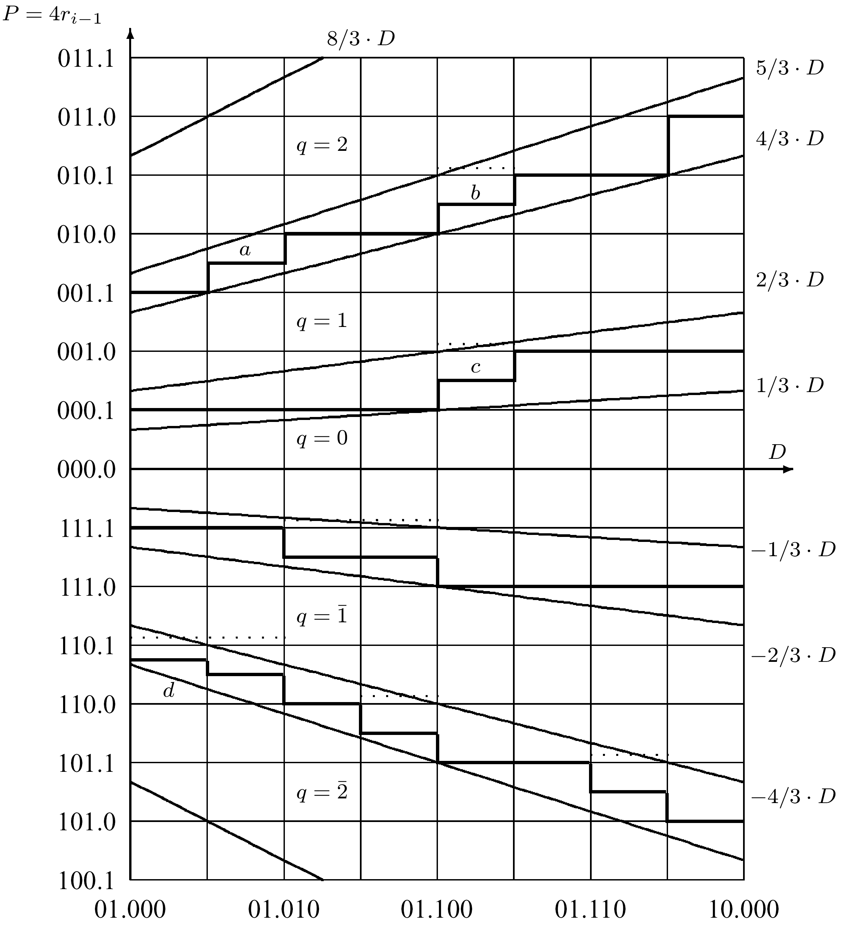
Example: P-D Plot (β=4, α=2)
D∈[1,2)
  Horizontal lines determined to reduce complexity of PLA
  Only 3 divisor bits needed as PLA inputs - most significant bit of divisor always 1
  For partial remainder - 5 bits (including sign bit) sufficient in most cases

Slide 6
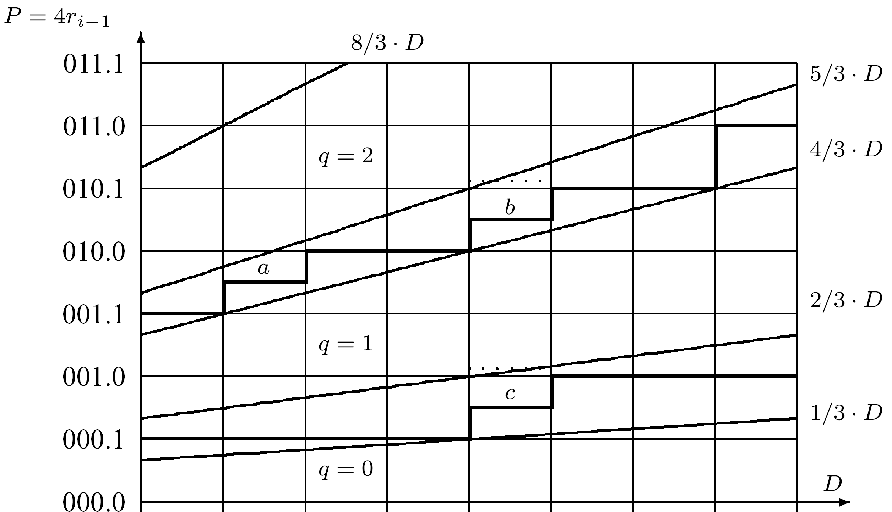
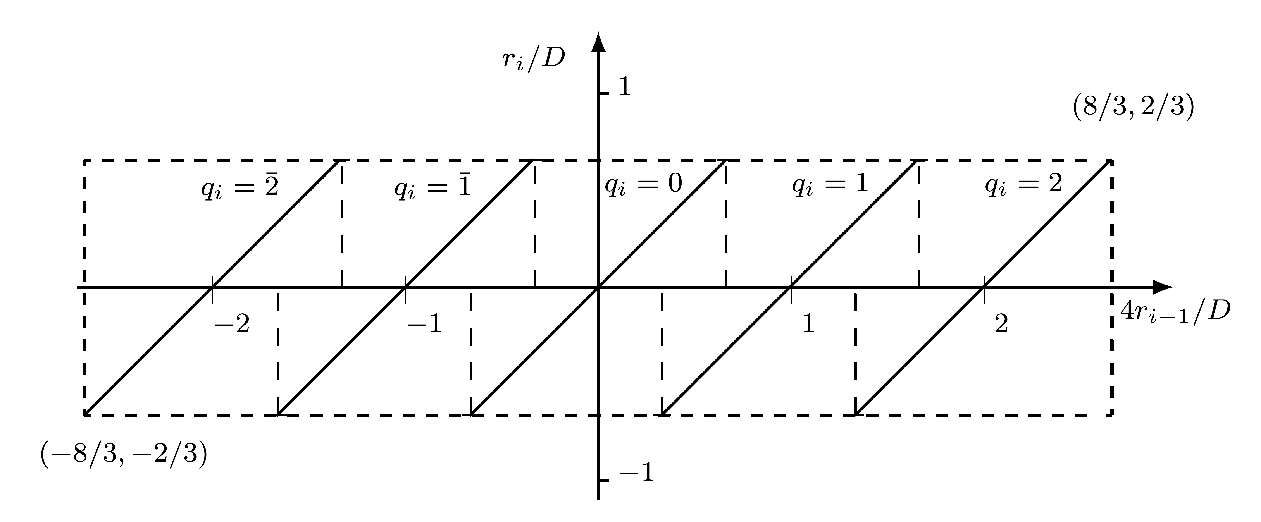
Positive Remainder
3 cases (a,b,c) when additional bit required
Case a: D=1.001, P=1.1 - single fractional bit of P insufficient
Divisor can assume any value from 1.001 to 1.010
Partial remainder can have a value from 1.1 to 10.0 - range for P/D from 1.1/1.010=1.2 to 10.0/1.001=1.77
First requires q=1, while second requires q=2
Add 2nd fractional bit to P
  Can select q=1 for P=1.10 and q=2 for P=1.11

Slide 7
Cases b and c
8-bit APR adder may introduce additional error - increasing P/D range
Case b: D=1.100, P=10.0
No APR adder: P/D range from 10.0/1.101=1.23 to 10.1/1.100=1.66 - q=1 can be selected
8-bit APR adder: introduces error of up to 2 in ri-1 - increases to 2 after multiplying by 4
This additional error increases maximum value of P/D from 1.66 to 1.7, requiring q=2
An extra fractional bit of P solves this problem
-6
-4

Slide 8
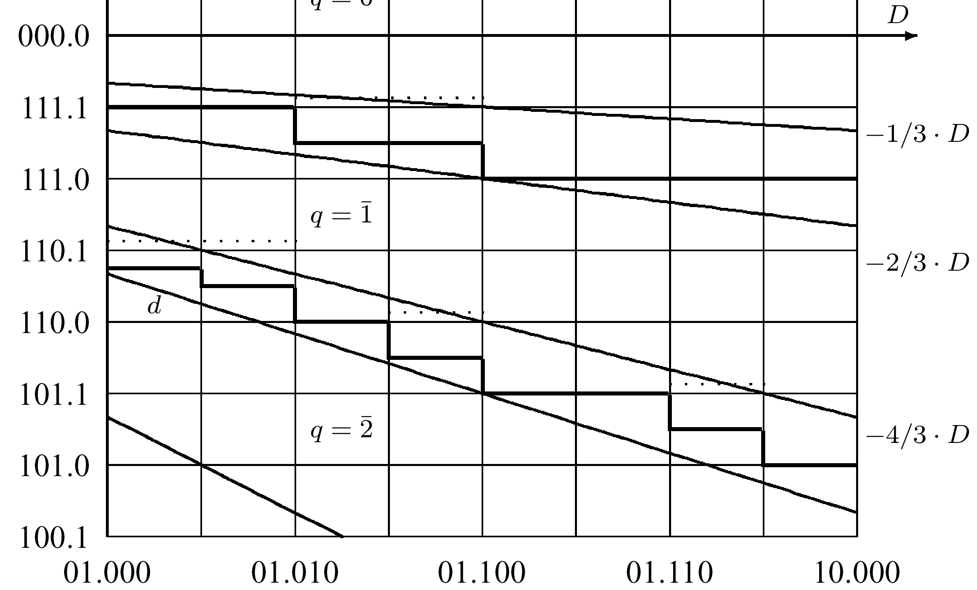
Negative Partial Remainder
Represented in two's complement
6 cases - 1 or even 2 additional output bits of APR adder required to guarantee correct selection of quotient digit

Slide 9
Second Speed-Up Method
In first method - time needed for division step determined by add/subtract for remainder - quotient digit selected in previous step
Second method avoids time-consuming carry propagation when calculating remainder
Truncated remainder sufficient for selecting next quotient digit - no need to complete calculation of remainder at any intermediate step
Replace carry-propagate adder by carry-save adder
  Partial remainder in a redundant form using 2 sequences of intermediate sum and carry bits (stored in 2 registers)
Only most significant sum and carry bits must be assimilated using APR adder to generate approximate remainder and allow selection of quotient digit

Slide 10
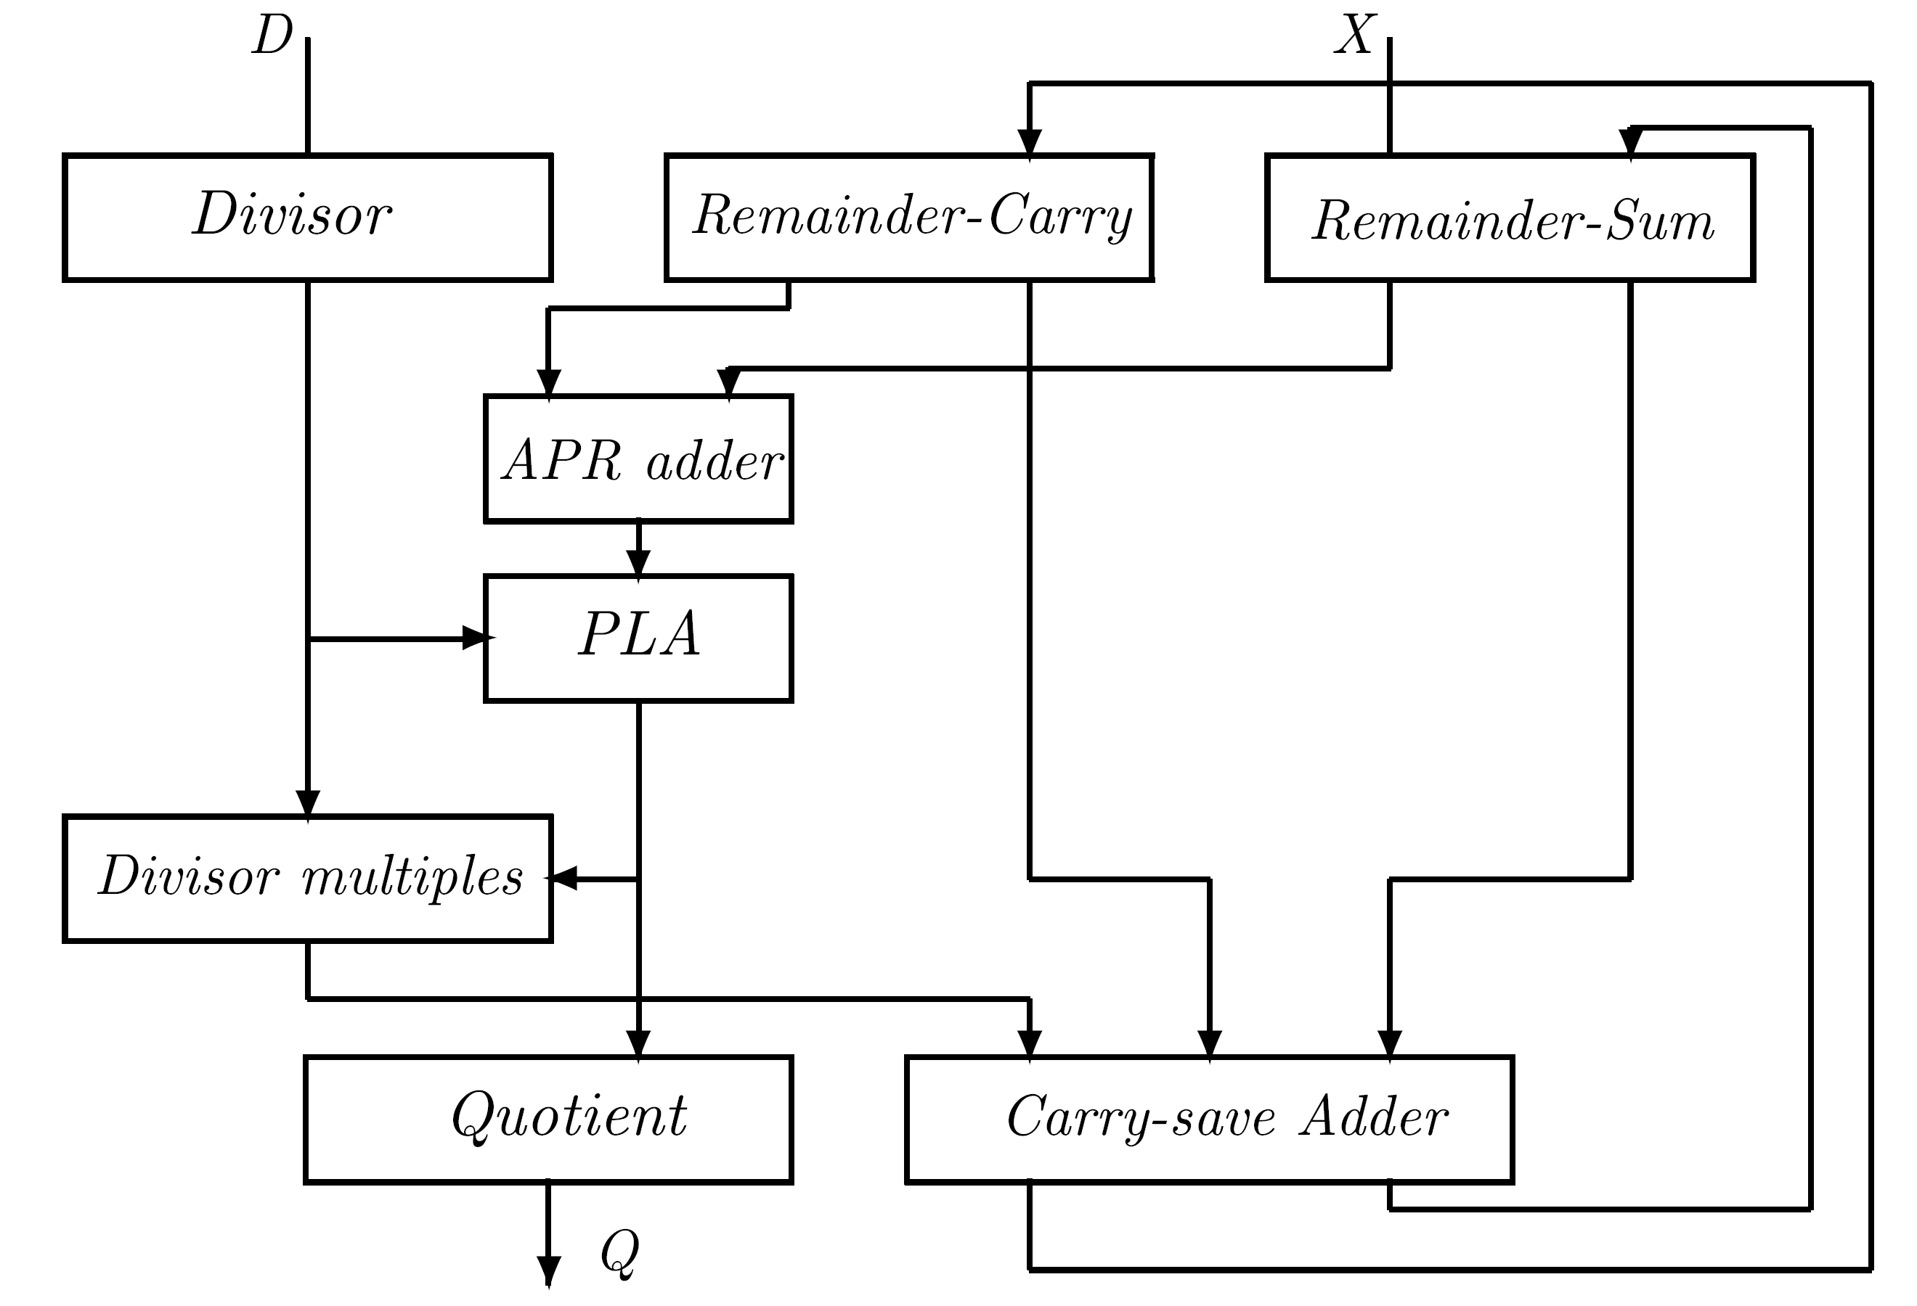
SRT Divider with Redundant Remainder
Most time consuming - calculate approximate remainder and select quotient digit
In each division step: carry-save adder calculates remainder, APR adder accepts most significant sum and carry bits of remainder & generates required inputs to quotient selection PLA
As in first method - number of PLA inputs and its entries need to be calculated, taking into account uncertainty in sum and carry bits representing truncated remainder

Slide 11
Example
An algorithm for high-speed division with β=4, α=2, D ∈ [1,2) has been implemented
Partial remainder calculated in carry-save manner resulting in a somewhat more complex design
8-bit APR adder used to generate most significant remainder bits - inputs to quotient selection PLA
Inputs to APR adder: 8 most significant sum bits and carry bits in redundant representation of remainder
Outputs of APR adder converted to a sign-magnitude representation - only 4 bits of approximate partial remainder needed in most cases
Additional bit required only in 4 cases - simple PLA

Slide 12
Further Speed-up of SRT Division
Achieved by increasing radix β to 8 or higher
Reduces number of steps to ⎡n/3⎤ or lower
Several radix-8 SRT dividers have been implemented
Main disadvantage: high complexity of PLA - most time-consuming unit of divider
Avoiding complex PLA - implementing radix-2 SRT unit as a set of m overlapping radix-2 SRT stages
Radix-2 SRT requires very simple quotient selection logic - qi ∈ {-1,0,1} solely determined by remainder - independent of divisor
Must overlap quotient selections for m bits - all m quotient bits generated in one step
m

Slide 13
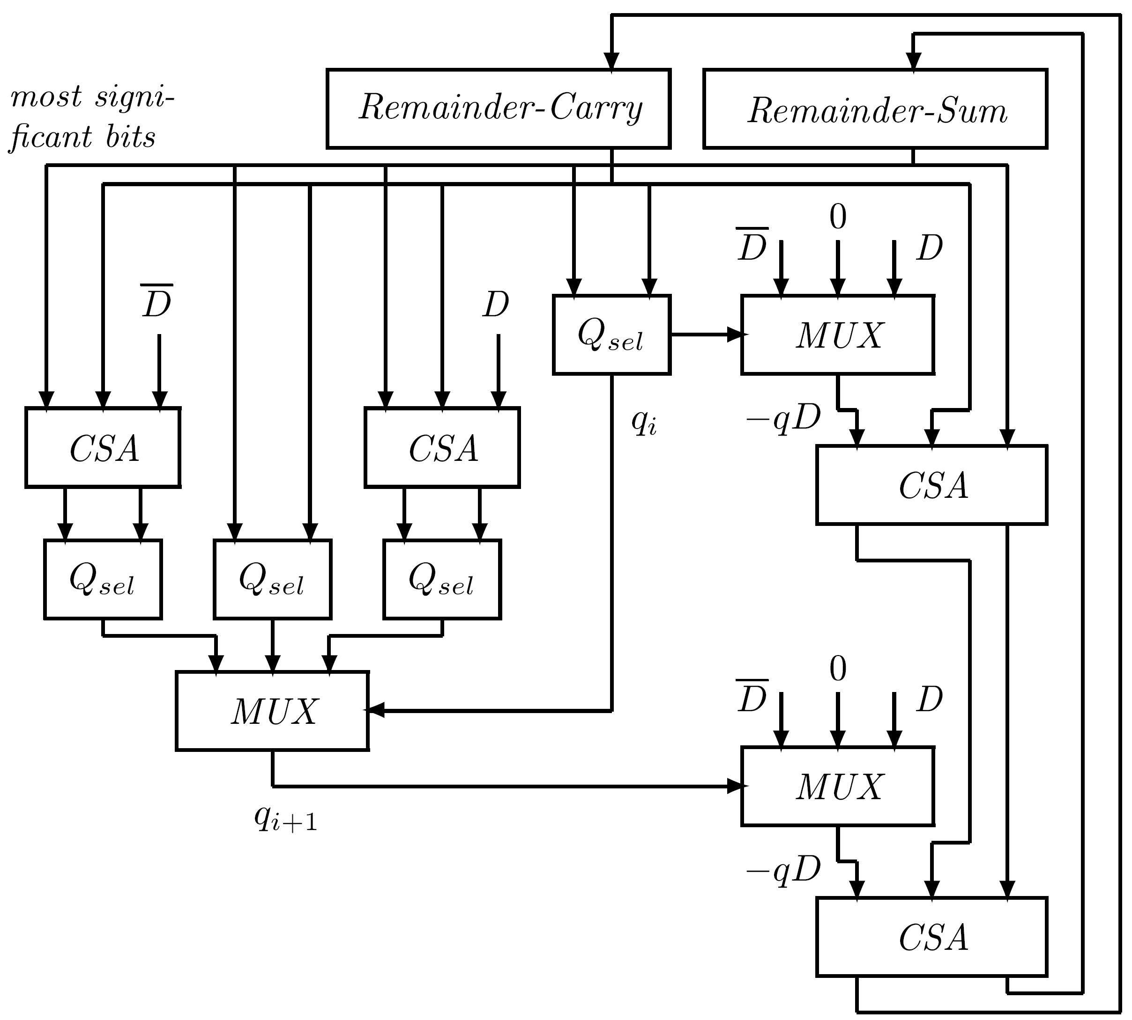
Two Overlapping Radix-2 SRT Stages
Implementing radix-4 division
All 3 possible values of qi+1 generated using 3 Qsel units - correspond to 3 possible intermediate remainders: 2ri-1-D, 2ri-1, 2ri-1+D
Only most significant bits of 3 remainders generated
Overall delay: CSA, Qsel, two Mux and final CSA
May be faster than radix-4 stage - higher complexity of radix-4 PLA

Slide 14
Extending to Radix-8 SRT division
More complex quotient selection circuit - 3 quotient digits (qi,qi+1,qi+2) generated in parallel
For qi+1: calculate speculative remainders 2ri-1-D,2ri-1,2ri-1+D
For qi+2: calculate 4ri-1-3D,4ri-1-2D,4ri-1-D,4ri-1,4ri-1+D, 4ri-1+2D,4ri-1+3D
  Only most significant bits of these 7 remainders
7 Qsel units required with multiplexors (controlled by qi and qi+1) to select correct value of qi+2
Extend to 4 overlapping radix-2 stages for radix-16 divider: number of Qsel units increases from 11 to 26
Another alternative for a radix-16 divider: 2 overlapping radix-4 SRT stages

Slide 15
Array Dividers
All division algorithms can be implemented using arrays: n rows with n cells per row for radix-2 division
Restoring: each row forms difference between previous remainder and divisor and generates quotient bit according to sign of difference
No need to restore remainder if quotient bit=0 - either previous remainder or difference transferred to next row
If ripple-carry in every row - n steps to propagate carry in a single row - total execution time of order n²
Nonrestoring array: same speed as restoring; only advantage - handle negative operands in a simple way
Final remainder may be incorrect - sign opposite to dividend

Slide 16
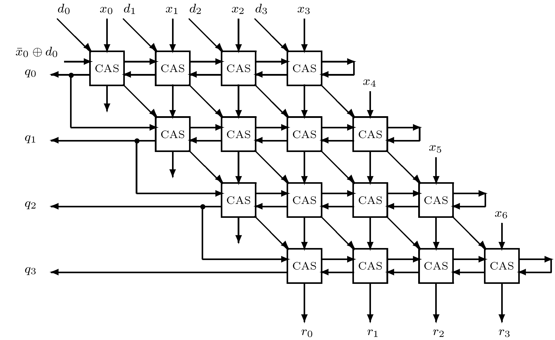
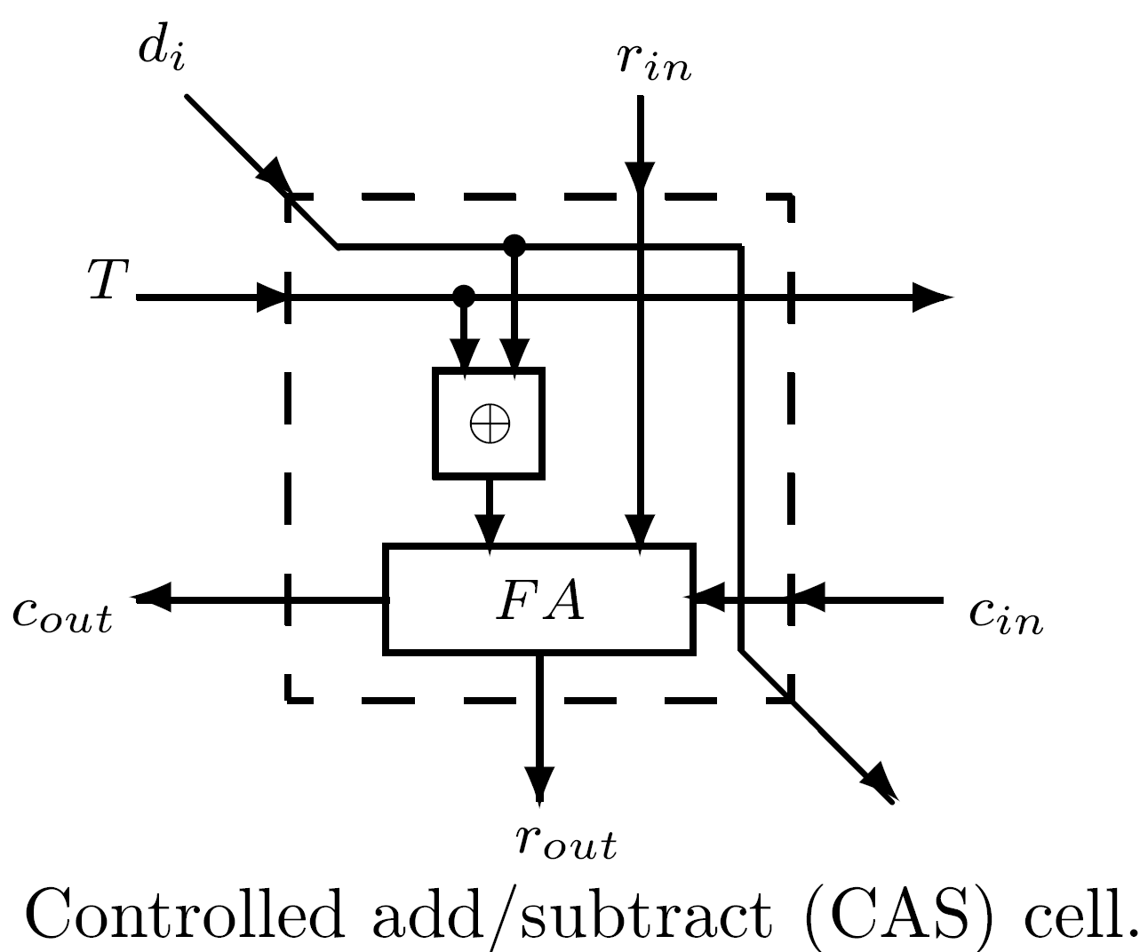
A Non-restoring Array Divider
If T=0 (1) - addition (subtraction) performed;
Subtract - add two's complement of divisor (assumed positive) & forced carry=T

Slide 17
Faster Array Dividers
Previous array dividers - add/subtract with carry-propagation performed in each row
Nonrestoring:
  Only sign bit of partial remainder needed to select quotient bit
  Can be generated by using fast carry-look-ahead circuit
  Other bits of remainder use carry-save adder
Each cell generates Pi and Gi besides sum and carry
Pi and Gi of all cells in a row connected to a carry-look-ahead circuit to generate quotient bit
Execution time - of order n log n vs. n²
Similarly, high-radix division array with carry-save addition
Small carry-look-ahead adder used to determine most significant bits of remainder to select quotient digit

Slide 18
Fast Square Root Extraction
Similar to division - small extensions to division unit
Nonrestoring algorithm - qi=1,1 ; Q=0.q1,...,qm - calculated square root
Advantages of adding 0 to the digit set of qi:
  Shift-only operation required when qi=0
  Overlap between regions of ri where qi=1 or qi=0 are selected leads to reduced precision inspection of remainder
Nonrestoring - must identify ri≥0 to correctly set qi
  Requires precise determination of sign bit of ri
If qi=0 allowed - lower precision comparison sufficient, enables use of carry-save adders for ri
Remainder: two sequences - partial sum and carries
Only a few high-order bits of these two sequences must be examined to select qi

Slide 19
Selection of qi=0
Square root Q restricted to normalized fraction - 1/2 ≤ Q < 1, with q1=1
Radicand: 1/4 ≤ X < 1
Remainder ri-1 (i≥2): -2(Qi-1-2 ) ≤ ri-1 ≤ 2(Qi-1+2 ) (Qi-1 is partially calculated root at step i-1 - Qi-1=0.q1q2...qi-1
In step i≥2, select qi=0 whenever ri-1 is in range [-(Qi-1 - 2 ),(Qi-1 + 2 )]
If qi=0, ri=2ri-1
-i
-i
-i-1
-i-1

Slide 20
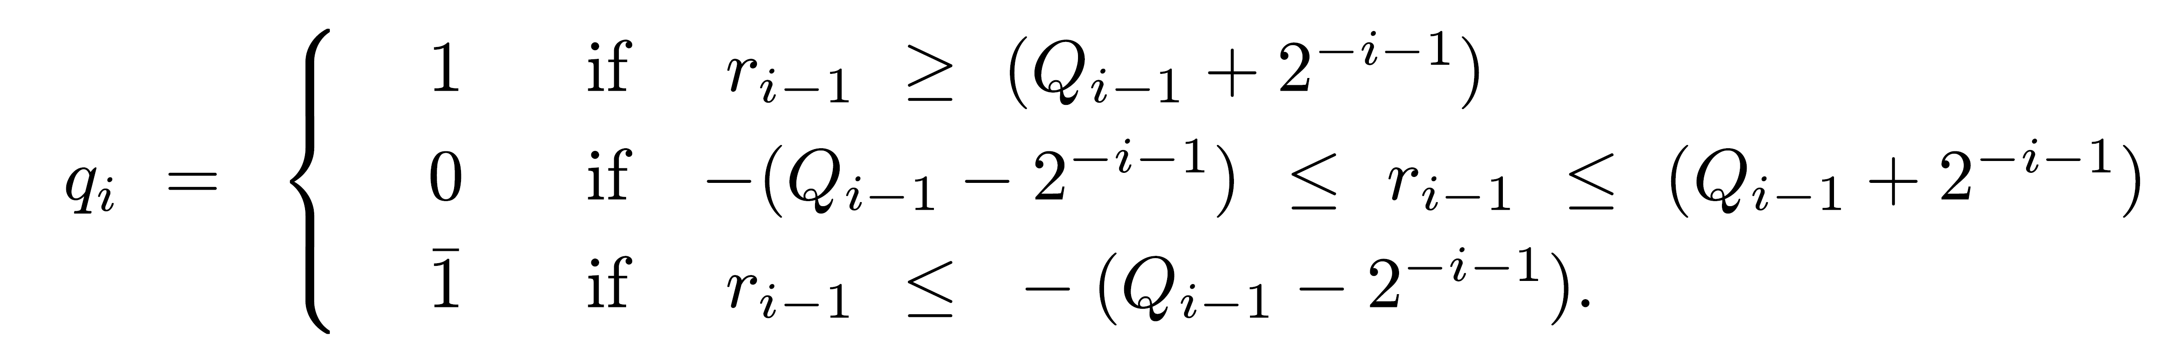
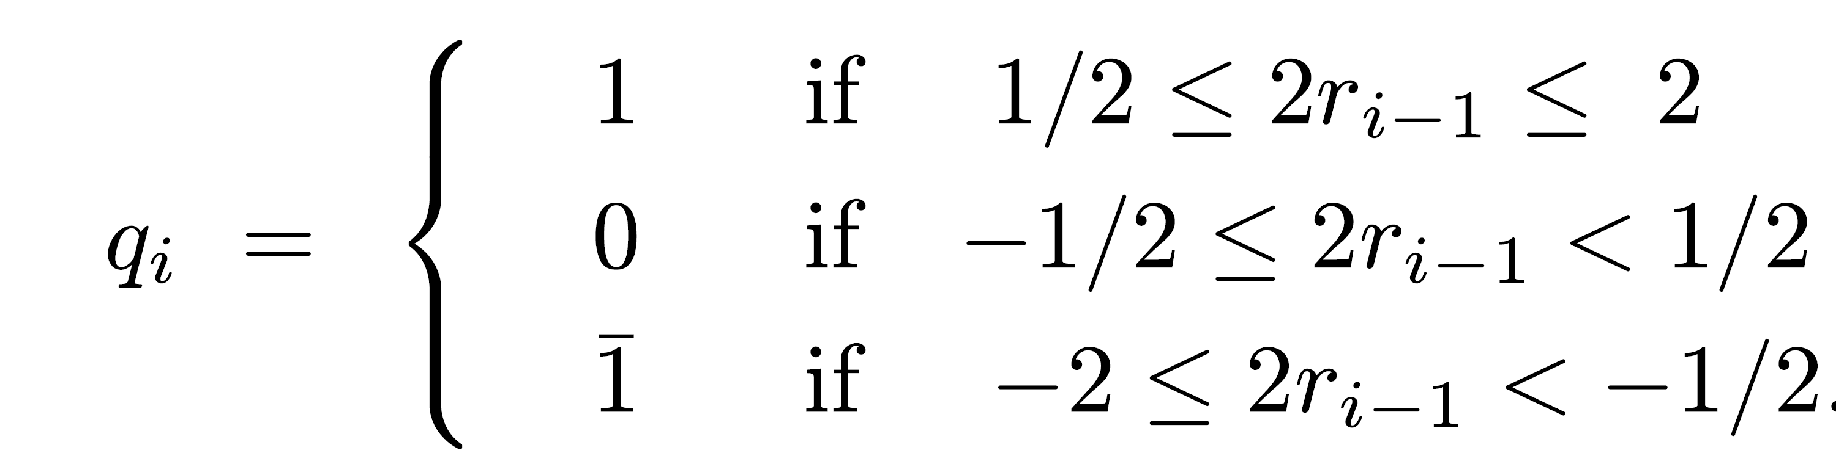
Selection Rule for qi
Since Qi-1 +2 and Qi-1 -2 are in [1/2,1], a selection rule which avoids a high-precision comparison is
Similar to the SRT rule
-i-1
-i-1

Slide 21
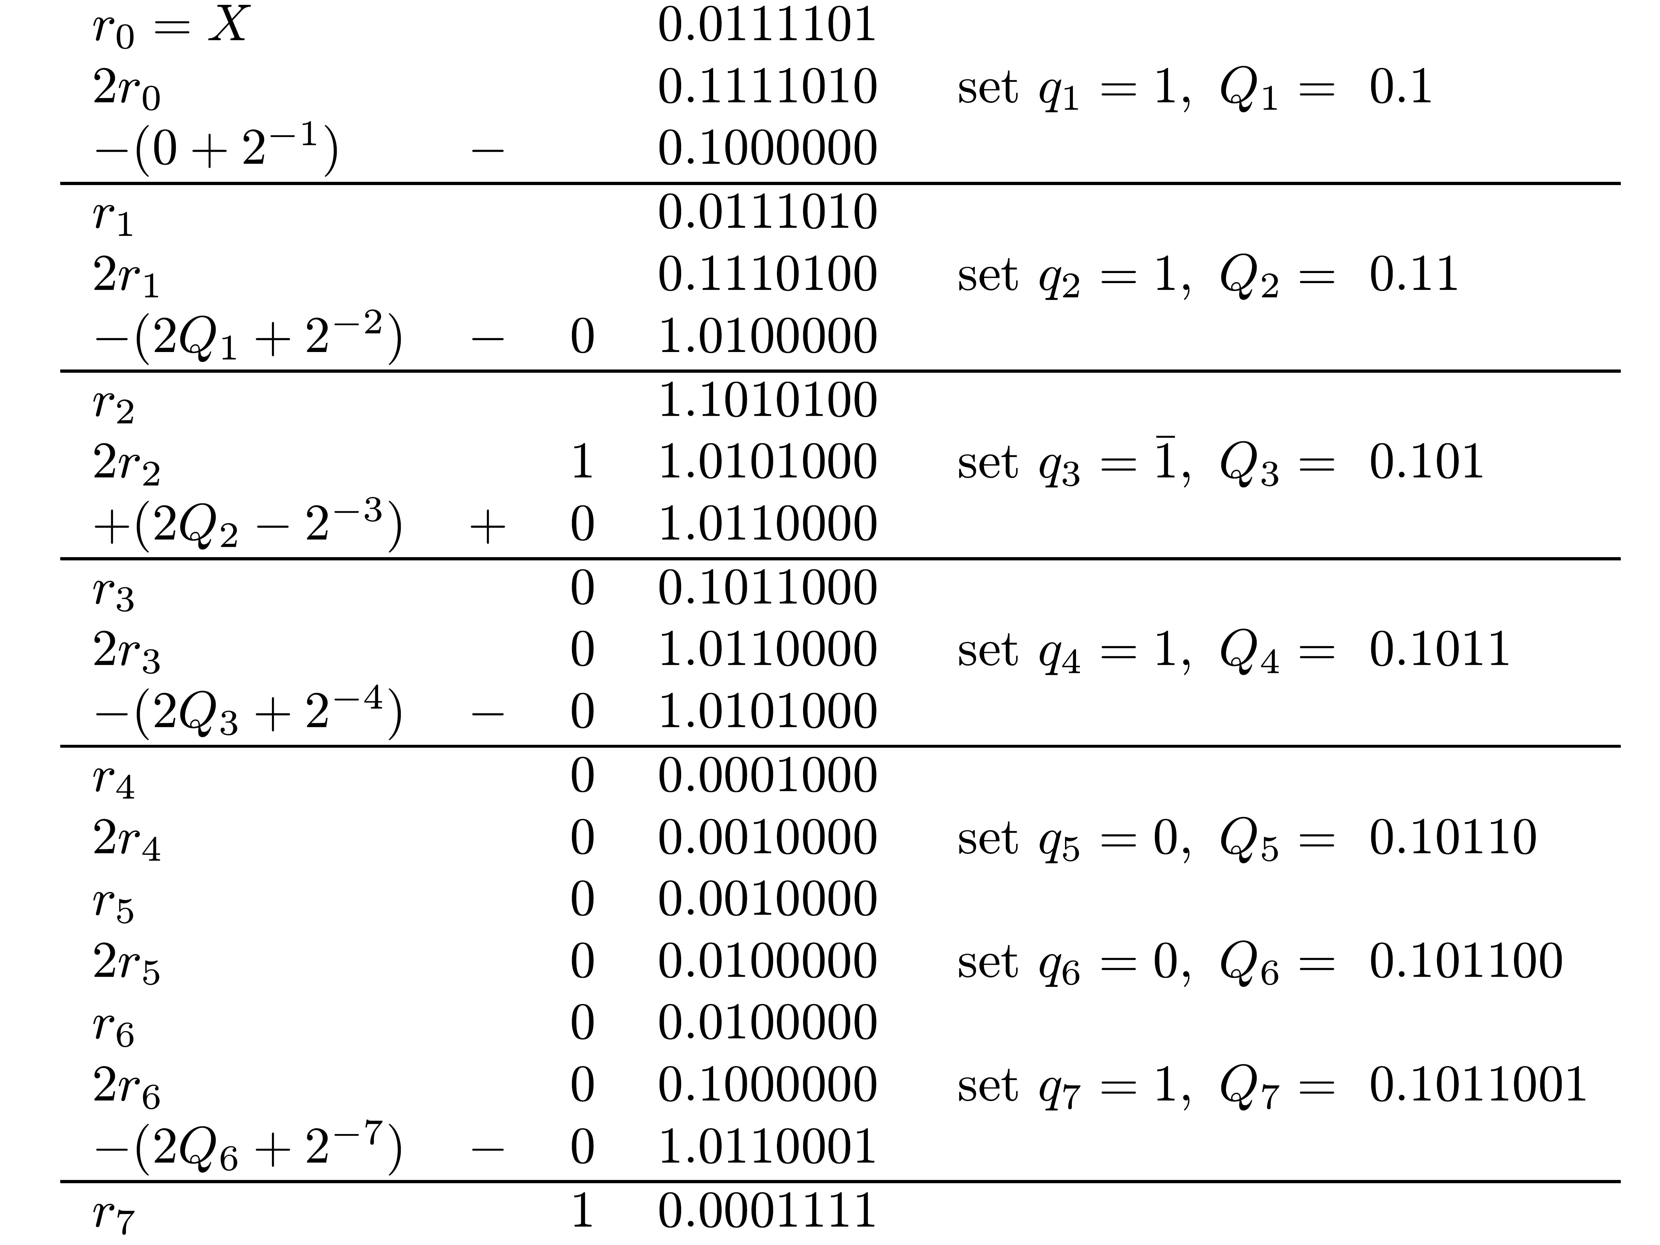
Example
X=.01111012 =61/128
Square root: Q=.10110012 =89/128
Final remainder: 2 r7 = -113/2 = X - Q = (7808-7921)/2
-7
14
2
14

Slide 22
High-Radix Square Root Extraction
β - radix; digit set for qi - {α,α -1,…,1,0,1,…,α}
Computing new remainder: ri = βri-1 - qi (2Qi-1 +qi β )
Example: β=4, digit set {2,1,0,1,2} preferable - eliminates need to generate multiple 3Qi-1
Generation of qi (2Qi-1 + qi 4 ) makes square root extraction somewhat more complex than division
Calculation can be simplified
For qi=1,2 - subtract Q0012 & Q0102, respectively
For qi=1 - add Q0012 - same as (Q-1)1112
For qi=2 - add Q0102 - same as (Q-1)1102
Two registers with Q and Q-1, updated at every step, simplify execution of square root algorithm
-i
-i

Slide 23
Selecting Quotient Digit
Only low-precision comparison of remainder needed to select quotient digit -
  Perform add/subtract in carry-save - small carry-propagate adder to calculate most significant bits of ri
  To provide inputs to a PLA for selecting square root digit qi
  Other inputs to PLA: most significant bits of root multiple
Several rules for selecting qi have been proposed
  Intervals of remainder determine size of carry-propagate adder (between 7 and 9 bits for base-4 algorithm with digits 2,1,0,1,2) and exact PLA entries
Selected qi depends on truncated remainder and truncated root multiple
In first step no estimated root available
Separate PLA for predicting first few bits of root

Slide 24
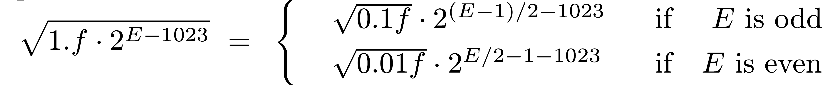
Example - Square Root Using Radix-4 Divider
P-D plot for divide also used for square root
Same PLA (with 19 product terms) used for predicting next quotient digit and root digit
A separate PLA (with 28 product terms) added
  Inputs - 6 most significant bits of significand and least significant bit of exponent (indicates whether exponent odd or even)
  Output - 5 most significant bits of root
Radicand in [1/4,1] ⇒ square root in [1/2,1]

