Slide 1
REMOTE PATIENT MONITORING SERVICE
Andrea Canepa, Stefano Rebora – ADM project 2017/18

Slide 2
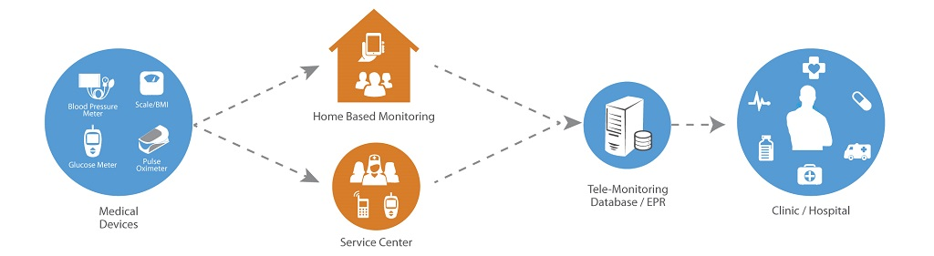
REMOTE PATIENT MONITORING (RPM)
Technology to enable monitoring of patients outside of conventional clinical settings
Based on IoT
Data-intensive application

Slide 3
AIM OF THE PROJECT
The goal of the project is the design and the development of the large-scale data management/data processing layer
PART I
Provide application and system requirements (~10h)
Choice of the reference technology
PART II
Schema and workload definition (~15h)
Cluster and dataset creation (~10h)
Schema and workload implementation (~10h)

Slide 4

CASSANDRA AS REFERENCE TECHNOLOGY
Why?
Practical reasons
We have studied Cassandra during the course and labs
Conceptual reasons
The aim of our application is to collect patient data instead of carrying out periodical regular analyses
No need of real time monitoring and real time streaming of data

Slide 5
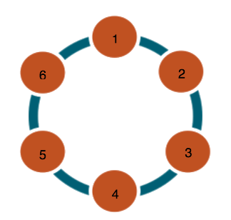
CLUSTER SETUP AND CCM
Configuration development and cluster test using Cassandra Cluster Manager (CCM)
Replication factor of three and ‘SimpleStrategy’ replication strategy
Cassandra ring topology (six nodes, one rack)
Distributed Hash Partitioning
Each node has the 50% of the data

Slide 6
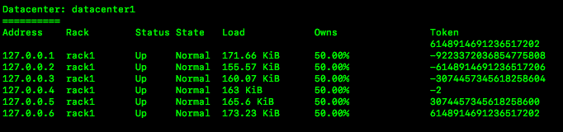
CCM: COMMANDS
Easy start
ccm create cluster_name –v 3.11.1
ccm populate –n 6
ccm start
Utilities
ccm status
ccm node1 ring

Slide 7
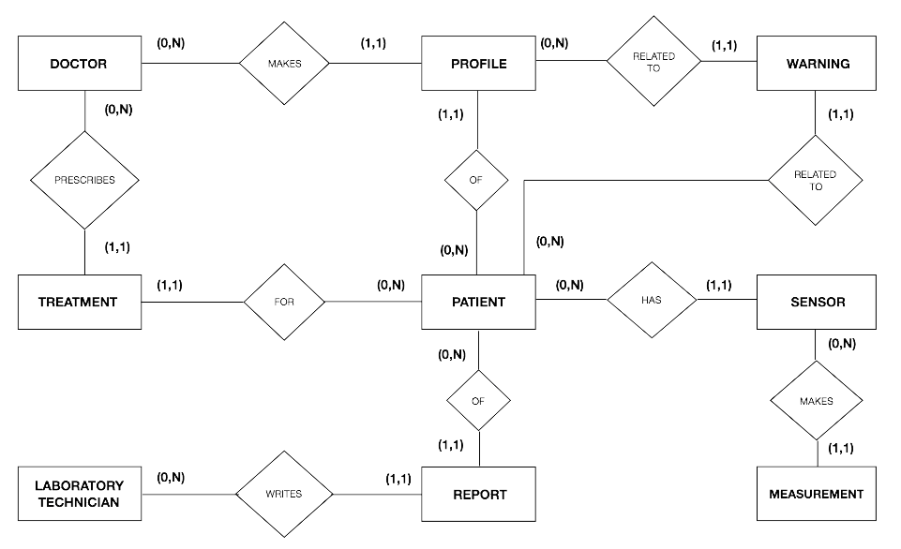
CONCEPTUAL SCHEMA
WARNING
DAEMON

Slide 8
WORKLOAD AND CQL
Cassandra’s tunable consistency for client requests
CONSISTENCY LOCAL_QUORUM for strong consistency
CONSISTENCY ONE for operations where consistency requirements are not stringent
Cassandra Query Language (CQL)
Schema creation and population
Workload operations

Slide 9

EXAMPLES: WORKLOAD OPERATIONS
A technician can look for raised warnings
Creation of a new Patient’s account
Consistency setting

Slide 10
EXAMPLES: WORKLOAD OPERATIONS
A technician can look for raised warnings
Creation of a new Patient’s account
Consistency setting
LIGHTWEIGHT TRANSACTION

Slide 11
REFERENCES
THANKS!
http://cassandra.apache.org/
https://www.datastax.com
https://github.com/riptano/ccm
http://www.freedatagenerator.com
https://www.trifacta.com

