Slide 1
REMOTE PATIENT MONITORING SERVICE
Andrea Canepa, Stefano Rebora – ADM project 2017/18

Slide 2
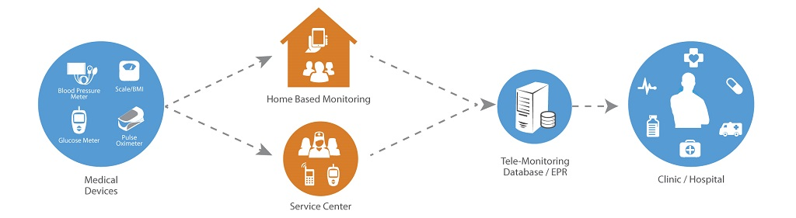
REMOTE PATIENT MONITORING (RPM)
Technology to enable monitoring of patients outside of conventional clinical settings
Based on IoT
Data-intensive application

Slide 3
AIM OF THE PROJECT
The goal of the project is the design and the development of the large-scale data management/data processing layer
PART I
Provide application and system requirements (~10h)
Choice of the reference technology
PART II
Schema and workload definition (~15h)
Cluster and dataset creation (~10h)
Schema and workload implementation (~10h)

Slide 4

CASSANDRA AS REFERENCE TECHNOLOGY
Why?
Practical reasons
We have studied Cassandra during the course and labs
Conceptual reasons
The aim of our application is to collect patient data instead of carrying out periodical regular analyses
No need of real time monitoring and real time streaming of data

Slide 5
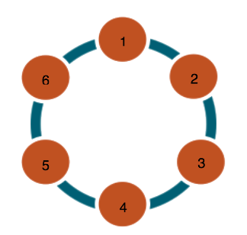
CLUSTER SETUP AND CCM
Configuration development and cluster test using Cassandra Cluster Manager (CCM) which relies on NodeTool utility.
Replication factor of three and ‘SimpleStrategy’ replication strategy
Cassandra ring topology (six nodes, one rack)
Distributed Hash Partitioning
Each node has the 50% of the data

Slide 6
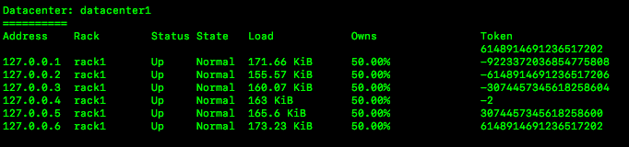
CCM: COMMANDS
Easy start
ccm create cluster_name –v 3.11.1
ccm populate –n 6
ccm start
Utilities
ccm status
ccm node1 ring

Slide 7
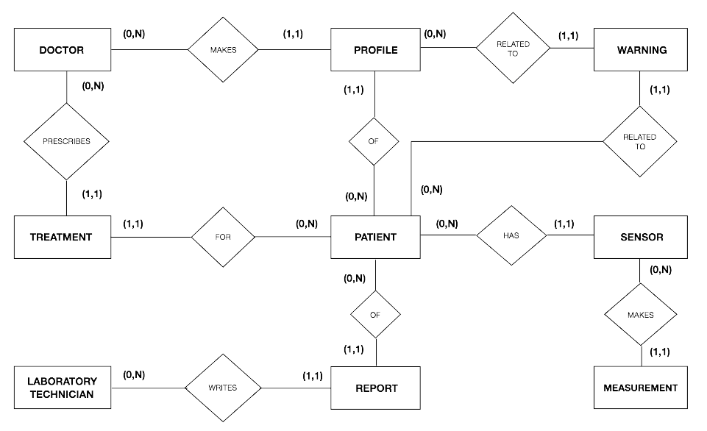
CONCEPTUAL SCHEMA
WARNING
DAEMON

Slide 8
WORKLOAD AND CQL
Cassandra’s tunable consistency for client requests
CONSISTENCY LOCAL_QUORUM for strong consistency
CONSISTENCY ONE for operations where consistency requirements are not stringent
Cassandra Query Language (CQL)
Schema creation and population
Workload operations

Slide 9
EXAMPLES: WORKLOAD OPERATIONS
Warnings generation by ‘WarningDaemon’
Creation of a new Patient’s account

Slide 10
EXAMPLES: WORKLOAD OPERATIONS
Warnings generation by ‘WarningDaemon’
Creation of a new Patient’s account
LIGHTWEIGHT TRANSACTION

Slide 11
REFERENCES
https://www.datastax.com
https://github.com/riptano/ccm
http://www.freedatagenerator.com
https://www.trifacta.com

Slide 12
INSTRUCTIONS FOR USE
EDIT IN GOOGLE SLIDES
Click on the button under the presentation preview that says "Use as Google Slides Theme".
You will get a copy of this document on your Google Drive and will be able to edit, add or delete slides.
You have to be signed in to your Google account.
EDIT IN POWERPOINT®
Click on the button under the presentation preview that says "Download as PowerPoint template". You will get a .pptx file that you can edit in PowerPoint.
Remember to download and install the fonts used in this presentation (you’ll find the links to the font files needed in the Presentation design slide)
More info on how to use this template at www.slidescarnival.com/help-use-presentation-template
This template is free to use under Creative Commons Attribution license. You can keep the Credits slide or mention SlidesCarnival and other resources used in a slide footer.

Slide 13

HELLO!
Andrea Canepa, Stefano Rebora – ADM project 2017/18
I am Jayden Smith
I am here because I love to give presentations.
You can find me at @username

Slide 14
1.
TRANSITION HEADLINE
Let’s start with the first set of slides

Slide 15
Quotations are commonly printed as a means of inspiration and to invoke philosophical thoughts from the reader.

Slide 16
THIS IS A SLIDE TITLE
Here you have a list of items
And some text
But remember not to overload your slides with content
Your audience will listen to you or read the content, but won’t do both.

Slide 17
YOU CAN ALSO SPLIT YOUR CONTENT
White
Is the color of milk and fresh snow, the color produced by the combination of all the colors of the visible spectrum.
Black
Is the color of coal, ebony, and of outer space. It is the darkest color, the result of the absence of or complete absorption of light.

Slide 18
IN TWO OR THREE COLUMNS
Yellow
Is the color of gold, butter and ripe lemons. In the spectrum of visible light, yellow is found between green and orange.
Blue
Is the colour of the clear sky and the deep sea. It is located between violet and green on the optical spectrum.
Red
Is the color of blood, and because of this it has historically been associated with sacrifice, danger and courage.

Slide 19
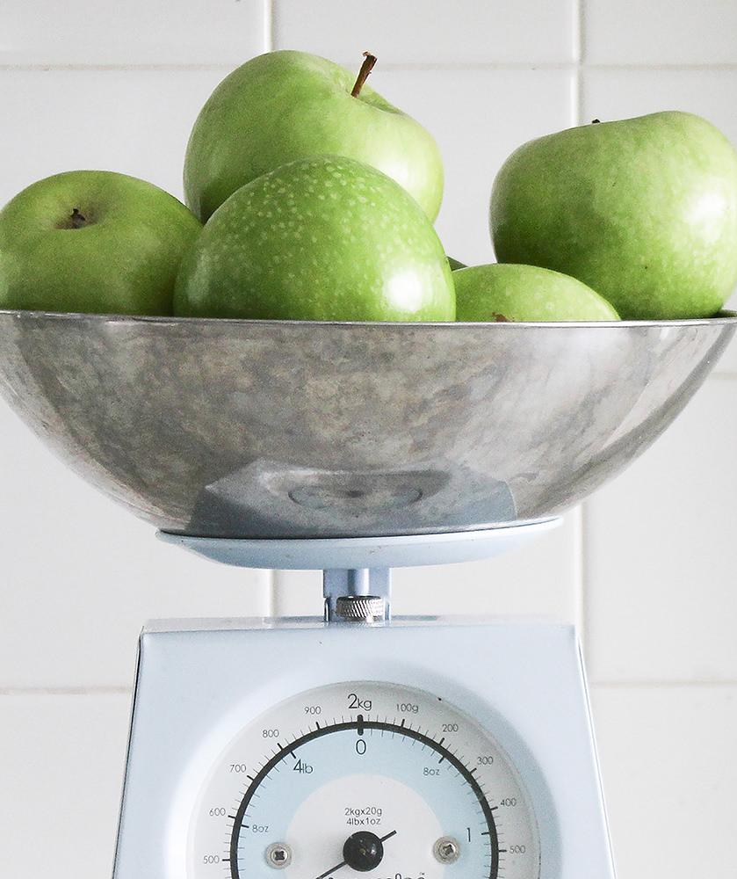
A PICTURE IS WORTH A THOUSAND WORDS
A complex idea can be conveyed with just a single still image, namely making it possible to absorb large amounts of data quickly.

Slide 20
BIG CONCEPT
Bring the attention of your audience over a key concept using icons or illustrations

Slide 21
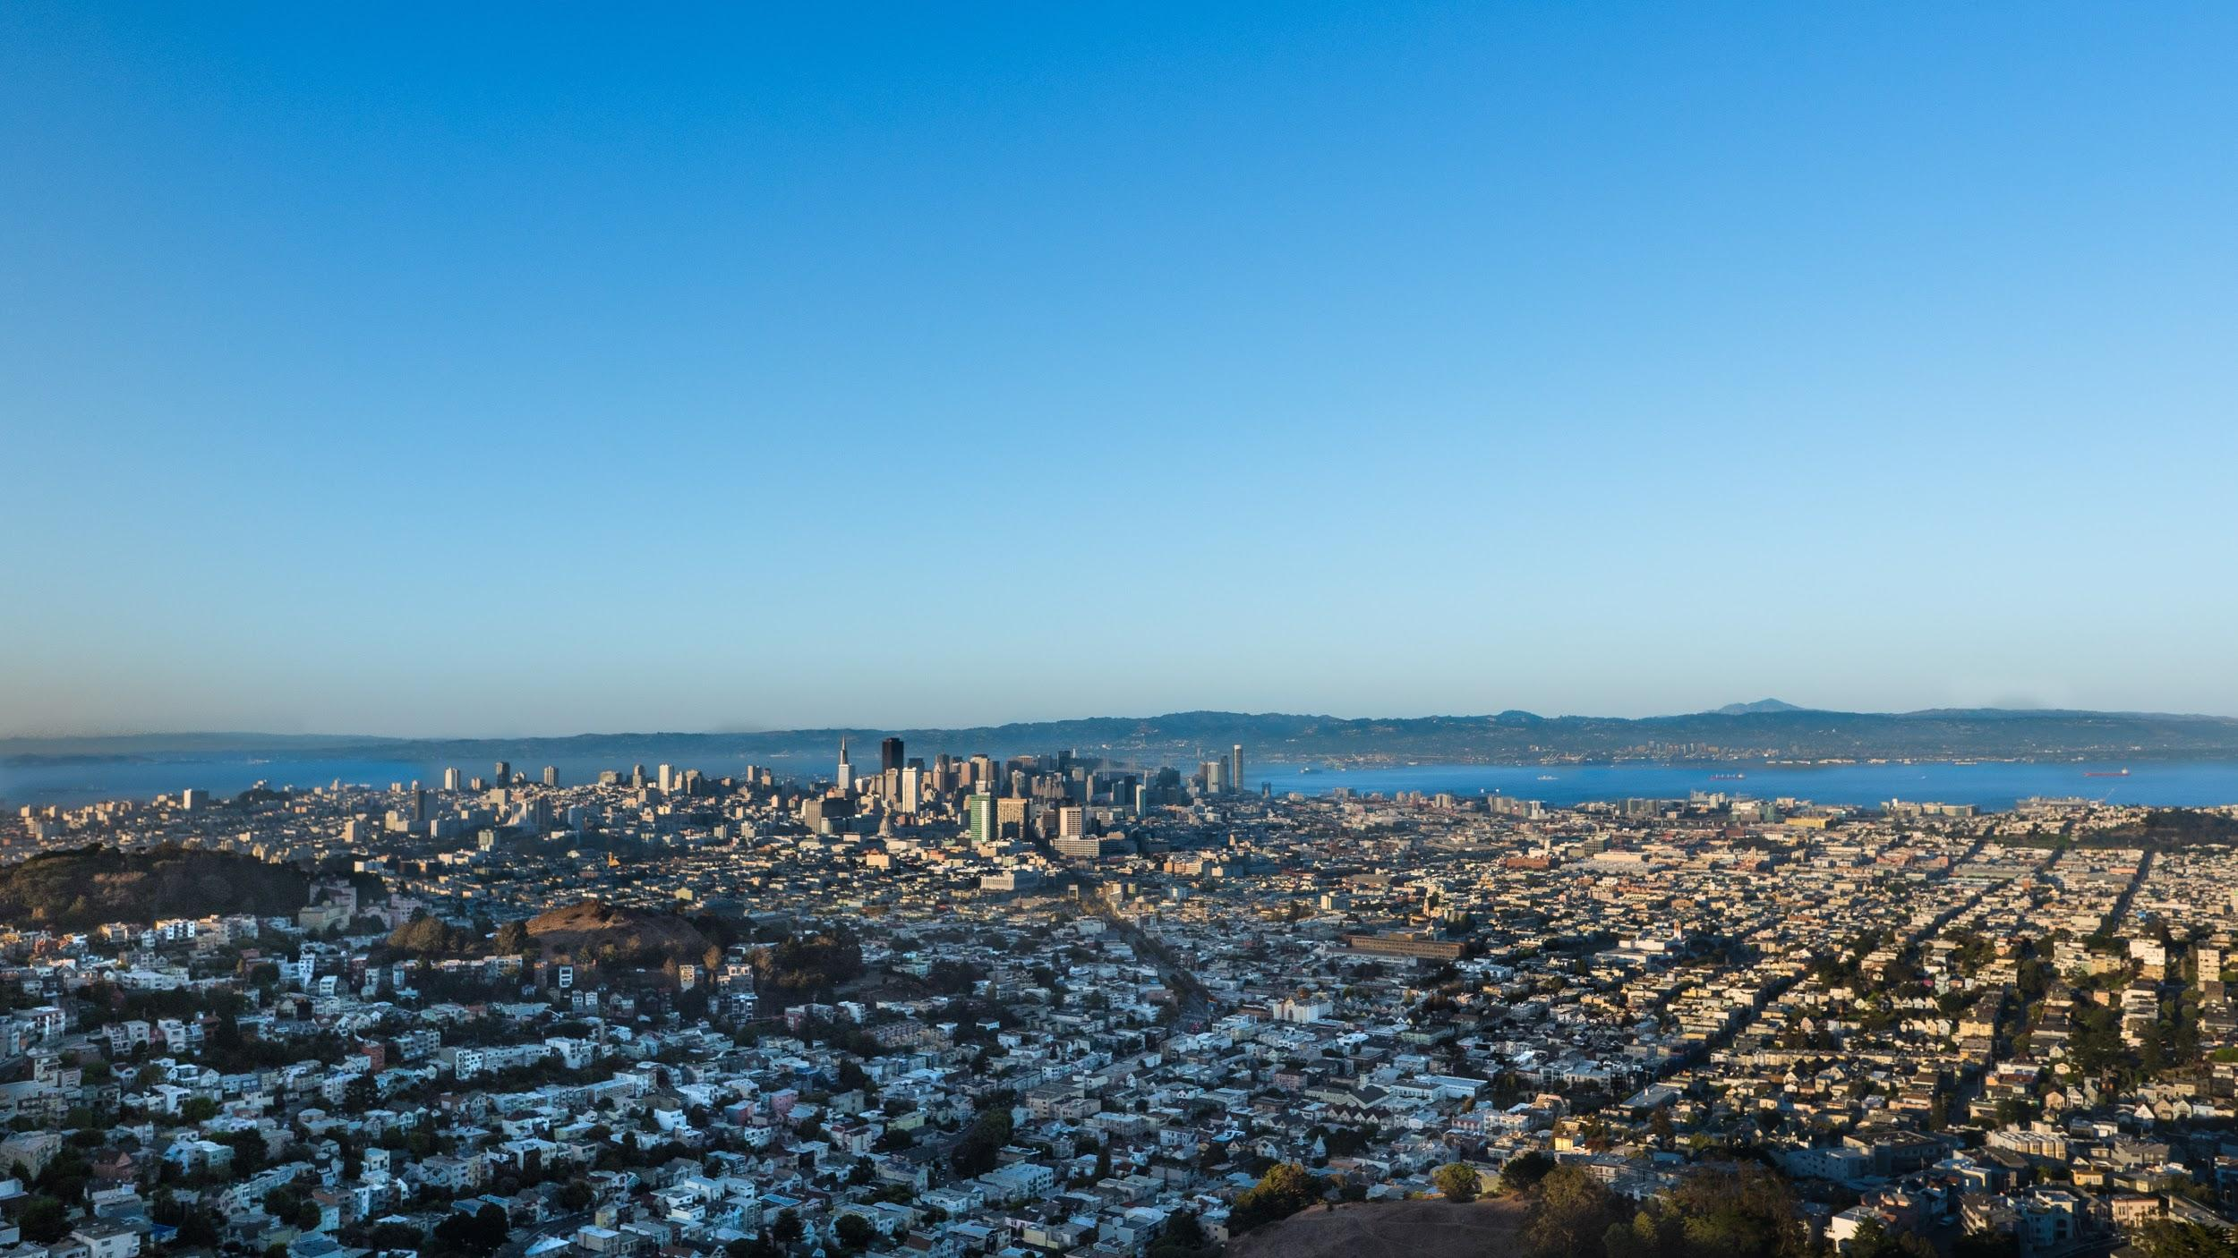
WANT BIG IMPACT?
USE BIG IMAGE.

Slide 22
USE CHARTS TO EXPLAIN YOUR IDEAS
White
Gray
Black

Slide 23
AND TABLES TO COMPARE DATA
 | A | B | C
Yellow | 10 | 20 | 7
Blue | 30 | 15 | 10
Orange | 5 | 24 | 16

Slide 24
MAPS
OUR OFFICE

Slide 25
89,526,124
Whoa! That’s a big number, aren’t you proud?

Slide 26
89,526,124$
185,244 users
100%
That’s a lot of money
And a lot of users
Total success!

Slide 27
OUR PROCESS IS EASY
first
last
second

Slide 28
LET’S REVIEW SOME CONCEPTS
Yellow
Is the color of gold, butter and ripe lemons. In the spectrum of visible light, yellow is found between green and orange.
Blue
Is the colour of the clear sky and the deep sea. It is located between violet and green on the optical spectrum.
Red
Is the color of blood, and because of this it has historically been associated with sacrifice, danger and courage.
Yellow
Is the color of gold, butter and ripe lemons. In the spectrum of visible light, yellow is found between green and orange.
Blue
Is the colour of the clear sky and the deep sea. It is located between violet and green on the optical spectrum.
Red
Is the color of blood, and because of this it has historically been associated with sacrifice, danger and courage.

Slide 29
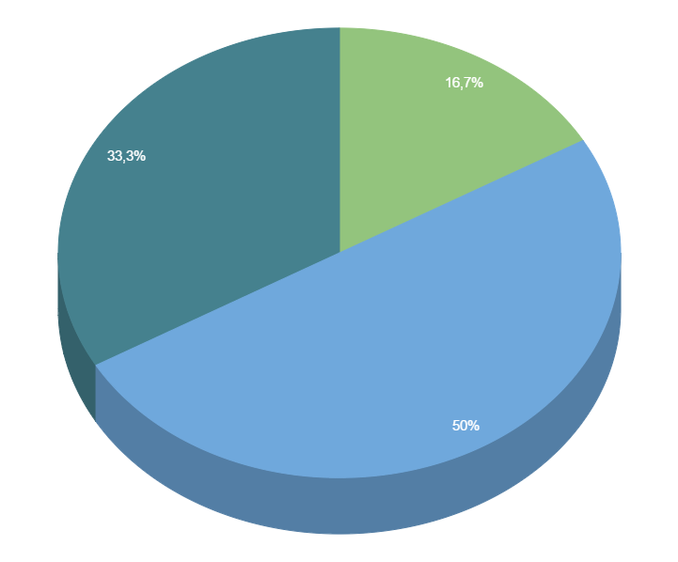
You can copy&paste graphs from Google Sheets

Slide 30
ANDROID PROJECT
Place your screenshot here
Show and explain your web, app or software projects using these gadget templates.

Slide 31
iPHONE PROJECT
Place your screenshot here
Show and explain your web, app or software projects using these gadget templates.

Slide 32
TABLET PROJECT
Place your screenshot here
Show and explain your web, app or software projects using these gadget templates.

Slide 33
DESKTOP PROJECT
Place your screenshot here
Show and explain your web, app or software projects using these gadget templates.

Slide 34
THANKS!
Any questions?
You can find me at
@username
user@mail.me

Slide 35

PRESENTATION DESIGN
This presentation uses the following typographies and colors:
Titles: Dosis
Body copy: Source Sans Pro
You can download the fonts on this page:
https://www.google.com/fonts#UsePlace:use/Collection:Dosis:400,700|Source+Sans+Pro:400,700
Click on the “arrow button” that appears on the top right
Aqua #0db7c4 / Red #f24745 / Green #a9d039
You don’t need to keep this slide in your presentation. It’s only here to serve you as a design guide if you need to create new slides or download the fonts to edit the presentation in PowerPoint®

Slide 36
EXTRA GRAPHICS · HUMAN BODY FRONT

Slide 37
EXTRA GRAPHICS · HUMAN BODY BACK

Slide 38
SlidesCarnival icons are editable shapes.
This means that you can:
Resize them without losing quality.
Change line color, width and style.
Isn’t that nice? :)
Examples:

Slide 39
😉
Now you can use any emoji as an icon!
And of course it resizes without losing quality and you can change the color.
How? Follow Google instructions https://twitter.com/googledocs/status/730087240156643328
✋👆👉👍👤👦👧👨👩👪💃🏃💑❤😂😉😋😒😭👶😸🐟🍒🍔💣📌📖🔨🎃🎈🎨🏈🏰🌏🔌🔑 and many more...

