Slide 1


DATA MINING AND TEXT MINING
BIP PROJECT 2020
10529039 Cappelletti Andrea, 10532096 Maglione Sandro

Slide 2
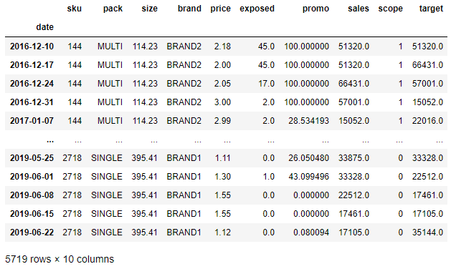
1) PREPROCESSING
Check for missing weeks
Fill missing values with data from next week

Slide 3
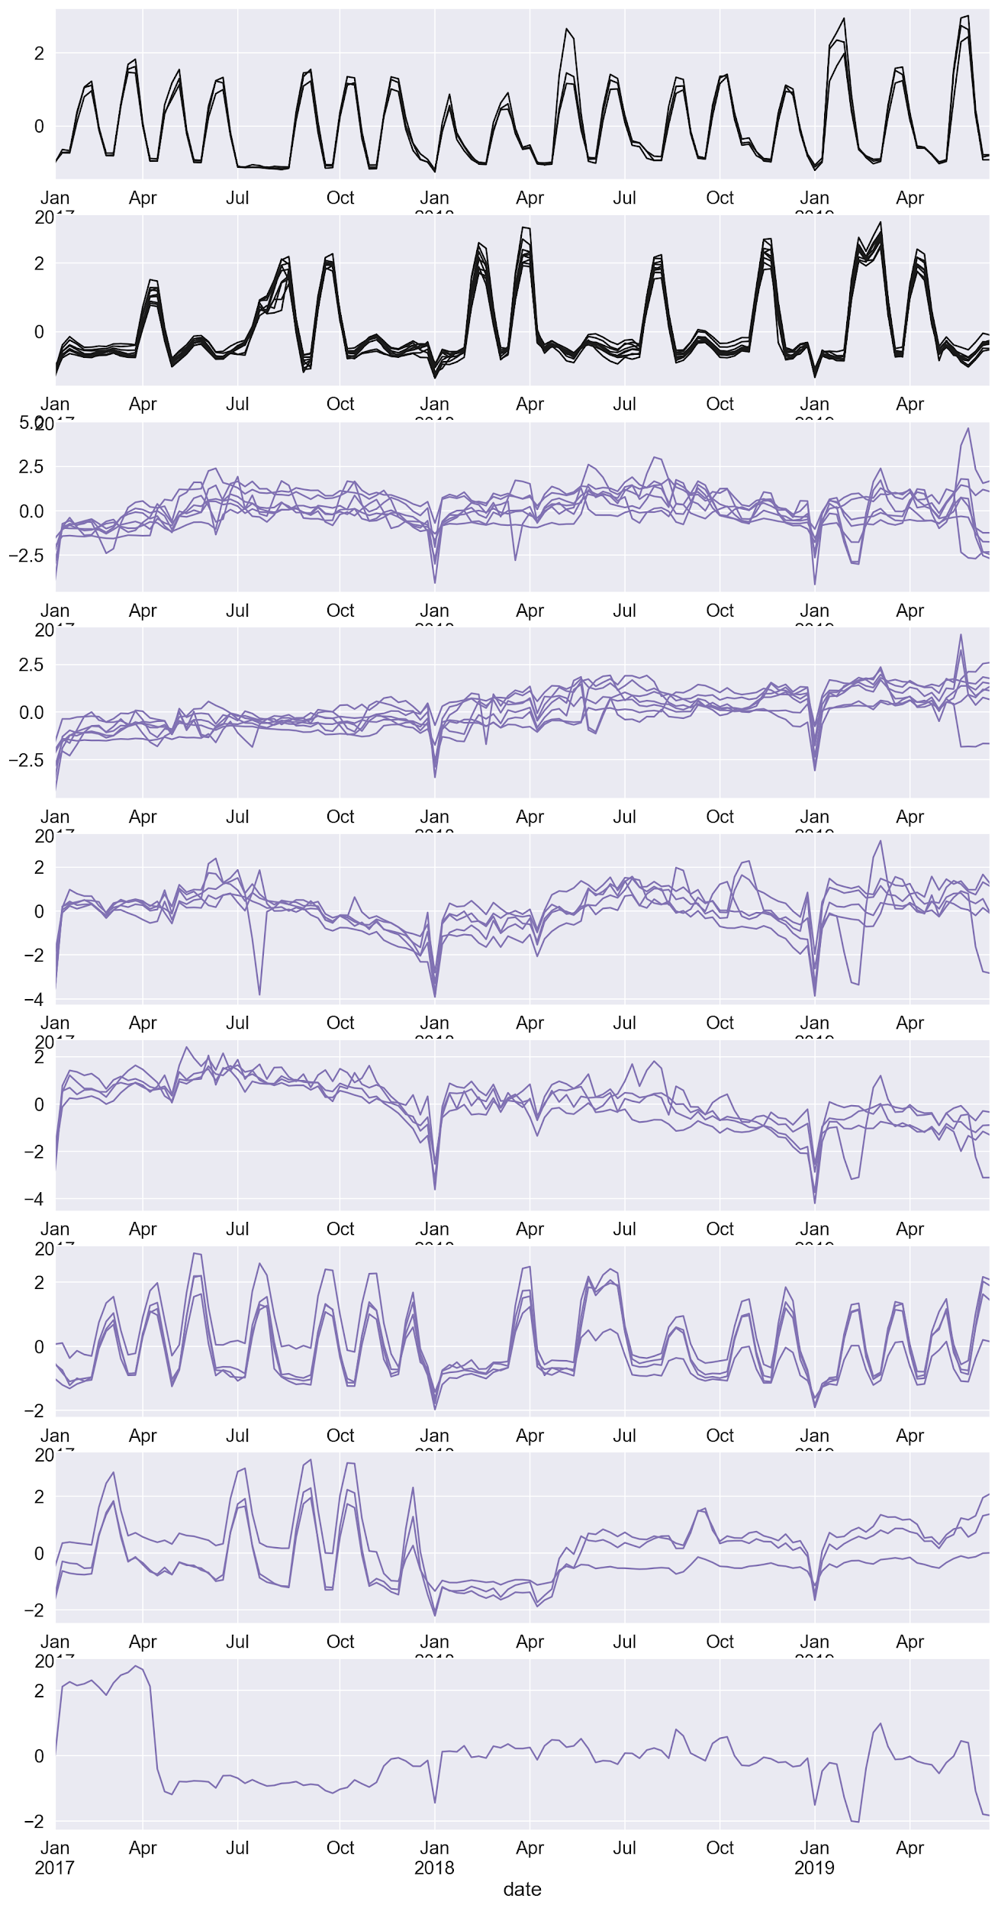
2) DATA ANALYSIS
Hierarchical Clustering Products in scope similar time series (2 clusters)
Scope
BRAND2 and BRAND4

Slide 4
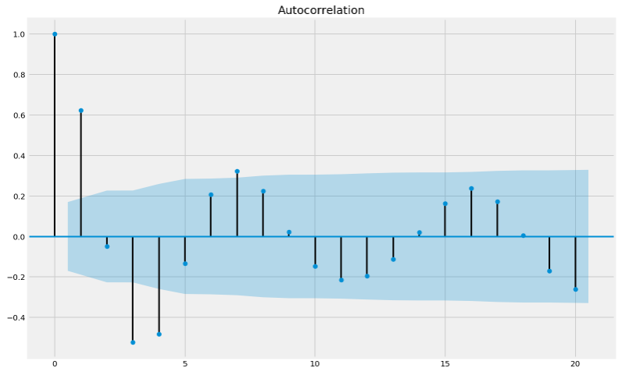
3) MODEL
Build new DataFrame
Past data to predict current week
Autocorrelation
Features selection

Slide 5
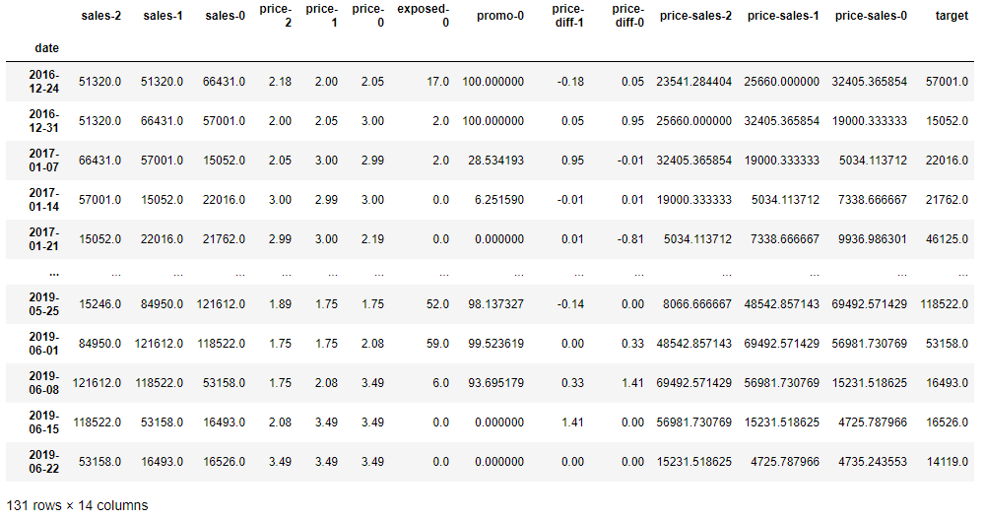
4) CONCLUSION
CONCLUSION
10-Fold Cross Validation
Random Forest: MAPE = 11.26
Lasso: MAPE = 17.90
AdaBoost: MAPE = 15.08

