Slide 1

MT-RRT: a general purpose multithreading library for path planning
Andrea Casalino, Andrea Maria Zanchettin and Paolo Rocco

Slide 2
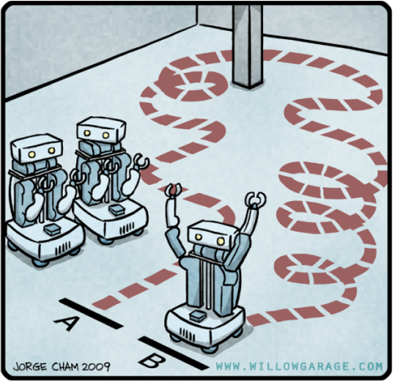
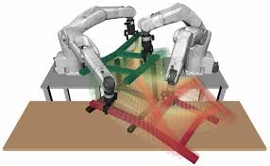
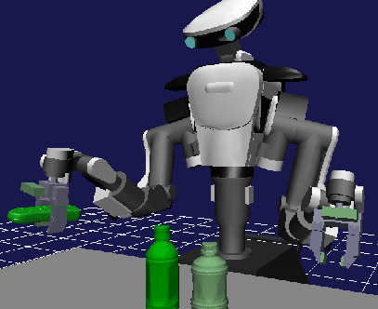
Motivations
Possible planning problems:
Mobile robots navigation
Pick and place
Plan grasping motions
Andrea Casalino

Slide 3
Possible approaches
Possible approaches to solve a planning problem:
closed loop control schemes
Repulsive/attractive fields
MPC approaches
Local minimum problems
May fail to find a feasible solution for
complex workspace
Rapidly random exploring tree strategies
Flexible and capable of always finding a
solution, in the case a solution exists…
… but computionally intense: thousands
of iterations are required also to get at a
sub-optimal solution.
Andrea Casalino

Slide 4
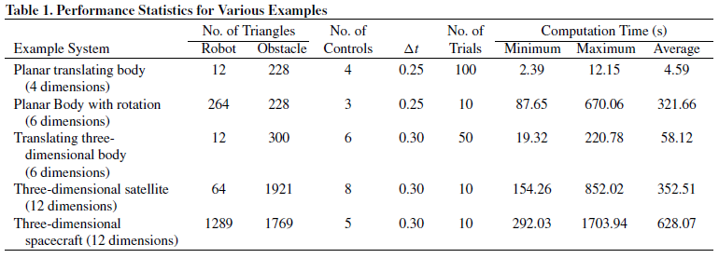
RRT computational issue
Thousands of collision checks must be done even for medium complex problem:
Taken from ‘Randomized Kinodynamic Planning’, S.M. LaValle and J.J. Kuffner
Andrea Casalino

Slide 5
RRT mechanism
The algorithm consists essentially in exploring the configurational space admitted by a series of constraints, with the aim of building a search tree. Once the starting and the ending states are connected at least a solution is found.
Iterations
Database of connections
Starting state
Ending state
Regions not allowed by constraints
Andrea Casalino

Slide 6
Accelerating RRT algorithms
Why don’t explore the configurational space in different threads in order to grow faster the search tree?
Standard single thread
Ideal multi-threaded approach
After N iterations
After N iterations
Database of
connections
=
How to achieve a good parallelism when applying RRTs?
Andrea Casalino

Slide 7
RRT profiling
The computational times are shared by the following main operations:
Optimal trajectory computation (includes Nearest Neighbour searches)
Check the feasibility of sampled states
problem A
problem B
problem C
The ripartition of times can significantly vary from one application to another.
Andrea Casalino

Slide 8
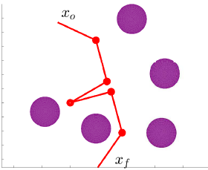
Benchmark A
Path planning of a planar 3 d.o.f. robot:
The optimal trajectories connecting the nodes are assumed as simple
segments in the joint space
Optimal trajectory computation (includes Nearest Neighbour searches)
Check the feasibility of sampled states
Andrea Casalino

Slide 9
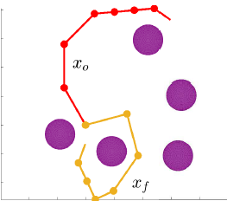
Benchmark B
Path planning of a planar 7 d.o.f. robot:
The optimal trajectories connecting the nodes are assumed as simple
segments in the joint space
Optimal trajectory computation (includes Nearest Neighbour searches)
Check the feasibility of sampled states
Andrea Casalino

Slide 10
Benchmark C
Trajectory planning of a planar 3 d.o.f. robot:
The optimal trajectories connecting the nodes are minimum time second order time laws. The state is made of both the position and the velocity of the robot
Optimal trajectory computation (includes Nearest Neighbour searches)
Check the feasibility of sampled states
Andrea Casalino

Slide 11
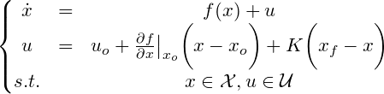
Benchmark D
Kinodynamic planning:
The optimal trajectories connecting the nodes are computed by considering a LQR controller applied on a linearization of the system.
Optimal trajectory computation (includes Nearest Neighbour searches)
Check the feasibility of sampled states
Andrea Casalino

Slide 12
Strategy 1
A pool of threads is used to parallelize the nearest neighbour search and the near set computation (only for RRT*). A single thread performs all the other exploration steps.
Search tree
Pool of threads
Exploring thread
Andrea Casalino

Slide 13
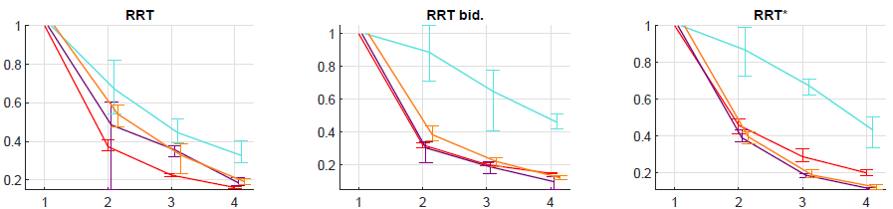
Strategy 1: results
3 dof path planning
7 dof path planning
3 dof traj. planning
Kinodynamic planning
Normalized speed up
#threads
#threads
#threads
Andrea Casalino

Slide 14
Shared tree exploration
The whole exploration process is parallelized. Threads share the same tree and have to synchronize each other for modifying it.
Shared search tree
Exploring threads
Andrea Casalino

Slide 15
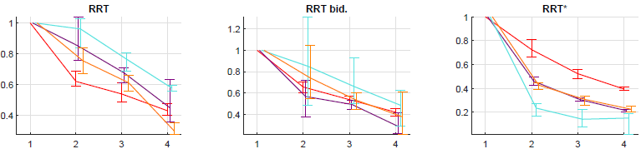
Shared tree exploration: results
3 dof path planning
7 dof path planning
3 dof traj. planning
Kinodynamic planning
Normalized speed up
#threads
#threads
#threads
Andrea Casalino

Slide 16
Local tree copies
The whole exploration process is parallelized. Each thread has its proper tree to expand. In this case, threads don’t need to synchronize at each iteration. With a certain frequency, data are exchanged among threads.
The trees owned by threads
Exploring threads
Andrea Casalino

Slide 17
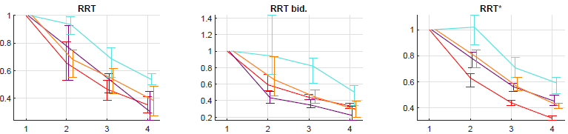
Local tree copies: results
3 dof path planning
7 dof path planning
3 dof traj. planning
Kinodynamic planning
Normalized speed up
#threads
#threads
#threads
Andrea Casalino

Slide 18
Multi agents approach
Blinded multi agents exploration: a pool of threads locally explore the configurational space, starting every time from a new root and obtaining a new tree. The explorations are notified to a master, which integrates the knowledge acquired by the slaves into a single tree and dispatch new roots to explore.
Rewirds are locally done on the local tree in case of the RRT*.
Exploring agents having a local knowledge
Master thread
Andrea Casalino

Slide 19
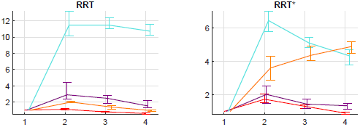
Multi agents approach: results
3 dof path planning
7 dof path planning
3 dof traj. planning
Kinodynamic planning
Speed up increased
dramatically
Normalized speed up
#threads
#threads
Andrea Casalino

Slide 20
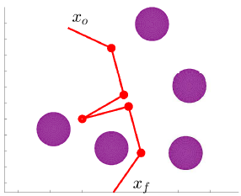
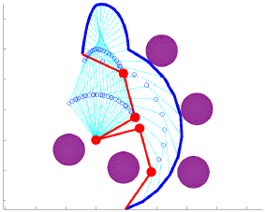
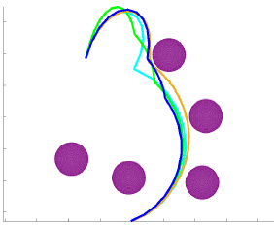
Multi agents approach
The optimality property of the RRT* seems to be preserved also in this multi agents strategy:
Solutions obtained by the RRT*
parallelized with the
multi agents strategy
3 d.o.f. path
planning problem
Minimum distance
path (in joint space)
Andrea Casalino

Slide 21

MT-RRT C++ library
All the proposed strategies are contained in an open source library C++. It was made so as to easily customize a new planning problem and use the proposed solvers.
Check out the the Github profile:
https://github.com/andreacasalino/MT_RRT
Andrea Casalino

