Slide 1
Financial Analysis Report
Market Section and Geographical Analysis

Slide 2
Executive Summary
This report provides an in-depth analysis of revenue by market section and geography. Key highlights include the identification of the most profitable market sections and countries, along with strategic recommendations for revenue growth.

Slide 3
Market Section Overview
The market section 'A' stands out as the most lucrative. A detailed review of the top segments reveals varying revenue patterns that present both opportunities and challenges.

Slide 4
Market Section Analysis
The analysis indicates that market section 'A' leads in revenue generation. However, sections like B, C, D also show potential growth opportunities. Focus on these sections may yield higher returns. Conversely, sections with lower revenues may require a reevaluation of strategy or resources.

Slide 5
Geographical Revenue Overview
The geographical analysis shows that 'PERU' is the highest revenue-generating country. This suggests market strength in this region. Countries like EL SALVADOR, HUNGARY, RUSSIAN FEDERATION also contribute significantly, indicating a diverse revenue base.

Slide 6
Geographical Analysis
The high revenue in 'PERU' suggests a strong market presence. Investment in marketing and operations in this region could further solidify market dominance. In contrast, regions with lower revenues could represent untapped opportunities or markets that require a different strategic approach.

Slide 7
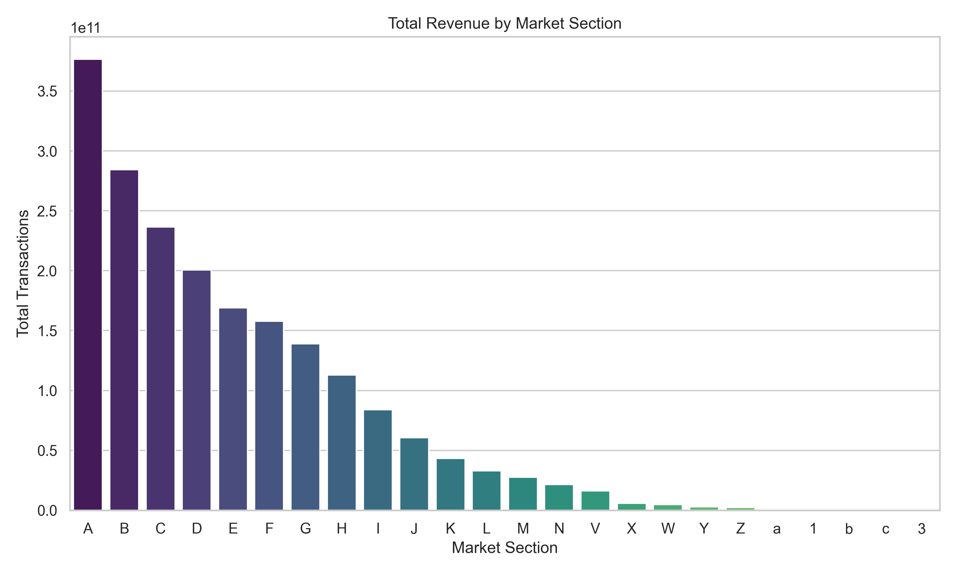
Revenue by Market Section

Slide 8
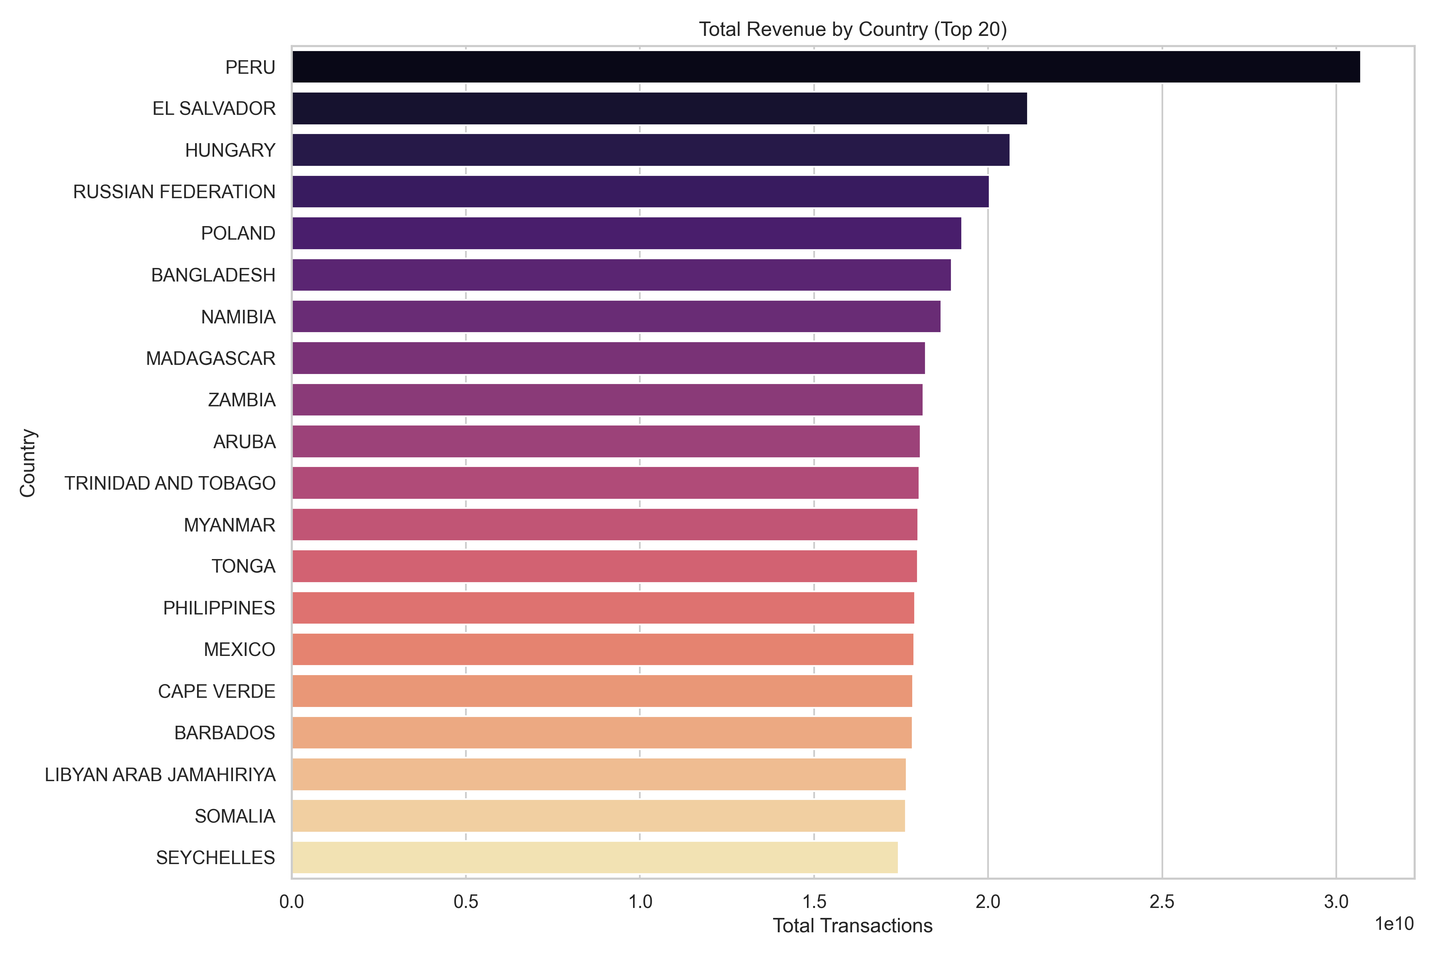
Revenue by Country (Top 20)

Slide 9
Recommendations and Next Steps
1. Prioritize market sections like 'A' and 'B' to maximize profitability.
2. Invest in marketing and operational efforts in top-performing countries like Peru.
3. Explore potential growth in underperforming sections and regions.
4. Conduct further analysis to identify factors driving success in high-revenue segments.
5. Develop targeted strategies to enhance revenue in regions with lower market penetration.

Slide 10
Conclusions and Acknowledgements
The analysis provides valuable insights into revenue distribution across market sections and geographies. Implementing the recommended strategies can enhance revenue growth and optimize market presence. Thank you for your attention and consideration of these findings.

