Slide 1

REsource Advertisement and Reservation protocol
Francesco Cappa, Stefano Galantino

Slide 2
WHAT IS REAR?
The REAR protocol facilitates the efficient exchange of resources and services through a standardized workflow.
Providers advertise their available resources and services using a consistent format.
Consumers search, discover and potentially negotiate resources or services based on specific criteria.
The protocol accommodates different resource and service types and allows for future expansions.
For simplicity, we are going to refer as resource both computational resources(e.g. VMs, clusters, storage systems) and services (e.g. SaaS like DBs, message queues, etc.)
Francesco Cappa, Stefano Galantino

Slide 3
Terminology
Provider: entity that advertises and offers resources
Consumer: entity that looks for specific resources, discovers offering providers and possibly negotiates those resources
Flavor: data model provides a structured way to represent and manage different kinds of resources
Francesco Cappa, Stefano Galantino

Slide 4
STATE OF THE ART
Different companies provide documentation on their functionalities for resource selection, reservation and purchase:
Online Services:
Booking
Ticketmaster
…
Each platform has its own technical documentation, which explains the specific details of the workflows used by these companies.
Link to the State of the Art Doc
Francesco Cappa, Stefano Galantino

Slide 5
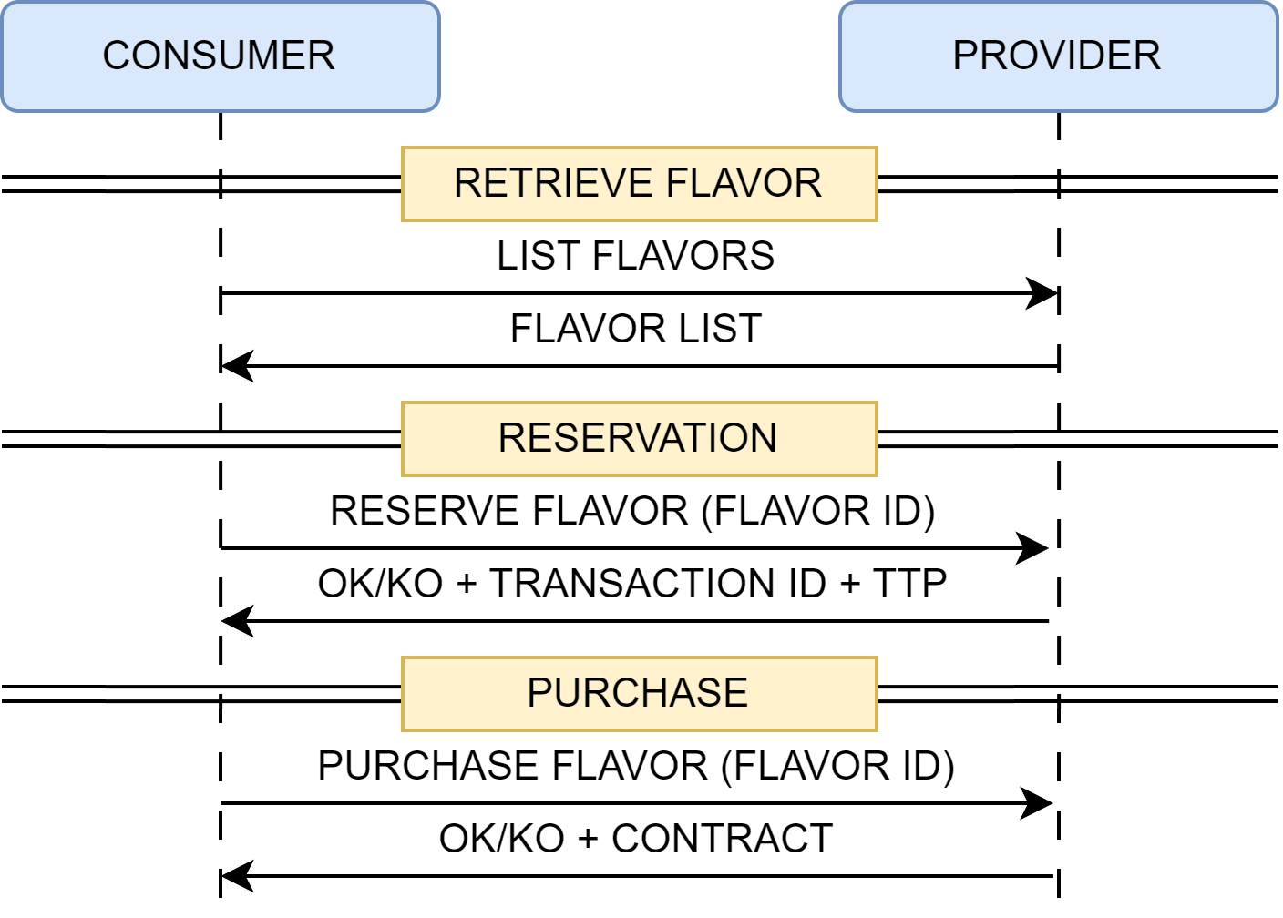
REAR MAIN WORKFLOW
Customer asks for the list of flavors (optional: selector for a certain amount of CPU, RAM, etc.) through the LIST_FLAVORS message.
Producer returns the list of flavors that matches the consumer request.
Consumer pick one flavor by its ID and start to reserve it through the RESERVE_FLAVOR message.
Producer returns the response: transaction object which details the potential purchase (info on seller, buyer, negotiated flavor) and a timer to confirm and complete the purchase (TTP).
Customer complete the purchase for the Flavor through the PURCHASE_FLAVOR message
Producer returns the response: if the purchase is completed, a contract is drafted and returned to the consumer.
Francesco Cappa, Stefano Galantino
Notes:
TTP: Parametric value that indicates the amount of time for which the flavor can be reserved

Slide 6
LIST_FLAVOURS: KEY ELEMENTS
The Flavor list will be made with different Flavor, each one with the following information:
Flavor ID: this field uniquely identifies flavors.
Provider ID: this associates the flavor to a specific provider, the entity advertising and offering the flavor.
Type: this specifies the type of the flavor (e.g., VM/K8s Cluster/etc.).
Characteristics: this specifies the flavors' capabilities and it depends on the flavor type. (e.g. VMs has CPU, RAM, storage whereas a DB has Reds/S, Writes/S)
Policy: optional fields that specifies if the Flavor can receive negotiation policies and it also depends on the flavor type.
Owner: represents the entity that owns the Flavor (FQDN/unknown). It can correspond to the Provider ID of the Flavor.
Francesco Cappa, Stefano Galantino
Notes:
Owner unknown 🡪 Il provider sa con chi sta parlando. Unknwon è per client, non per provider (tipo viene comunque definite 🡪 grazie ad esso sappiamo qual è il match selector). Provider può indicare l’ownership o ometterlo.

Slide 7
LIST_FLAVOURS: KEY ELEMENTS (CONT’D)
Price or Fee: this specifies the prices of the flavor.
Expiration Time: this characterizes the duration of the flavor, after which a refresh updates is need to keep its availability. The Expiration Time can be computed by adding a specific timestamp to the current time, indicating the number of hours or days until expiration.
Optional Fields: Other details such as limitations, promotions, availability etc., can be included as optional information. This fields enhance flexibility when dealing with peculiar characteristics of a specific flavor.
Francesco Cappa, Stefano Galantino

Slide 8
WHAT IS A SELECTOR?
A selector is a criterion or rule used to choose or select specific entities from a larger set based on certain characteristics or properties.
In REAR, it is a filter that allows consumers to select specific flavors from a wider availability from the providers.
In the context of negotiating a VM, the consumer can filter flavors based on the computing capacities: VMs with at least 4 vCPU and 16 GB RAM; this request would filter out VMs having smaller capacities.
In the current REAR implementation, the selector is a body object put into the LIST_FLAVOR message.
In the next REAR implementation release, the selector is going to be a query string that is embed into the LIST_FLAVORS query: e.g. GET https://flavours?type=vm&vcpu=4&ram=16G
Francesco Cappa, Stefano Galantino

Slide 9
WITHDRAWAL & REFRESH MESSAGES (OPTIONAL)
Consumers can optionally choose to subscribe to future flavor update messages:
A withdrawal message is sent by the provider to the consumer to notify that a specific flavor is no longer available. This message serves as a notification mechanism to inform the consumer that the requested flavor is no longer available.
A refresh message is sent by the provider to refresh a particular flavor. By sending a refresh message, the provider helps maintain the availability of flavors and allows the consumer to effectively manage and allocate resources based on the updated expiration time.
Francesco Cappa, Stefano Galantino
Notes:
Subscription opzionale: flag dentro un messaggio vs gestione out-of-band con protocolli come Websocket (o altre opzioni)?

Slide 10
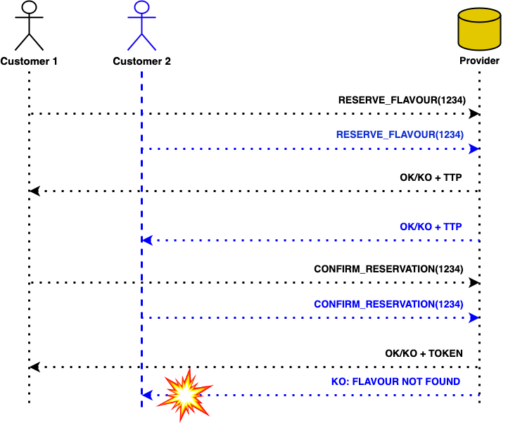
WHAT IF TWO CUSTOMERS REQUEST THE SAME FLAVOR AT THE SAME TIME?
Francesco Cappa, Stefano Galantino

Slide 11
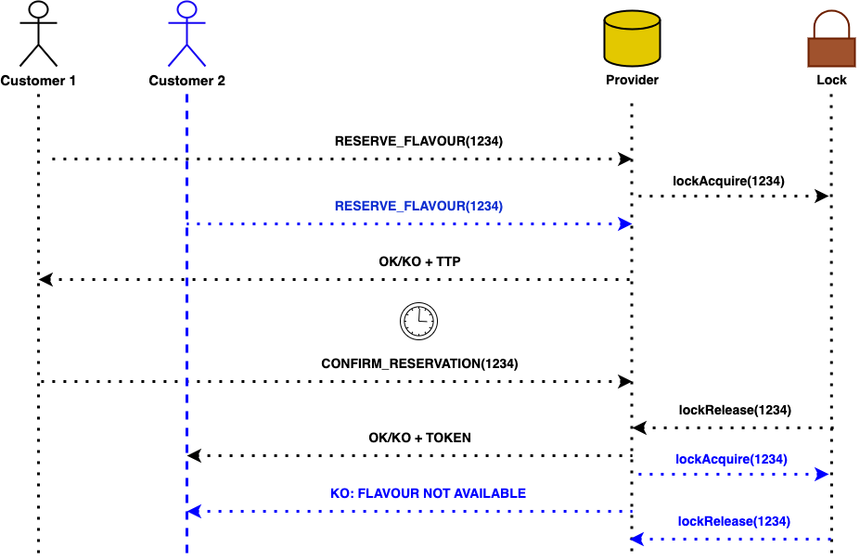
SOLUTION
Francesco Cappa, Stefano Galantino

Slide 12
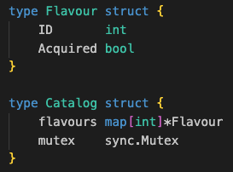
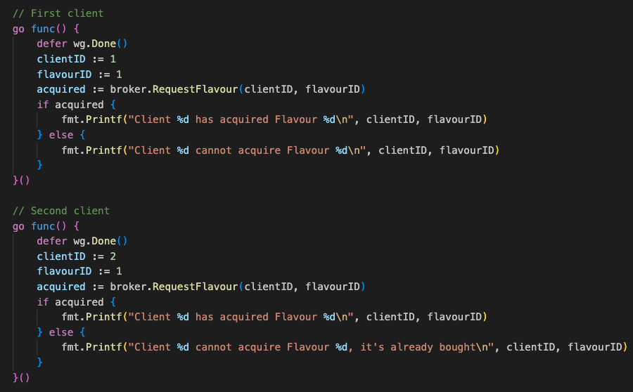
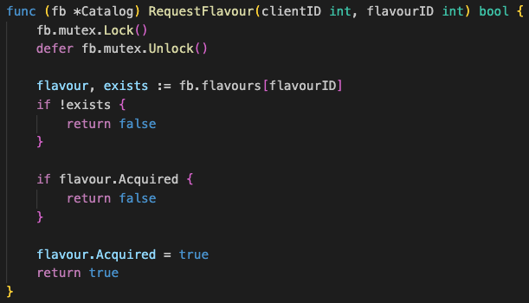
SOLUTION (CONT’D)
Francesco Cappa, Stefano Galantino

Slide 13
DESIGN OPTIONS
Francesco Cappa, Stefano Galantino

Slide 14
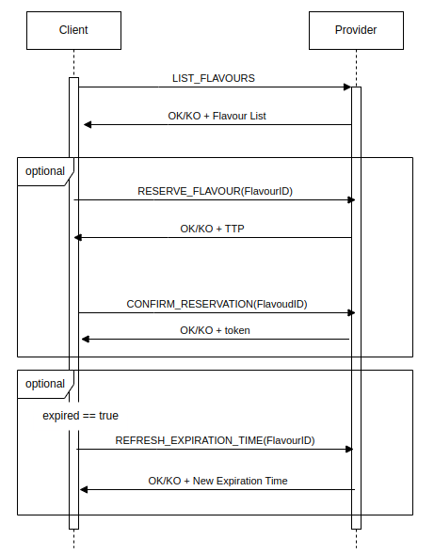
OPTION 1
Full REST interaction
PROS
Simplicity : the consumer handles resource's update and the provider is not potentially overwhelmed
CONS
Real-time updates are lost
No possibility of defining a withdraw message
Francesco Cappa, Stefano Galantino

Slide 15
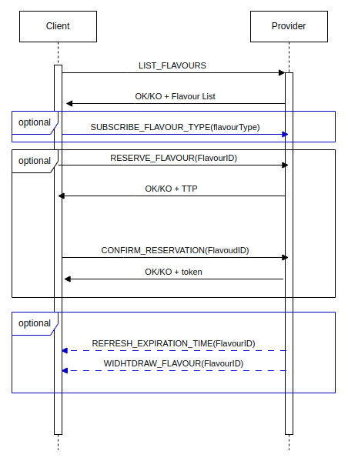
OPTION 2
REST and WebSocket interaction
PROS
Real-time updates
Possibility of defining a withdraw message
CONS
Design is more complex
Provider can be overwhelmed by the number of WS connections
NOTE: the SUBSCRIBE message could have an “all” parameter, which subscribes to all flavors advertised by the provider.
Francesco Cappa, Stefano Galantino

Slide 16
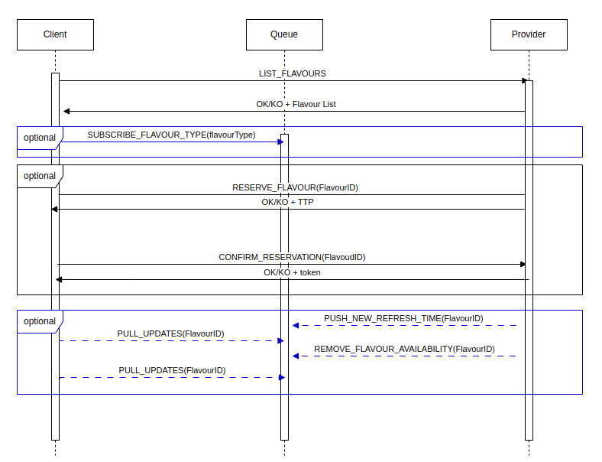
OPTION 3
REST and WebSocket interaction with Message Queue
PROS
Same advantages from the previous option
Decoupling the main logic form WS connection management
CONS
The most complex design
Updates are near real-time
Pull based strategy vs intermediate WS server between client and Message Queue
Francesco Cappa, Stefano Galantino

Slide 17
APPENDIX
HOW THE NEGOTIATION WORKS?
Different companies provide documentation on their functionalities for resource selection, reservation and purchase:
Booking.com Connectivity APIs:
https://developers.booking.com
Ticketmaster:
https://developer.ticketmaster.com
Each platform has its own technical documentation, which explains the specific details of the workflows used by these companies.
Francesco Cappa, Stefano Galantino

Slide 18
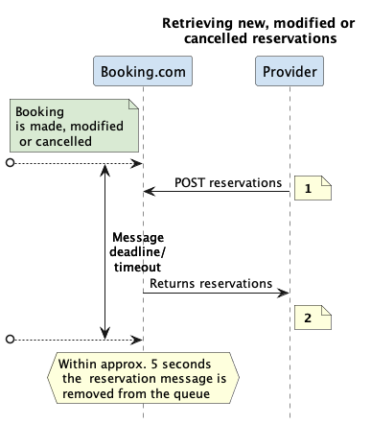
EXAMPLE: BOOKING (1)
[1] https://connect.booking.com/user_guide/site/en-US/reservations-api/reservations-overview/
Francesco Cappa, Stefano Galantino

Slide 19
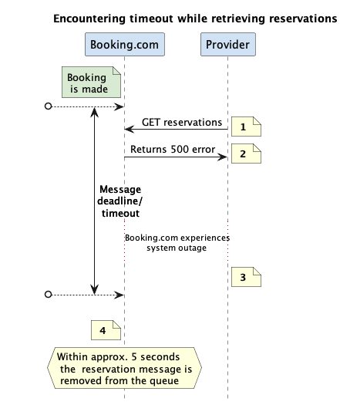
EXAMPLE: BOOKING (2)
[2] https://connect.booking.com/user_guide/site/en-US/reservations-api/reservations-overview/
Francesco Cappa, Stefano Galantino

Slide 20
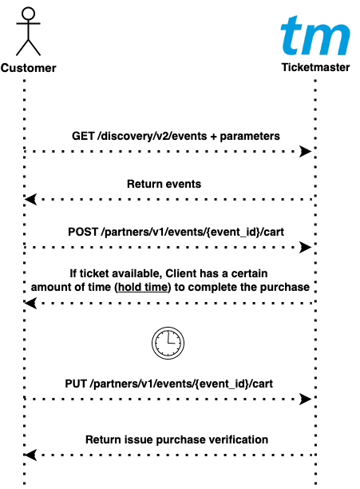
EXAMPLE: TICKETMASTER
Francesco Cappa, Stefano Galantino

Slide 21
OTHER APPROACHES: SELECTOR SYNTAX
Ownership Discovery: The flow begins with the client requesting a specific resource from the provider. Once the provider identifies an owner willing to provide that resource, a notification is sent to the client, providing information about the owner and the type of available resource. At this point, the client can determine the type of selector to use based on the identified owner.
However, it's important to note that in an architecture where the client does not have direct access to the data (such as a web architecture), obtaining the ownership selector requires an additional HTTP call to the owner's servers. This introduces potential latency issues and adds complexity to the overall process.
Data Model Derivation: Another approach is to derive the selector's data model from the provider's response to a client's "get" request for a list of available resources. By examining the structure and attributes of the response, the client can construct the selector based on the derived data model, ensuring compatibility and correct resource selection.
Francesco Cappa, Stefano Galantino

