Slide 1
Xtream IPTV Description
Andrea De Giovine

Slide 2
Revision History
Version | Date | Description | Author
1.0 | 2026.11.10 | First version for the app certification Covers app version 1.4.x | Andrea De Giovine

Slide 3
Contents
UI Structure
Usage Scenario (with test account)
Menu & function description
Key policy
How to change languages

Slide 4
UI Structure
Whole UI Structure
  Start screen (logo) → Parental PIN (first start only) → Add a provider (first start only) → Home
  Top bar, always reachable with UP: Home, Search, Movies, TV Series, Live TV, Favorites, Collections, Suggestions, Provider, Settings
  Movies / TV Series: sidebar + grid → Title page → Player
  Live TV: programme guide + channel lists → Channel page → Player
  RETURN always goes one step back; on Home it opens the Exit popup
  The flow graph is on the next slide.

Slide 5
UI Structure – flow graph
Start screen
(logo)
Parental PIN
(first start)
Add a provider
(Xtream / M3U)
Home
(rows of titles)
Exit popup
(RETURN on Home)
Top bar (UP from any screen): Home · Search · Movies · TV Series · Live TV · Favorites · Collections · Suggestions · Provider · Settings
Search
movies, series,
channels, programmes
Movies / TV Series
sidebar of genres
+ grid of titles
Favorites · Collections
· Suggestions
grids of titles
Live TV
programme guide,
channels, genres
Provider · Settings
providers, keys,
preferences
Title page
play / resume, watched, trailer, favourite, episodes, cast
Channel page
watch / schedule
Dialogs
keyboard, PIN, confirm
Player (full screen)
progress bar, play/pause, episodes, aspect ratio, subtitles, audio; Ch. Up/Down
RETURN: back one step on every screen

Slide 6
Usage Scenario
No log-in, activation or payment. The app plays the IPTV service the user already has; testers add a provider:
Test account (same for every model group, any number of testers at once):
  Provider kind: M3U / XMLTV · Name: Test
  M3U playlist URL: https://iptv-org.github.io/iptv/countries/it.m3u (public, free and legal channels)
  XMLTV guide URL: leave empty · Spare lists: …/countries/uk.m3u, …/categories/news.m3u
Steps:
  1. Launch the app; set any 4-digit parental PIN twice (RETURN skips it).
  2. Choose "M3U / XMLTV", fill in the fields above with the on-screen keyboard, press Confirm.
  3. Home opens; the catalog downloads in the background (a notice says when it is done).
  4. UP → Live TV → "Show all" → a channel → Play. Ch. Up/Down change channel.
  5. RETURN closes the player and goes back; RETURN on Home → Exit popup → "Exit" closes the app.

Slide 7
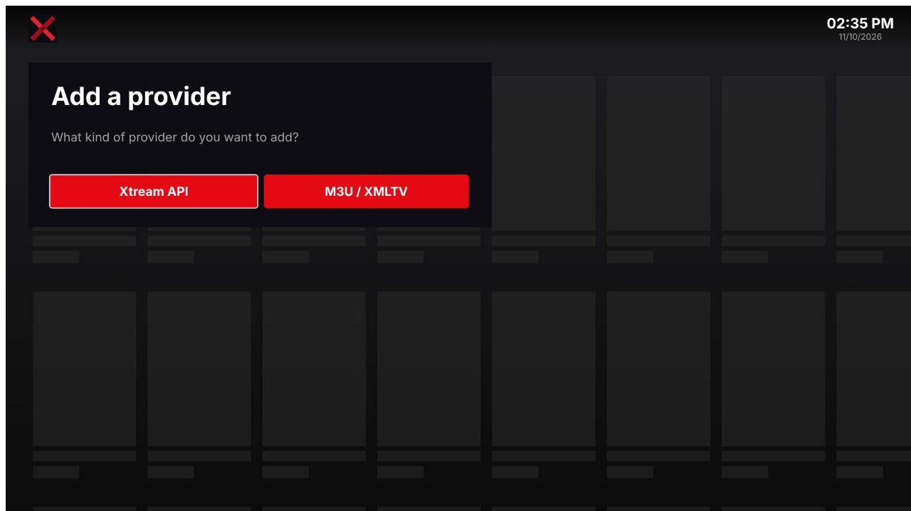
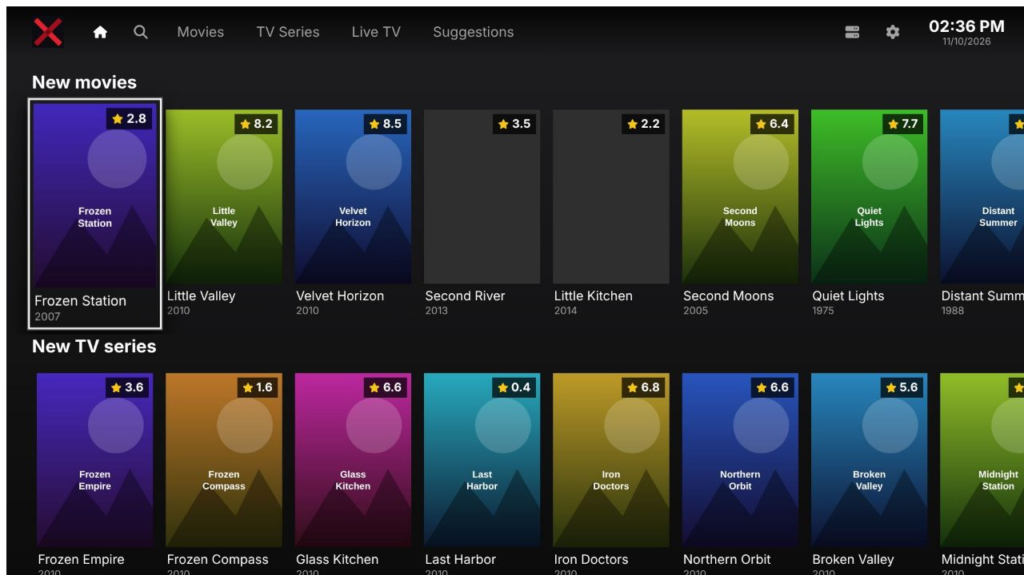
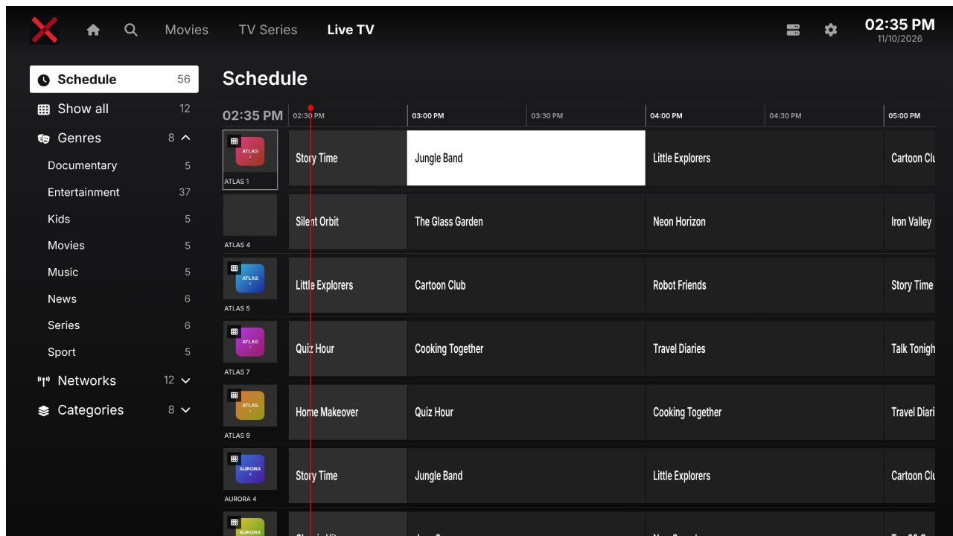
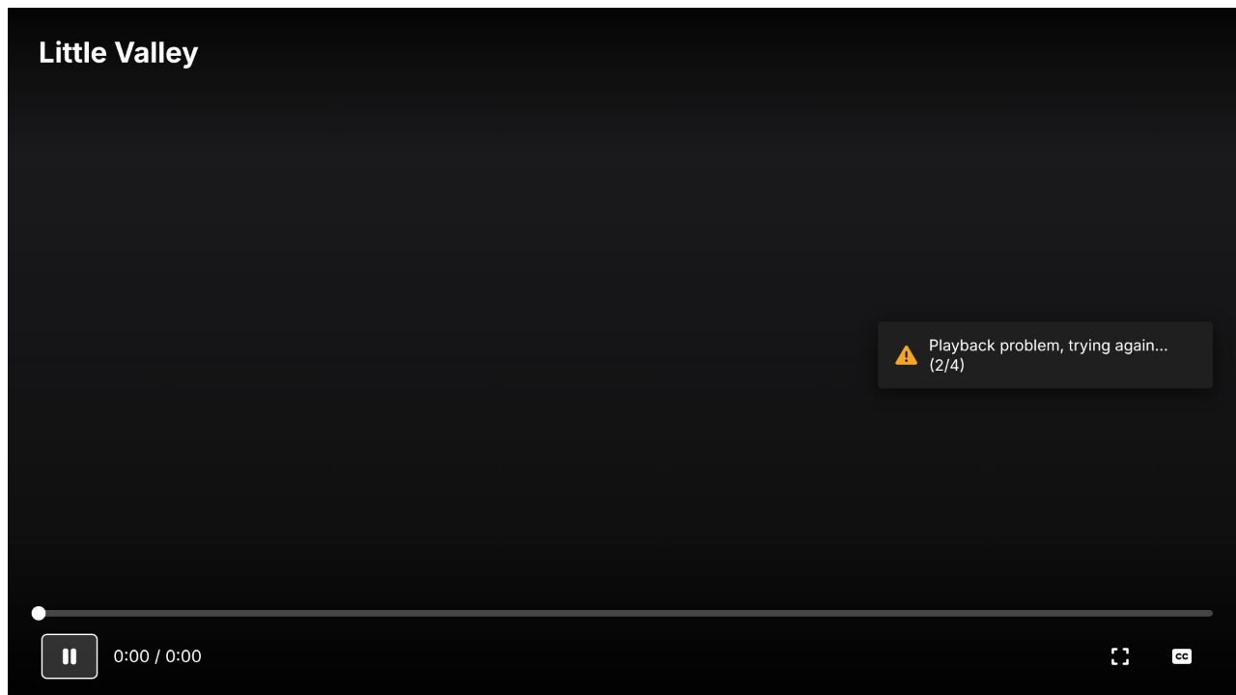
Usage Scenario – screens
First start with the test playlist: PIN → provider → Home → Live TV → Player
1. Add a provider: "M3U / XMLTV"
2. Home (catalog downloading)
3. Live TV: guide, OK on a channel
4. Player: RETURN to go back

Slide 8
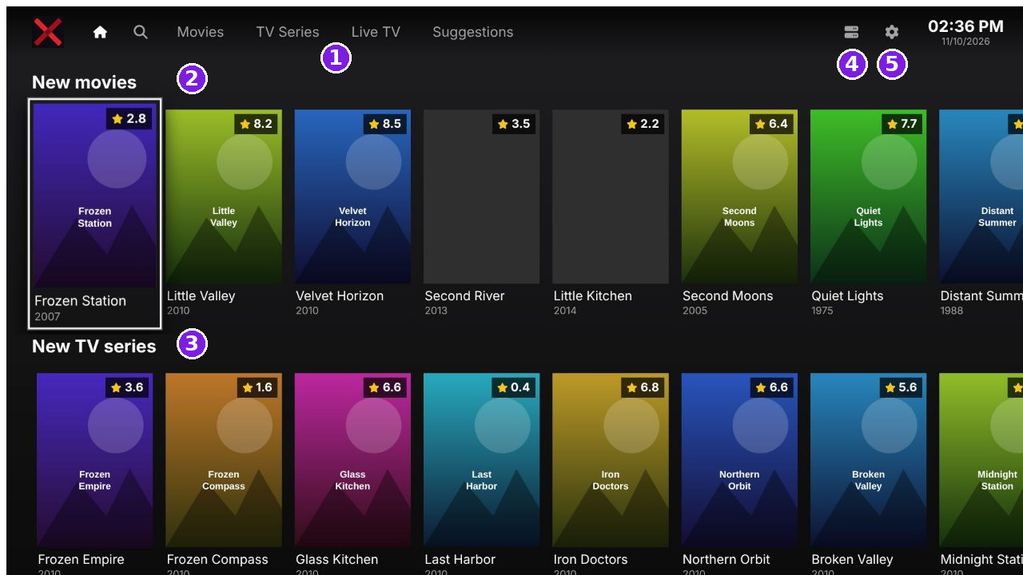
Menu & function – Home
1 Top bar: Home, Search, Movies, TV Series, Live TV, Favorites, Collections, Suggestions (UP from the first row)
2 Rows of titles: continue watching, new movies, suggestions; LEFT/RIGHT move, more cards load while scrolling
3 New TV series row; UP/DOWN move between rows, ENTER opens the title page
4 Provider: list of the IPTV providers the user added
5 Settings; the clock shows time and date

Slide 9
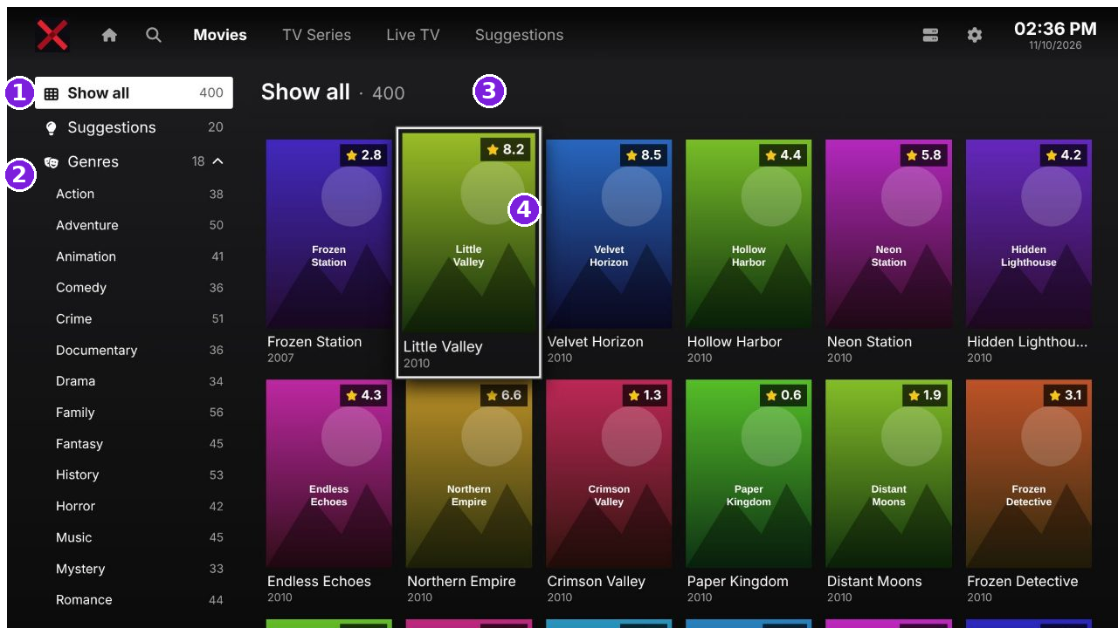
Menu & function – Movies / TV Series
1 Sidebar: Show all, Continue watching, Favorites, Suggestions (shown only when not empty)
2 Genres and categories of the provider; adult ones are locked by the parental PIN
3 Title of the list and number of titles
4 Grid of posters: ENTER opens the title page; LEFT from the first column returns to the sidebar

Slide 10
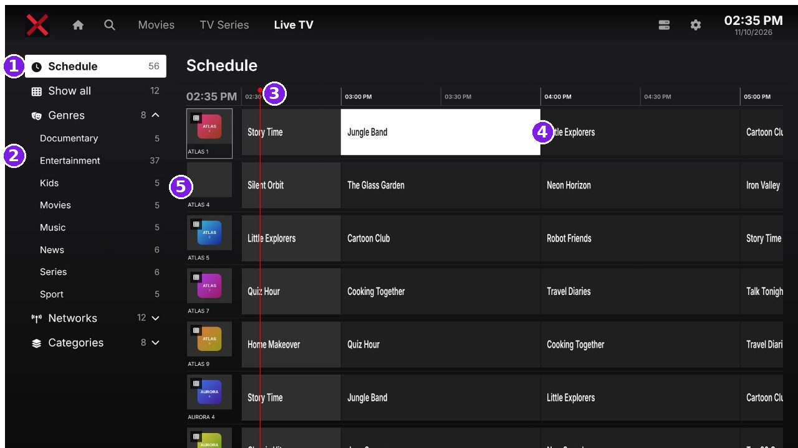
Menu & function – Live TV
1 Schedule: grid programme guide of the user's channels
2 Show all, Favorites, programme genres, TV networks, categories of the provider
3 Time axis; the red line is the current time
4 Programme: LEFT/RIGHT move in time, UP/DOWN change channel, ENTER opens the channel page (watch or schedule)
5 Channel logo and name; ENTER held on a row: move up/down, remove from the guide

Slide 11
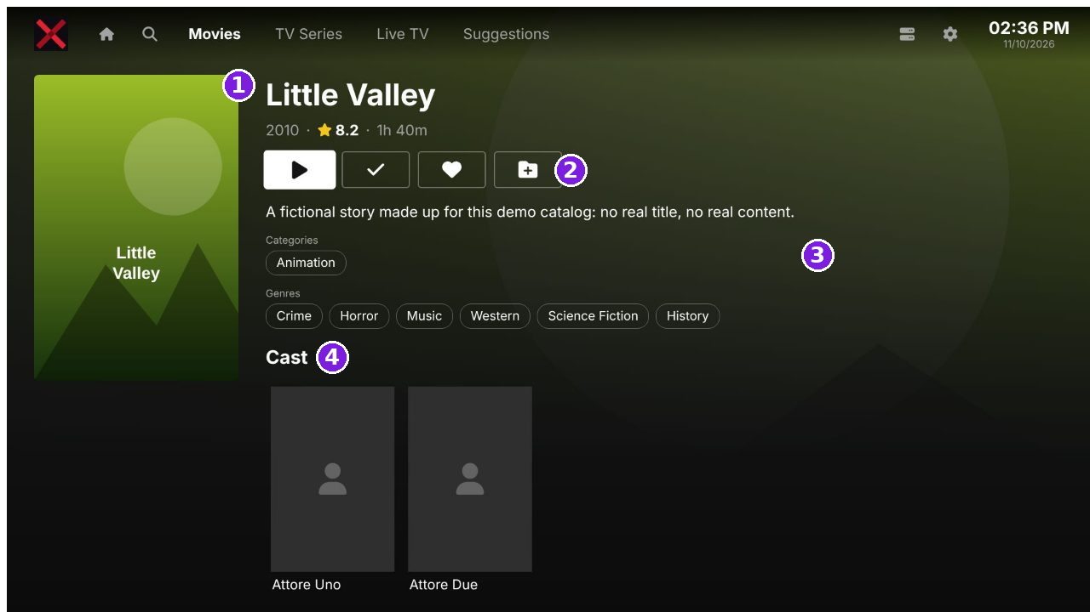
Menu & function – Title page
1 Poster, title, year, rating, duration
2 Buttons: Play / Resume, Watched, Favourite, Add to collection (and Trailer: opens the YouTube app)
3 Plot, categories and genres (ENTER on a genre opens it)
4 Cast; below: related titles. Series also show seasons and episodes
5 RETURN goes back to the grid, on the same card

Slide 12
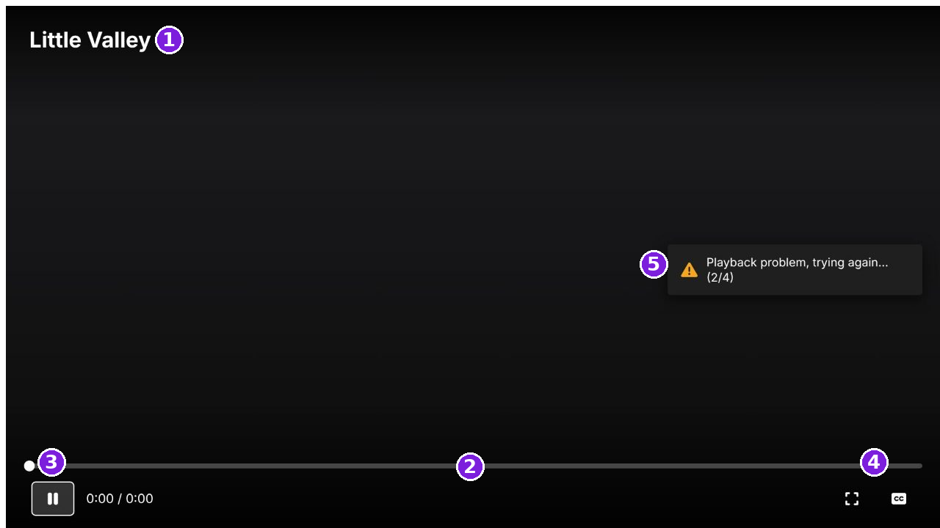
Menu & function – Player
1 Title of the movie, episode or channel (live: programme on air and its end time)
2 Progress bar: UP reaches it, LEFT/RIGHT move, ENTER jumps; REW/FF seek
3 Play / Pause (also PLAY, PAUSE, STOP keys); episode buttons for series
4 Aspect ratio, subtitles and audio tracks
5 Notices: a stream that fails is retried; RETURN hides the controls, then closes the player

Slide 13
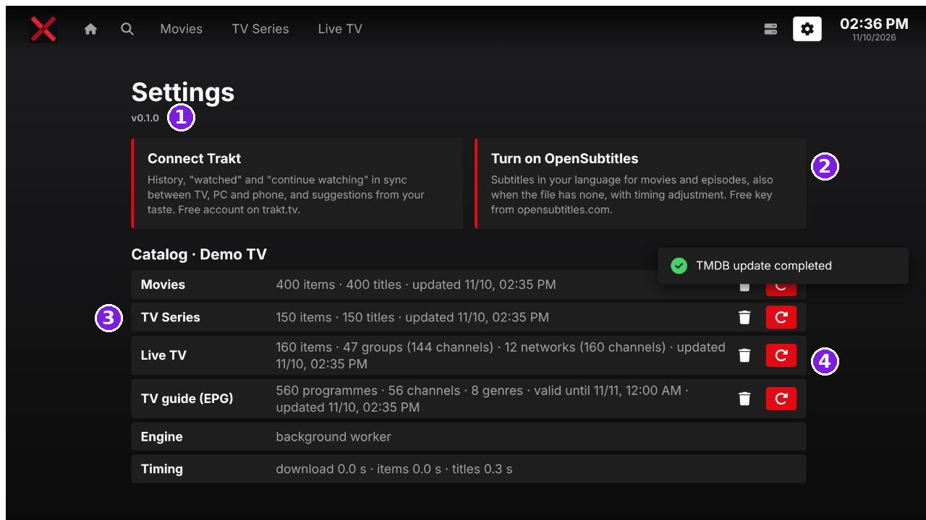
Menu & function – Settings
1 App version
2 Optional services (Trakt, OpenSubtitles, TMDB) with the user's own free keys
3 Catalog and guide status: number of items, last update
4 Update or delete the catalog and the guide
5 Below: device information, preferences (language, text size, clock, screensaver, player, parental PIN), reset

Slide 14
Key Policy
The app uses the standard remote keys only; colour and number keys are not used.
Button | Action | Remarks
ENTER (OK) | Select the focused item. Held on a guide row: actions (move up/down, remove).
Ch. Up/Down | Player: previous / next channel (live) or episode (series).
UP/DOWN | Move the focus; UP from the first row reaches the top bar.
LEFT/RIGHT | Move the focus; in the player, move the progress bar.
PLAY, PAUSE, STOP, REW, FF | Player: play, pause, stop, seek back / forward.
RETURN | Move to the previous page; in the player hide the controls, then close it. | Samsung Mandatory
EXIT | Close the app (system). | Samsung Mandatory
RETURN on Home | Exit popup: "Exit" closes the app, "Stay" returns to Home. | Samsung Mandatory

Slide 15
How to change languages
Items | Contents
How to change languages | Supported languages: English and Italian. By default (Language: Automatic) the app follows the TV menu language (TV: Settings > General > System Manager > Language): Italian when the TV is in Italian, English for every other language. Inside the app: UP to the top bar > Settings (gear icon) > General > Language > Automatic / English / Italiano. The screens change at once.

