Slide 1
Why bother to learn programming?
Programming is becoming a necessity in most of the sciences. We’ll stick to physical problems in this course
Traditional analytical tools have certain limitations, since although they have enabled us to solve an incredible range of problems, they are mostly restricted to linear systems
And the vast majority of outstanding problems are inherently nonlinear!
Also, spurred by the rising cost of experimentation, computational physics is used to conduct “experiments” in the virtual world through simulations
Computational physics serves as a critical role at the interface between experimental and theoretical physics
Notes:
Linear system = linear function satisfying additivity and homogeniety (wave propagation, differentiation, integration)
Nonlinear system = otherwise (pendulum equation, mass-spring)
In order to insure that experiments are designed properly before construction is ever begun, detailed simulations of the apparatus are carried out. This can only be accomplished by understanding the interaction of the experimental device with the physical phenomenon it is meant to measure. Thus, computational physicists must understand not only the physics that is being studied, but also the capabilities and limitations of the experiment intended to make the measurements.

Slide 2
Start with the basics… what is a computer?
Various definitions:
a programmable machine that receives input, stores and manipulates data, and provides output in a useful format.
a machine for performing calculations automatically
the most useful and most frustrating thing any human being will ever work with
a very, very expensive punching bag
A definition more applicable to us:
A set of devices which work under the control of a stored program, automatically accepting and processing data to produce information
Notes:
Distinction between data and information

Slide 3
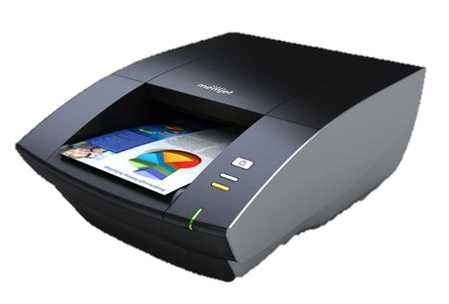
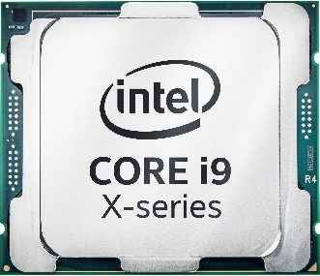

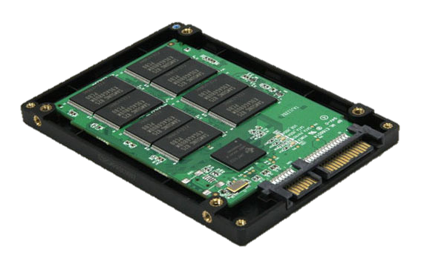
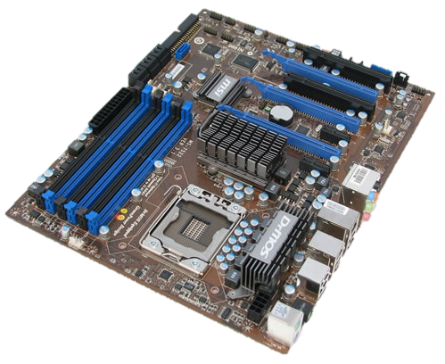
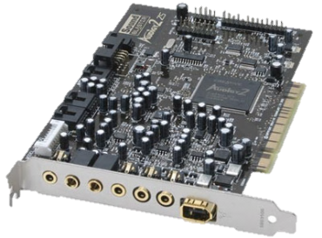
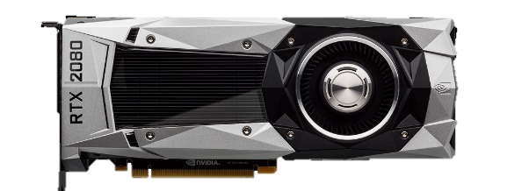
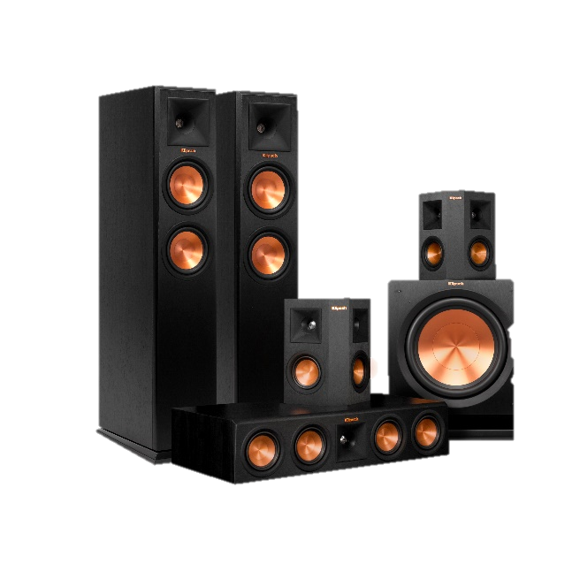
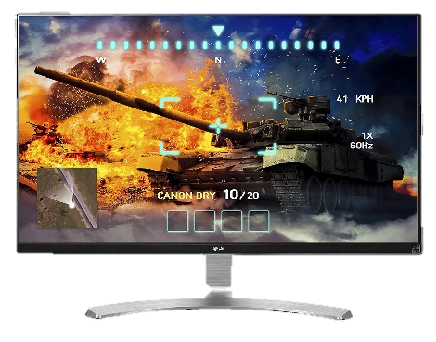
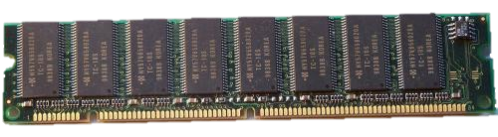
Elements of a computer system
Network
Printer
CPU
Hard Disk
Sound Card
GPU
Speakers
Motherboard
Memory - RAM
Display

Slide 4
Elements of a computer system
Network
Printer
CPU
Hard Disk
Sound Card
GPU
Speakers
Motherboard
Memory - RAM
Display

Slide 5
Elements of a computer system
Network
Printer
CPU
Hard Disk
Sound Card
GPU
Speakers
Motherboard
Memory - RAM
Display

Slide 6
Elements of a computer system
Network
Printer
CPU
Hard Disk
Sound Card
GPU
Speakers
Motherboard
Memory - RAM
Display

Slide 7
Elements of a computer system
Network
Printer
CPU
Hard Disk
Sound Card
GPU
Speakers
Motherboard
Memory - RAM
Display

Slide 8
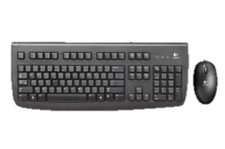
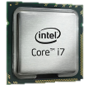
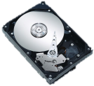
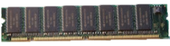
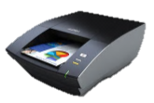
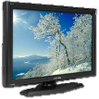
Four basic elements
Input
Getting instructions and data into the computer
Process
The Central Processing Unit (CPU) processes data according to instructions. Actions include arithmetic operations, comparisons and data transfer
Store
Main memory (RAM) is used to store temporary data and software in use
Data for future use is stored on backing store (hard disks, DVDs, flash drives)
Output
Produce outgoing information or to generate hard copies (monitors, printers)

Slide 9
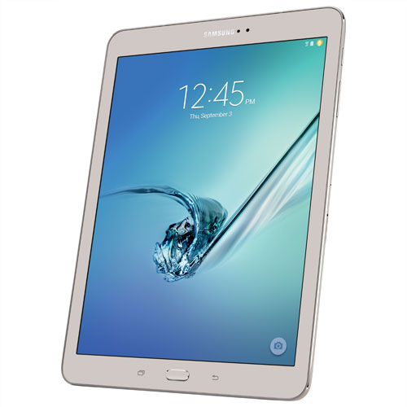
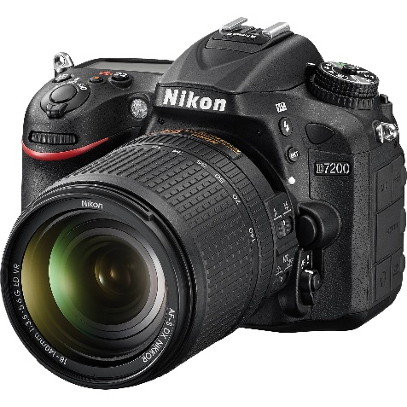
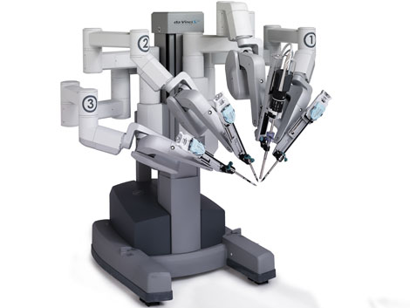
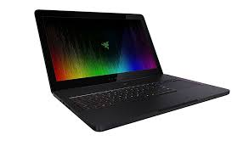
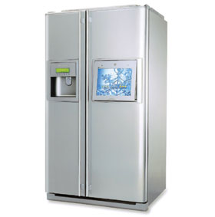
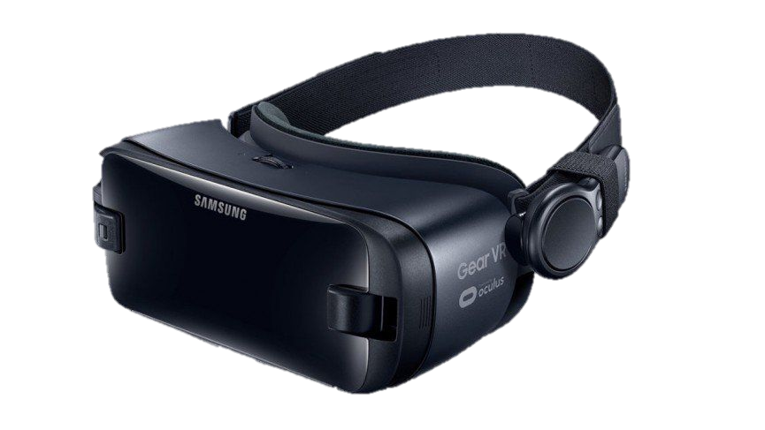
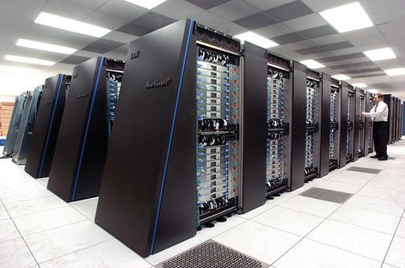
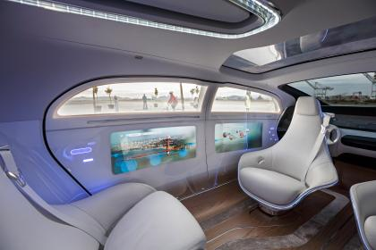
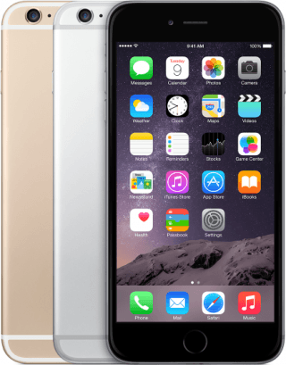
There are Computers everywhere!

Slide 10
Some definitions
Computer carry out instructions, a set of which is called a program. It tells the computer’s control unit what to do
A program is written using a computer language
Software is the general term to describe all the programs and data used in computer systems
Hardware is the collective term used to refer to the series of devices making up a computer
Programming is the art/science/magic of writing software. Programs are usually written as text files. Code is the textual representation of programs
A compiler transforms these text files into a form which the CPU can understand and execute
When a program behaves incorrectly, it is said to have a bug. Debugging is the act of removing bugs from a program

Slide 11
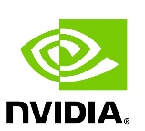
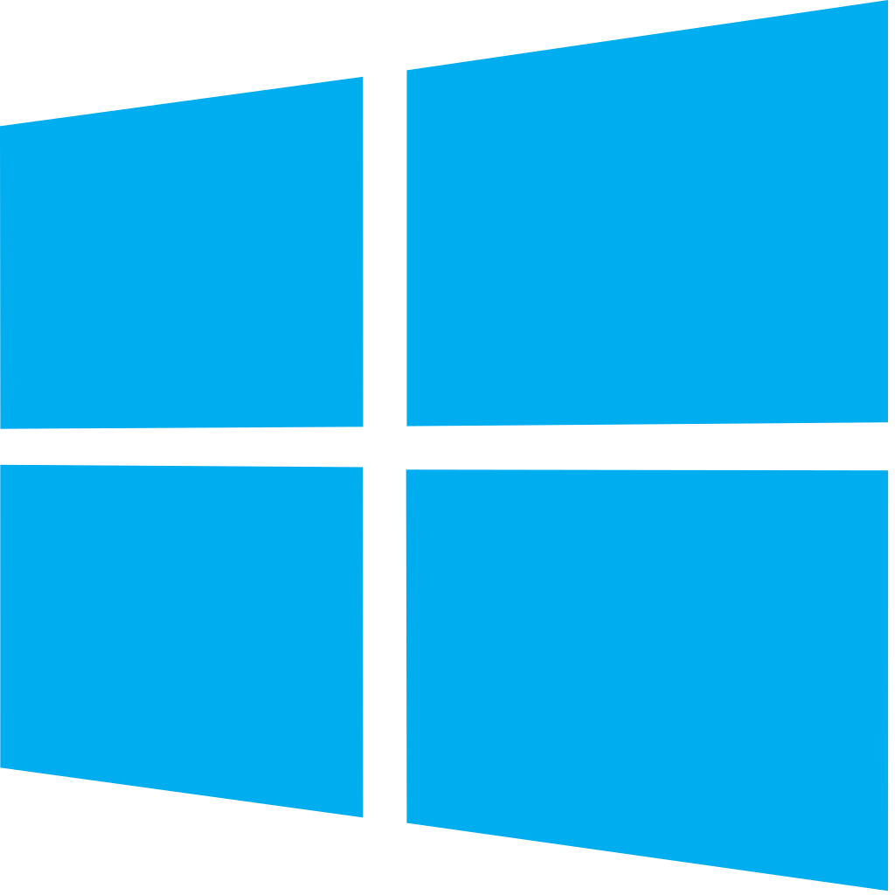






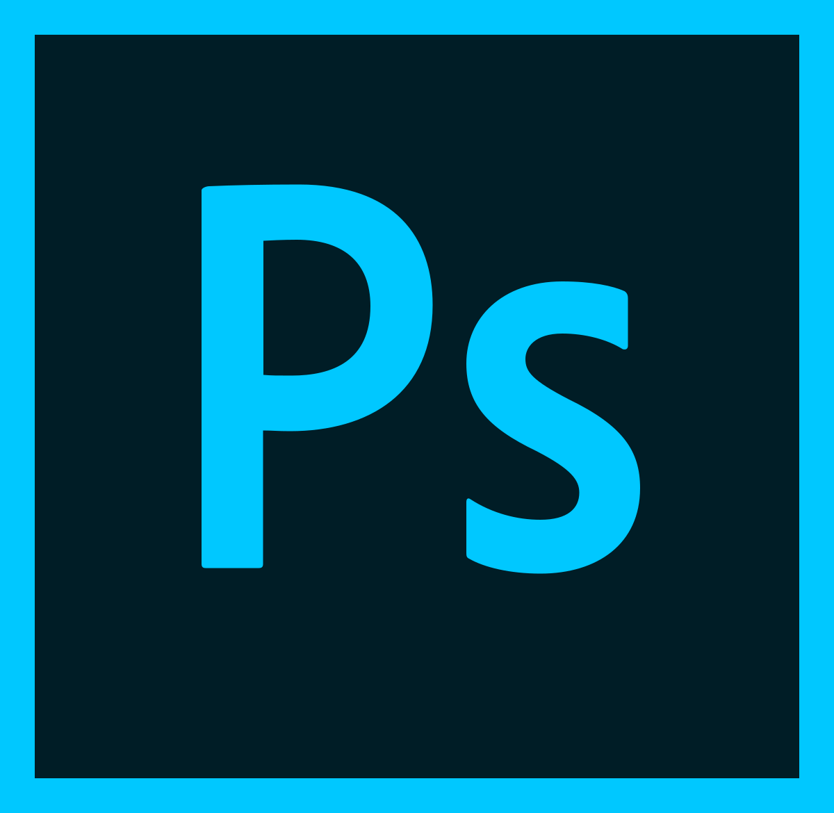
software
There are two basic software types
System software
Affects the control and performance of a computer system:
To make the best use of the hardware
To provide common functionality
To provide a simple interface between the user and computer
Application software
Written to solve a particular problem
User application programs
Application packages

Slide 12


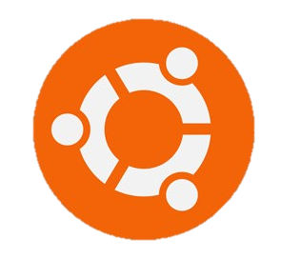
Operating systems
A set of programs residing in RAM which directs all operations in a computer
Booting up is the process of calling the OS into RAM from disk
It makes it easier to interact with the computer and helps in managing computer resources
Some main functions of an operating system include:
Job Control
Memory management
Disk management
Hardware control
Security
Multitasking
Networking

Slide 13
How a Computer system works
Let’s have a quick look at

Slide 14
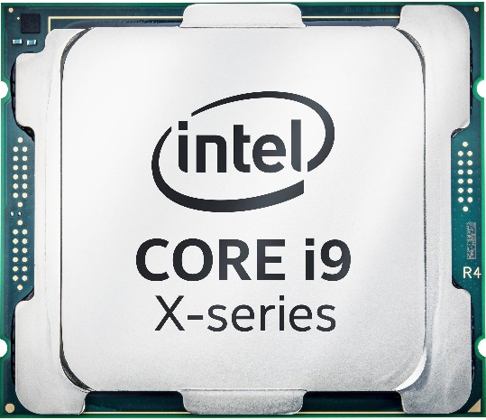
What does a cpu do?
The CPU is analogous to the brain of a computer. It’s three main functions are to:
Carry out instructions and tell the rest of the computer system what to do (the Control Unit)
Perform arithmetic calculations and data manipulation (the Arithmetic and Logic Unit)
Hold data and instruction which are in current use (Main Memory)
The speed at which a CPU can performs these tasks depends on its clock-rate (eg. 2.4 GHz: 2.4 billion instructions per second)
The current trend is to pack many CPUs on the same chip (due to transistor size limits & the speed of light)

Slide 15
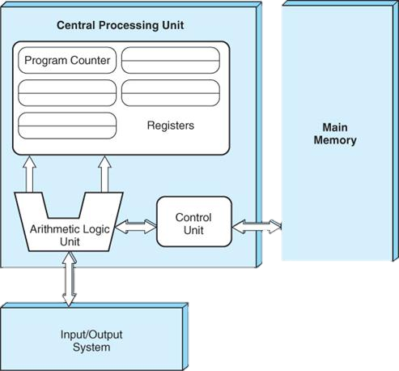
The von-neumann architecture
Internal memory locations performing specific tasks
Equivalent to a calculator, performing an arithmetic/logical operation on two operands, producing one result
Data paths between the CPU and memory
Controls instruction processing, movement of internal CPU data and provides timing and control signals

Slide 16
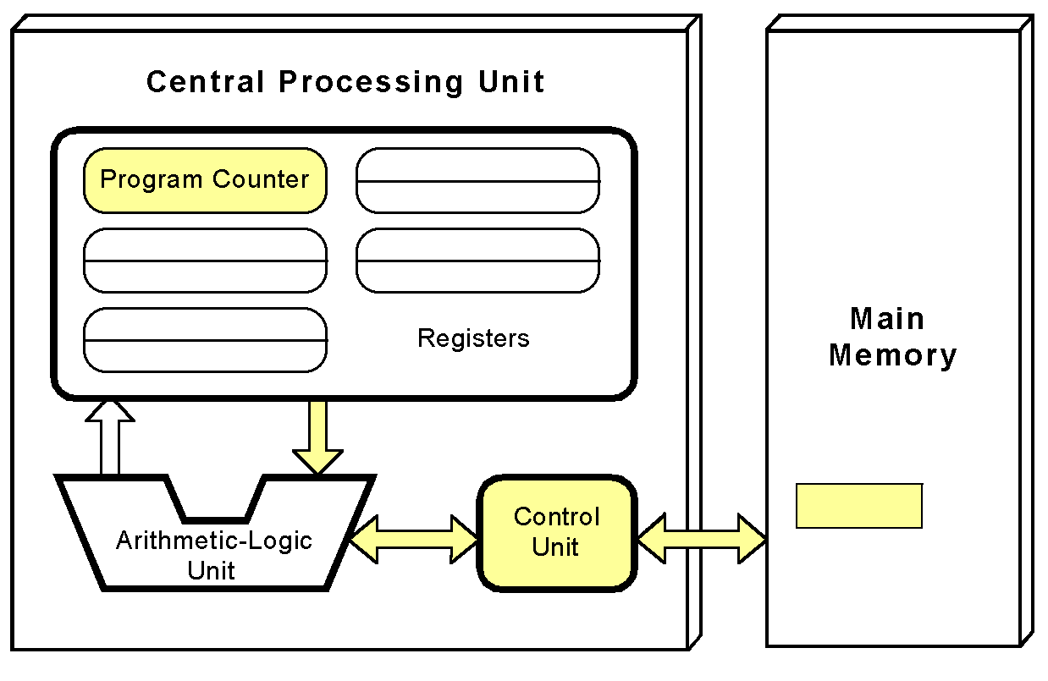
The fetch-decode-execute cycle
1
CU fetches the next instruction from main memory (program counter determines instruction address)

Slide 17
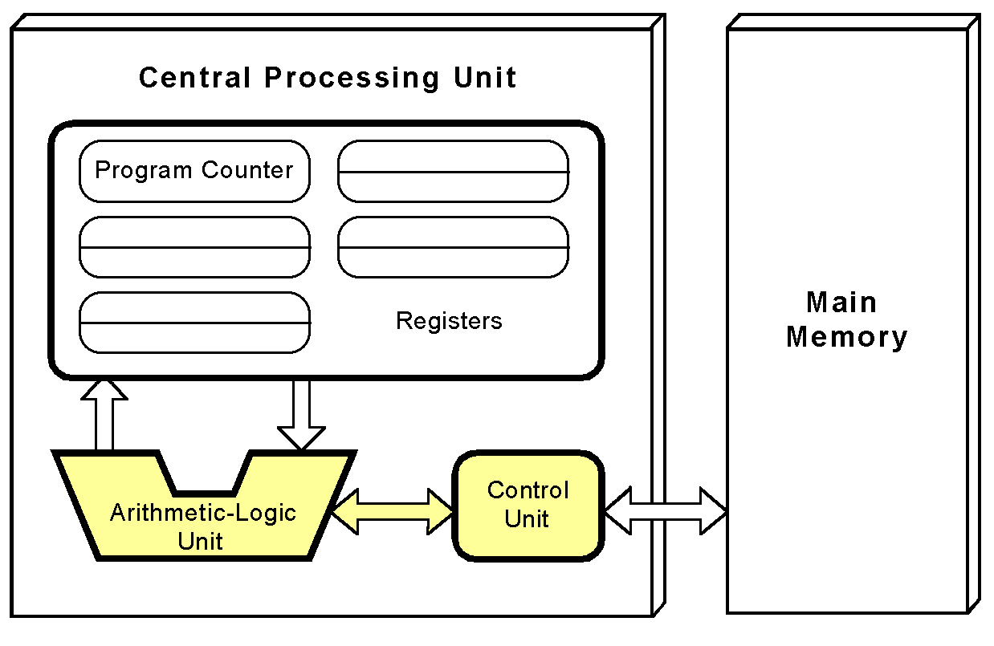
The fetch-decode-execute cycle
2
The instruction is decoded into a language that the ALU can understand

Slide 18
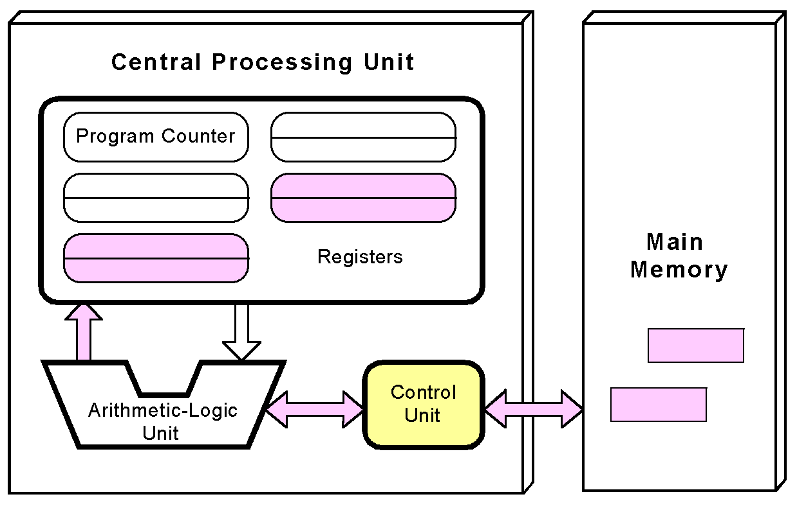
The fetch-decode-execute cycle
3
Any data operands required to execute the instruction are fetched from memory and placed in registers

Slide 19
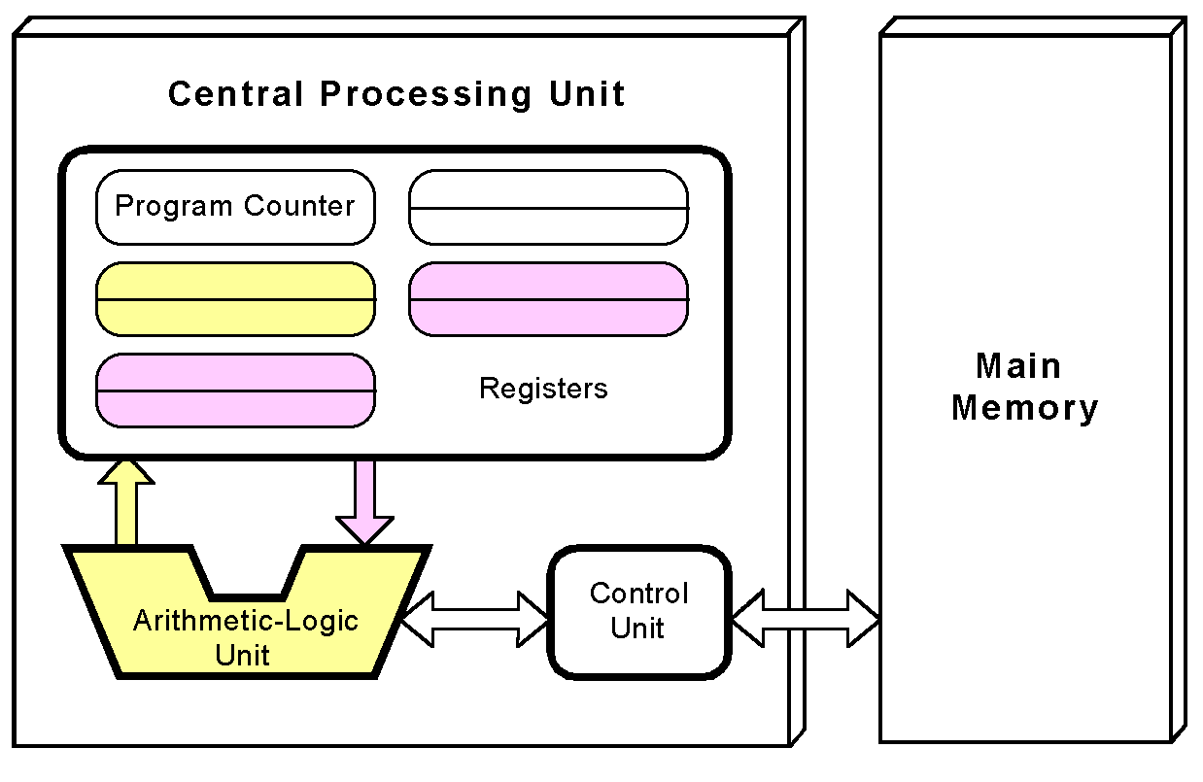
The fetch-decode-execute cycle
4
The ALU executes the instruction and places the results in registers or memory

Slide 20
How computers represent data
Revisiting old concepts

Slide 21
The binary number system
Computers are digital, electronic machines, and thus use binary logic
There are only two allowable states in a binary system:
ON (1) or OFF (0)
The binary number system uses these two digits (1 and 0), called binary digits, or bits
All programs and data are ultimately recognised as patters of 1’s and 0’s
A byte is the number of bits used to represent one character (8)
Memory size is usually measured in bytes:
Kilobytes: 1024 bytes in 1 KB = 2¹⁰ bytes
Megabytes: 1024 KB in 1 MB = 2²⁰ bytes
Gigabytes: 1024 MB in 1 GB = 2³⁰ bytes

Slide 22
Representing numbers
We count in base 10 (the decimal number system)
Tens Units
1 3
+ 9
2 2
267₁₀ = (2 x 10²) + (6 x 10¹)
+ (7 x 10⁰)
The binary system has two digits (0,1) and the place values are units 2’s, 4’s, 8’s, 16’s …
1011₂ = (1 x 2³) + (0 x 2²) + (1 x 2¹) + (1 x 2⁰) = 11
18₁₀: 18 / 2 = 9 remainder 0
9 / 2 = 4 remainder 1
4 / 2 = 2 remainder 0
2 / 2 = 1 remainder 0
18₁₀ = 1 0 0 1 0

Slide 23
Other number systems
Sometime different number systems are used as shorthand for binary
Octal numbers are base 8
69₁₀: 69 / 8 = 8 remainder 5
8 / 8 = 1 remainder 0
1 / 8 = 0 remainder 1
69₁₀ = 1 0 5₈
Hexadecimal numbers are base 16. The symbols 0-9 and letters A-F (equivalent to 10-15) are used, and place values increase in powers of 16
91₁₀: 91 / 16 = 5 remainder 11
5 / 16 = 0 remainder 5
91₁₀ = 5 B₁₆

