Slide 1
DNSProxy
Local DNS-over-HTTP private resolver
Massimilano Fantuzzi

Slide 2
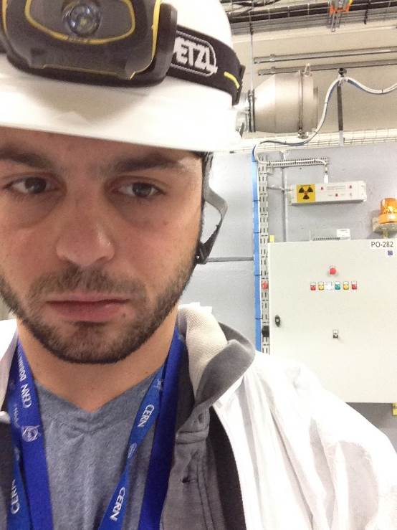
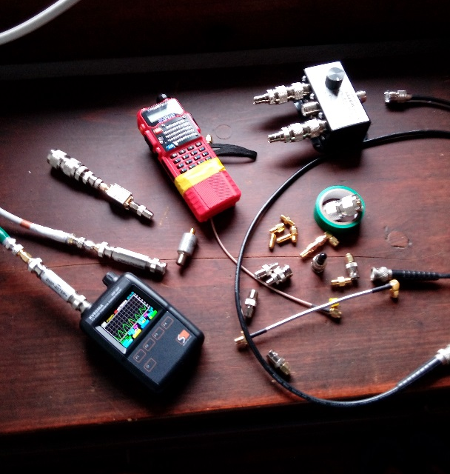

WHO
IBM, CERN
Landline mobile and sat Telcos
Hosting on ARM since 2005
Radioamateur
Interested in HTTP since
Have seen DNS mistreated / misunderstood
https://github.com/fantuz/DNSProxy
superfantuz@gmail.com

Slide 3
WHY
Wished to:
  TOR like a boss (hushmail, 2011)
  Reliable transport on high delay networks (2013-2015)
  Using polipo proxy (IRIF Paris). Pipelining, HTTP version 1.
Must be:
  Reliable. A, MX...
  Must allow for timing out & fail
  Idempotent/idiosyncratic (not the case with ISP/caches)
  Sometimes, no auth/add needed (compression, chances of no-change, Skype 5sec..)
BIND is amazing, Coredns.io too
  DNSP: no zone files (yet), 1 contributor
  Poor’s man total-system wrapper, slow (from <1msec to more than 400msec)
  K8S, Docker, GCP ?
Adhere to doh-draft (2018)
https://github.com/fantuz/DNSProxy
superfantuz@gmail.com

Slide 4
HOW
Many options, I choosen C+PHP (Golang is sexier)
Works on a single workstation, little LAN, small sat ISP.
Forging packets is fun, spawning threads too. Learning.
In a sense, back to /etc/hosts (or CURL_RESOLVE)
Added H2 + PUSH with a simple update of CURL.
Bye bye polipo. Welcome Charles (or do it on CDN layer)
Would test with NGHTTP2 but my boost is worse than my C.
Need to preserve the gethostbyname/resolv principles (=no PUSH, can’t be understood by a local DNS client, not in paradigm, response not wanted=drop)
https://github.com/fantuz/DNSProxy
superfantuz@gmail.com

Slide 5
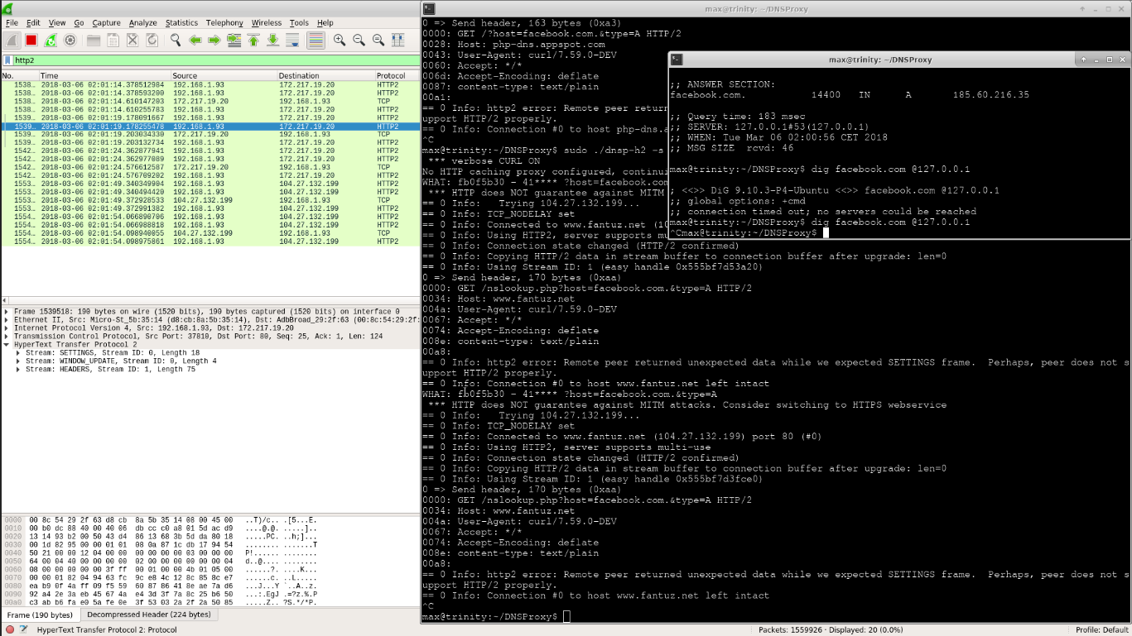
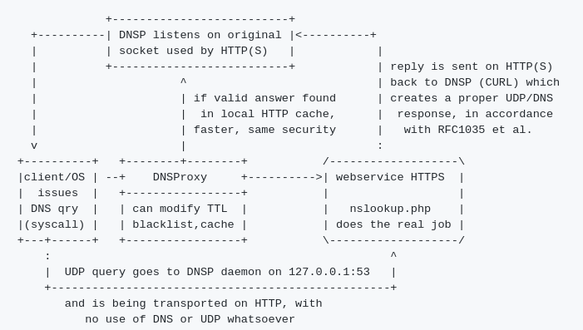
HOW
max@trinity:~/DNSProxy$ sudo ./dnsp-h2 -s https://www.fantuz.net/nslookup-doh.php -T 86400
*** TTL SET TO 86400
No HTTP caching proxy configured, continuing without cache
WHAT: 8f6cb60 - 39
HTTP/2 200
x-powered-by: PHP/7.1.12
x-powered-by: PleskLin
content-type: text/plain;charset=UTF-8
last-modified: Thu, 15 Mar 2018 16:56:48 GMT
etag: c99cc4d4646f4e9ee2b3e87f21cbc8df
cache-control: public, max-age=127, s-maxage=127
content-length: 35
content-encoding: gzip
vary: Accept-Encoding
date: Thu, 15 Mar 2018 16:56:48 GMT
accept-ranges: bytes
server: LiteSpeed
alt-svc: quic=":443"; ma=2592000; v="35,37,38,39"
216.58.207.46
https://github.com/fantuz/DNSProxy
superfantuz@gmail.com

Slide 6
INSPIRATION
torsocks
pdns / Power DNS
http_dns_proxy
google_https_dns
unbound
PCAP_Dnsproxy
Reports from users:
  dnspod et Ali https://www.v2ex.com/t/250611
  Netflix bypass
  Webex prep call Hackathon 101
  Arduino version
https://github.com/fantuz/DNSProxy
superfantuz@gmail.com

Slide 7
HOW REALLY
HTTP headers
PHP dns_get_record
libcurl
Does:
  «comply»
  memcache (Etag, Last-modified)
  expire
  cluster
Solves .. problems
  Poisoning ?
  Censorship ?
  Redundancy
Offers .. solutions
  Democratisation (end of anycast is not the idea, regional stuff should stay as-is)
  CDN-friendly, Etag, Vary
  Anti DDOS
  Proxify HTTP(S) (i.e. charles)
https://github.com/fantuz/DNSProxy
superfantuz@gmail.com

Slide 8
GOALS
GET --> POST ? Points of view
Load balancing (or multipath, or parallel resolution
(How verbose is verbose ?)
Authority, Additional back in at no cost (not my pref)
DNSSEC, as draft says, is transparent (truth/belief)
Keep supporting googleDNS / D-o-H / Max’s D-o-H / others
redis WIP, arduino radio blockchain, fun
https://github.com/fantuz/DNSProxy
superfantuz@gmail.com

Slide 9
FUTURE EVOLUTIONS (!)
HTTP/2 on
  8.8.8.8
  9.9.9.9, 9.9.9.10
  16.16.16.16 ?
  ☺ see cloudlflare entering the game
DNS ≠ DN$ (Tuvalu island --> .tv)
APIs. How many ?
https://github.com/fantuz/DNSProxy
superfantuz@gmail.com

Slide 10
Something to add to draft proposals ?
Being verbal adds no trust over domain naming (service, discovery) ?
Create more official test bed (see Yeti) !?
?

