Slide 1
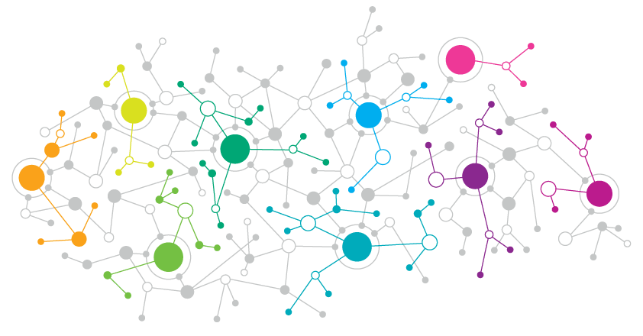

Bluesky Social
Andrea Failla
andrea.failla@phd.unipi.it

Slide 2


In a nutshell…
Twitter Clone
“Classical” microblogging service
Federated Architecture
Users can join one of thousands of servers to store their data
Fully Open!
Everything is public: posts, metadata, profiles, blocked-lists

Slide 3
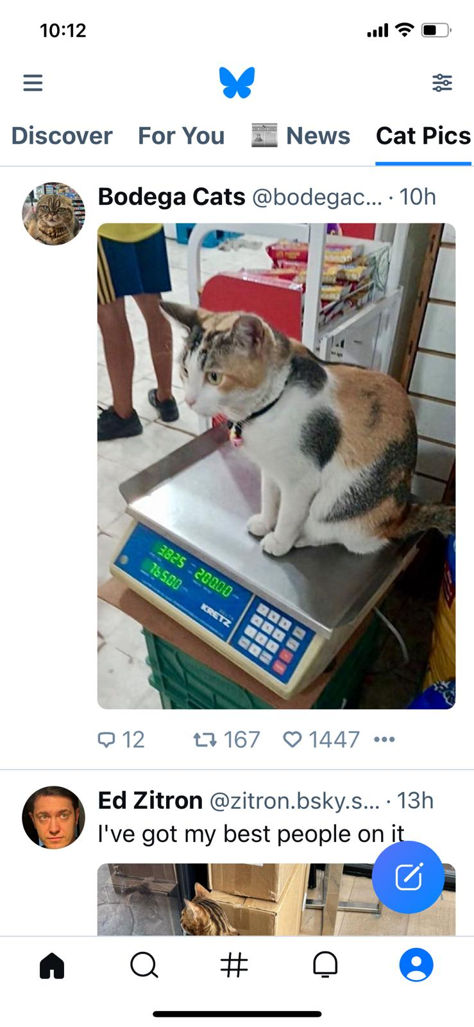
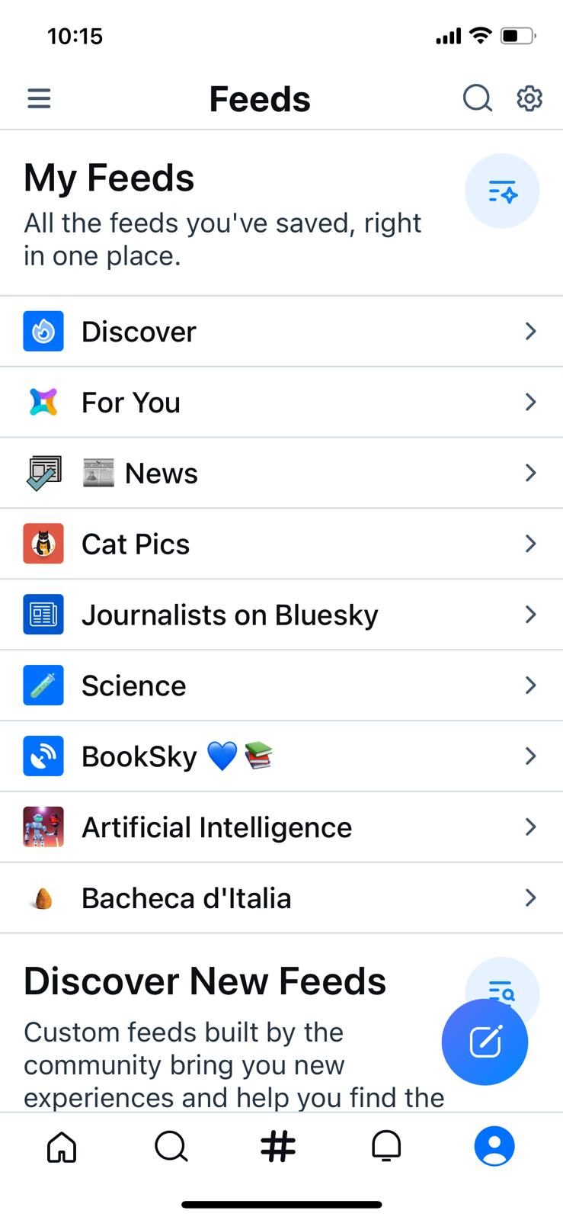
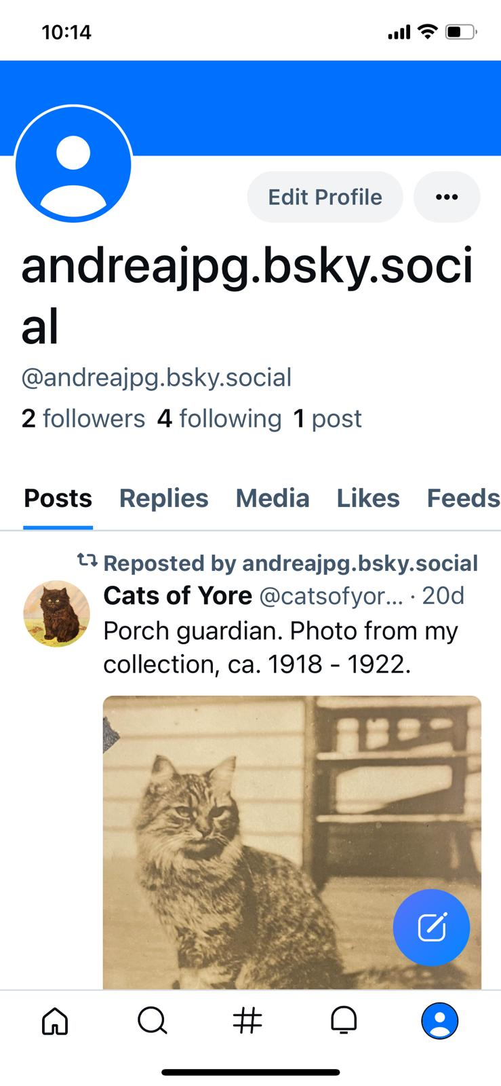

Slide 4
Why Bluesky?
APIcalypse
& Twitter Bias
DOSNs’
Structure and Dynamics
RecSys &
Algorithmic Choice

Slide 5
Dataset

Slide 6
The Pipeline
Collect followers Start at @bsky.app. Once 1M users are discovered, distribute subsequent requests over 10 machines.
Collect followings A second pass to improve coverage. If new user, also collect their timeline.
Clean, Anonymize & Augment Solve inconsistencies in post metadata, assign unique ids, sentiment analysis, etc.
Feb 25
Mar 2
Mar 20
Mar 21
Mar 21
Mar 22
Mar 23
Mar 23
Mar 29
Apr
Collect users’ timelines Distribute requests over 10 machines
Collect feeds Most popular feeds on various topics & social issues
Analyze More on that in a few slides…

Slide 7
Results
Follow Network
Post Collection
Feed Collections

Slide 8
81%
235M
Registered Users
Posts

Slide 9
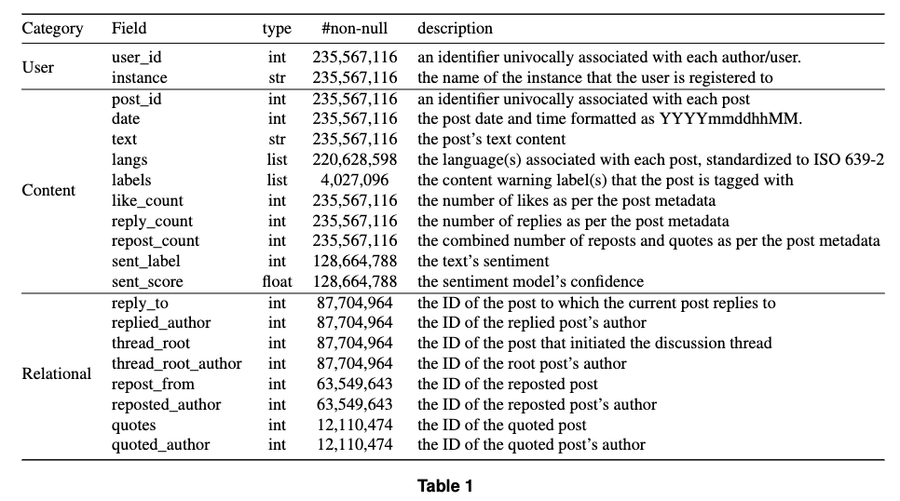

Slide 10
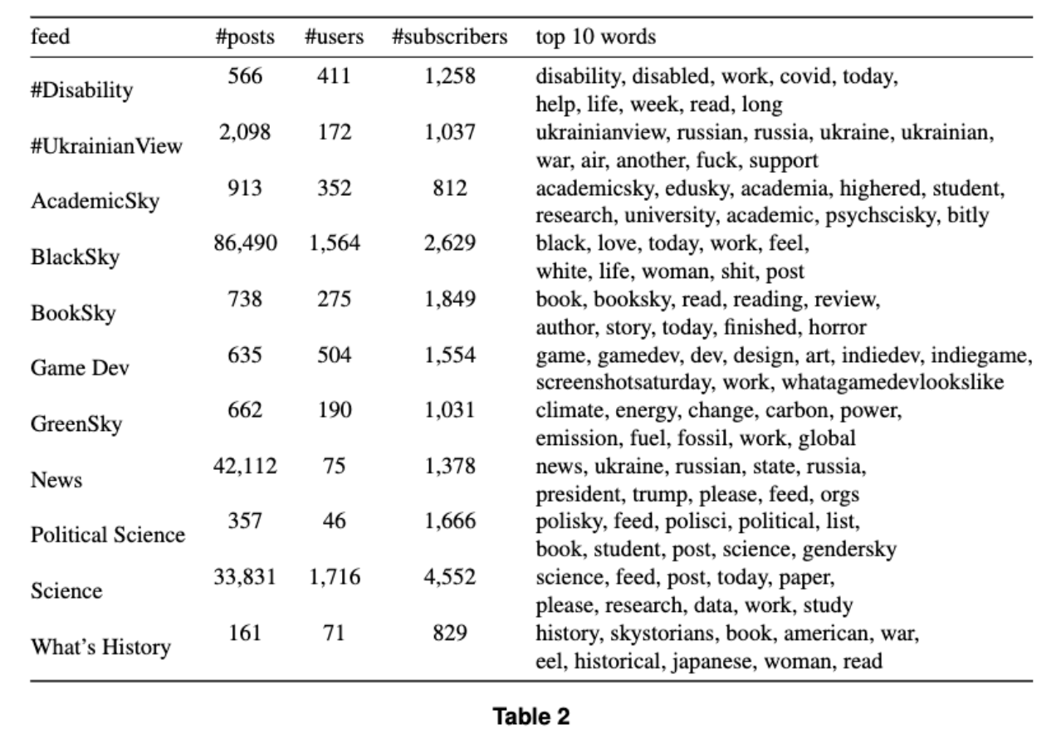

Slide 11
Preliminary Exploration

Slide 12
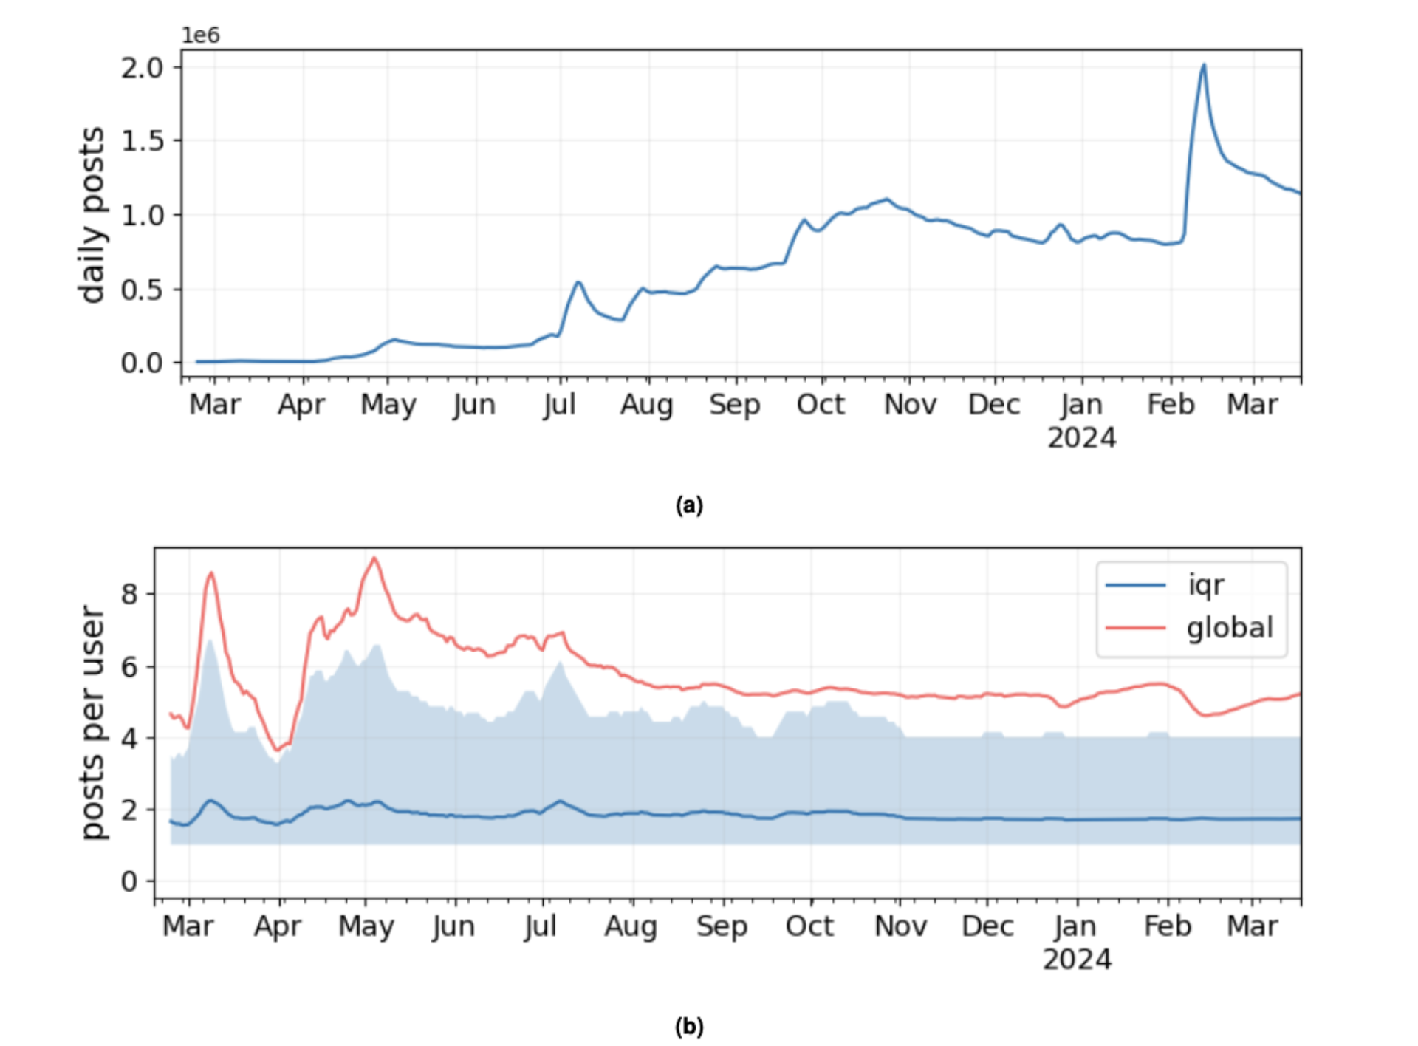
Posting Activity I

Slide 13
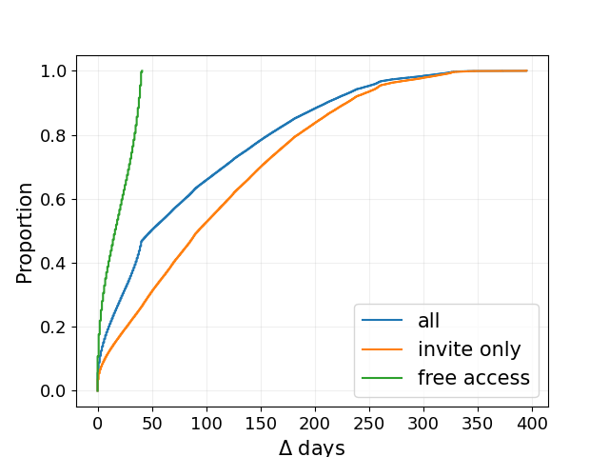
Posting Activity II

Slide 14
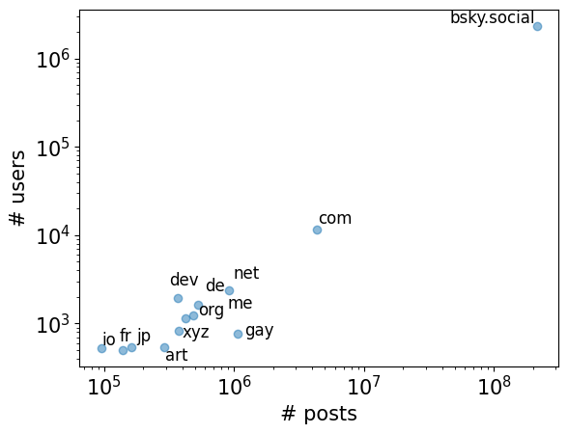
Instances

Slide 15
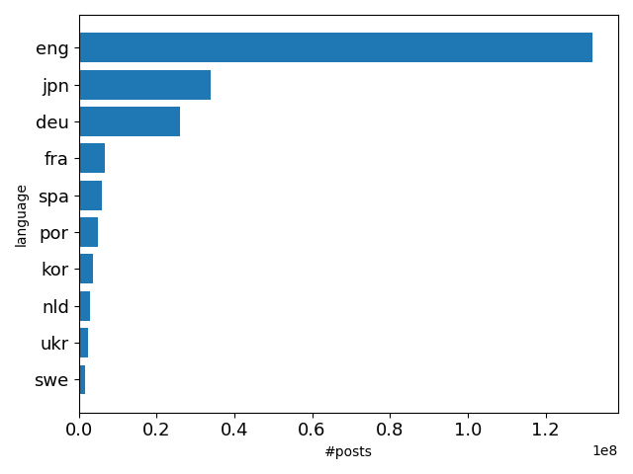
Languages

Slide 16
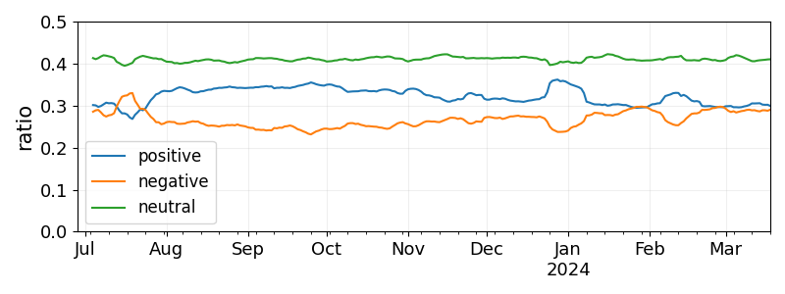
Sentiment

Slide 17
Thank you!

