Slide 1

ADVANCED DATA MANAGEMENT 2018-2019
Andrea Garrone & Marco Mochi

Slide 2
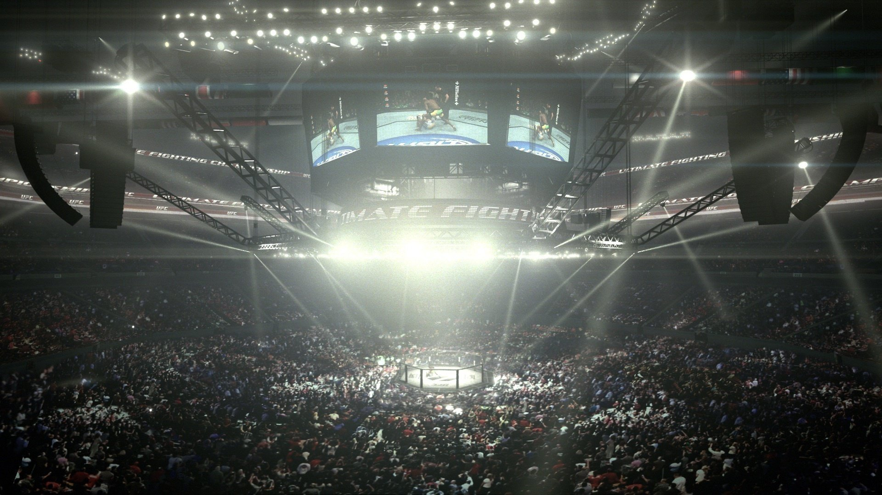


INTRODUCTION
The Ultimate Fighting Championship (UFC) is the largest mixed martial arts promotion company in the world .
We imagine to be dana white, the president of ufc, and wanting to sell to tv’s, media of any kind and gyms a tool to analyze and present a match.
There are two main applications:
a desktop application for media and tv’s that give access to some basic information about an event and some statistics
a desktop application for coaches that dive deeper into statistics.

Slide 3


AIM OF THE PROJECT
The goal of the project is the design and the development of a large-scale data management/data processing layer, in order to have a periodically updated ufc database with a lot of read and write operations.
PART 1
PART 2
Propose a domain and a related application (2h)
Schema and workload definition (15h)
Provide application and system requirements (10h)
Schema creation and population (10h)
Choice of the reference technology
Workload implementation (10h)

Slide 4

REFERENCE TECHNOLOGY
Cassandra is one of the technologies we studied during the course and it is the one we appreciate the most among the others, both from a conceptual and practical point of view.
We will need to write data periodically:
every time an event (and all the fights included) is created
every time a fighter signs a contract with the UFC promotion.
We also need to read data :
every time a tv or any other media need information about an event or a fight for advertising
every time a coach wants to know some statistics about a fighter in order to train his fighter at best

Slide 5

CONCEPTUAL SCHEMA
FIGHTER
EVENTS
(1,N)
(1,N)
(1,N)
FIGHTS
(N,1)
(0,N)
DISPUTE
INCLUDE
(0,N)
(0,N)
FIGHTING
(0,N)
HAS
STATISTHICS
WITH

Slide 6

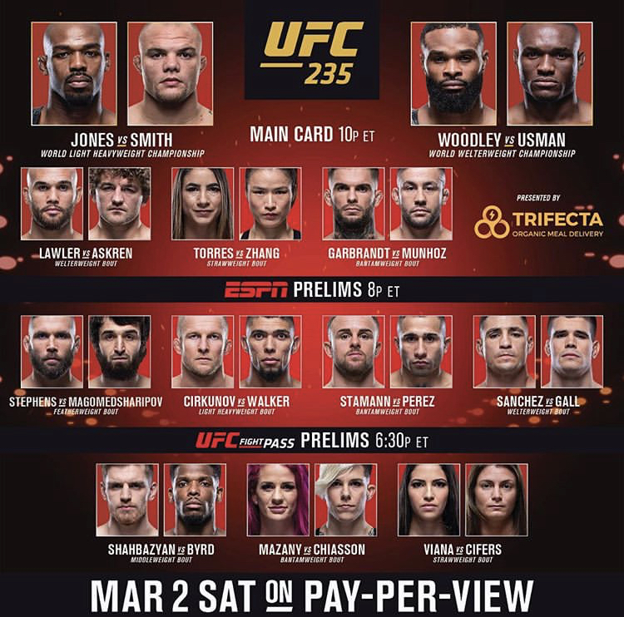
WORKLOAD OPERATIONS: info_card
UFC promotion create a new event with a new fight:
INSERT INTO info_card (Event_ID, Fight_ID, Date, Name, ID, corner) VALUES (772, 5990, 2016-04-25,’Jon Jones', 549, ‘red’);
A media want to know the data of an upcoming event:
SELECT DATA from INFO_CARD where EVENT_ID = N
A media want to know the fighter’s name of a match:
SELECT NAME FROM INFO_CARD WHERE EVENT_ID = N AND FIGHT_ID = X
UFC promotion has to update information about a fight due to a fighter's injury (fighter substitution): UPDATE info_card SET (Name, ID) = (‘Alexander Gustafsson’, 1139) WHERE Event_ID = 772 AND ID = 549;

Slide 7

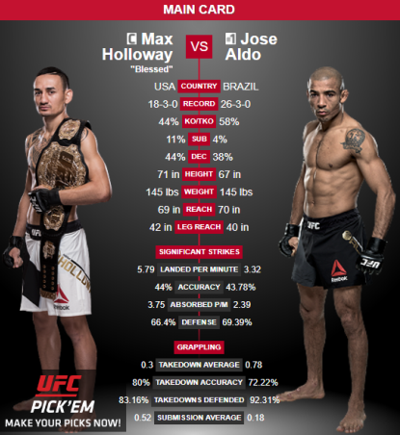
WORKLOAD OPERATIONS: info_fight
UFC promotion insert a new fight:
INSERT INTO info_fight (Fight_ID, ID, Event_ID, Date, corner, Max_round, RStreak, Height, Age, HomeTown) VALUES (5990, 549, 772, 2016-04-25, ‘red’, 5, 2, 193.0, 29.0, ’Rochester, New York USA’);
A media need some fighter’ information in order to introduce a new match:
SELECT (Height, Weight, Age) FROM info_fight WHERE Fight_ID = 5990 AND ID = 549;
A media want to know how a fight ended and the winner:
SELECT (winby, winner) FROM info_fight WHERE Fight_ID = 5990
UFC promotion update fight information: UPDATE info_fight SET (winner, winby, Last_round, Weight) = (‘red’, ‘DEC’, 5, 93) WHERE Event_ID = 772 AND ID = 549;

Slide 8

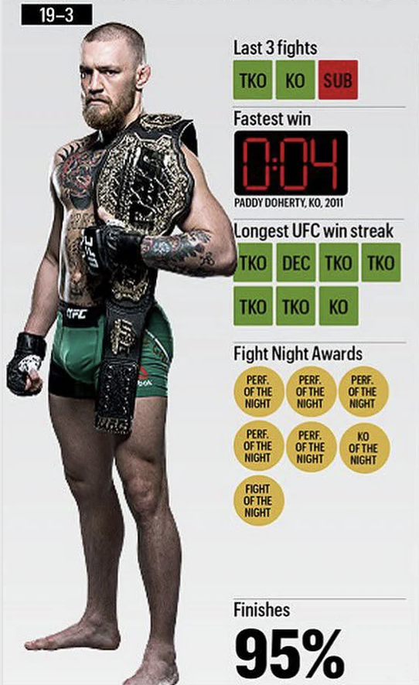
WORKLOAD OPERATIONS: info_fighter_general
A media want to know every match disputed by a fighter:
SELECT (*) FROM info_fighter_general WHERE ID = 549;
A media want to know the weight of a fighter at a particular date:
SELECT Weight FROM Info_fighter_general WHERE ID = 549 AND AGE = 29.0 AND DATA = 2016-04-25;
A media want to know the actual record of a fighter:
SELECT RStreak FROM info_fighter_general WHERE ID = 549 AND DATA = 2016-04-25;
A media want to know the best record of a fighter in a certain period:
SELECT MAX(RStreak) FROM info_fighter_general WHERE ID = 549 AND Date < 2013-05-03 AND Date > 2016-04-25;

Slide 9

WORKLOAD OPERATIONS: info_fighter_statistics
Number of takedowns attempts from a fighter in one round of a match:
SELECT Round1_Grappling_takedowns_attempts FROM info_fighter_statistics WHERE ID = 549 AND Fight_ID = 772;
Number of takedowns landed by a fighter in one round of a match:
SELECT Round1_Grappling_takedowns_LANDED FROM INFO_FIGHTER_STATISTICS WHERE ID = X AND Fight_ID = N
Total number of strikes landed in one round of a match:
SELECT Round1_Strikes_Total_Strikes_Landed FROM info_fighter_statistics WHERE ID = 549 AND Fight_ID = 772;
Total number of strikes landed during one fighter career:
SELECT SUM(ROUND1_STRIKES_TOTAL_STRIKES_ATTEMPTS) FROM INFO_FIGHTER_STATISTICS WHERE ID = X

