Slide 1
EDA German Credit Risk Dataset

Slide 2
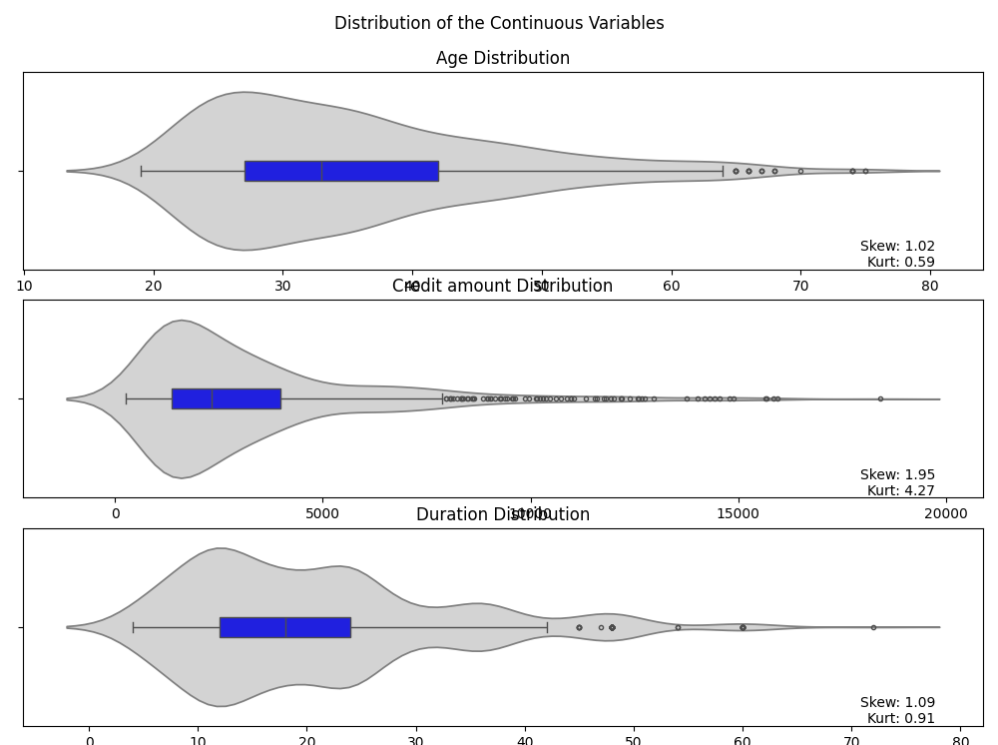
Distribution of Continuous Features
Continuous variables have high skewness. Please evaluate the presence of outliers, consider extracting specific features, or operating normalizing data transformations.

Slide 3
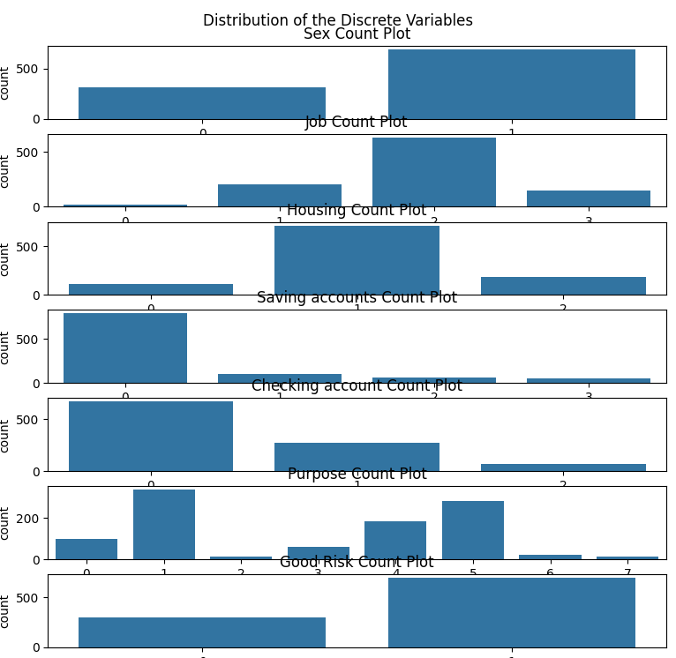
Features Interpretation and Distribution
Features of the GCR database
Age (int16)
Sex (catcode numeric): 0-female, 1-male
Job (catcode numeric): 0-0, 1-1, 2-2, 3-3
Housing (catcode numeric): 0-free, 1-own, 2-rent
Saving accounts (catcode numeric): 0-little, 1-moderate, 2-quite rich, 3-rich
Checking account (catcode numeric): 0-little, 1-moderate, 2-rich
Credit amount (int32)
Duration (int16)
Purpose (catcode numeric): 0-business, 1-car, 2-domestic appliances, 3-education, 4-furniture/equipment, 5-radio/TV, 6-repairs, 7-vacation/others
Good Risk (boolean)
Observations about the features distribution
A higher percentage of credits involve smaller amounts and are requested by younger people.

Slide 4
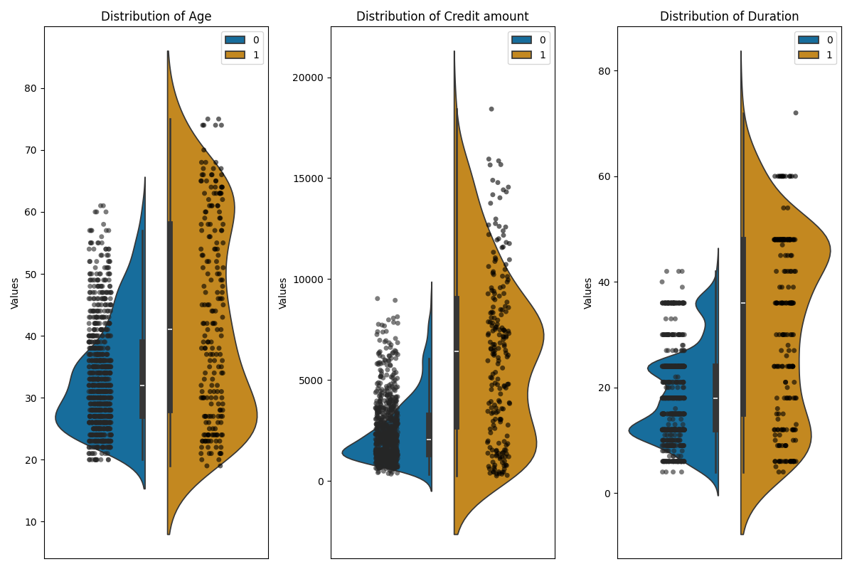
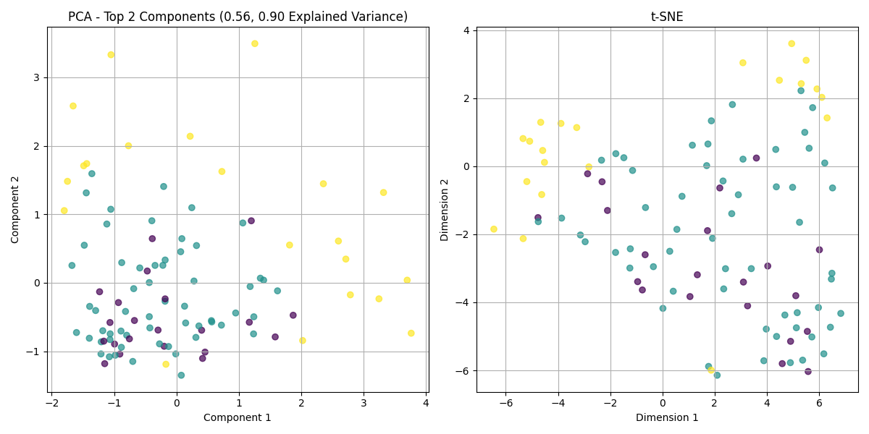
Outliers analysis
Random isolation forest identified 207 outliers
Subsequent profiling indicates that outliers are actually related to higher age or credit amount
Maybe perform squashing transformation if needed?

Slide 5
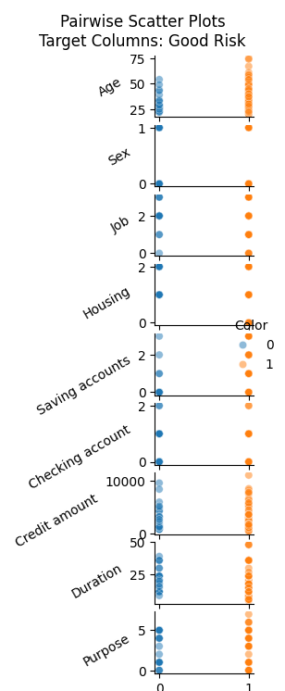
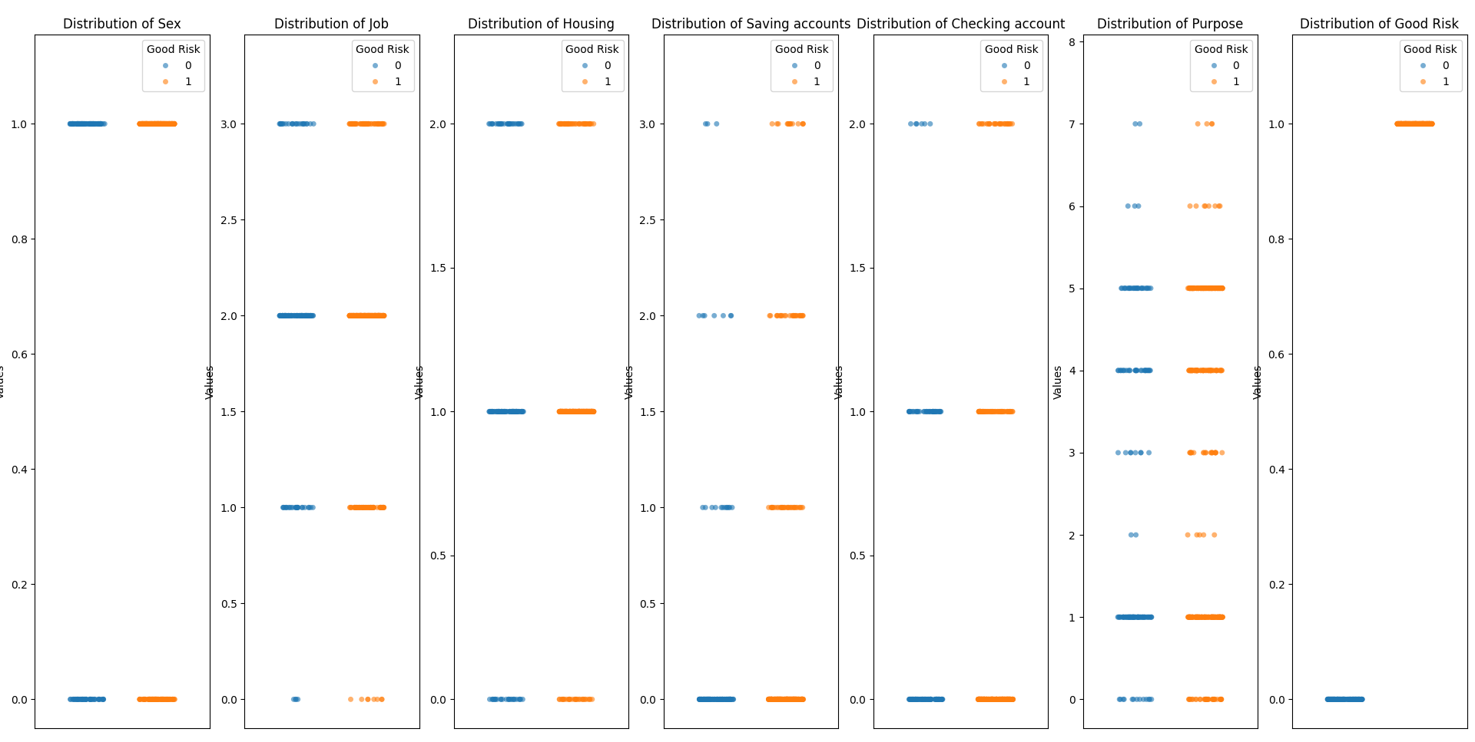
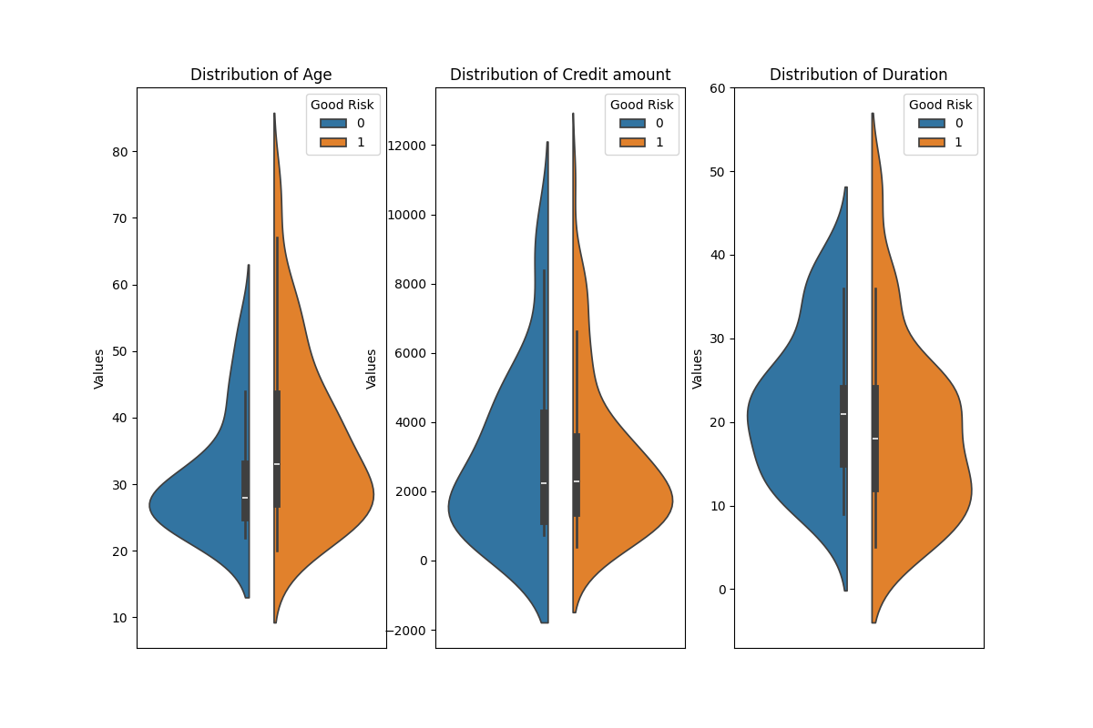
Relationship between Features and Target
Observations that align with financial behavior
Violinplot tails reveal that risk is worse for younger people, higher credit amounts, and longer credit duration.
Stripplot reveals that comparaively better risk is observed for jobs of category 1, increasing savings in either saving or checking accounts,
that risk is worse if more money in checking accounts and less money in saving accounts. Feature-feature pairplot later indicates that people saves more money in either one or the other, and those who save in saving accounts are associated with better risk.

Slide 6
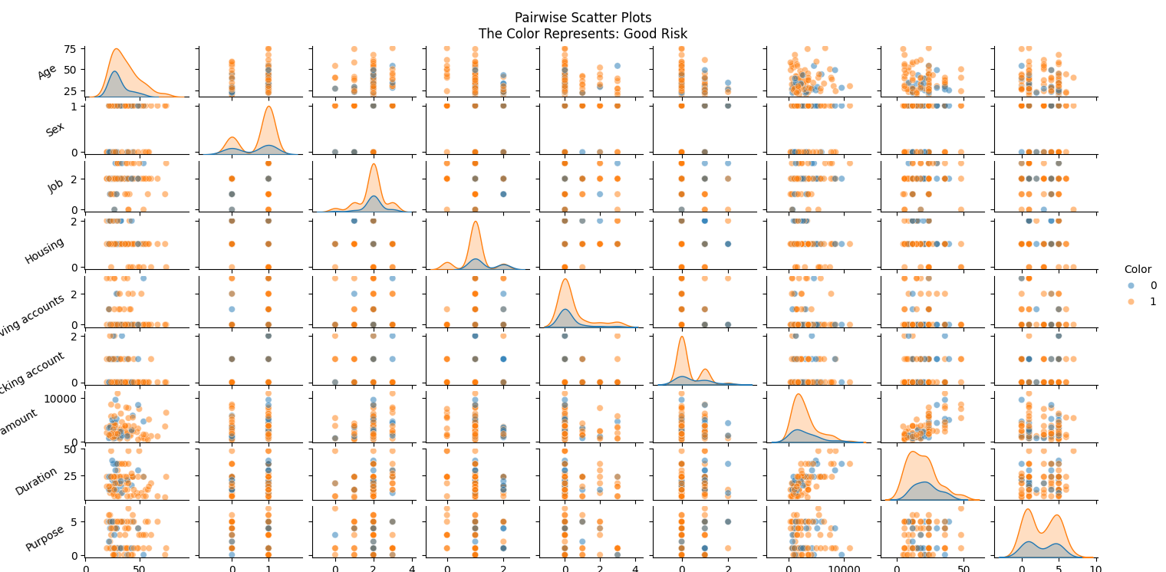
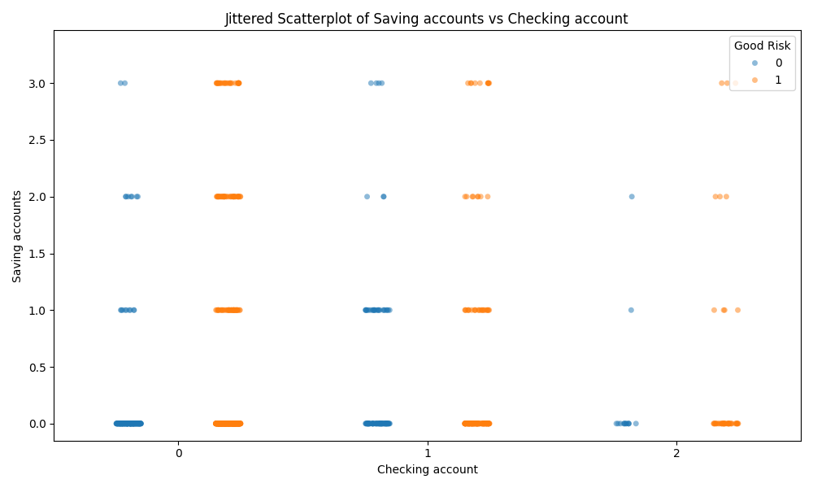
Relationship between Feature Pairs
Interplay exists between the size of saving and checking accounts. Saving accounts are preferred for better risk. Interestingly, having 1S-1C is worse than having 1S-0C or 0S-1C.

Slide 7
