Slide 1
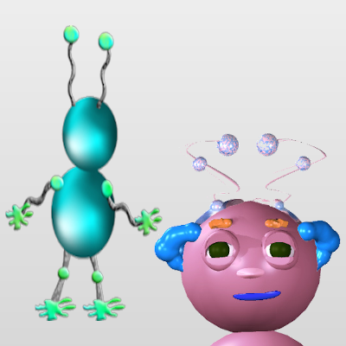
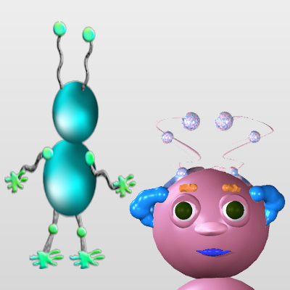
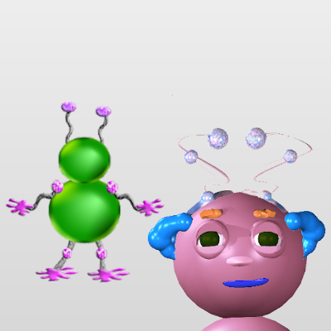


Notes:
Today, we need your help.
We have a lot of pictures of Wuggle named Wiggle.
In all of these pictures, another Wuggle is talking to Wiggle.

Slide 2
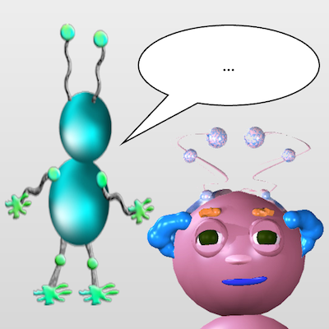
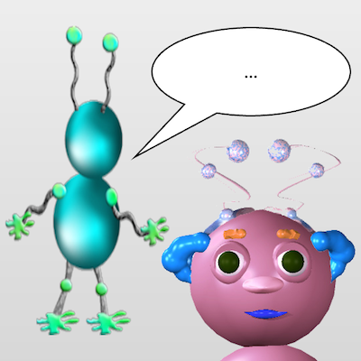

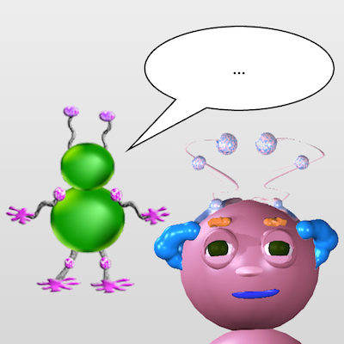

Notes:
But we don’t know what that Wuggle just said to Wiggle, because we don’t speak Wugglese!
So we need your help guessing what Wiggle will do next #, using what you see in the picture.

Slide 3


Notes:
Sometimes, this Wuggle # will be talking.
And sometimes, this Wuggle # will be talking.
#

Slide 4
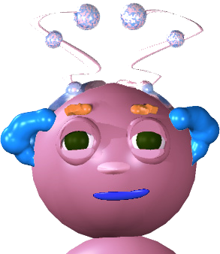
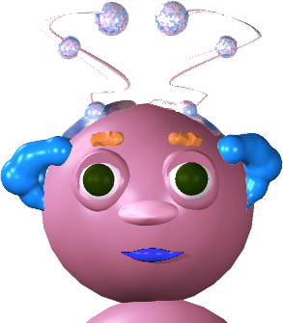
Notes:
Sometimes, Wiggle’s face will look like this. #
And sometimes, Wiggle’s face will look like this. #
#

Slide 5
Notes:
Your job in this game is to figure out what Wiggle will do next in each kind of picture.

