Slide 1


Notes:
Great job! Now, there’s one thing that will be different about the real game.
In the real game, you won’t be looking at pictures of human people.

Slide 2



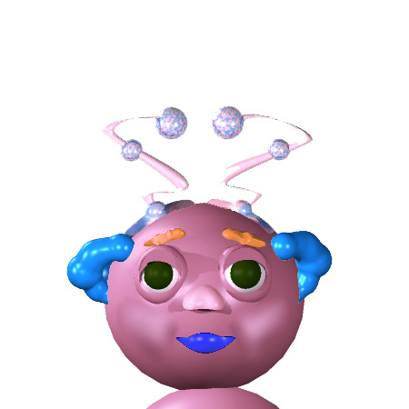
Notes:
You’ll be looking at pictures of aliens # called Wuggles.
Here’s what you need to know about Wuggles:
First, Wuggles live on a faraway planet. #
Also, Wuggles can talk! # But they don’t speak the same language we do. They have their own language, Wugglese.
Finally, Wuggles have feelings #, just like us. But their feelings can look different from our feelings.

