Slide 1

Notes:
Today, we need your help.

Slide 2
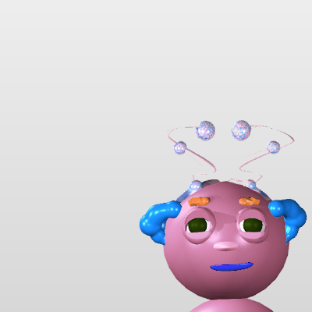
Notes:
We have a lot of pictures like this one of a Wuggle named Wiggle.

Slide 3
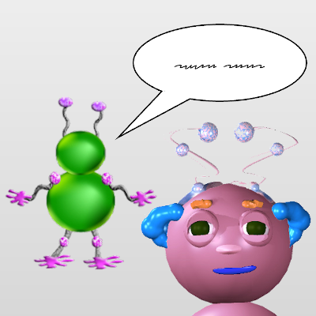
Notes:
In all of these pictures, another Wuggle is talking to Wiggle.
But we don’t know what that Wuggle just said to Wiggle, because we don’t speak Wugglese!

Slide 4


Notes:
We need your help guessing what Wiggle will do next.

Slide 5

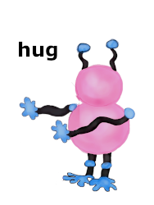
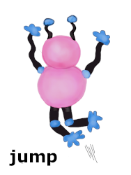
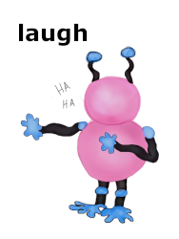
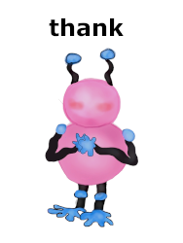
Notes:
After each picture, there are four different things Wiggle might do.
# Wiggle might hug the other Wuggle.
# Or he might jump up and down.
# Or he might laugh.
# Or he might say thank you to the other Wuggle.

Slide 6

Notes:
To figure out what Wuggle will do next, you’ll have to use what you see in the picture.

Slide 7
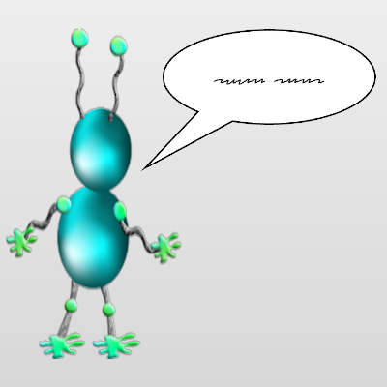
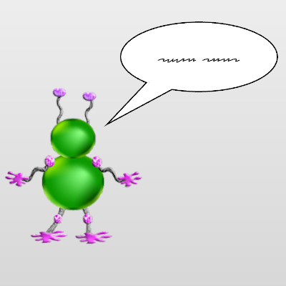
Notes:
In some pictures this wuggle # will be talking to Wiggle.
And in other pictures this wuggle # will be talking to Wiggle.

Slide 8
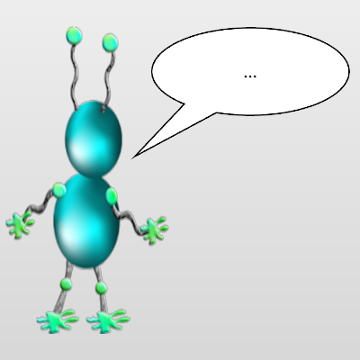
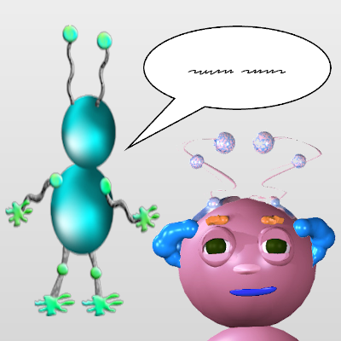
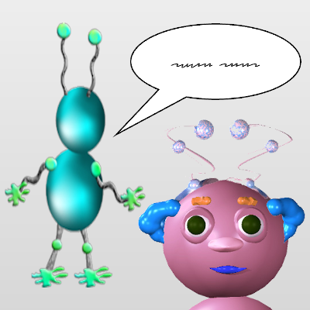
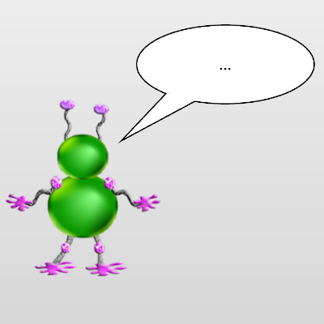


Notes:
In some pictures, Wiggle’s face will look like this. #
And in other pictures, Wiggle’s face will look like this. #

Slide 9


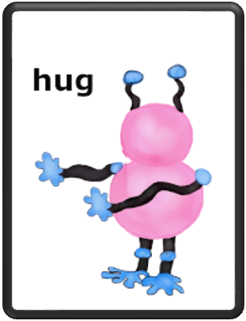
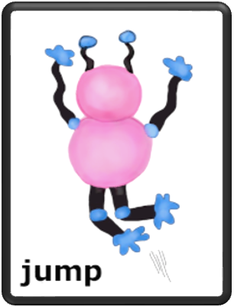
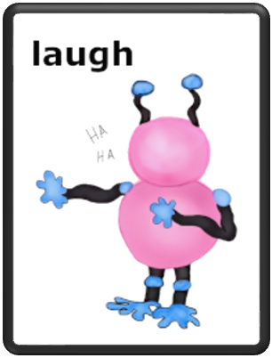
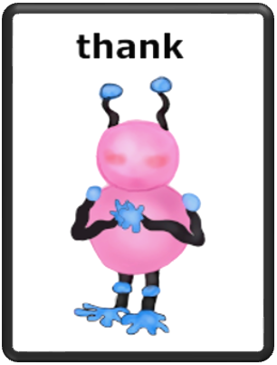


Notes:
For each kind of picture, you’ll have to guess what Wiggle will do next.

