Slide 1

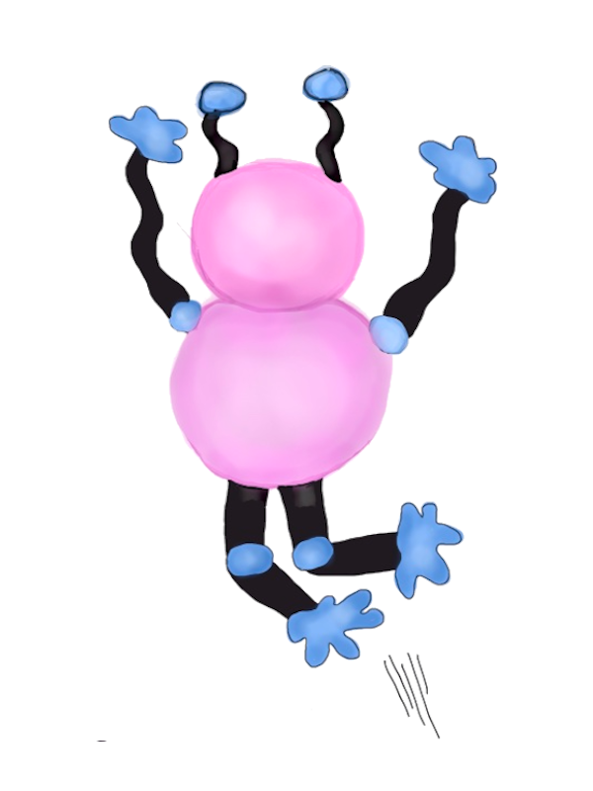
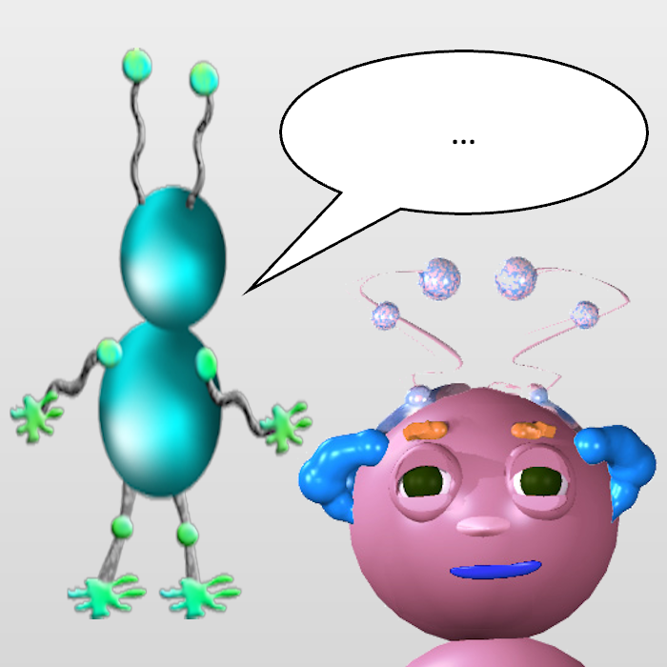
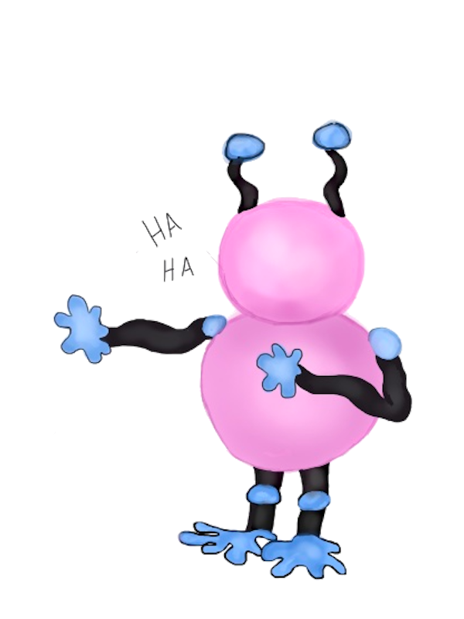

Notes:
13.33 by 7.5
Left: (6.67-6.33)/13.33 = 2.5%
Left: (6.67+0.83)/13.33 = 56%
Top: 0
Left: (6.67+3.83)/13.33 = 79%
Top: 0
Left: (6.67+0.83)/13.33 = 56%
Top: 50%
Left: (6.67+3.83)/13.33 = 79%
Top: 50%

