Slide 1



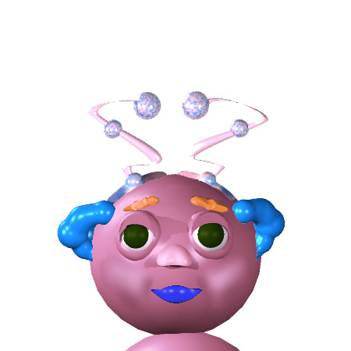
Notes:
Great job! Now, there’s one thing that will be different about the real game.
In the real game, you won’t be looking at pictures of human people.
You’ll be looking at pictures of aliens called Wuggles. #
Here’s what you need to know about Wuggles:
First, Wuggles are friendly aliens that live on a faraway planet. #
Also, Wuggles can talk! # But they don’t speak the same language we do. They have their own language, Wugglese.
Finally, Wuggles have feelings, just like us. # But their feelings can look different from our feelings.

