Slide 1

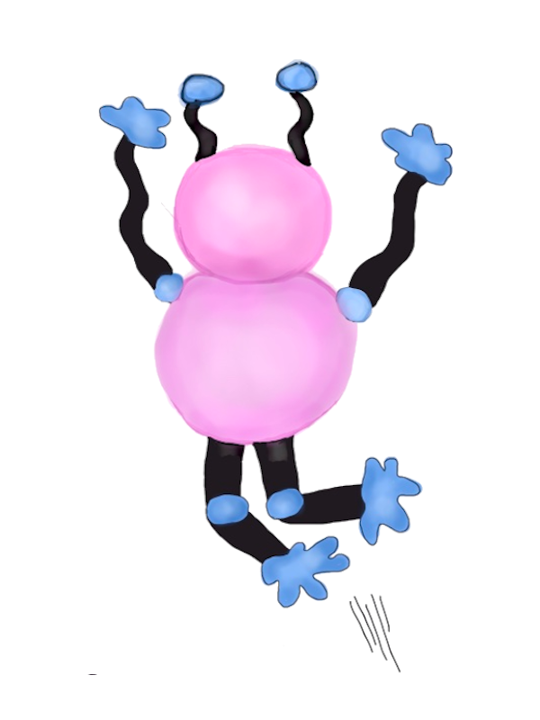
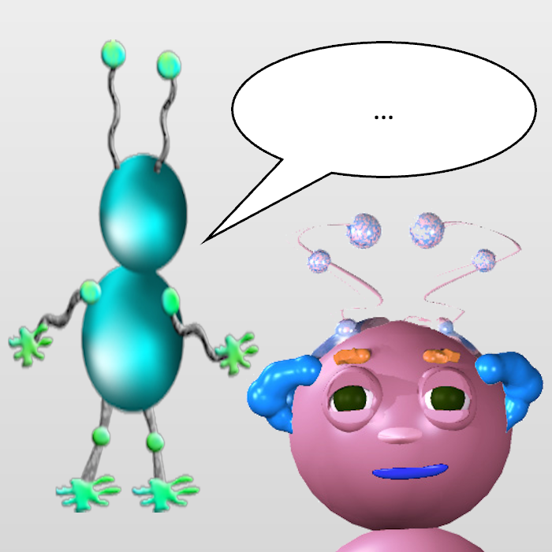
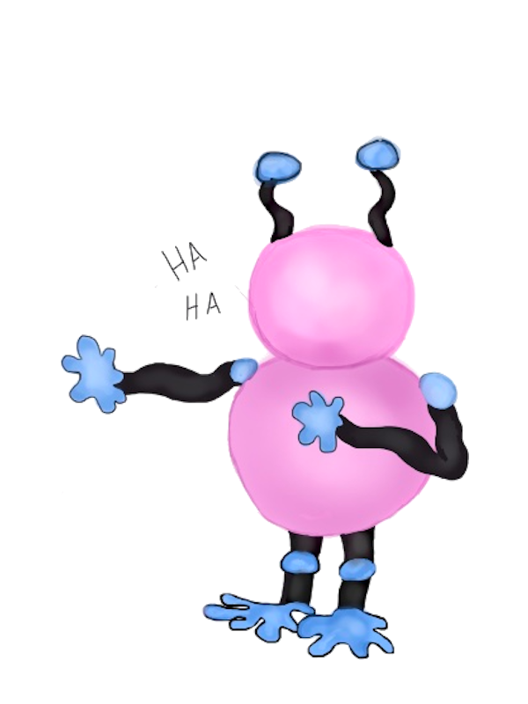

Notes:
13.33 by 7.5
Left: (6.67-6.33)/13.33 = 2.5%
Top: (3.75-2.79)/7.5 = 12.8%
Width: 5.56/13.33 = 42%
Left: (6.67+0.83)/13.33 = 56%
Top: 0%
Width: 2.6/13.33 = 19.5%
Left: (6.67+3.83)/13.33 = 79%
Top: 0%
Width: 2.6/13.33 = 19.5%
Left: (6.67+0.83)/13.33 = 56%
Top: 50%
Left: (6.67+3.83)/13.33 = 79%
Top: 50%
Arrow
Left: (6.67-.5)/13.33 = 46.3%
Top: (3.75-.42)/7.5 = 44.4%
Width: (.46+.71)/13.33 = 8.8%

