Slide 1
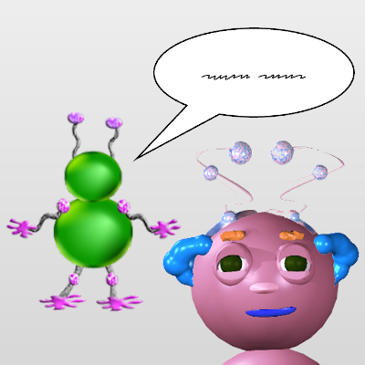

Notes:
To figure out what Wuggle will do next, you’ll have to use what you see in the picture.

Slide 2

1
2
3
4
Notes:
There are four different kinds of pictures.

Slide 3
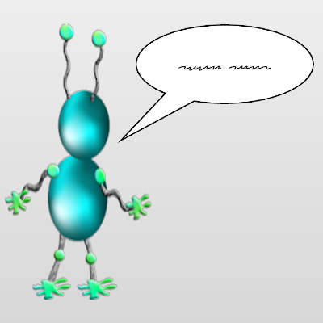
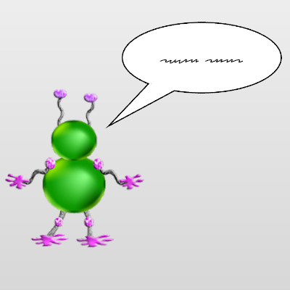
Notes:
In some pictures this wuggle # will be talking to Wiggle.
And in other pictures this wuggle # will be talking to Wiggle.

Slide 4
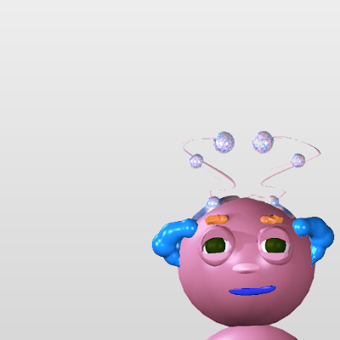

Notes:
In some pictures, Wiggle’s face will look like this. #
And in other pictures, Wiggle’s face will look like this. #

Slide 5
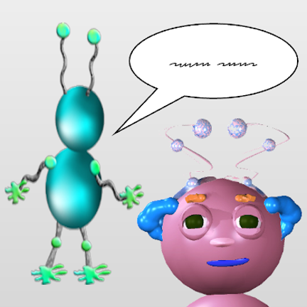
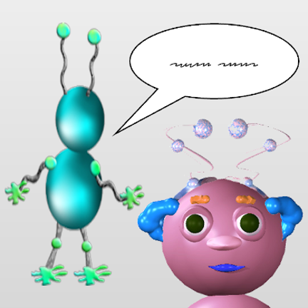
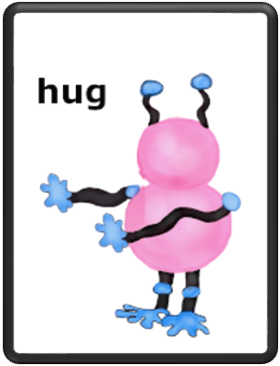
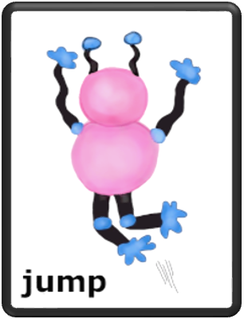
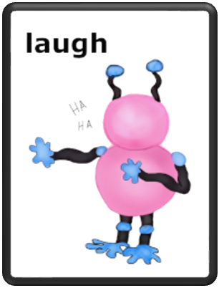



Notes:
For each kind of picture, you’ll have to guess what Wiggle will do next.

