Slide 1
Chosen Set-Up

Slide 2
Notes:
Height: 13.33
Top: (3.75-.5) = 3.25/7.5 = 43.33
Left: (6.67-.5)= 6.17/13.33 = 46.29

Slide 3
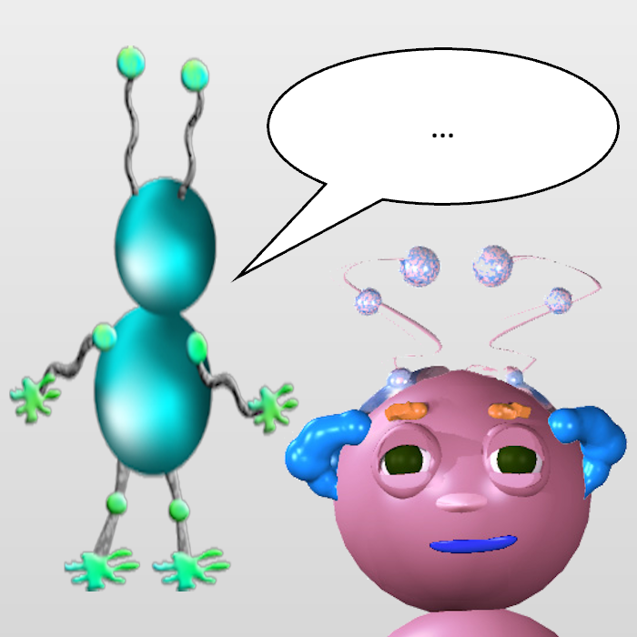
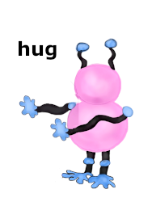
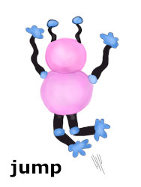
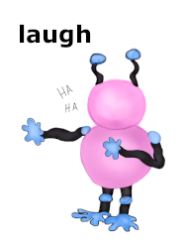
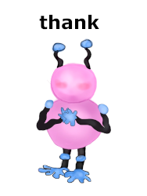
“What will Wiggle do next?”
Notes:
13.33 by 7.5
Picture
Top: 0
Left: (6.67-2.25)/7.5 = 33.13
Height: 4.5/7.5 = 60
Buttons:
Top: 4.75/7.5 = 63.3
Width: 2/13.33 = 15
Left: 14
Left: 33
Left: 52
Left: 71

Slide 4
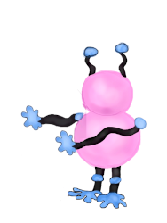
”Wiggle hugged them”
Notes:
Picture
Height: 4.5/7.5 = 60
Top: 1.25/7.5 = 16.67
Left: .88/13.33 = 6.60
Outcome
Height: 4.5/7.5 = 60
Top: 1.25/7.5 = 16.67
Left: 61.55
Arrow
Height: 1/7.5 = 13.33
Top: 3.25/7.5 = 43.33
Left: 45.28

Slide 5
Option 1: Based on current set-up

Slide 6
“What will Wiggle do next?”
Notes:
13.33 by 7.5
Picture
Top: 0
Left: (6.67-2.25)/7.5 = 33.13
Height: 4.5/7.5 = 60
Buttons:
Top: 4.75/7.5 = 63.3
Width: 2/13.33 = 15
Left: 14
Left: 33
Left: 52
Left: 71

Slide 7
“Wiggle hugged them.”

Slide 8
Option 2: Alternate set-up

Slide 9
“What will Wiggle do next?”

Slide 10
”Wiggle hugged them”

