Slide 1


Slide 2


Tell us what
you thought!
Learn to
play!
Game
Part 2
Game
Part 1
END
START
Notes:
Today, you’re going to play a feelings game!
Along the way, you’ll earn trophies to thank you for helping us with science!
Here’s how the game will go:
First, # you’ll learn how to play the game.
Then, # you’ll play the game.`
The game has two parts.
Last, # we’ll ask you some questions about the game.

Slide 3

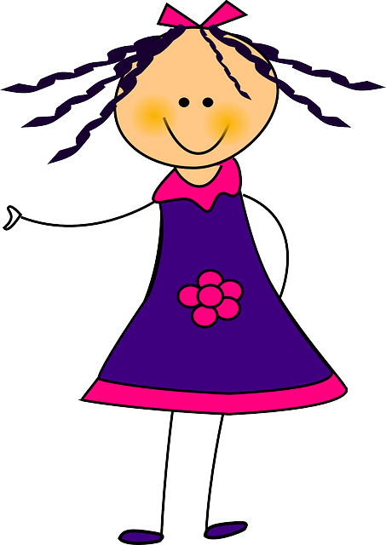
Notes:
In this game, you’ll see a picture of someone feeling a feeling.

Slide 4

Notes:
Your job will be to guess what they will do next.

Slide 5
Notes:
If your guess is right, you’ll hear this sound. [sound]

Slide 6
Notes:
Let’s practice now!

