Slide 1


Slide 2

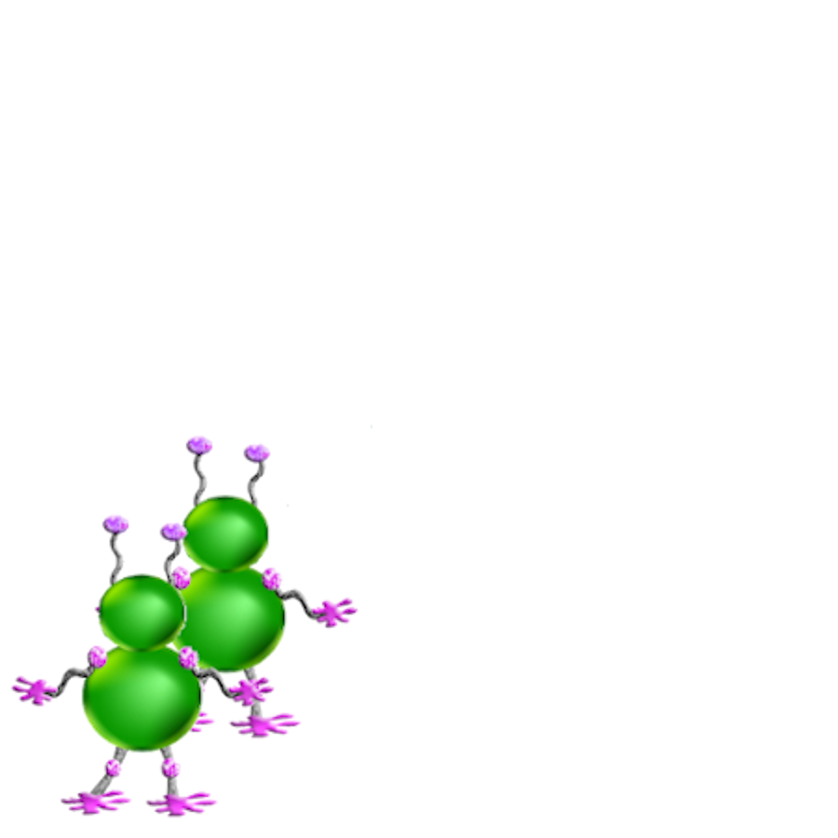



Notes:
There are a lot of different things you can look at in each picture to make your guess.
You can look at where Wiggle is. #
And You can look at who he’s with. #
You can also look at his eyes. #
And at his mouth. #

