Slide 1
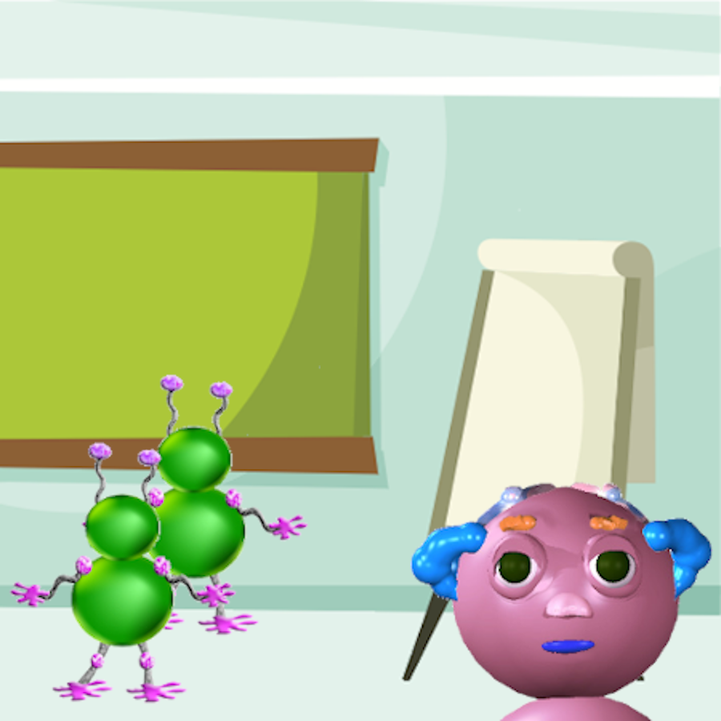

Notes:
When the game starts, you’ll see pictures like this one of a Wuggle named Wiggle.
In each picture, Wiggle will be feeling a feeling.

Slide 2


Notes:
Your job will be to guess what Wiggle will do next.

Slide 3

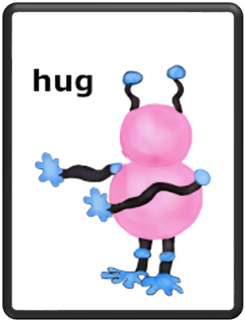
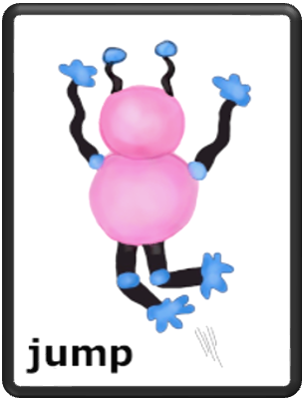
Notes:
You’ll have two choices.
After each picture, Wiggle will either hug another Wuggle or jump up and down.

