Slide 1

Notes:
So the pictures you’ll see in the game will be different from each other in two ways.

Slide 2
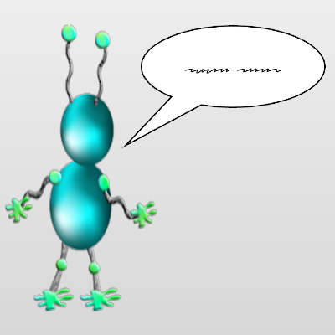
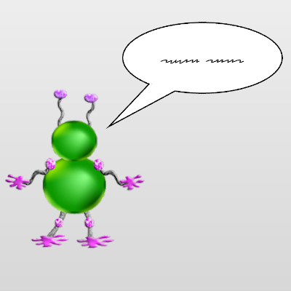
Notes:
First, in different pictures, a different Wuggle will be talking to Wiggle.

Slide 3
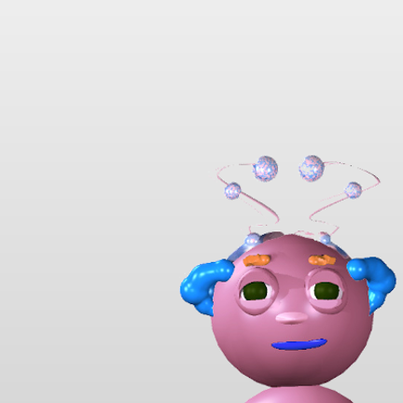

Notes:
Second, in different pictures, Wuggle’s face will look different.

Slide 4
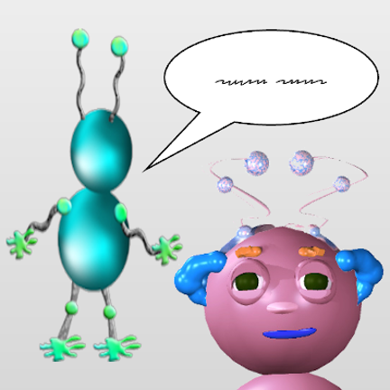
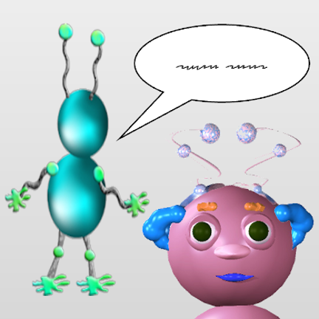
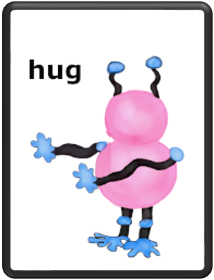
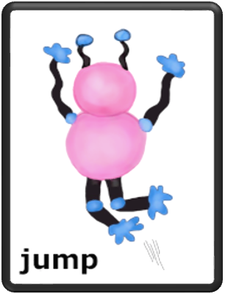
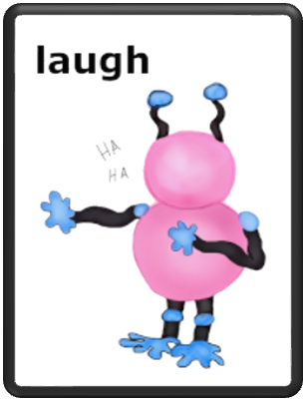
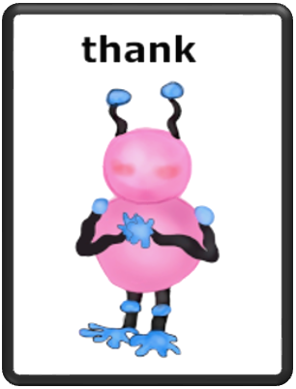
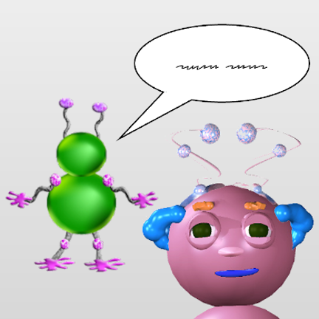

Notes:
For each kind of picture, you’ll have to guess what Wiggle will do next.
All of the kids who play this game start by just guessing what Wiggle will do next. They usually get a lot of questions wrong at first. And that’s totally okay!
See if you can make your guesses better as the game goes on. And remember, your only job is to try your very best.

