Slide 1

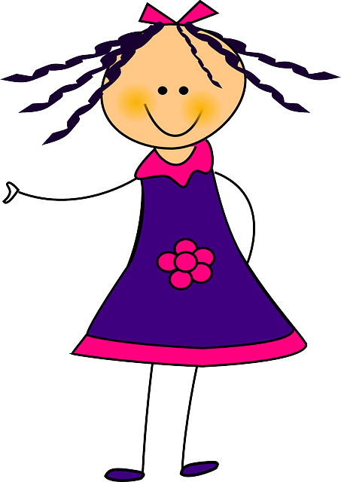

Notes:
In this game, you’ll see a picture of someone feeling a feeling.

Slide 2

Notes:
Your job will be to guess what they will do next.

Slide 3
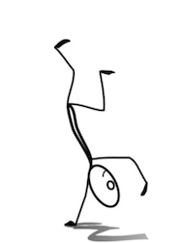
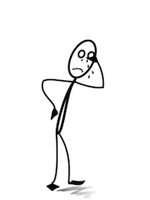
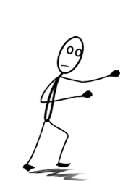
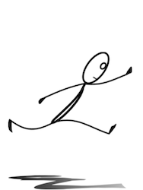
Notes:
You’ll have four choices.
After you guess, we’ll tell you whether you were right, and show you what they did next.
Let’s practice now!

