Slide 1


Notes:
Today, we need your help.

Slide 2
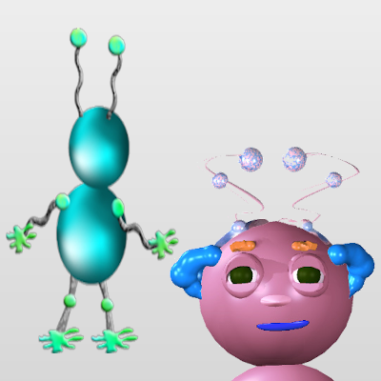
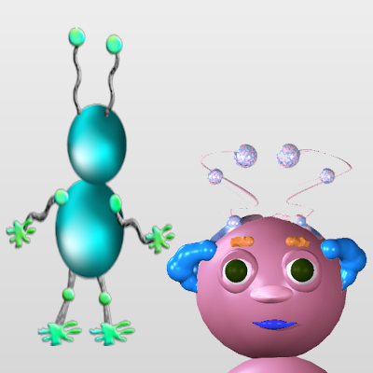
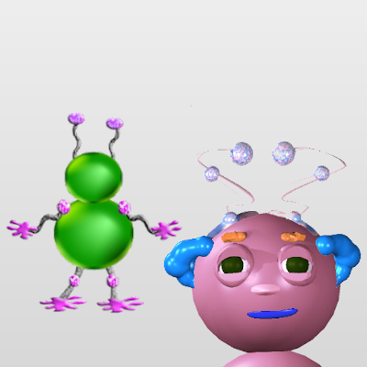

Notes:
We have a lot of pictures of a Wuggle named Wiggle.

Slide 3
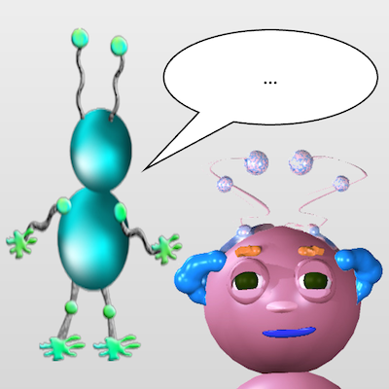
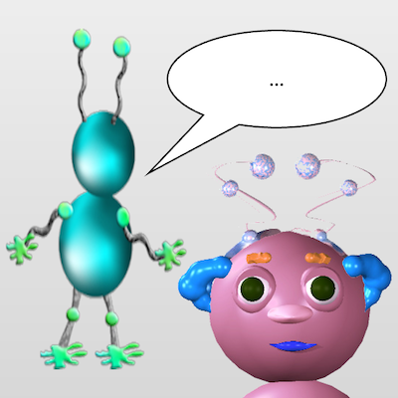
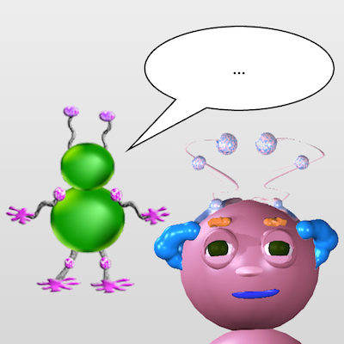

Notes:
In all of these pictures, another Wuggle is talking to Wiggle.
But we don’t know what that Wuggle just said to Wiggle, because we don’t speak Wugglese!

Slide 4

Notes:
So we need your help guessing what Wiggle will do next.

Slide 5
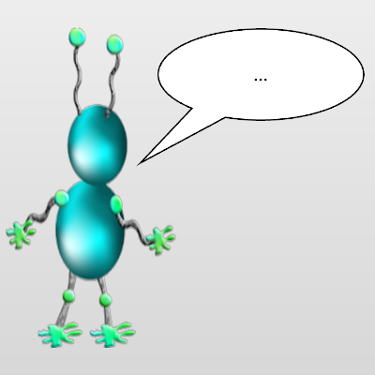
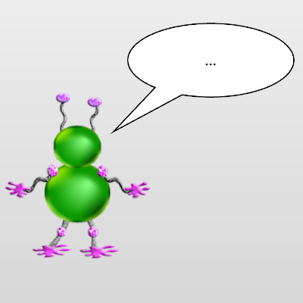
Notes:
In some pictures #, this wuggle will be talking to Wiggle.
And in other pictures #, this wuggle will be talking to Wiggle.

Slide 6
Notes:
In some pictures #, Wiggle’s face will look like this.
And in other pictures #, Wiggle’s face will look like this.

Slide 7

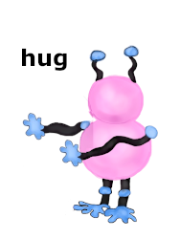
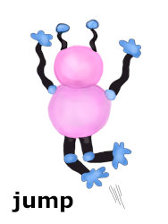
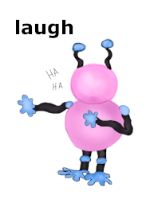
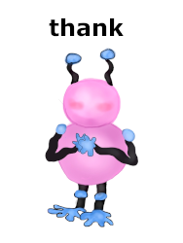
Notes:
After each picture #, there are four different things Wiggle might do.
# Wiggle might hug the other Wuggle.
# Or he might jump up and down.
# Or he might laugh.
# Or he might say thank you to the other Wuggle.

Slide 8
Notes:
In the game, you’ll have to guess which of these four things Wiggle will do next after each kind of picture.

