Slide 1
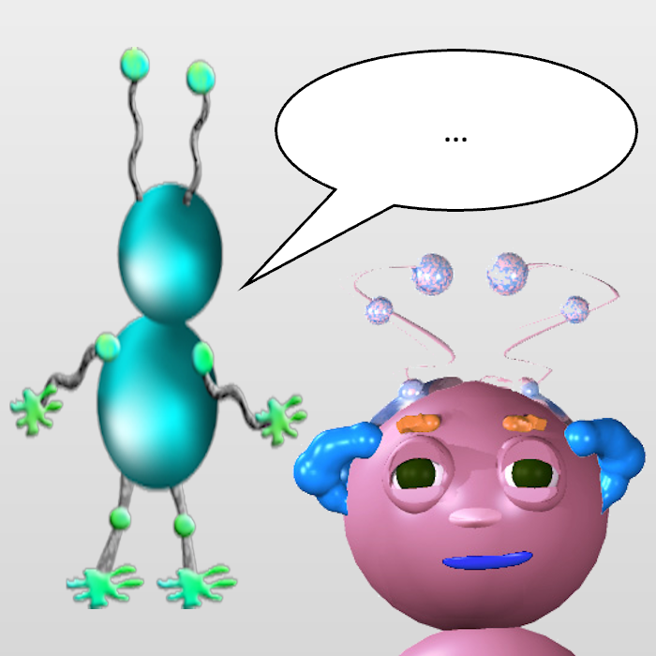

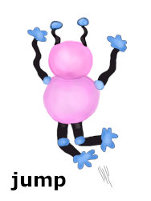
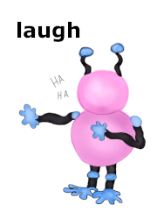

Notes:
13.33 by 7.5
Picture
Top: 0
Left: (6.67-2.25)/7.5 = 33.13
Heigh: 4.5/7.5 = 60
Buttons:
Top: 4.75/7.5 = 63.3
Width: 2/13.33 = 15
Left: 14
Left: 33
Left: 52
Left: 71

Slide 2
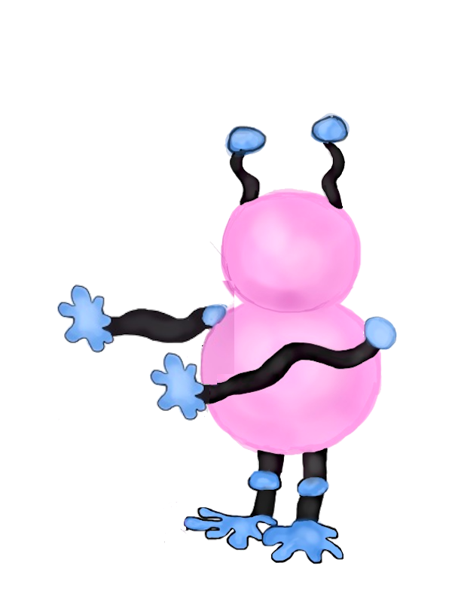
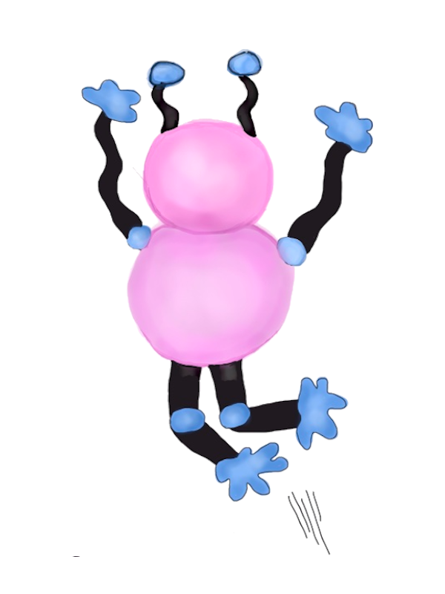
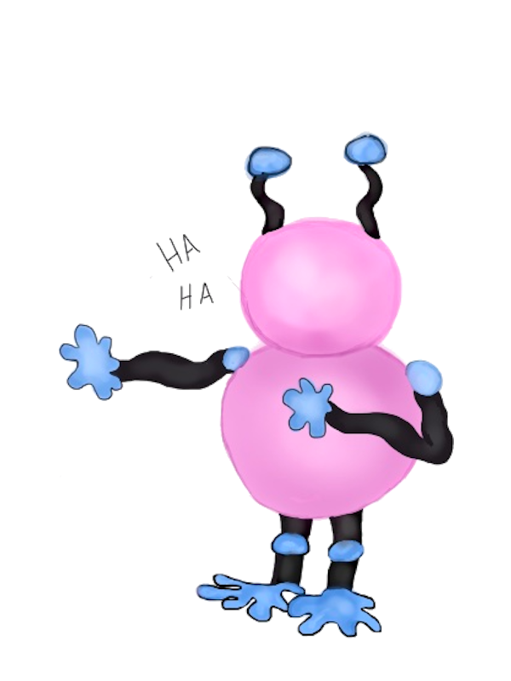

Notes:
13.33 by 7.5
Left: (6.67-6.33)/13.33 = 2.5%
Top: (3.75-2.79)/7.5 = 12.8%
Width: 5.56/13.33 = 42%
Left: (6.67+0.83)/13.33 = 56%
Top: 0%
Width: 2.6/13.33 = 19.5%
Left: (6.67+3.83)/13.33 = 79%
Top: 0%
Width: 2.6/13.33 = 19.5%
Left: (6.67+0.83)/13.33 = 56%
Top: 50%
Left: (6.67+3.83)/13.33 = 79%
Top: 50%
Arrow
Left: (6.67-.5)/13.33 = 46.3%
Top: (3.75-.42)/7.5 = 44.4%
Width: (.46+.71)/13.33 = 8.8%

