Slide 1
Preservation Capability Miscellany
By Ross Spencer
Twitter: @beet_keeper

Slide 2
A brief ‘provenance’ note…

Slide 3























Slide 4
2014-06-20: Play It Again Conference Report: http://bit.ly/2d8Bnw0
(playitagain.org)
2014-11-25: The Reality of Digital Transfer:
http://bit.ly/2ctxocQ
(slideshare.net)

Slide 5
We (Archives NZ) have got quite far… But there's still a lot more to do…

Slide 6
So let's remind ourselves: What is the point?
Work in concert with agencies and their consultants.
Generate better information and records management
Cleaner transfers...
Create a more open and transparent government where the digital record is concerned...
DIA’s line... Support New Zealanders to build strong communities by providing access to trusted information and knowledge.

Slide 7
And! Digital Preservation
At this point in time, idiomatic methods of preservation are still forming...
Whatever the future of archival custodianship...
Or the future of digital preservation...
Techniques need to be developed to support agencies with information and records management, and memory institutes with long-term custodianship.
Don't fall into the processing trap...

Slide 8
What can we identify as important?
Infrastructure/team, supported by the organisation
Some things work, some don’t; some change... be flexible.
Look at what you can do...
Continue to develop... evidence, real use-cases
Work iteratively...

Slide 9
Is it all there for us..?

Slide 10
No, but we have a good foundation…

Slide 11
Policy...
Has been a constant in my time here.
Was a draw to me starting in NZ
Sets the rules by which we can play…
Literally, play: bend don’t break
Achieved through careful stakeholder consultation and consideration of impact.
Sign-off process at director level.
Two favourite policies, checksum, pre-conditioning.

Slide 12
Team...
We could always do with more people…
But we recognise that we've been allowed more folk dedicated to this than some places.
The team is supported in their decision making and their skills.
Breakdown: Curious; driven; up-to-date; drive to ‘solve’ born-digital transfer; different but complementary skills… *passion*!
(And opinionated! ;-) )
It doesn’t always look that way but there is a certain amount of leeway from IT support too...

Slide 13
Technology...?
Rosetta by Ex-Libris: is the Long-term preservation system, it allows us to manage some quite complex bits 'n' pieces… but:
Does not yet enable transfer from Agency-to-Archives (it supports)
Is not a clearing house for records
Spot preservation risks up-front
Doesn't 'do' sentencing…
Does not build ingest packages…
Does not 'do' archival description...
Does not contain every tool under the sun to handle all the file formats…
Machine Learning: http://nautil.us/blog/the-fundamental-limits-of-machine-learning

Slide 14
The processes we need are biased toward transfer and ingest…
Rosetta can only help so much…
The other processes we will still need will be about (active) long term custodianship…
Rosetta is still only beginning that journey...
||---------------- ||---------------------------------------------------------------------------------------------------||
Creation Transfer (Life of a record ~25 years) Life of an archive ~∞

Slide 15
The miscellany in this presentation...
A story about the tools that can help us...
Technical Registries (of practice)
DROID/Siegfried Analysis Report
Fuzzy Hashes

Slide 16
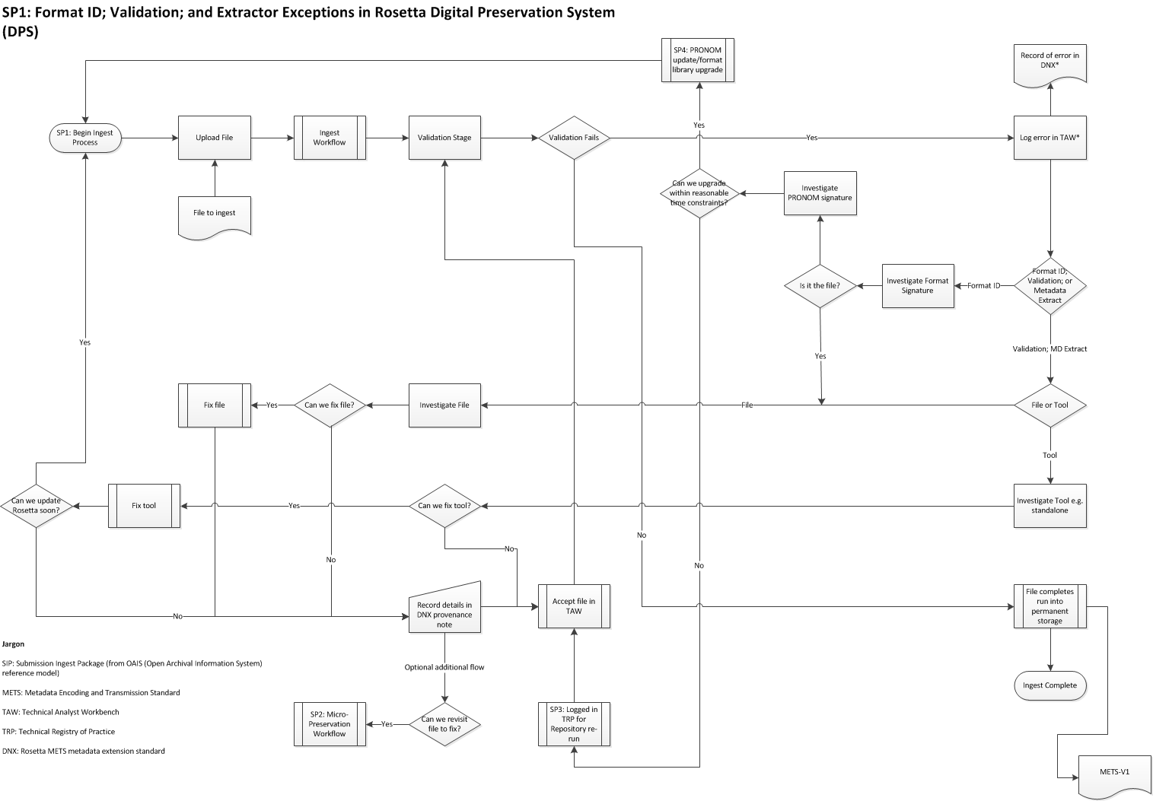

Slide 17
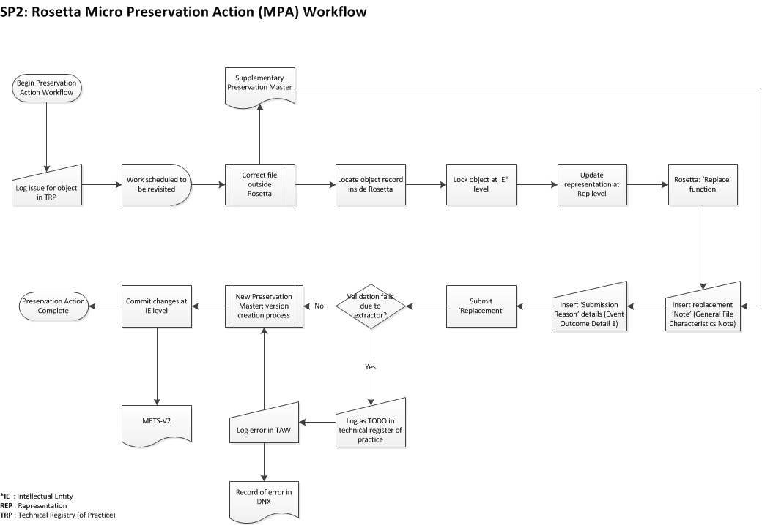

Slide 18
With everything we need to do…
We cannot action it all at the same time...

Slide 19
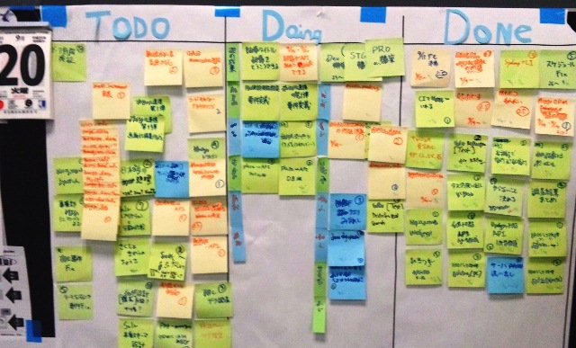
Knowledge needs to remain alive and accessible, record it:
Source: https://commons.wikimedia.org/wiki/Category:Kanban#/media/File:Simple_Task_Kanban.jpg

Slide 20
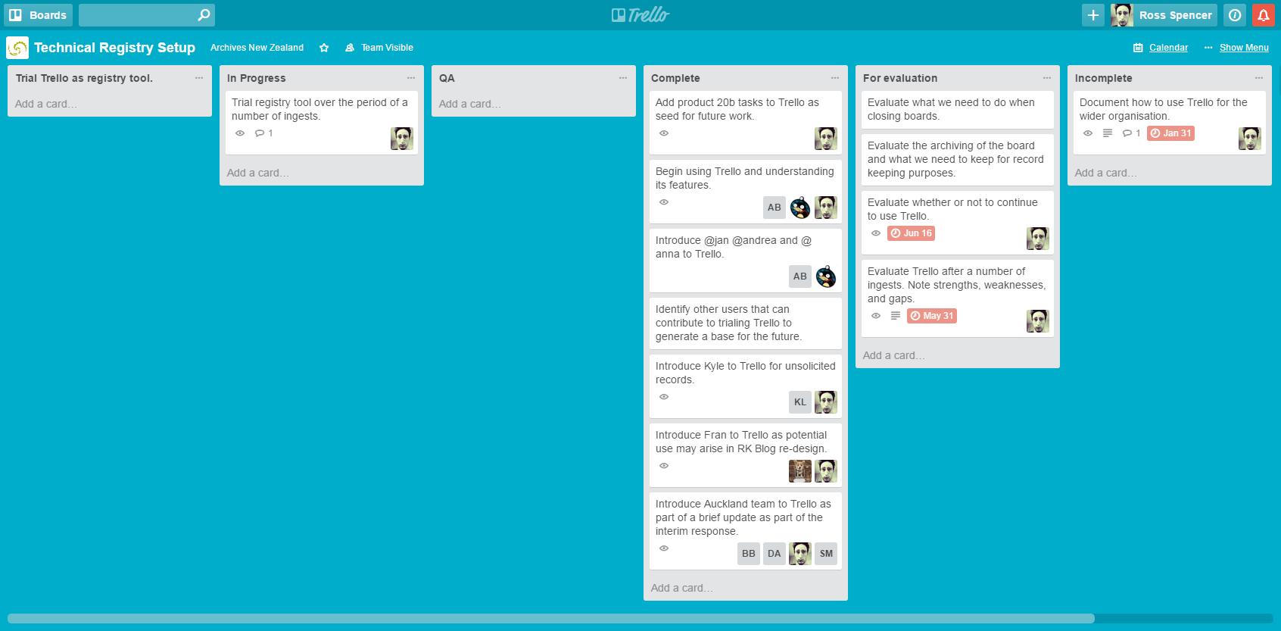
Trello: is one option...

Slide 21
Features...
Kanban
Teams
Ownership
Visibility
Accessibility
Reduce transitory records
Create temporality
Centralize knowledge
Invite external colleagues

Slide 22
DROID/Siegfried Analysis Report
Example of changing needs and capability
Initially a plain-text reporting tool
Evolved into a 'team' tool…
Evolving into an organisation’s tool…
Hopefully a community tool…
Our first port of call for any transfer...
* Marriage of DROID and Siegfried: http://bit.ly/2ddS0IP
* A little bit more about the tool: http://bit.ly/2dii3jP

Slide 23
DROID/Siegfried Analysis Report
Available to all the community (December 2013): http://bit.ly/2cB8gFY
Maps DROID and Siegfried output to an SQLite database for querying power and speed.
Aside from Python, ZERO-dependencies – user needs to be able to download it and go...
Complete flexibility over output.
TXT, HTML, Rogues, Heroes… Normalization via database layer – write your own!
Normalization via database layer – abstracted for multiple ID tools
The tools each do what they're supposed to well, the dissection of output can be left to others.
* Marriage of DROID and Siegfried (OPF Blog): http://bit.ly/2ddS0IP
* A little bit more about the tool (OPF Blog): http://bit.ly/2dii3jP

Slide 24
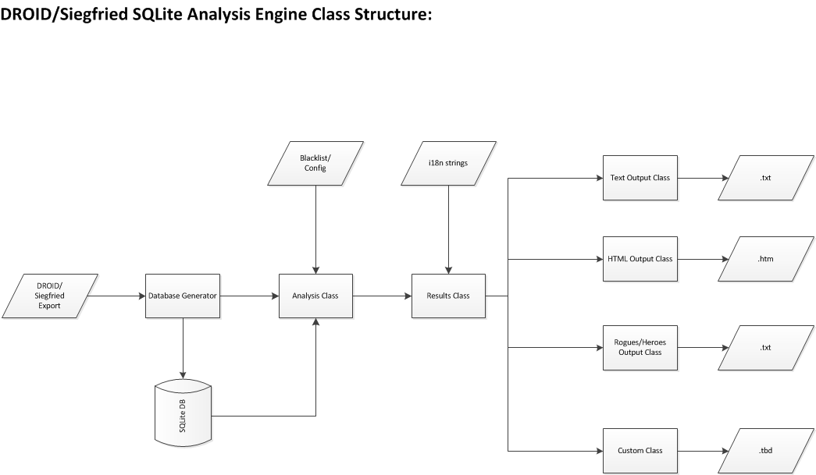

Slide 25
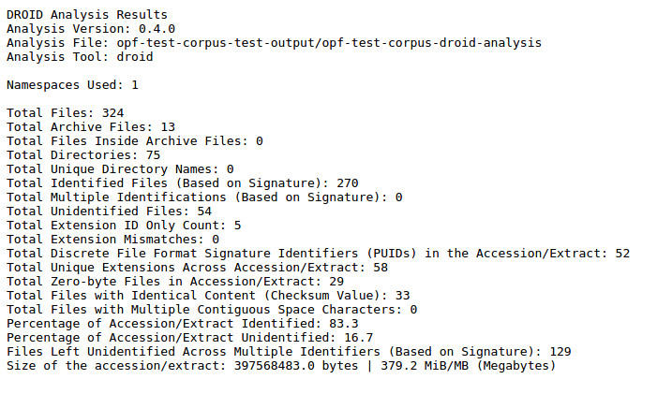
Plain-text example...

Slide 26
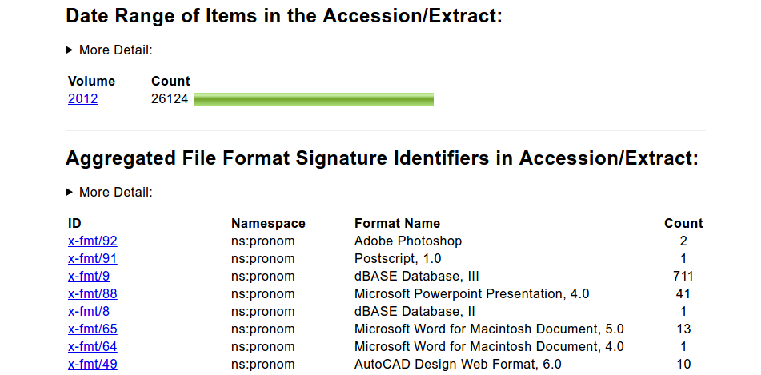
HTML Example…

Slide 27
Let’s have a look…
http://bit.ly/2dircst

Slide 28
Benefits...
Sets a baseline for a lingua franca… beginners and experts alike...
Definitions contributed by our archivists!
Easier on the eye
Re-factored to be more flexible
Give it a try! Let us know how it goes!

Slide 29
Checksums
Look like:
  MD5: d41d8cd98f00b204e9800998ecf8427e
  SHA1: da39a3ee5e6b4b0d3255bfef95601890afd80709

Slide 30
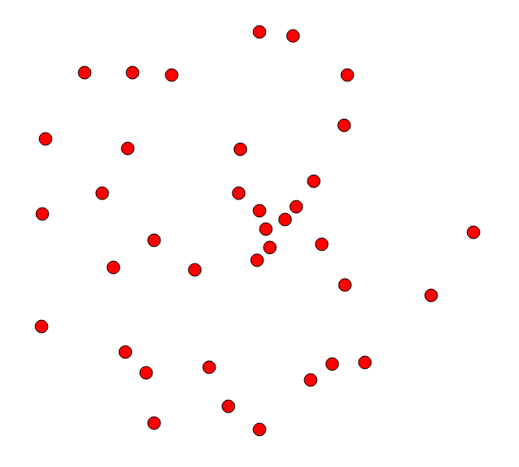
Checksums

Slide 31
Checksums
Looking to be unique
  De-duplication
  Fixity
No connection between
  Security function
  Cannot reverse

Slide 32

But every file has a connection...
Binary
File Format
Textual Content
Embedded Content
Template
Author
Like DNA, with many different strands to dissect...
Fuzzy Hashing!

Slide 33
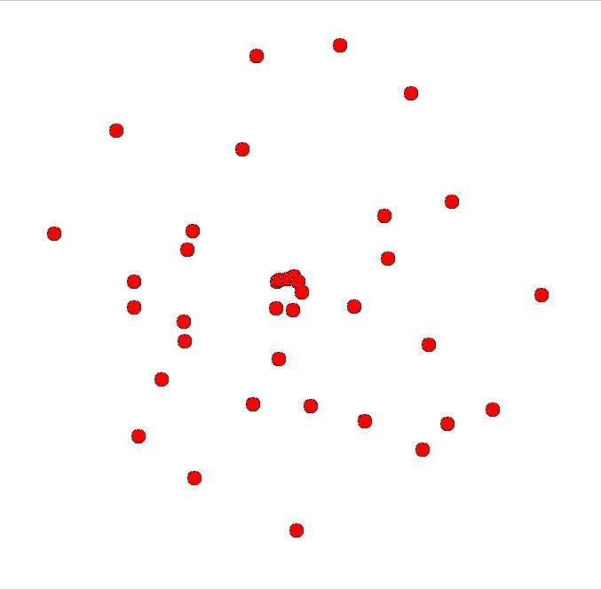
Fuzzy Hashing: SSDEEP
Source: https://github.com/KLDavies/ssdeep/

Slide 34
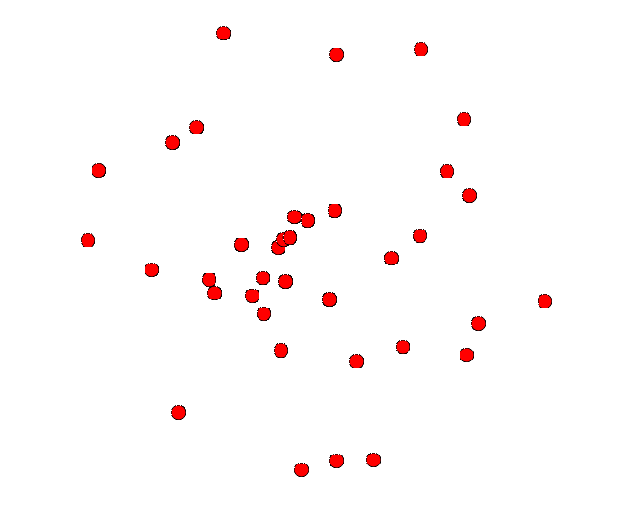
Fuzzy Hashing: tlsh
Source: https://github.com/trendmicro/tlsh

Slide 35
And they look like...
aad371039d588b43e02887f87e570f6d2b1a7f1da89667ef11227d9b3e706610d8e12d
0dc36013dd088b43e02983f87e534e6d2b1a7f1da88627ef11267d8b3e716610d9e16d
Not that different from regular checksums!
But help us to demonstrate a closer relationship between files…
“The sum of the parts is greater than the whole.”
  ~ Arist!otle

Slide 36
Which we're about to find out!

Slide 37
Workshop!

Slide 38
Results!
CODE | SSDEEP | TLSH | Code | Source | Code | Target
0x01 | 96 | 11 | E2 | Backup of NZ Music Month quiz questions 2006.wbk | E2 | NZ Music Month quiz answers 2006.doc
0x02 | 100 | 11 | E4 | key reaction.doc | E4 | mccarthyism.doc
0x05 | 100 | 17 | E4 | election date.doc | E4 | stalactites.doc
0x06 | 100 | 19 | E4 | dhb changes draft.doc | E4 | taiwan national day.doc
0x07 | 100 | 23 | E4 | kiwisaver amendment.doc | E4 | belgrave.doc
0x08 | 96 | 25 | E2 | 081308 - Study shows, auckland packed with entrepreneurs.doc | E2 | 080507 - new prison welcomed.doc
0x09 | 82 | 28 | E3 | Grey Power Manawatu 15 July.doc | E3 | OSC brief copingwithoutcar 7Jul05.doc
0x0A | 100 | 35 | E4 | zero tertiary fees.doc | E4 | dhb changes.doc
0x0B | 96 | 44 | E1 | Waitangi day Atawhai opening.doc | E1 | Suter Art Gallery .doc
0x0C | 36 | 45 | E4 | supreme court.doc | E4 | air nz future.doc
0x0D | 60 | 60 | E2 | Tui NZ music awards 10May02.doc | E2 | Bike regs.doc

Slide 39
Results!
CODE | SSDEEP | TLSH | Code | Source | Code | Target
0x0E | 96 | 61 | E1 | Backup of Ruataniwha speech 2.wbk | E1 | Speech notes - Fishermen's Daughters 2008.doc
0x0F | 96 | 77 | E1 | Arts Pasifika Awards 2007 .doc | E1 | Speech notes - Fishermen's Daughters 2008.doc
0x10 | 66 | 107 | E2 | New NZSO CEO 8May02.doc | E2 | NZ music a hit in New Yorkl.doc
0x11 | 60 | 126 | E2 | Tui NZ music awards 10May02.doc | E2 | te papa 05.doc
0x12 | 47 | 144 | E2 | Geographical Indications 04.DOC | E2 | Auckland roading projects start 21Nov03.doc
0x13 | 25 | 188 | E2 | Otago Heritage Seminar 10Oct02.doc | E2 | Sarjeant gallery.doc
0x14 | 25 | 215 | E2 | Otago Heritage Seminar 10Oct02.doc | E2 | Sargent gallery.doc
0x15 | 82 | 14 | E2 | Sarjeant gallery.doc | E2 | Sargent gallery.doc

Slide 40

How can we use this?
Sentencing... while still teaching our machines, we can still close the net while looking at records manually…
Discovery: Amazon like results: You might also like this record!

Slide 41
The experiment continues...
Matches are relative to themselves...
Algorithms make a difference...
And perhaps, like genetics... some traits are more dominant than others...
Consider working with content in different ways...
  Utilize format bias... normalize
  Separate content from structure and analyse?
Keep trying things, but at minimum cost... (another agile concept: minimal viable product)

Slide 42
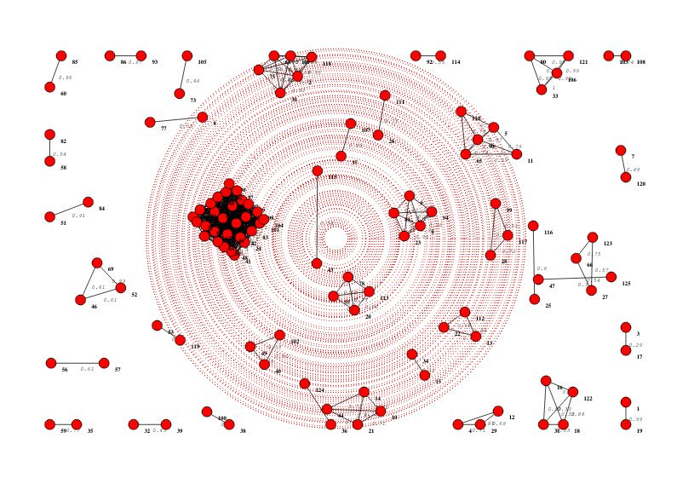

Slide 43
Conclusion: A bit more miscellany
Keyword: Interim
Our needs change constantly, and there's a lot to do…
Don't suffer paralysis by analysis.
Do a requirements analysis
Look at what you can do (minimum viable product) and iterate...

Slide 44
Conclusion: A bit more miscellany
Lot's of hints to bits 'n' pieces I haven't been able to talk about:
    Role of the community… (They/We're here to help! Same problems!)
    Communication and sharing… (Do it!)
    Software development skills… (There are other ways to be involved)
Maybe also a seed for discussion.
What's the point? (OPF Blog): http://bit.ly/2ddXnaY

Slide 45
Thank you!

