Slide 1
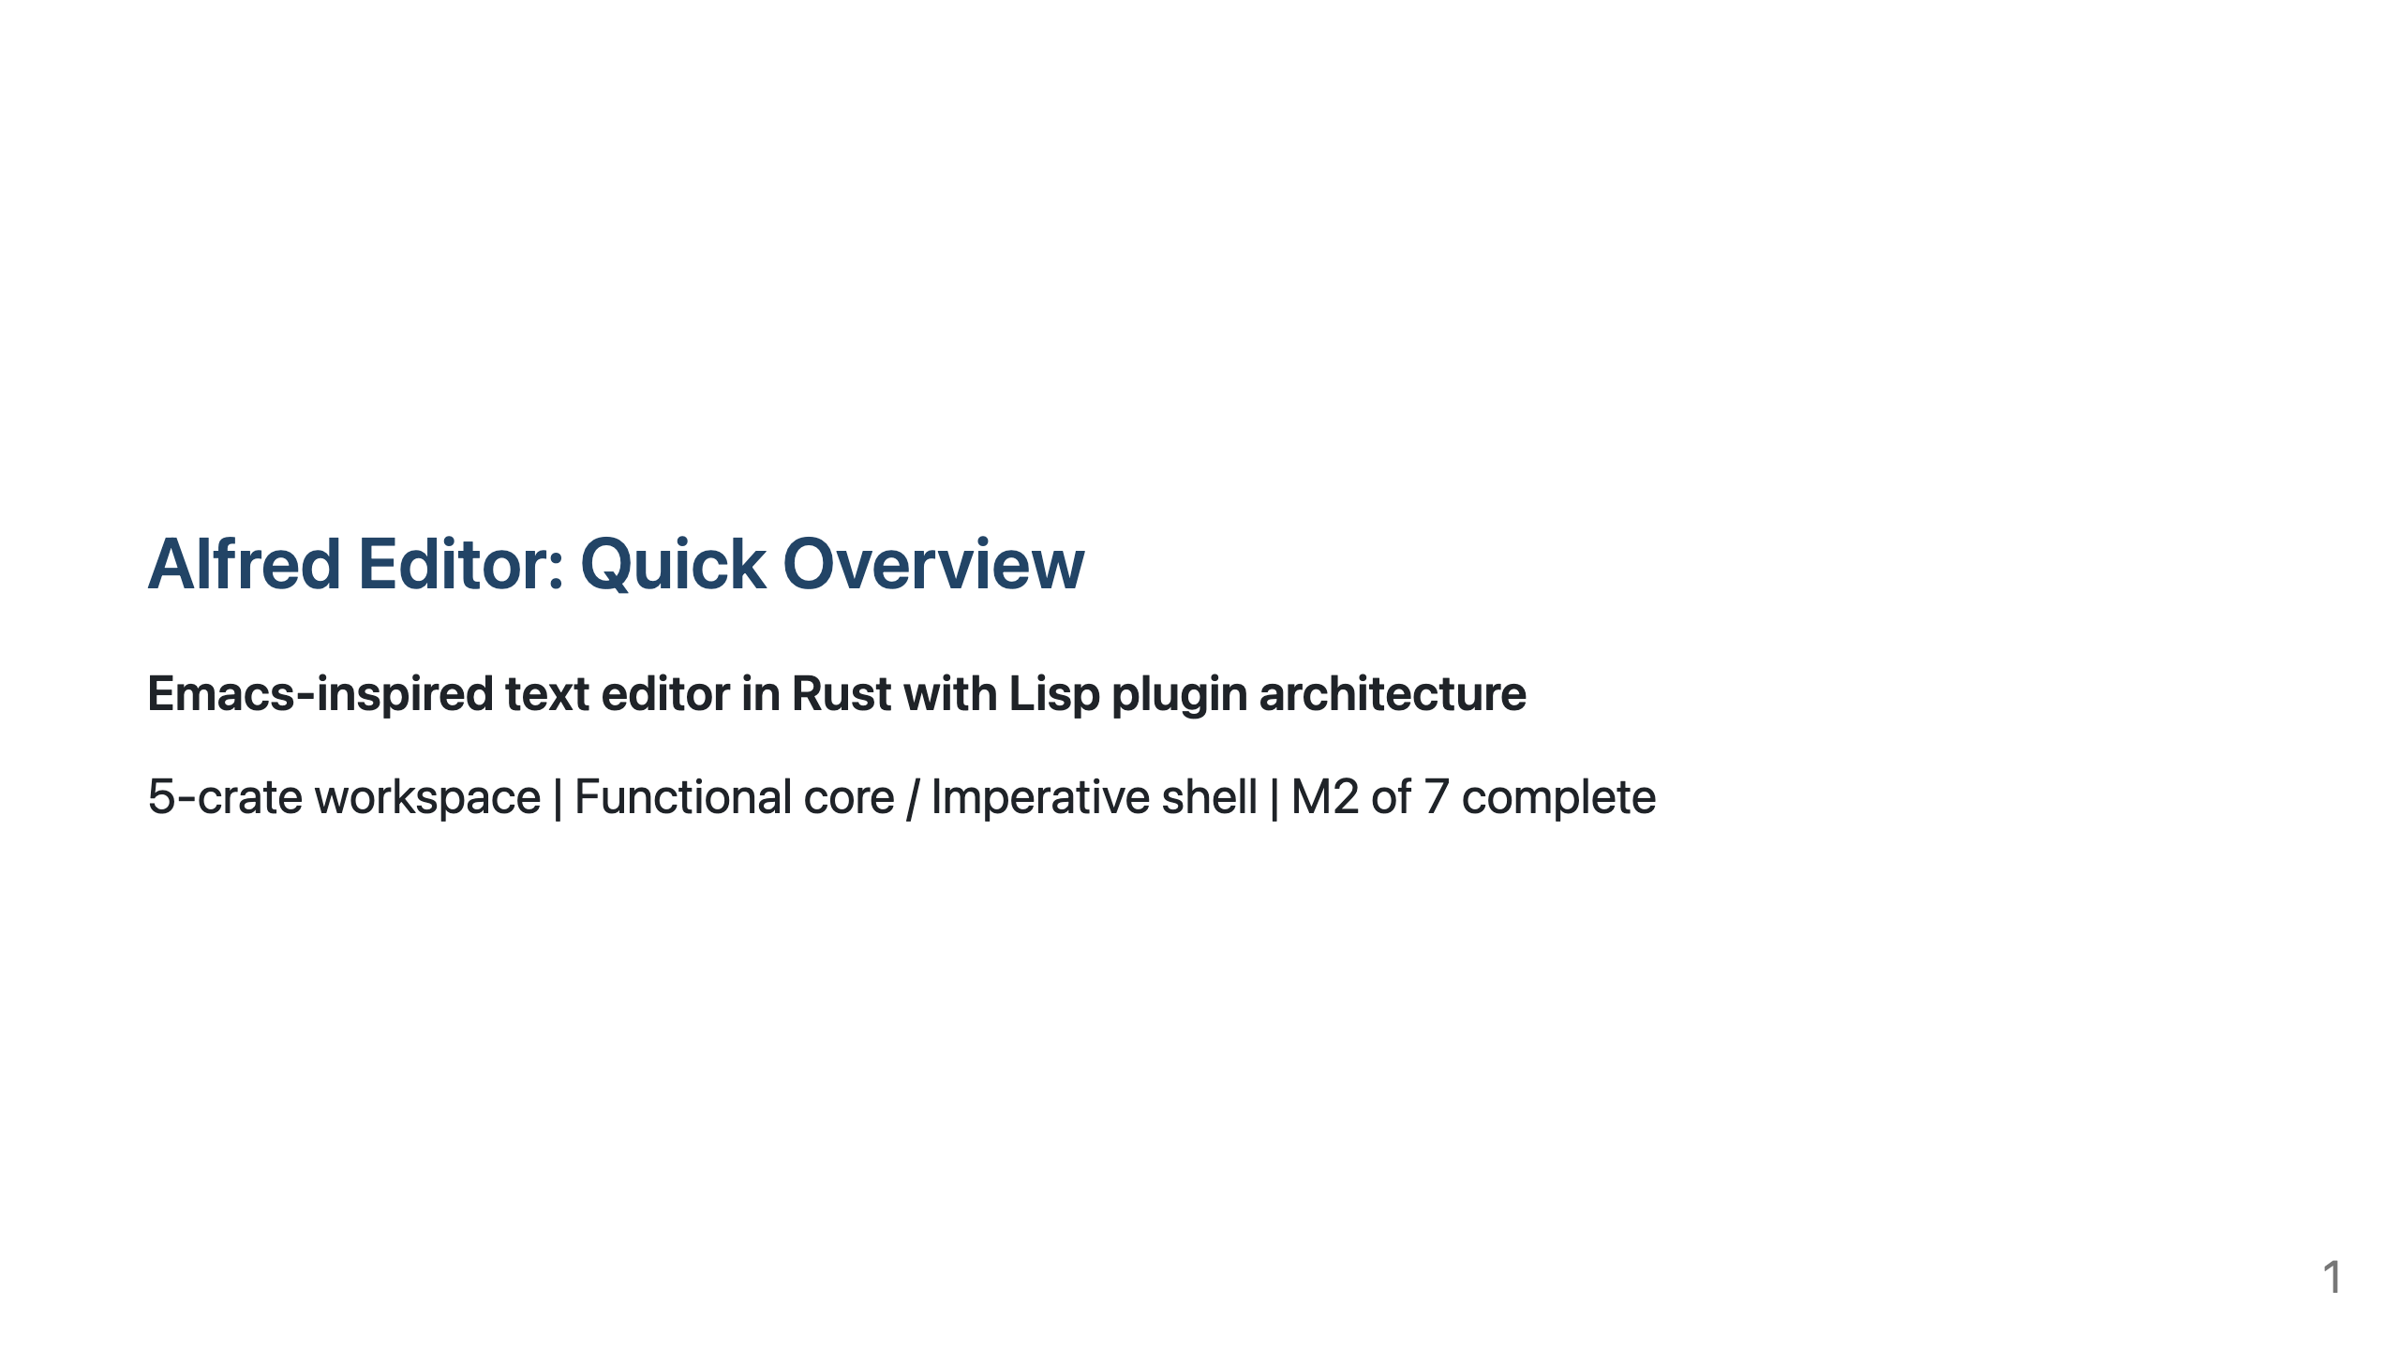
Notes:
Slide 1 Presenter notes: Quick 10-minute overview for anyone needing context on the Alfred project. For deep-dives into specific areas, see the full walkthrough deck.

Slide 2
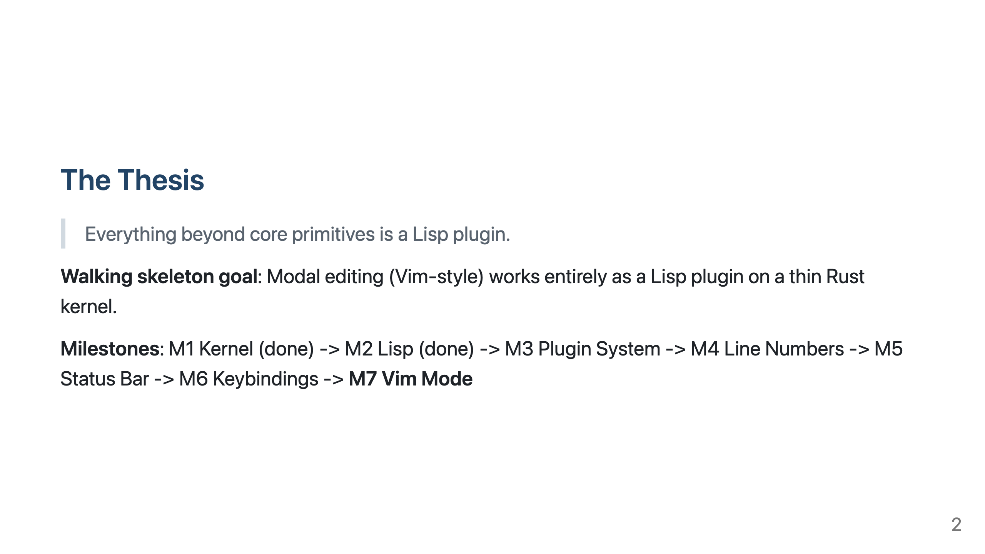
Notes:
Slide 2

Slide 3
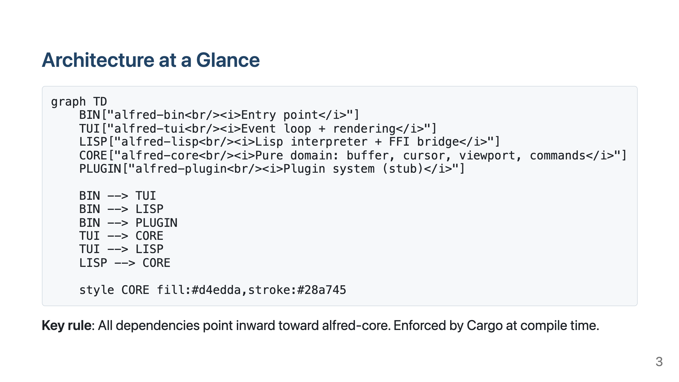
Notes:
Slide 3

Slide 4
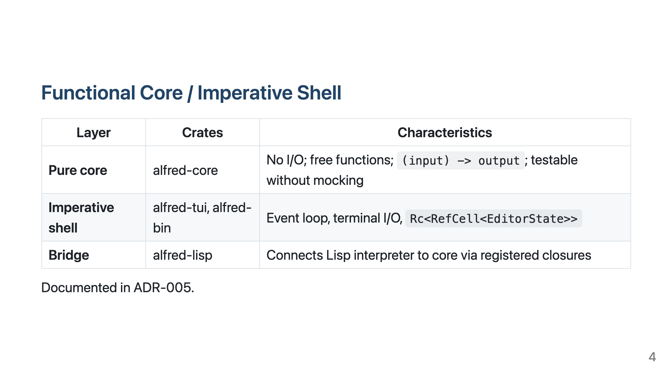
Notes:
Slide 4

Slide 5
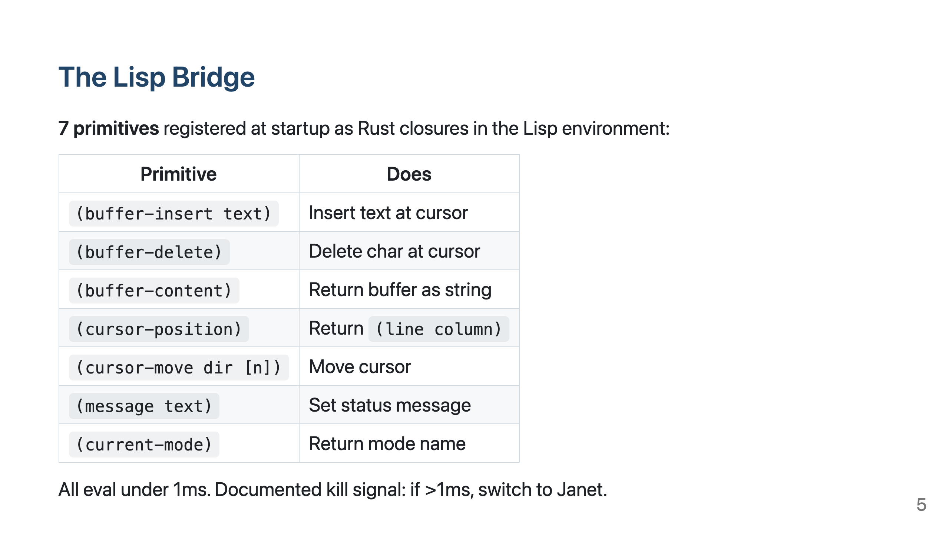
Notes:
Slide 5

Slide 6
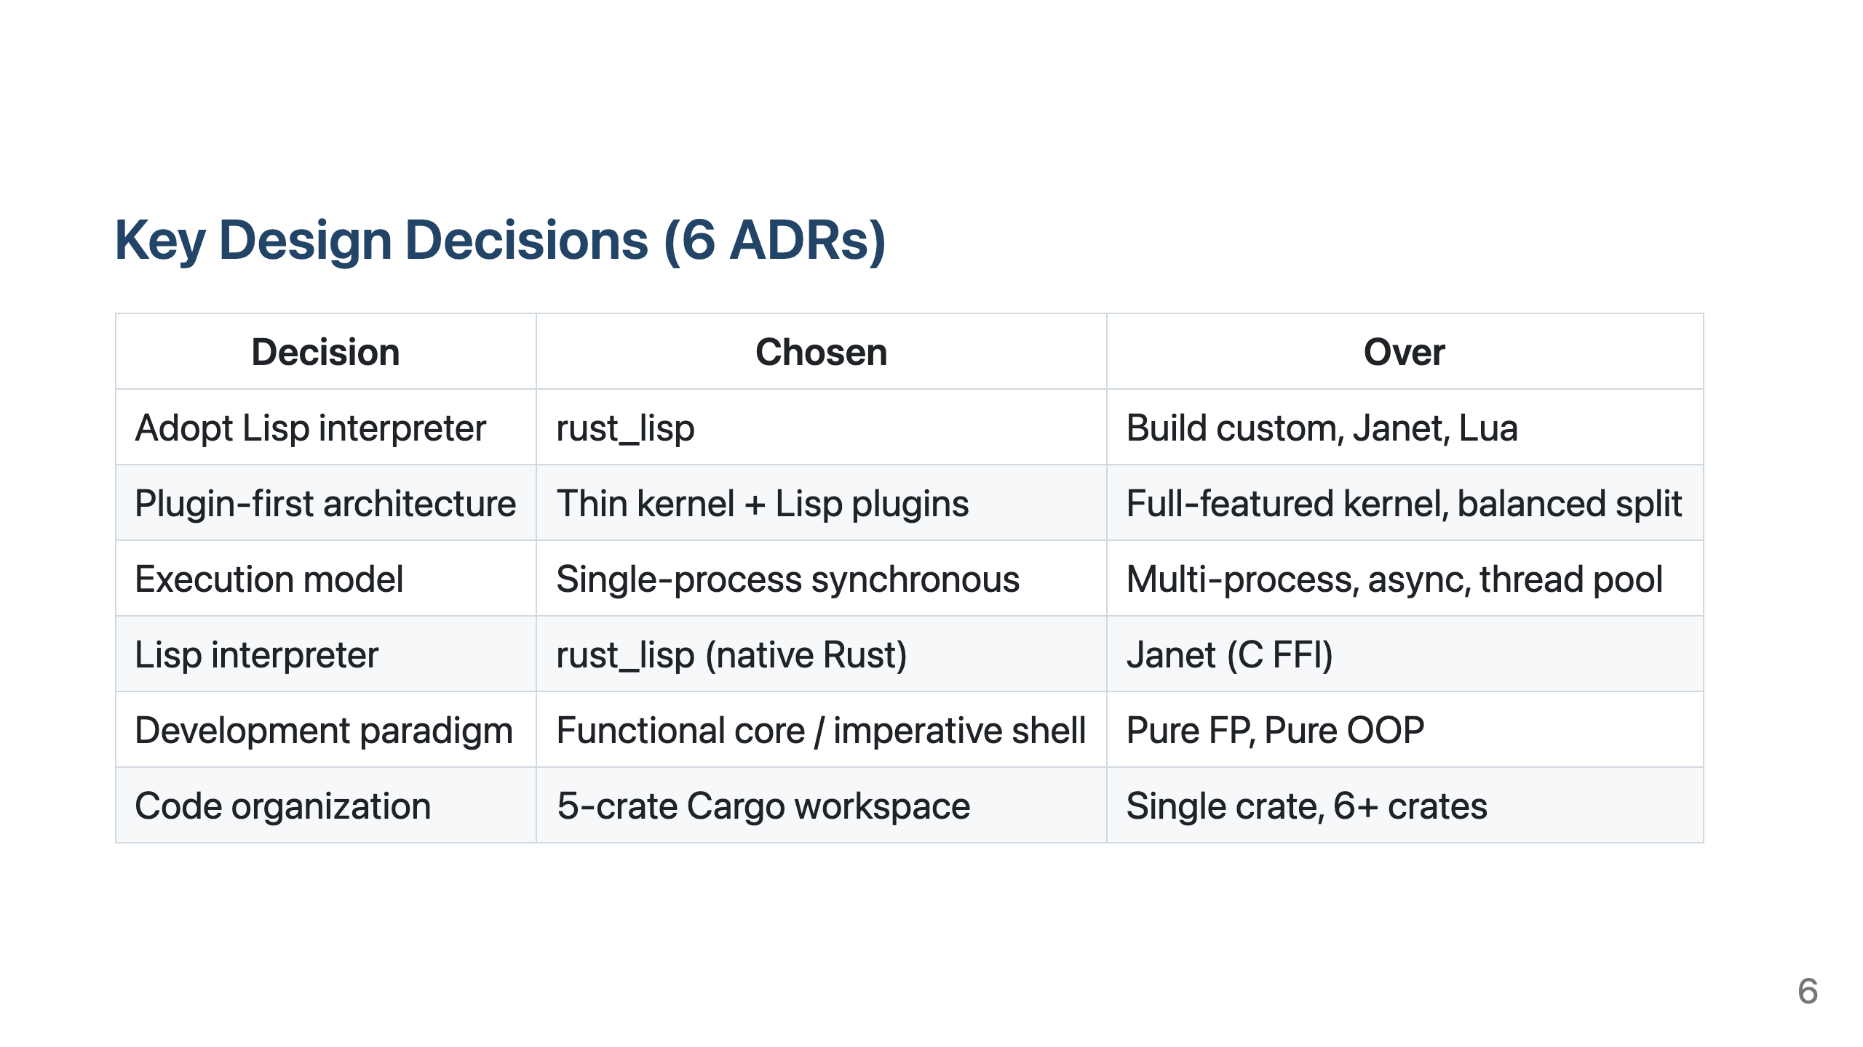
Notes:
Slide 6

Slide 7
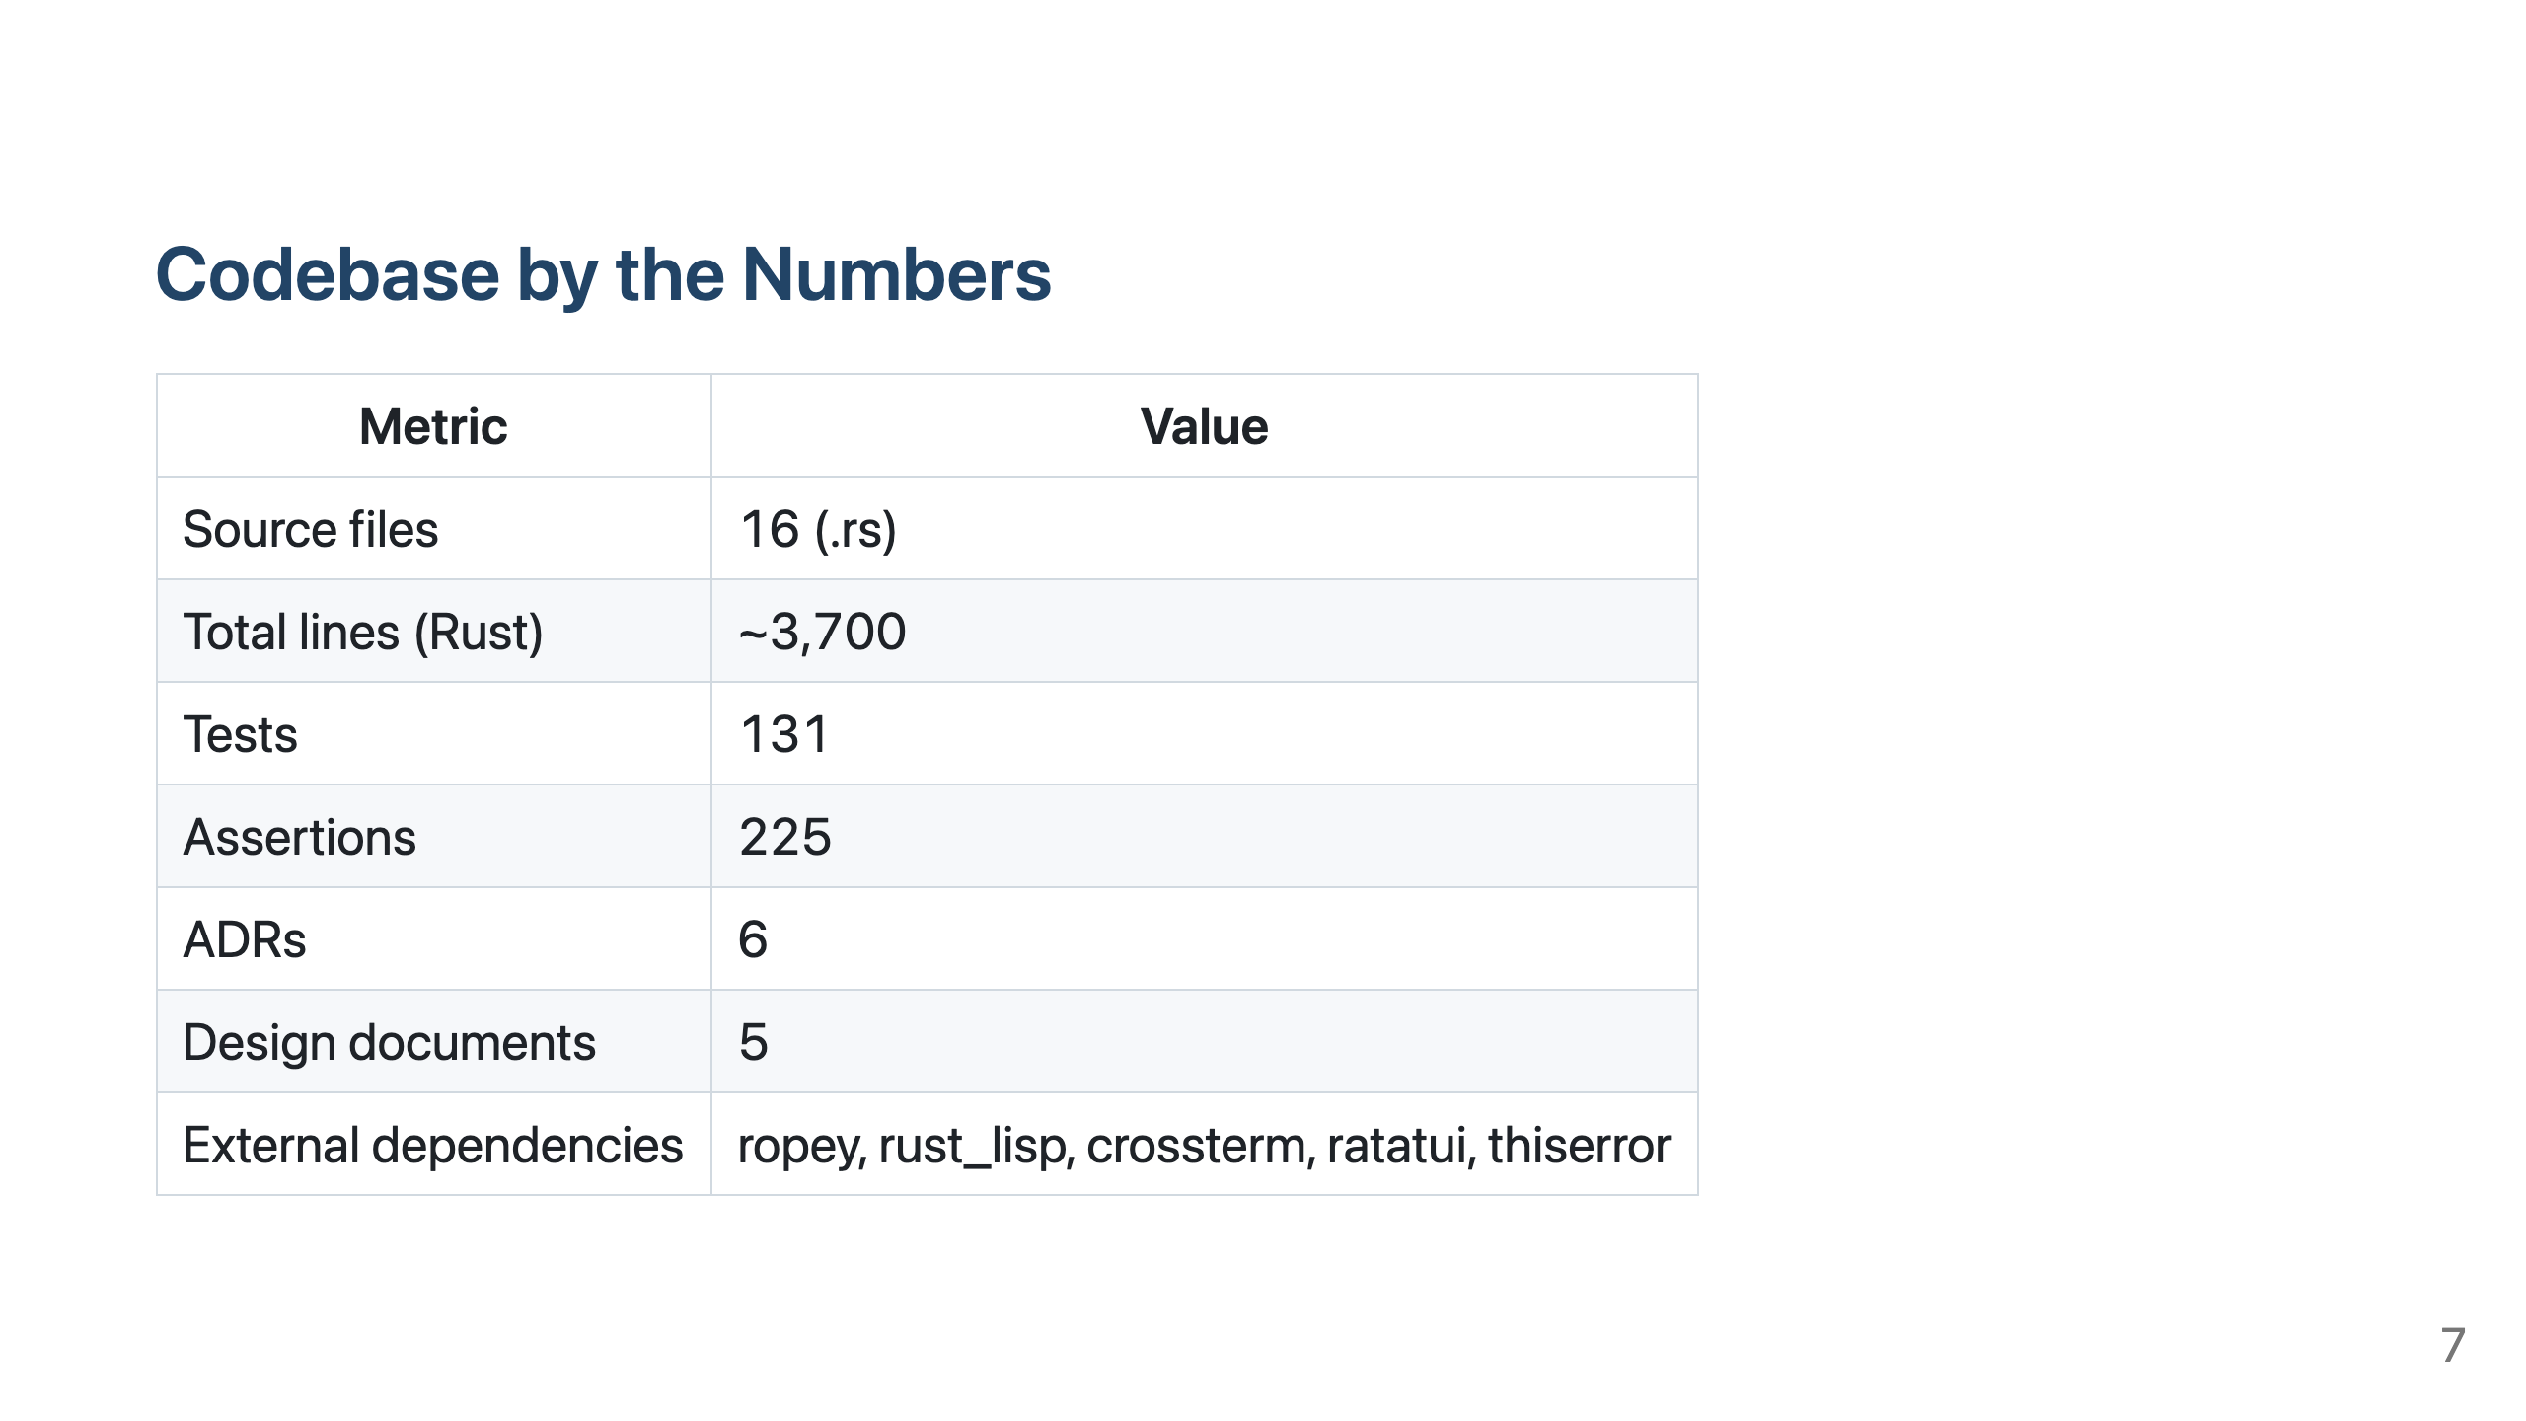
Notes:
Slide 7

Slide 8
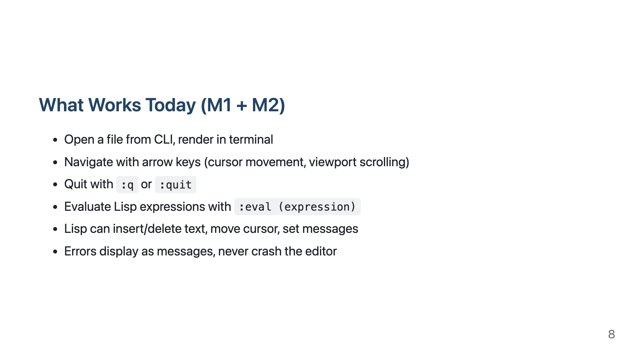
Notes:
Slide 8

Slide 9
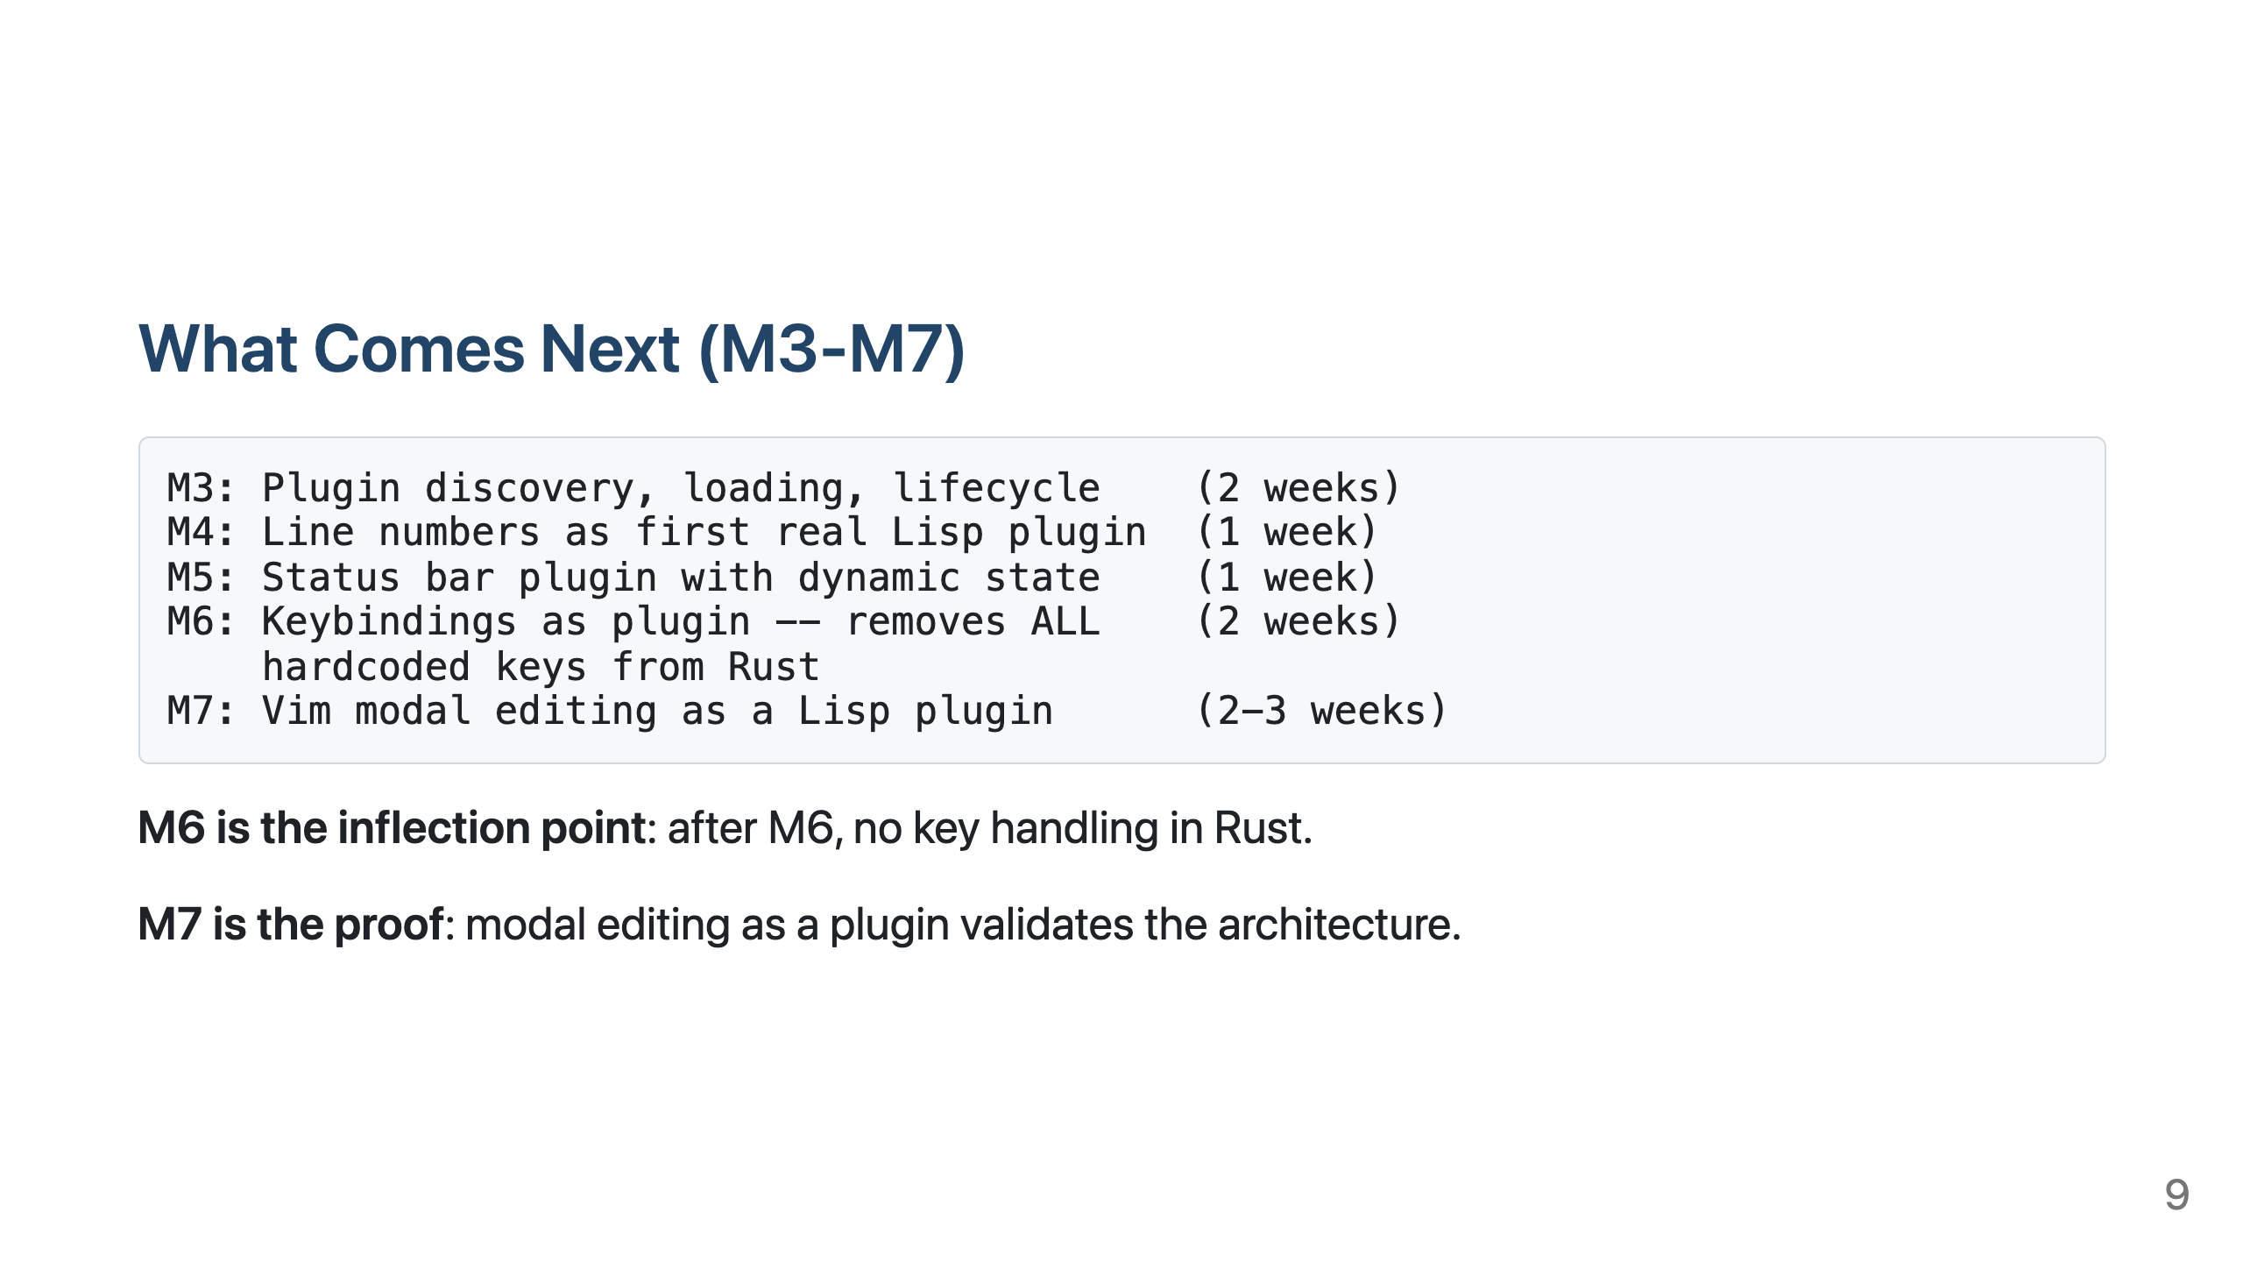
Notes:
Slide 9

Slide 10
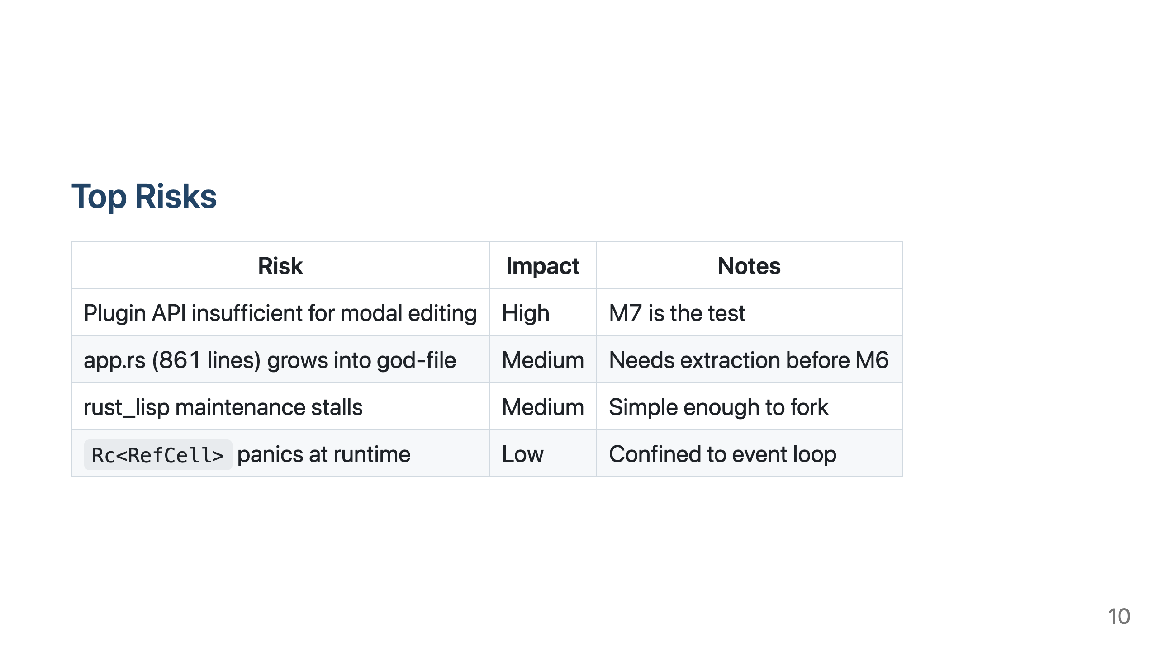
Notes:
Slide 10

Slide 11
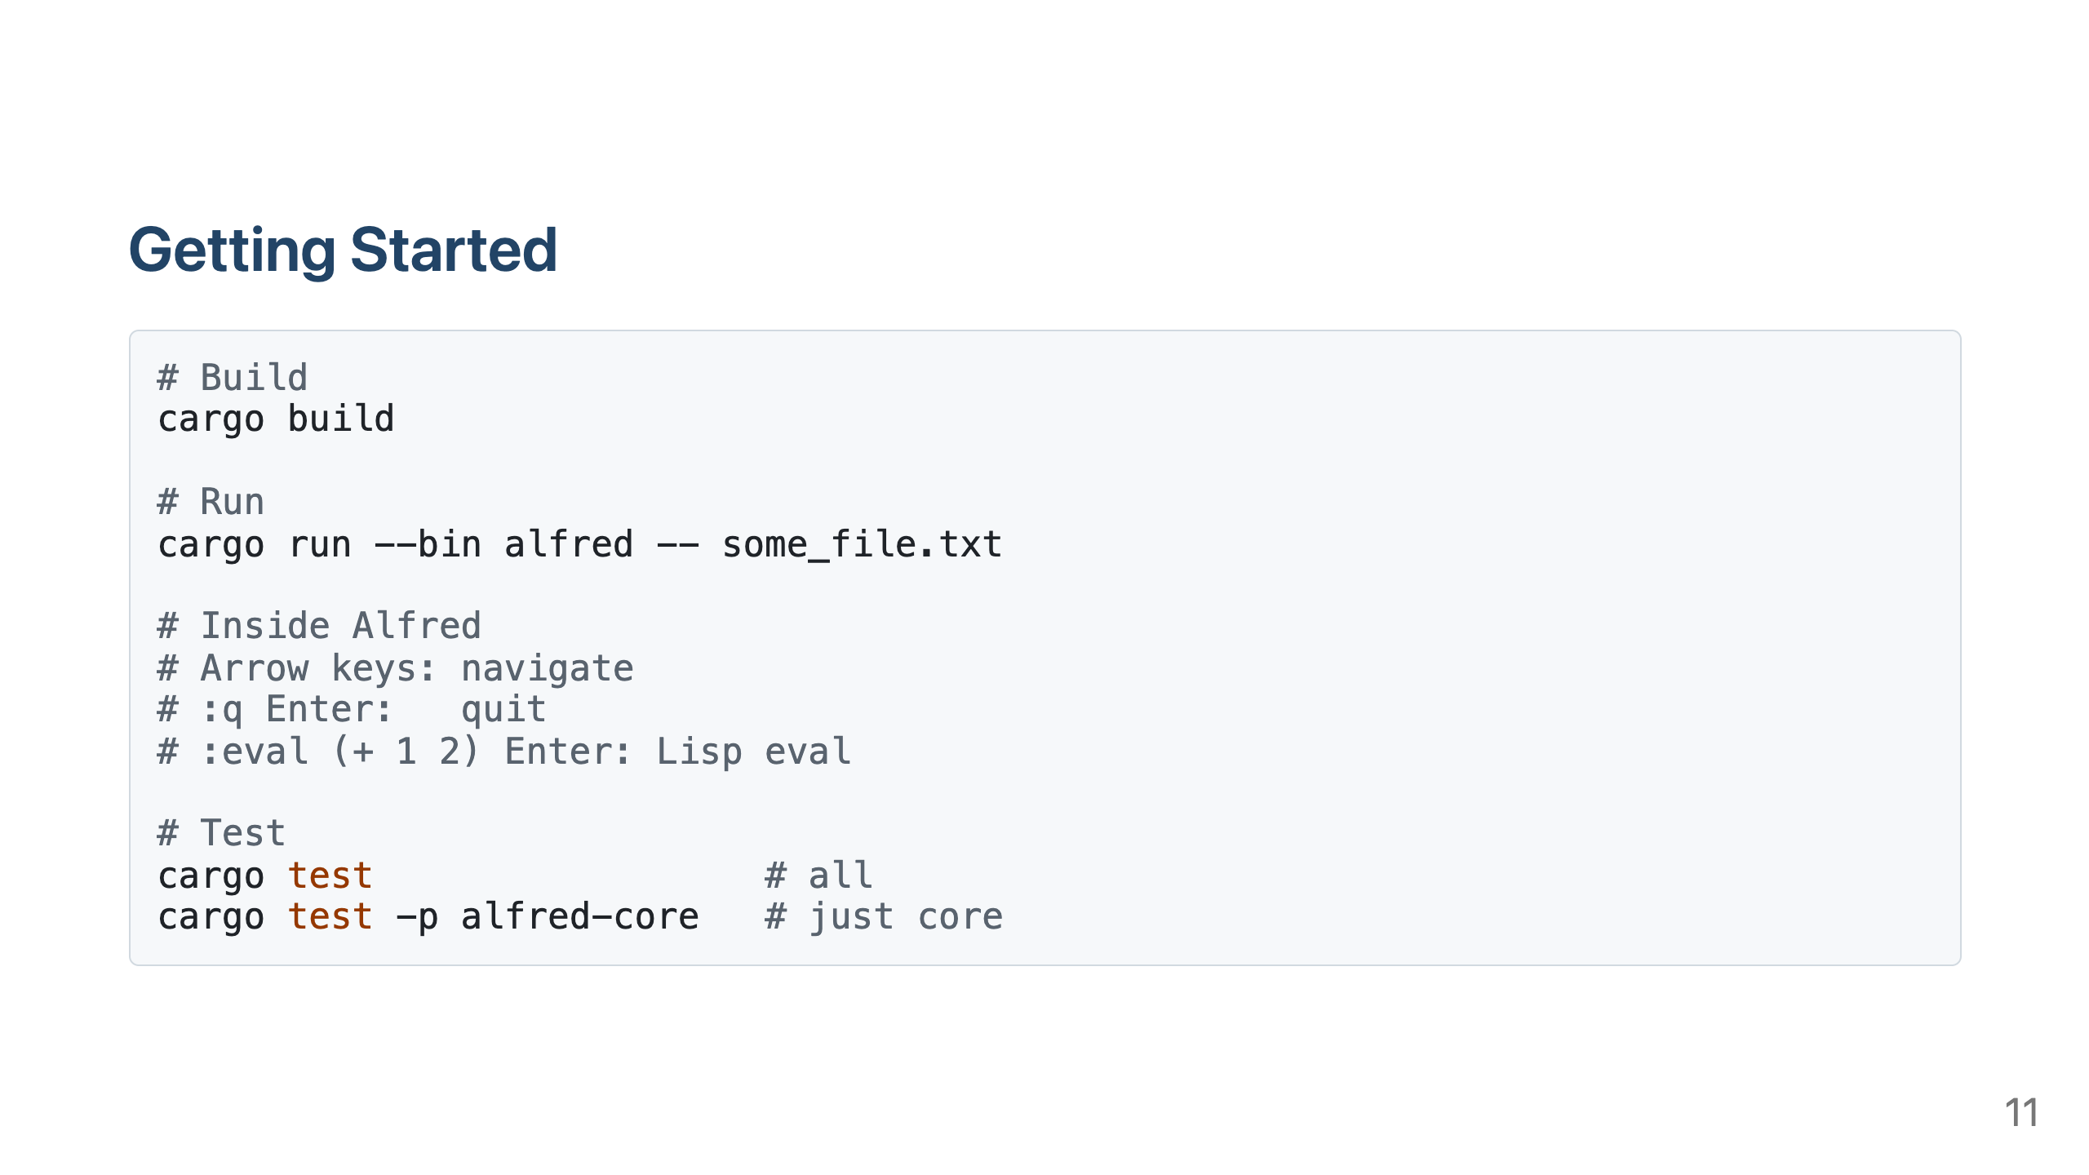
Notes:
Slide 11

Slide 12
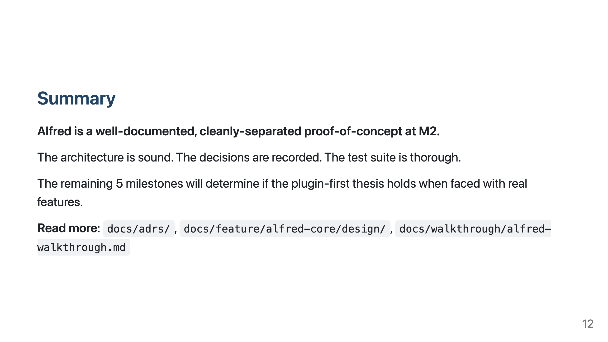
Notes:
Slide 12

