Slide 1
GED Python Workgroup
Week 1
2/20/2020

Slide 2
Why Py?
Efficient (loop friendly)
Versatile (C, but can integrate C#, .net, JS, ObjectiveC etc.)
Libraries/packages by domain experts (e.g. pandas, geopandas, scipy)
Readable
Fun Monty python references
R Vs Python:
https://www.datacamp.com/community/tutorials/r-or-python-for-data-analysis
https://blog.rstudio.com/2019/12/17/r-vs-python-what-s-the-best-for-language-for-data-science/
EPA R user group/python Community of Practice (COP) 7/2019 on rp2 and reticulate (jupyter)

Slide 3
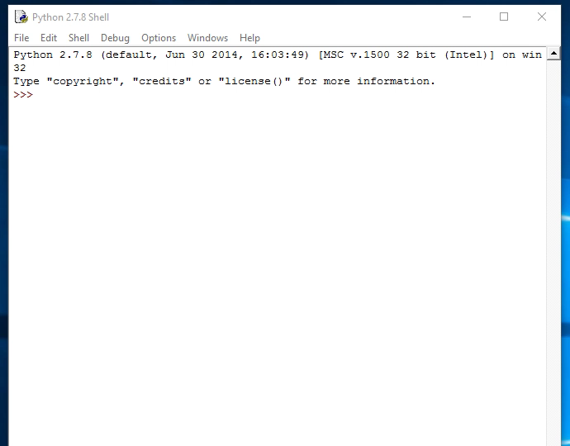
Readable

Slide 4
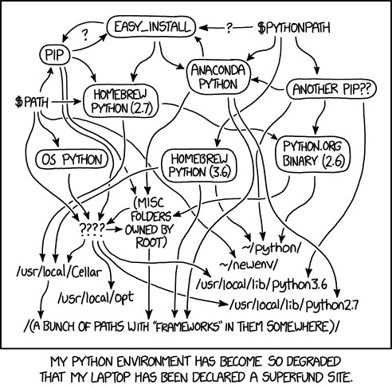
Python Installations & environments
Dependencies – A library may be written to require a specific version of another library.
Environments – help manage multiple set-ups with different library versions.
Anaconda distribution - comes with many scientific packages
Mini-conda distribution - same but fewer packages
ArcGIS Pro – includes conda and several standard GIS libraries (e.g. pandas)
All use Conda for environment management

Slide 5
The EPA python COP is working on a standard install to bypass the freeware approvals like R, for now these are their recommended installs
For now we are going rely on the environment already installed with ArcGIS Pro. ArcGIS desktop includes a python installation, but an early version (2.7) and no conda.

Slide 6
Tools
Text editor – where your script is written
IDLE (in python instal)
Notepad
Notepad++
Visual Studio
Rstudio
Development environment (IDE) – where code is run (Console)
Command line
Spyder (similar to R studio/matlab, comes with annaconda)
PyCharm (good for web dev, Git, support for JS, HTML/CSS etc.)
Jupyter notebooks (cloud- based, great for instruction and web based)
Rodeo (very similar look/feel to Rstudio)
More IDEs

Slide 7
**EXERCISE**
Find your Python installation
Import arcpy lib
Create a new environment

Slide 8
Python 2.7 or 3?
2.7 is the last 2.x release (released July 2010)
ArcGIS desktop install is 2.7
No longer supported after 2020 (doc link)
3.x has added base functionality and gets the dev focus
ArcGIS Pro standard install has 3.x
The differences are minor and there are scripts that will automatically convert most things (useful list)

Slide 9
Example difference - Print
print is used to display text in the terminal
print is a statement in py2.7 and a function in 3.x
print(“Hello world!”)
print “Hello world”

Slide 10
Structure of workgroup
Independent study using codeacademy (free account, not the trial):
https://www.codecademy.com/es/learn/learn-python
Each week you’ll do 2-4 lessons on there (1-2 hours)
Followed by meeting as a group to take what you learned and apply it in the arcpy environment or automating other tasks

Slide 11
**EXERCISE**
Log in to Codecademy
Python 2 vs 3

Slide 12
Workgroup 1
Lesson 1 - Syntax (10-20 min)
Variables
Data types
Whitespace
Comments
Math
Lesson 2 – Strings (15-30 min)
Strings
Escape characters
Index
String methods (dot notation)
Coercing variables
Datetime

Slide 13
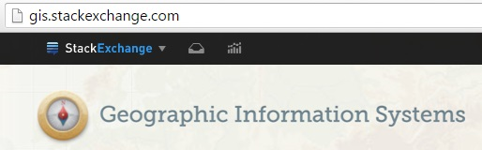
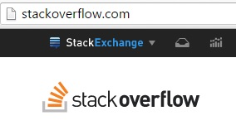

Resources-Troubleshooting
Stack (Q/A Forum)
GIS – gis.stackexchange.com
GeoNet: geonet.esri.com
Python – stackoverflow.com

Slide 14
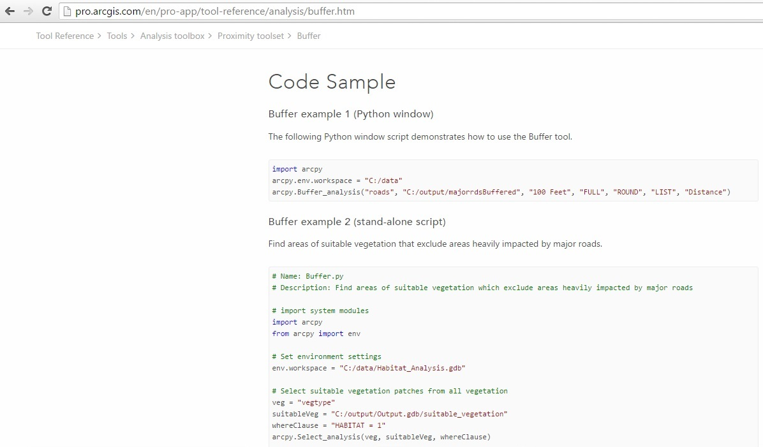
Arcpy Documentation
Notes:
Arcpy buffer

Slide 15
**ArcGIS EXERCISE**
Take process from results and write it in a script
Example using Copy Features
How to lookup documentation

