Slide 1
GED Python Workgroup
Week 1
1/9/2018

Slide 2
Why Py?
Efficient (loop friendly)
Versatile (C, but can integrate C#, .net, JS, ObjectiveC etc.)
Libraries/packages by domain experts(e.g. scipy)
Readable
Fun Monty python references

Slide 3
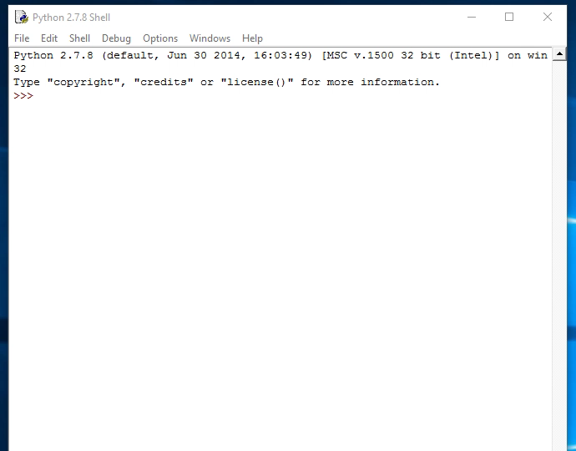
Readable

Slide 4
Python Installation
Anaconda distribution (comes with many scientific packages)
Conda environment management (part of anaconda & ArcGIS Pro)
If you have a package that uses a different version it allows you to switch between them using environments.
A new EPA python workgroup is working on a standard install (bypasses approvals like R)
For now we are going rely on the environment already installed with ArcGIS desktop.

Slide 5
Tools
Text editor – where your script is written
IDLE (in python instal)
Notepad
Notepad++
Visual Studio
Rstudio
Development environment (IDE) – where code is run (Console)
Command line
Spyder (similar to R studio/matlab, comes with annaconda)
PyCharm (good for web dev, Git, support for JS, HTML/CSS etc.)
Jupyter notebooks (cloud- based, great for instruction and web based)
Rodeo (very similar look/feel to Rstudio)
More IDEs

Slide 6
Python 2.7 or 3?
2.7 has been around longer
ArcGIS standard install is 2.7
3.0 has added base functionality and is the direction things are going
ArcGIS Pro standard install has 3.0
The differences are minor and there are scripts that will automatically convert most things (useful list)

Slide 7
Print
print is used to display text in the terminal
print is a statement in py2.7 and a function in 3.0
print(“Hello world!”)
print “Hello world”

Slide 8
Structure of workgroup
Independent study using codeacademy:
https://www.codecademy.com/es/learn/learn-python
Each week you’ll do 2-4 lessons on there (1-2 hours)
Followed by meeting as a group to take what you learned and apply it in the arcpy environment or automating other tasks

Slide 9
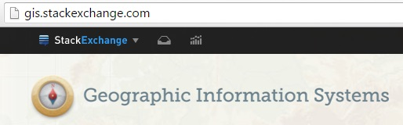
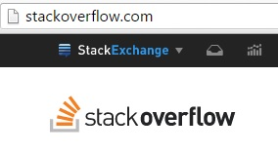

Resources-Troubleshooting
Stack (Q/A Forum)
GIS – gis.stackexchange.com
GeoNet: geonet.esri.com
Python – stackoverflow.com

Slide 10
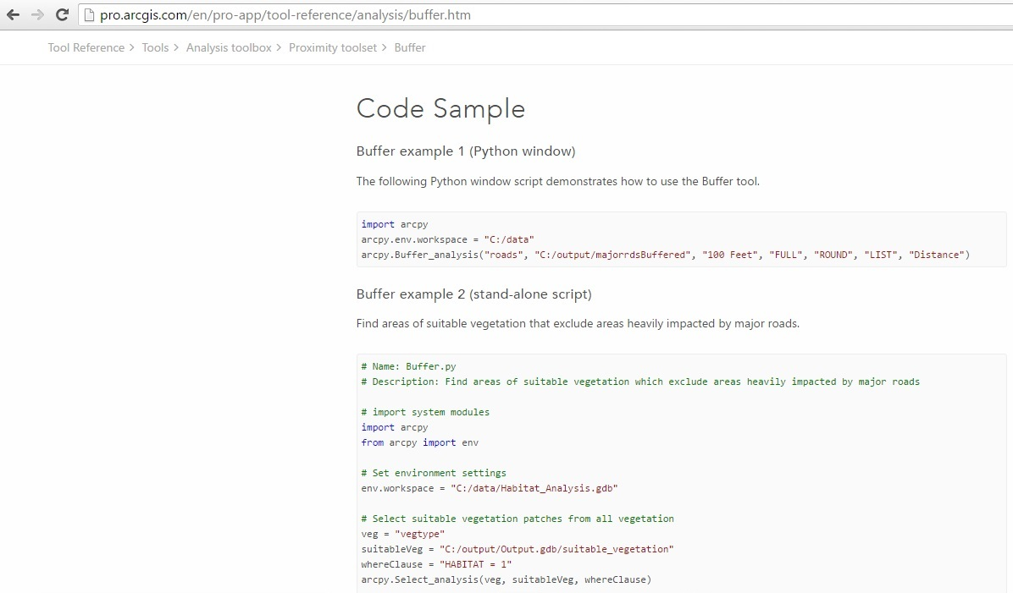
Arcpy Documentation
Notes:
Arcpy buffer

Slide 11
Workgroup 1
Lesson 1 - Syntax (10-20 min)
Variables
Data types
Whitespace
Comments
Math
Lesson 2 – Strings (15-30 min)
Strings
Escape characters
Index
String methods (dot notation)
Coercing variables
Datetime

Slide 12
Taking what you learned to ArcGIS
Take process from results and write it in a script
Example using Copy Features
How to lookup documentation

