Slide 1
Volatility Forecasting
Intermediate Presentation
University of Liechtenstein
Master of Science (MSc) in Finance
Advanced Investment Strategies
Andrea Landini, Simone Fruner, Ali Yaghoubi
October 17h, 2025
Notes:
Fields indicated in red should be adjusted according to the need and subsequently presented in black text color

Slide 2
Table of Contents
Introduction to Empirical Asset Pricing Challenges
Overview of Gu, Kelly, and Xiu (2020)
In-Depth Overview of De Nard, Hediger, and Leippold (2022)Key Connections and Implications
Project Preview and Conclusion
Introduction & Motivation
Today we'll explore two seminal papers that form the reference foundation for our semester project on volatility regime classification and forecasting.
We'll cover Gu et al. (2020) for ML benchmarks, then focus more deeply on De Nard et al. (2022) and its VASA method. Together, they provide tools for tackling high-dimensional financial data, such as forecasting in volatile environments.

Slide 3
Gu et al. (2020) Paper Overview
Empirical Asset Pricing Via Machine Learning
The paper addresses estimating risk premiums, which are difficult to measure due to unforecastable noise in financial data.
Uses a large dataset of U.S. equities from CRSP/Compustat, with 94 firm characteristics as predictors.
Key focus: Comparative analysis of ML methods for cross-sectional and time-series return prediction, showing gains from nonlinear interactions among signals like momentum, liquidity, and volatility, these will inform our volatility project

Slide 4
Gu et al. (2020) Paper Overview
Methodology and Key Findings
Methods include linear benchmarks like OLS and Elastic Net, tree-based approaches such as Random Forests (RF) and Gradient Boosted Regression Trees (GBRT), and shallow Neural Networks (NNs) with 1-5 layers.
Evaluation relies on out-of-sample R² and Sharpe ratios; models use split samples for training, validation, and testing to prevent overfitting.
Findings: Nonlinear models like RF and shallow NNs perform best in finance's low signal-to-noise environment, achieving stock R² of 0.33%-0.40% (vs. 0.16% for OLS-3) and higher Sharpe ratios.

Slide 5
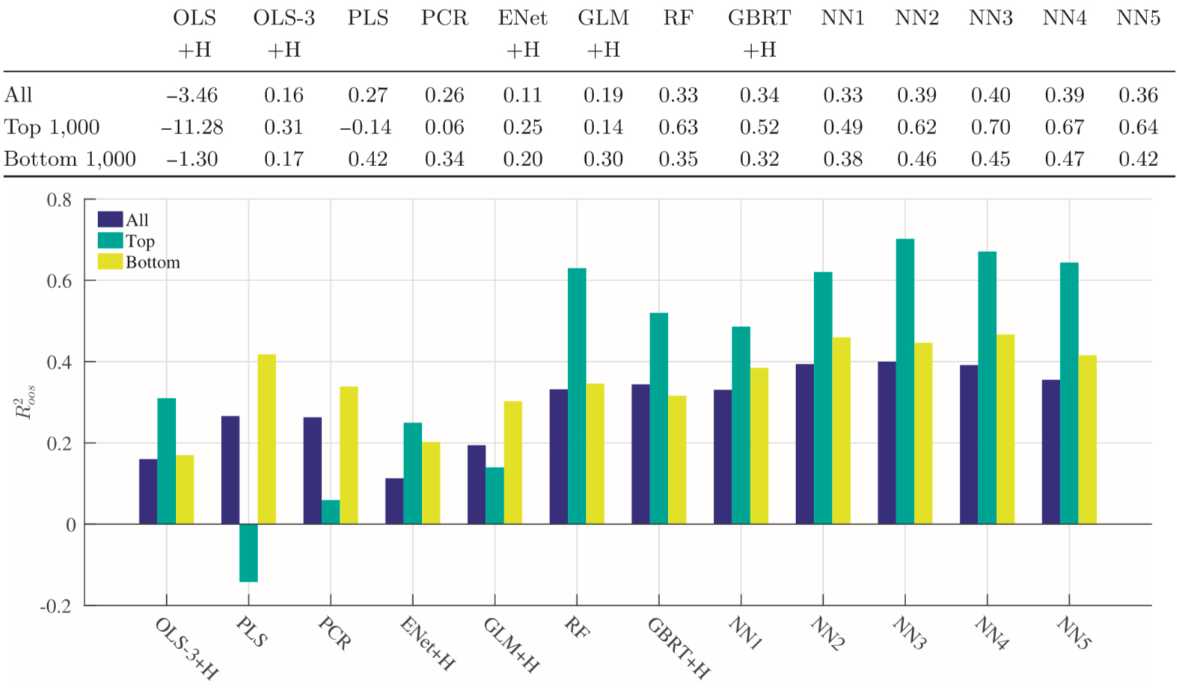
Gu et al. (2020) Paper Overview
Methodology and Key Findings

Slide 6
Gu et al. (2020) Paper Overview
Economic Implications
Delivers significant portfolio gains, up to 2.45 Sharpe ratio for equal-weighted strategies based on ML forecasts.
Limitations include the "black box" nature of models and potential variability in predictions, which can pose risks for practical use.
Broader impact: Establishes a foundation for ML in finance, inspiring applications like volatility forecasting and setting benchmarks for extensions in papers like De Nard et al.

Slide 7
De Nard et al. (2022) Paper Overview
Subsampled Factor Models For Asset Pricing: The Rise Of Vasa
Introduces Variable Subsample Aggregation (VASA) to handle the "factor zoo”, hundreds of predictors leading to overfitting and instability in high-dimensional models.
Based on U.S. equities from CRSP with a large set of factors; compares VASA to ML benchmarks like NNs and RFs.
Key problems addressed: Reducing dimensionality while maintaining predictive power, with a focus on stability that we'll adapt for our volatility regime classification and forecasting.

Slide 8
De Nard et al. (2022) Paper Overview
Methodology and Key Findings
VASA core process: Randomly subsample predictors from the factor space, estimate simple linear models on each subsample.
Aggregation step: Average the predictions using specific weighting, such as based on subsample size, to minimize variability and model-selection risk.
Benchmarks against Neural Nets and Random Forests from Gu et al.; evaluates via global R² for average accuracy and stock-specific R² distribution for variability.
Key insight: Subsampling effectively cuts dimensionality while averaging over multiple models mitigates potential mistakes, making it integrable with nonlinear ML for enhanced performance.

Slide 9
De Nard et al. (2022) Paper Overview
Detailed Simulation Analysis
Simulations test VASA on synthetic data mimicking high-dimensional financial environments with noise and correlations.
Results show high global R² comparable to benchmarks, but with minimal stock-specific variability, outperforming NNs and RFs in reducing "prediction risk.
Emphasizes how averaging multiple subsamples accounts for model uncertainties, leading to more consistent outcomes.
This stability is crucial for applications like our volatility classification, where consistent regime predictions (e.g., low/medium/high) are essential in noisy data.

Slide 10
De Nard et al. (2022) Paper Overview
Empirical Results and Portfolio Performance
Empirical setup uses CRSP U.S. equities and a broad factor zoo as predictors for return forecasting.
Key findings: VASA achieves competitive global R² with the lowest R² variability compared to NN/RF, preventing dispersion that harms practical use.
Portfolio outperformance: VASA-based strategies deliver superior Sharpe ratios due to stability, e.g., beating random forests in out-of-sample tests.
Demonstrates strong dimension reduction without sacrificing power, supporting economic value in risk-based investments.

Slide 11
De Nard et al. (2022) Paper Overview
Economic Implications
Provides portfolio gains superior to complex ML by significantly reducing prediction variability through subsampling and aggregation.
Limitations: Starts with linear bases but is adaptable to nonlinear extensions, like subsampled NNs for more flexible applications.
Broader impact: Simplifies ML approaches for finance, making it ideal for handling noisy signals such as volatility regimes and transitions.
Central to our project: VASA's stability will enhance our aggregation for volatility tasks in dynamic market conditions.

Slide 12
Connections Between the Papers
Both papers share a focus on high-dimensional predictors like momentum and volatility for improving asset pricing models.
Complementary strengths: Gu et al. highlights the power of nonlinear methods (trees/NNs) for capturing interactions; De Nard et al. adds aggregation via VASA for greater stability.
Implications and Project Preview
Advances risk premium measurement by combining nonlinear insights with aggregation for superior, stable forecasts.
Project tie-in: We'll extend these methods to classify and forecast volatility using CRSP data for the top 500 U.S. firms, with baselines like HAR-RV/GARCH, and evaluations through QLIKE/MSE metrics plus GMV portfolio performance; crypto extension considered if time and data allows.

Slide 13
Thank you for your attention.

Slide 14
Reference List
Gu, Shihao, Bryan Kelly, and Dacheng Xiu. 2020. “Empirical Asset Pricing via Machine Learning.” The Review of Financial Studies 33(5): 2223–2273. Oxford University Press.
De Nard, Gianluca, Simon Hediger, and Markus Leippold. 2022. “Subsampled Factor Models for Asset Pricing: The Rise of Vasa.” Journal of Forecasting 41(6): 1217–1247. Wiley Online Library.

