Slide 1
Enhancing Monetary Policy Forecasting
Andrea Landini & Ali Yaghoubi
Prof. Dr. Merlin Bartel
University of Liechtenstein
Master of Science (MSc) in Finance
AI and Machine Learning
October, 24th 2025
Winter Semester 25/26
Notes:
Fields indicated in red should be adjusted according to the need and subsequently presented in black text color

Slide 2
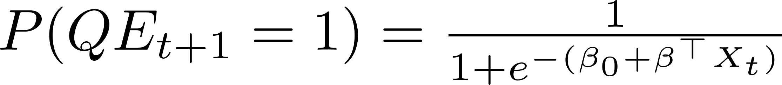
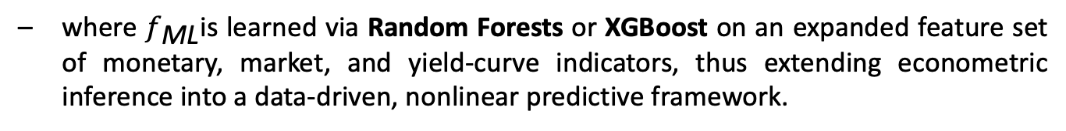
Introduction & Motivation
We enhance traditional econometric QE forecasting models by integrating machine learning methods that capture nonlinear and interaction effects among macro-financial variables. Formally, instead of assuming a linear relationship
we approximate the conditional probability using a flexible function
where $f_{\text{ML}}$is learned via Random Forests or XGBoost on an expanded feature set of monetary, market, and yield-curve indicators, thus extending econometric inference into a data-driven, nonlinear predictive framework.

Slide 3

Research Question
How can nonlinear interactions between financial stress, monetary policy stance, and market expectations help anticipate future QE actions?
This is a logistic regression, where:
$X_{t }$contains indicators such as Fed balance sheet growth, VIX level, and their lags.
$β$measures how each variable affects QE probability.
The model assumes each feature contributes linearly and independently, meaning:
An increase in volatility (VIX) always shifts QE probability by the same amount,
regardless of what other variables are doing.
This simplicity aids interpretation but limits flexibility, it cannot detect thresholds or interaction effects between stress and policy variables.

Slide 4
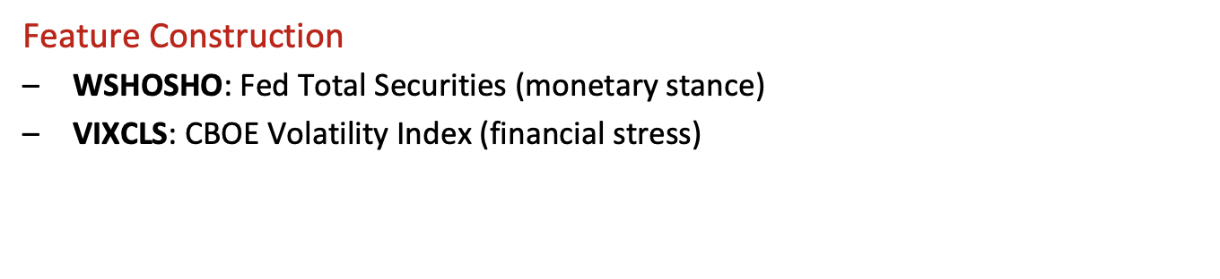
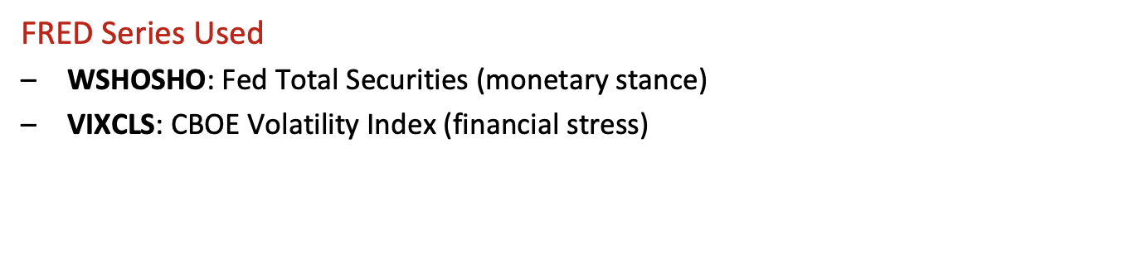
Data
FRED Series Used
$\text{WSHOSHO}$: Fed Total Securities (monetary stance)
$\text{VIXCLS}$: CBOE Volatility Index (financial stress)
Feature Construction
$\text{WSHOSHO}$: Fed Total Securities (monetary stance)
$\text{VIXCLS}$: CBOE Volatility Index (financial stress)

Slide 5
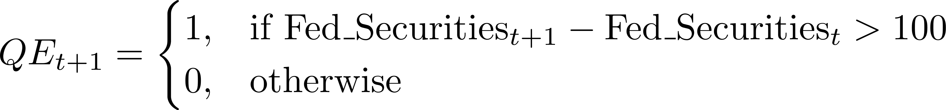
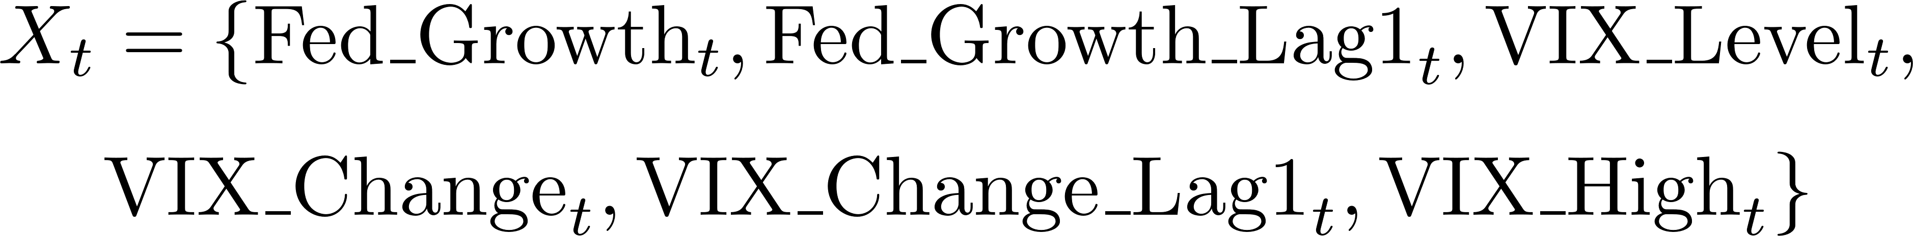
Methodology
The dependent variable captures whether the Federal Reserve initiates or continues a Quantitative Easing (QE) program in the following quarter. We define QE as a significant expansion of the Fed’s securities holdings, specifically, an increase greater than $100 billion compared to the previous quarter.
The feature set captures the interaction between monetary policy and market stress. Fed balance sheet growth measures policy stance and persistence, while VIX-based variables reflect volatility levels and changes. Together, they describe how financial conditions and policy responses jointly influence future QE decisions.

Slide 6
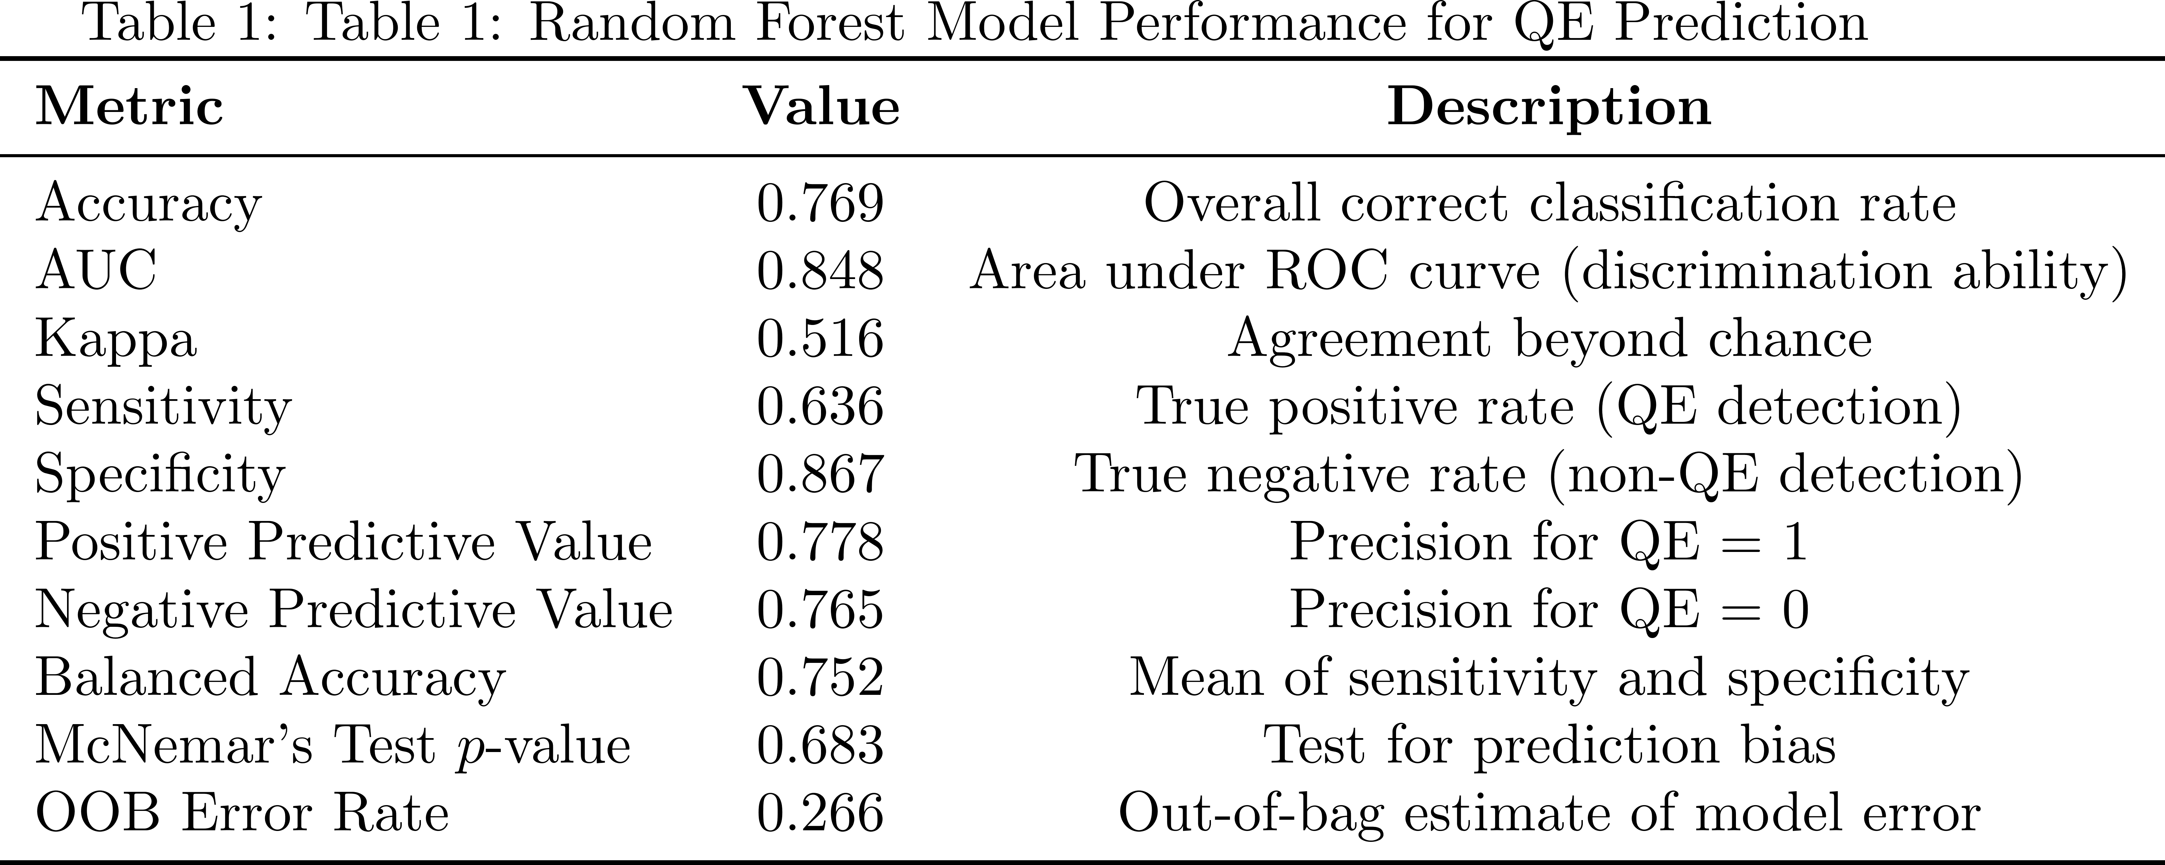
Results
The dataset contains quarterly observations of the Fed’s balance sheet and market volatility, with 38 non-QE and 52 QE periods, providing a balanced foundation for predicting future QE actions.

Slide 7
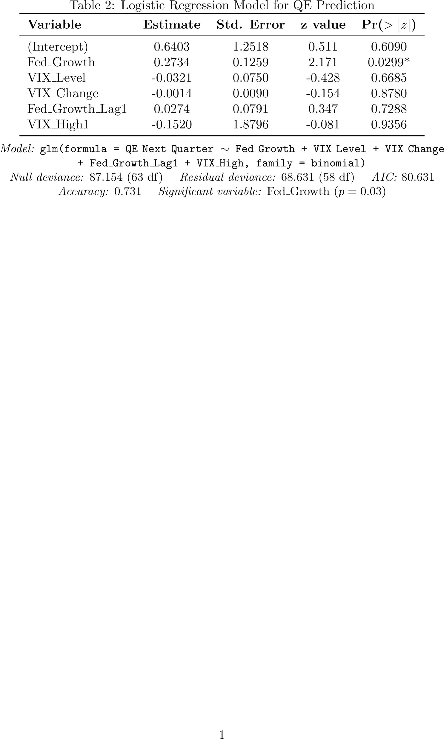
Results
The Random Forest model achieved higher predictive accuracy (0.77) compared to the Logistic Regression model (0.73), suggesting that nonlinear relationships between financial variables improve the model’s ability to anticipate future QE actions.

Slide 8
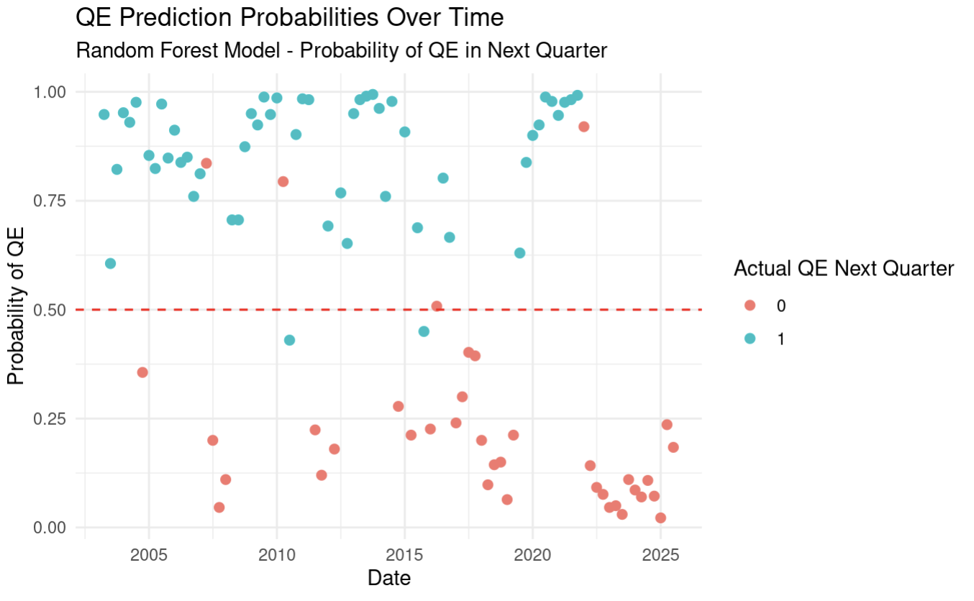
Results

Slide 9
Motivation for Expansion
The baseline QE prediction model relied on a narrow set of indicators, mainly the Federal Reserve’s securities holdings and market volatility (VIX). While this captured core monetary and market stress dynamics, it neglected other macro-financial channels influencing QE decisions, such as liquidity conditions, credit spreads, inflation expectations, and real activity.
To improve explanatory power and predictive accuracy, we expanded the feature set to include a broader cross-section of financial and macroeconomic indicators from the FRED database. The goal is twofold:
To test whether richer economic information improves traditional econometric performance.
To evaluate whether, ceteris paribus, modern machine learning (ML) methods can again outperform linear models even under a richer information environment.

Slide 10
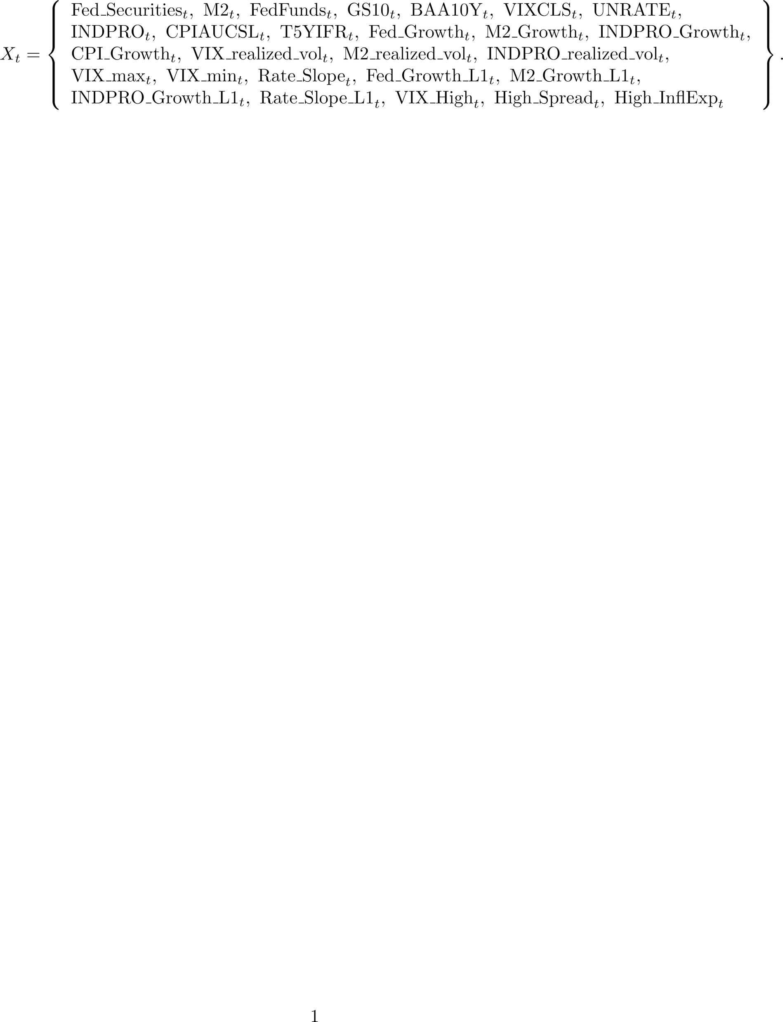

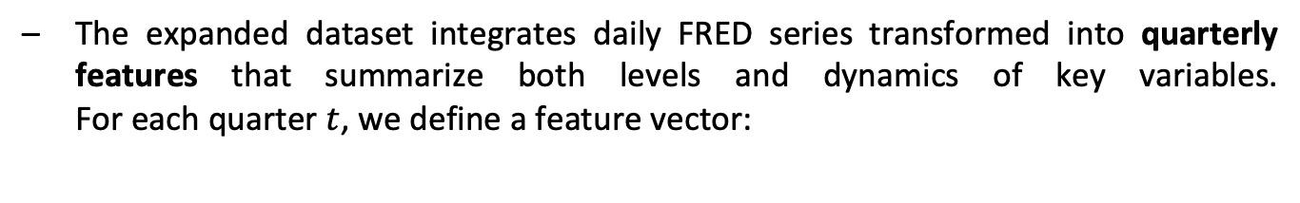
Expanded Model Structure
The expanded dataset integrates daily FRED series transformed into quarterly features that summarize both levels and dynamics of key variables. For each quarter $t$, we define a feature vector:
Each component captures a different channel:
Monetary policy stance: Fed securities ($\text{WSHOSHO}$), M2 money supply, and Fed funds rate.
Market stress: VIX level, spread between BAA and 10-year Treasury yields.
Macro fundamentals: Industrial production, inflation (CPI), and unemployment rate.
Expectations: 5-year, 5-year forward inflation expectation ($\text{T}\text{5}\text{YIFR}$).
Derived dynamics: within-quarter growth rates, realized volatility, and slope of the yield curve.

Slide 11
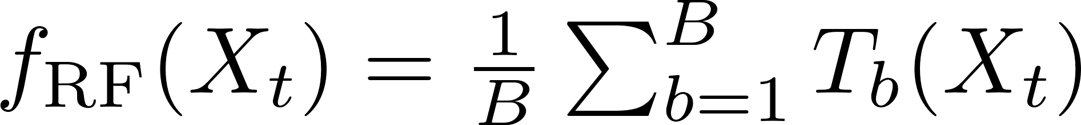


Machine Learning Extension
The expanded model replaces the linear structure of logistic regression with ensemble learning methods that can capture nonlinear dependencies and variable interactions. These models are designed to approximate complex decision boundaries that better represent the conditional probability of future QE actions.
In the Random Forest, multiple decision trees $T_{b}\left(X_{t}\right)$are trained on different bootstrap samples and subsets of predictors. The ensemble average reduces variance and overfitting, allowing the model to detect joint effects, for example, how volatility spikes combined with steep yield slopes increase the likelihood of QE.
The XGBoost model builds trees sequentially, each correcting the errors of the previous one while applying regularization through $Ω\left(f_{k}\right)$. This penalization and boosting structure enhance stability and predictive power, making the model more efficient at isolating nonlinear, state-dependent relationships that drive QE policy decisions.

Slide 12
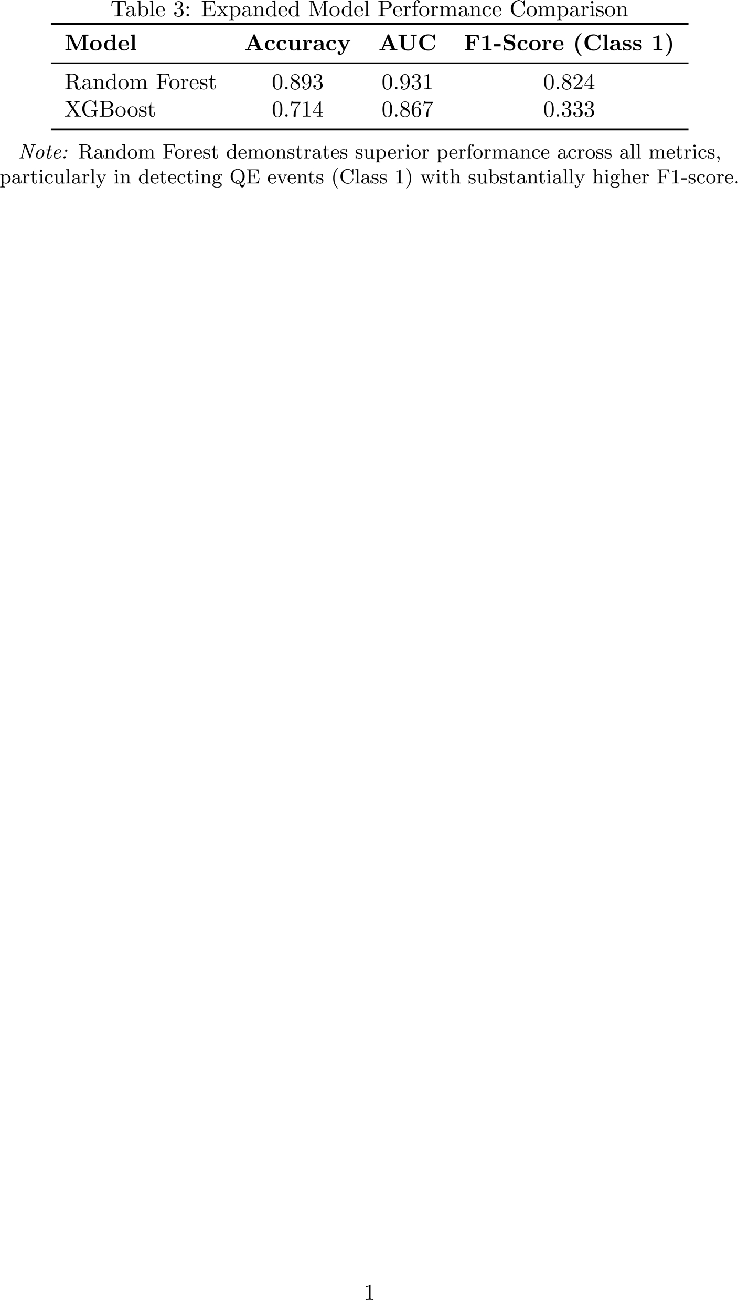
Results
The results show that expanding the feature set and applying advanced machine learning methods significantly enhance the model’s ability to anticipate future QE actions. Random Forest and XGBoost outperform the baseline logistic model by capturing nonlinear and interactive effects between policy, market stress, and macroeconomic variables, suggesting that QE decisions follow complex, state-dependent patterns better detected through ensemble learning.

Slide 13
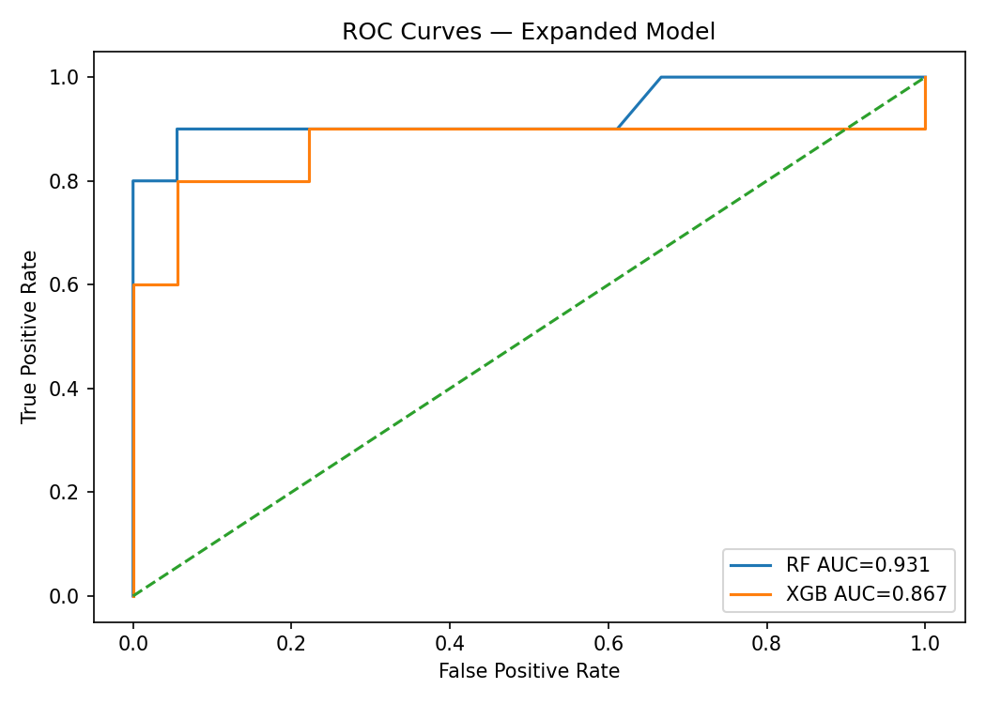
Results

Slide 14
Thank you for your attention.

