Slide 1
Noise vs. Signal in Decentralized Prediction Markets
Empirical Evidence from the 2025 Papal Conclave on Polymarket
Seminar in Finance | SS 2026
Master in Innovative Finance | Universität Liechtenstein
Interim Presentation | March 5, 2026
Andrea Landini, Simone Fruner, Emre Dalmizrak, Jan Mokrosinski

Slide 2
Agenda
1. Research Background & Research Question
2. Data: 482k Trades from Dune Analytics / Polymarket
3. Methodology: Three-Step Approach
4. Method 1 Results: Realized Variance
5. Method 2 Results: Realized Kernel
Method 3 Results: State-Space UC Model
7. Key Findings & The Prevost Puzzle
8. Next Steps for Final Paper

Slide 3
Research Context
Prediction markets aggregate dispersed information into real-time probabilities, potentially outperforming polls. But prices can be driven by noise: thin liquidity, herd behavior, and speculation rather than fundamentals.
The 2025 Papal Conclave as a Natural Experiment
Sistine Chapel doors closed: May 7, 17:46 Rome time
New Pope announced: May 8, 18:07 - 19:12 Rome time
A credible ~24-hour information blackout where no public signal could arrive from inside the conclave.
Research Question
How much of the variation in Polymarket-implied probabilities for papal candidates reflects pure noise (speculation, herding, liquidity shocks) versus rational updating based on publicly observable signals?

Slide 4
Data: Polymarket - Who Will Be the Next Pope?
Market Overview
• Total trades (all tokens): 482,861
• Yes-token trades (analysis set): 314,787
• Candidates tracked: 26
• Created: Feb 24, 2025 | Resolved: May 8, 2025
• Winner: Robert Francis Prevost (Pope Leo XIV)
Data Source
• Dune Analytics query on polymarket_polygon.market_trades
• DuneSQL with 29 conditionId filters, downloaded via REST API
• Sub-second timestamps, maker/taker wallets, USD volumes
Conclave Window
• Trades during conclave: 47,918 | Trades in control (matched 24h pre): 24,554
• Conclave = 15.2% of all trades in just ~1 day
• Top 3 by conclave activity: L.A. Tagle (3,524 trades, $107k) | P. Parolin (3,153, $185k) | Pizzaballa (3,132, $39k)

Slide 5
Methodology: Three-Step Approach
Step 1 - Realized Variance Benchmark
Compare RV of 1-min log-returns in conclave vs matched 24h control window.
Excess volatility during info-blackout = speculative churn. (Barndorff-Nielsen & Shephard, 2002)
Step 2 - Realized Kernel Estimator (Barndorff-Nielsen et al., 2008)
Microstructure-robust estimator using Parzen-weighted return autocovariances on raw tick data.
Noise Gap = RV − RK measures bid-ask bounce and non-informational friction.
Step 3 - State-Space UC Model (Harvey, 2010)
Decompose 1-min prices: permanent random-walk (signal) + mean-reverting cycle (noise).
Estimated via Kalman filter / MLE. Noise share = transitory variance / total variance.
Multi-resolution data: 1-min bars for Methods 1 & 3 | Raw ticks for Method 2 | All 26 candidates

Slide 6
Method 1: Realized Variance - Results
22 candidates with valid conclave + control windows | 1-min bars, n = 1,461 (conclave) / 1,440 (control)
Average variance ratio: 1.88x Median: 1.80x Candidates exceeding 2x: 11 / 22
Highest Excess Volatility:
• Matteo Zuppi: 3.71x | Baldassare Reina: 3.10x | Peter Turkson: 2.73x | Francis Arinze: 2.69x
• Pierbattista Pizzaballa: 2.43x | no new pope be elected in 2025?: 2.24x
• Robert Francis Prevost * (winner): 2.11x
Interpretation:
VR > 1 means conclave has excess volatility over the matched control period. Since no new information could arrive during the conclave, this excess is attributed to speculative churn and noise trading.
Notable: Arborelius (0.99x) and Scola (0.78x) show NO excess volatility during conclave.

Slide 7
Method 2: Realized Kernel - Results
Noise Gap = RV(tick) − RK(tick) | Ratio = noise gap conclave / noise gap control | 22 candidates with valid data
Average noise gap ratio: 2.42x Candidates exceeding 2x: 11 / 22
Largest Noise Gap Ratios:
• Matteo Zuppi: 4.88x
• Robert Francis Prevost: 4.72x *
• Baldassare Reina: 3.71x | Raymond Burke: 3.62x | Pierbattista Pizzaballa: 3.55x | Robert Sarah: 3.51x
The Prevost Anomaly
The eventual winner shows the 2nd-highest noise gap ratio (4.72x), contradicting the hypothesis that informed traders would reduce noise — or suggesting informed accumulation masked as noise.
Only outlier: L.A. Tagle (0.76x) — LESS microstructure noise during conclave.

Slide 8
Method 3: State-Space UC Model - Results
22 candidates with full estimation | Average noise share: 82.2% (conclave) | 90.2% (control)
Noise share INCREASED for 7 candidates:
• Raymond Burke: +18.0pp | Peter Turkson: +15.4pp | Pierbattista Pizzaballa: +14.7pp
• Pietro Parolin: +11.8pp | Matteo Zuppi: +11.0pp
Noise share DECREASED for 15 candidates:
• Francis Arinze: −29.7pp | Luis Antonio Tagle: −24.3pp | J.T. de Mendonca: −24.2pp
• Péter Erdő: −24.0pp | Mario Grech: −24.0pp
Interpretation:
Counterintuitive: noise share fell for most candidates. But absolute variance ROSE (Method 1 confirms). This means the signal component grew proportionally MORE than the noise during conclave.
Possible: genuine pre-conclave information arrival, or UC model attributing large persistent moves to ‘signal’ even if speculative.
Prevost (winner): +1.5pp only — smallest positive change, suggesting his price had more signal content relative to other frontrunners.

Slide 9
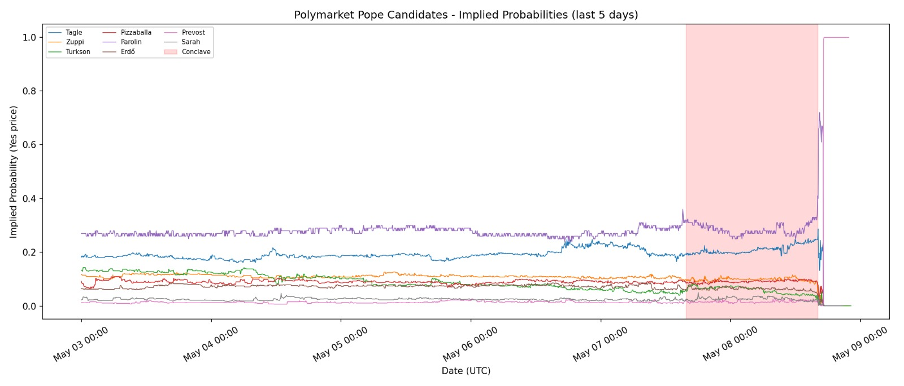
Preliminary Visualitation

