Slide 1
Simulating Music using R
Andrea Lanz
Git repo:
https://github.com/ST541-Fall2018/andrealanz-project-musicsim.git

Slide 2
Purpose/Goals
Explore how music is related to numerical information (frequency)
Create a formal definition of music
Use this definition to simulate music
Guiding Questions:
Are there properties and patterns in music that can be used to generate it?
How can music be expressed in terms of a numerical definition?
How can this numerical definition of music be simulated?

Slide 3
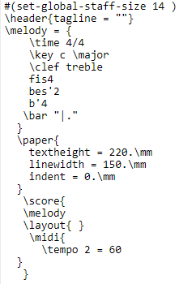

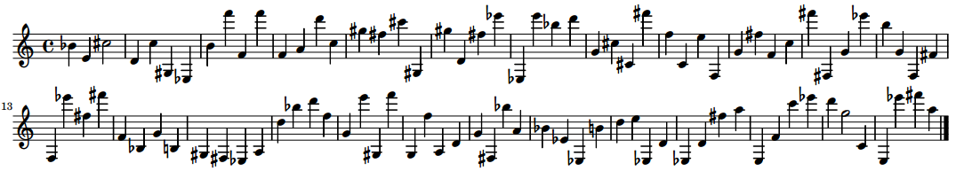
LilyPond
A program that generates sheet music
Written in text format and compiled to produce .midi, .txt, and a pdf of sheet music (see below)

Slide 4

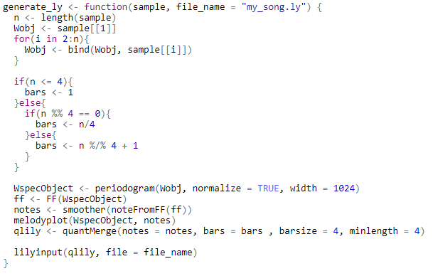
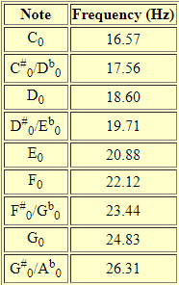

Method
Generate a random sample of notes:
Take a random sample from a list of fundamental frequencies tuned to 440 Hz (108 total)
Using tuneR functions, create a lilypond file
Generate a LilyPond file, given a sample:

Slide 5
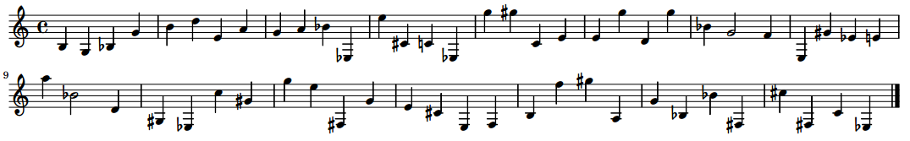
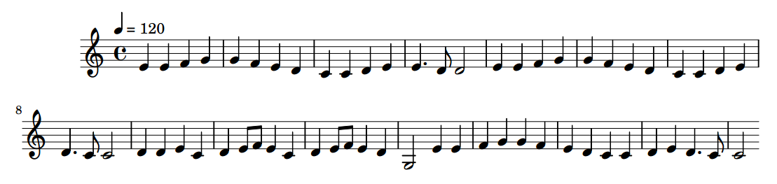
Results
Randomly generated notes:
Notes for “Ode To Joy”

Slide 6
Simulating Music using R
Andrea Lanz
Git repo:
https://github.com/ST541-Fall2018/andrealanz-project-musicsim.git

