Slide 1
Exploring Car Accident Severity Features
Data Science Capstone Project

Slide 2
Business Understanding
In this project, we will explore how the features affect car accident severity and find the most related features so we can improve them.
We will also build some machine learning models to predict the severity level of the car accident.

Slide 3
Data understanding:
The data set which will be used is the “Collisions—All Years” provided through IBM Data Science Capstone by Coursera. They are data from SDOT Traffic Management Division.
The data consists of the information about the accidents. This includes all types of collisions from 2004 to present. The data has 194,673 rows and 38 columns. The columns are referred as the features of the dataset and every row referred in a single collision

Slide 4
Data Preparation
In this step, we first drop some unrelated features like some meaningless id, descriptive contents like location, SDOT_COLDESC.
Then we replace the missing values with mode of that feature.
Next we normalize the data to get dummies
Finally we use upsample method to balance the data

Slide 5
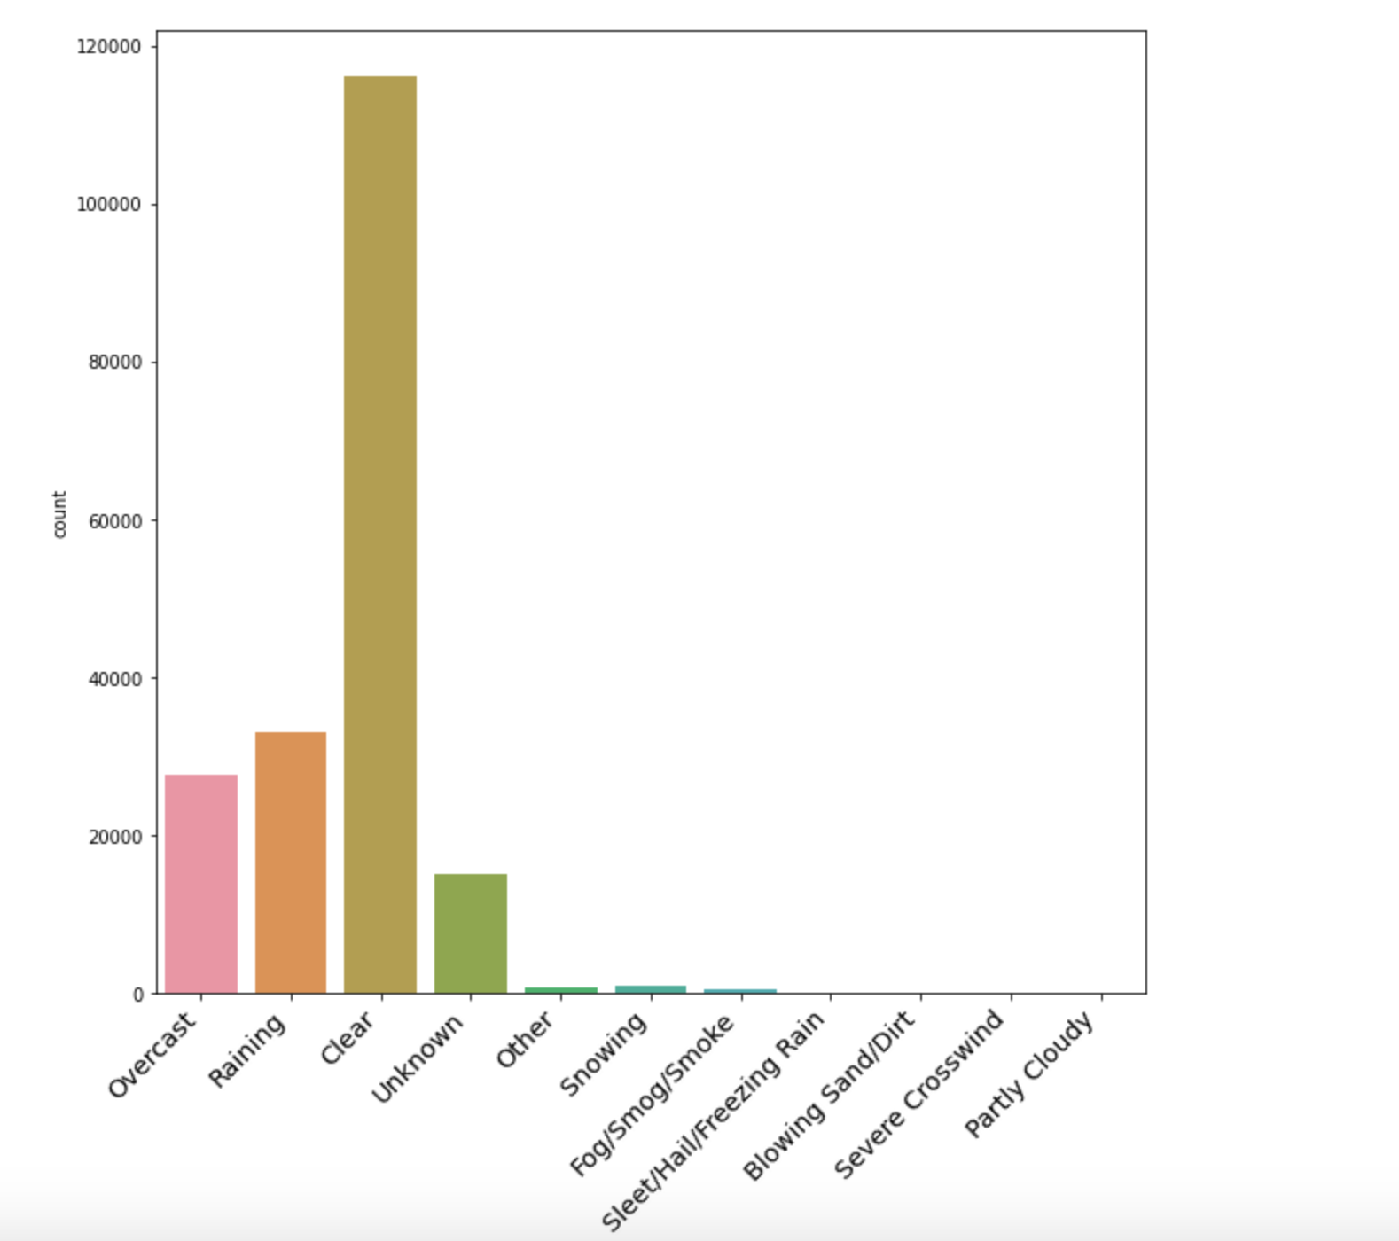
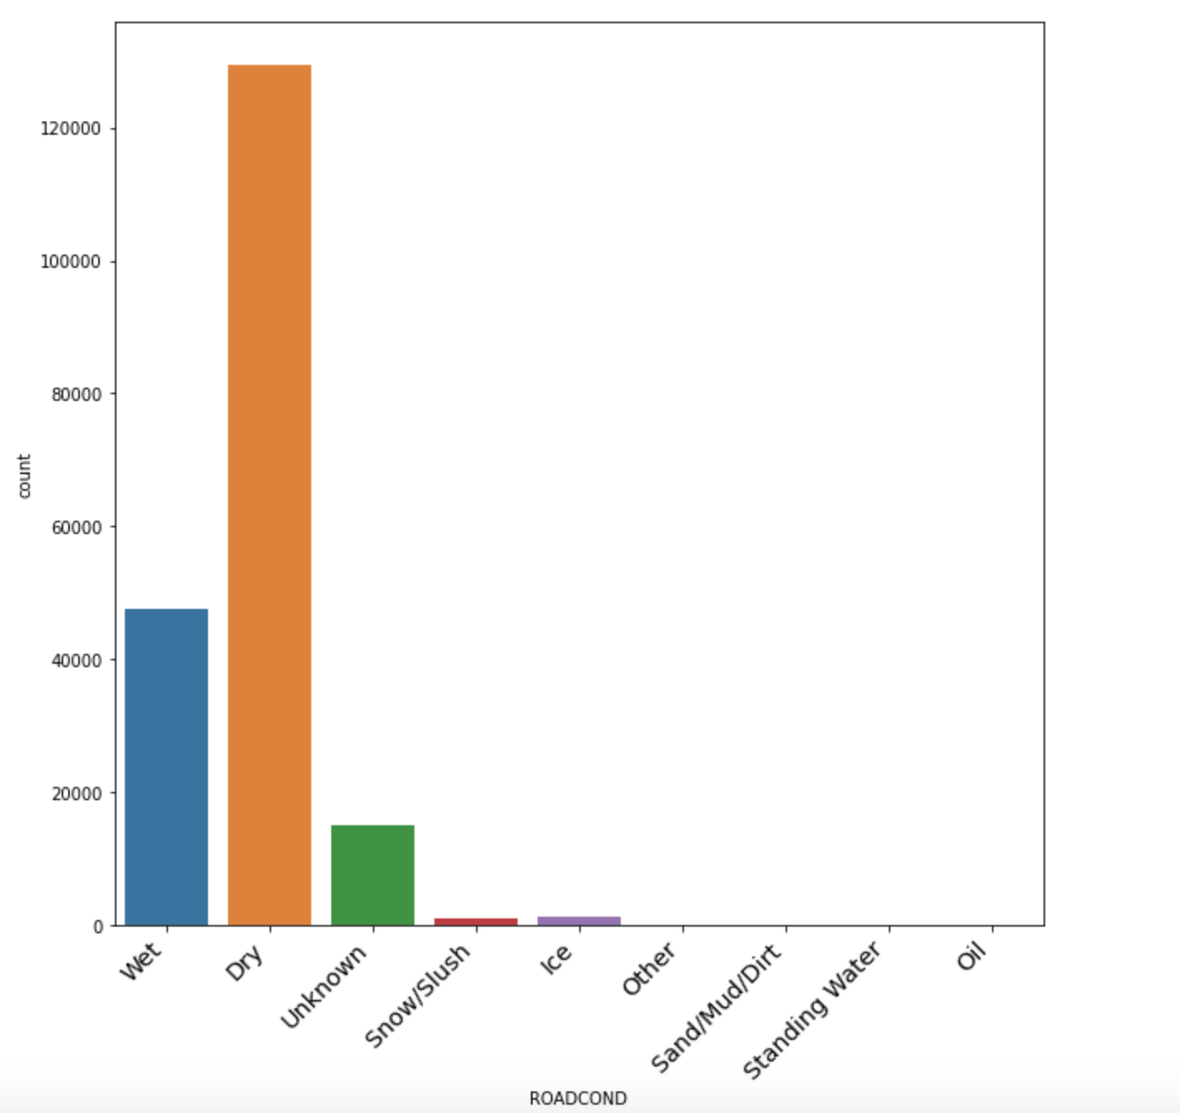
Data analysis
These two figures show most car accident happened in clear and dry whether.

Slide 6
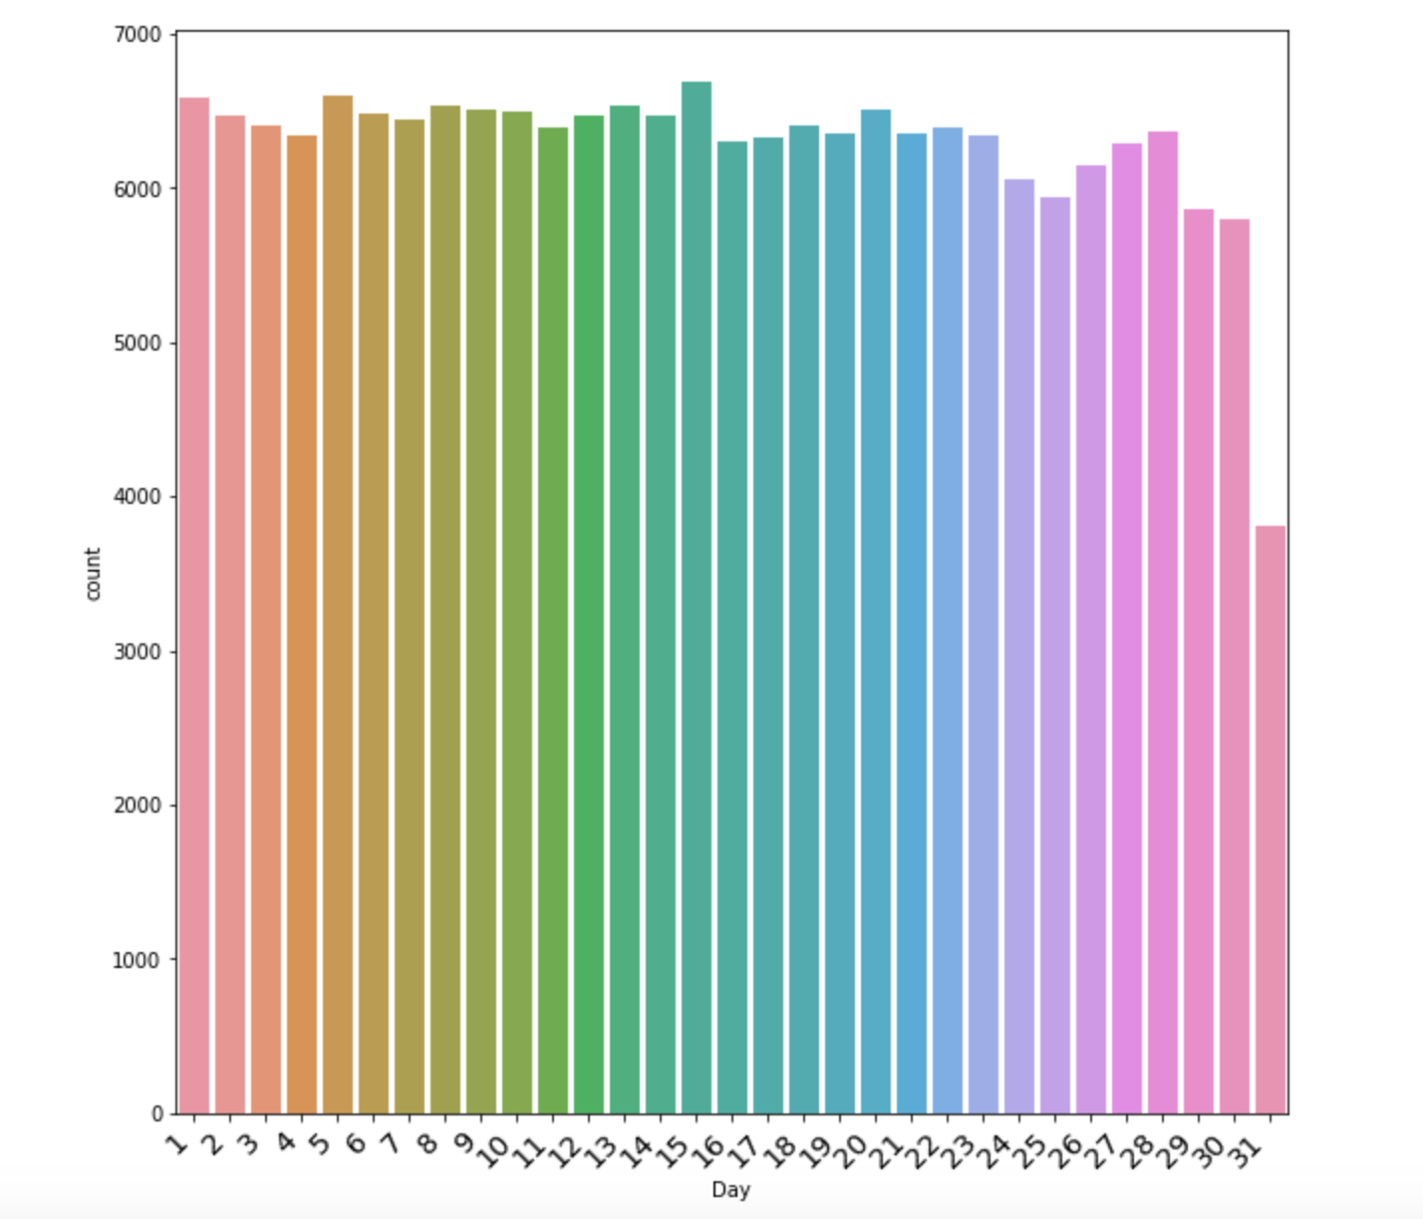
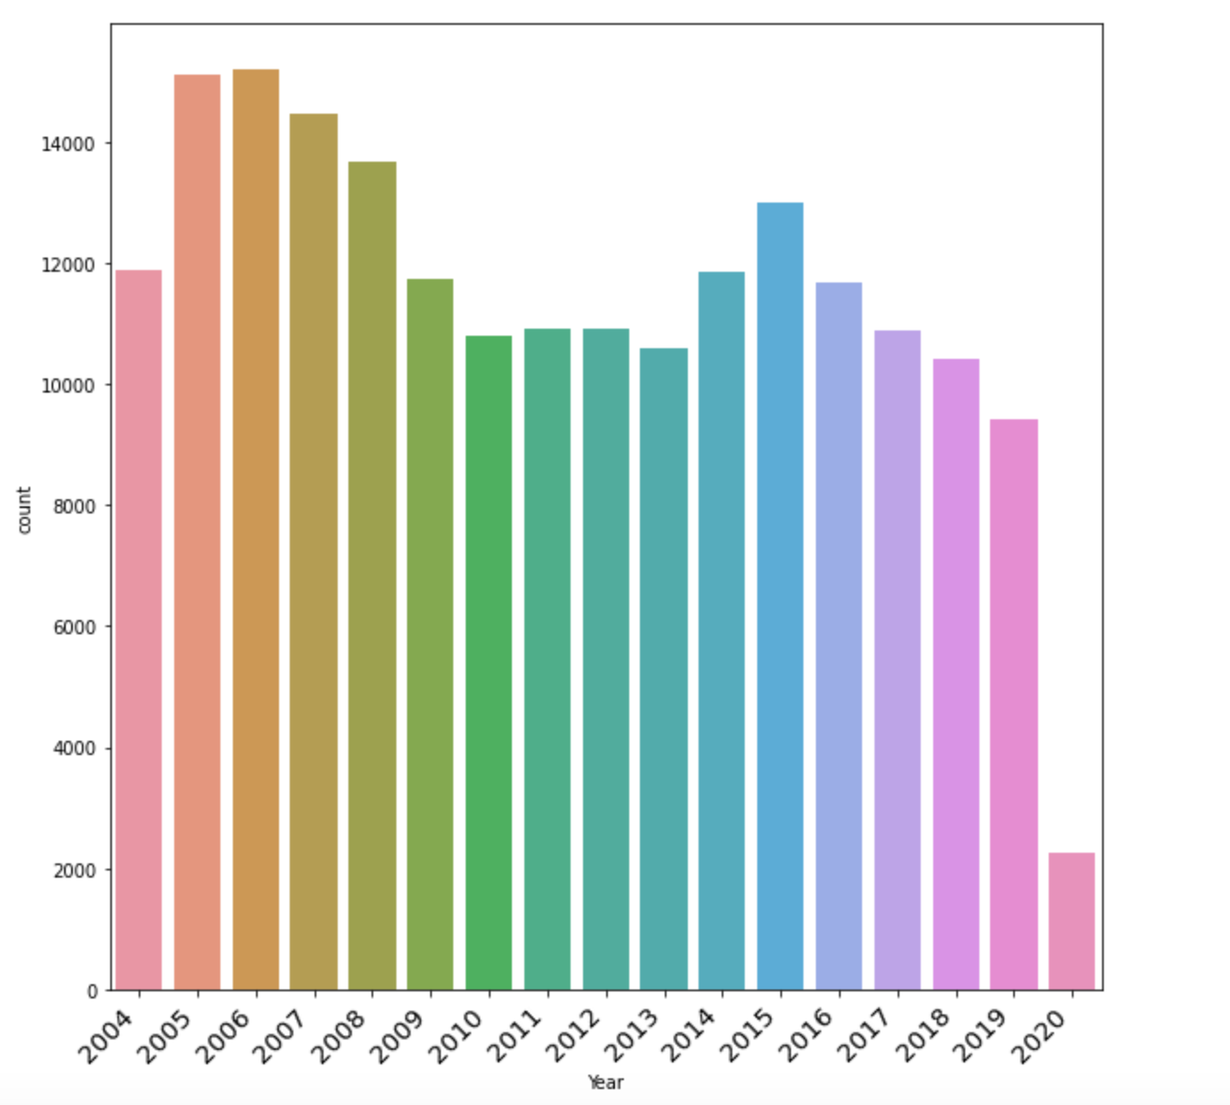
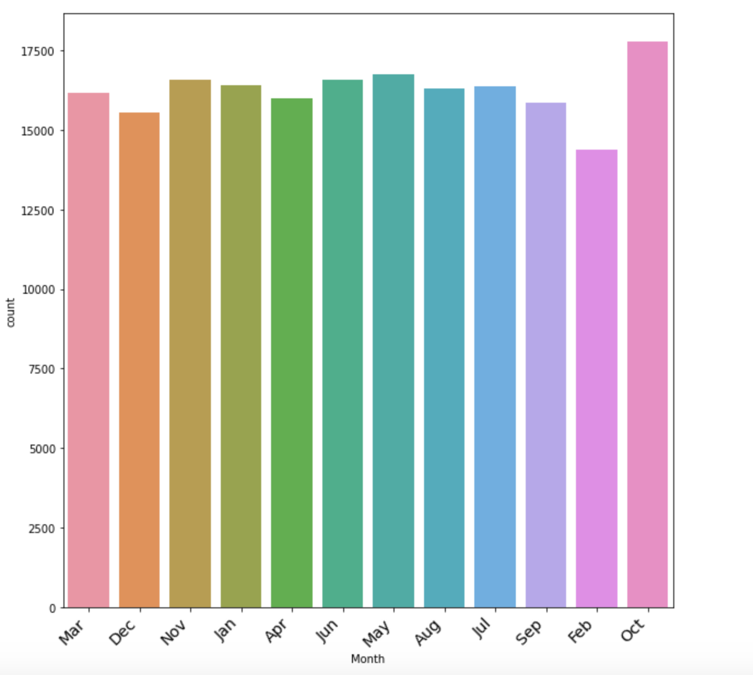
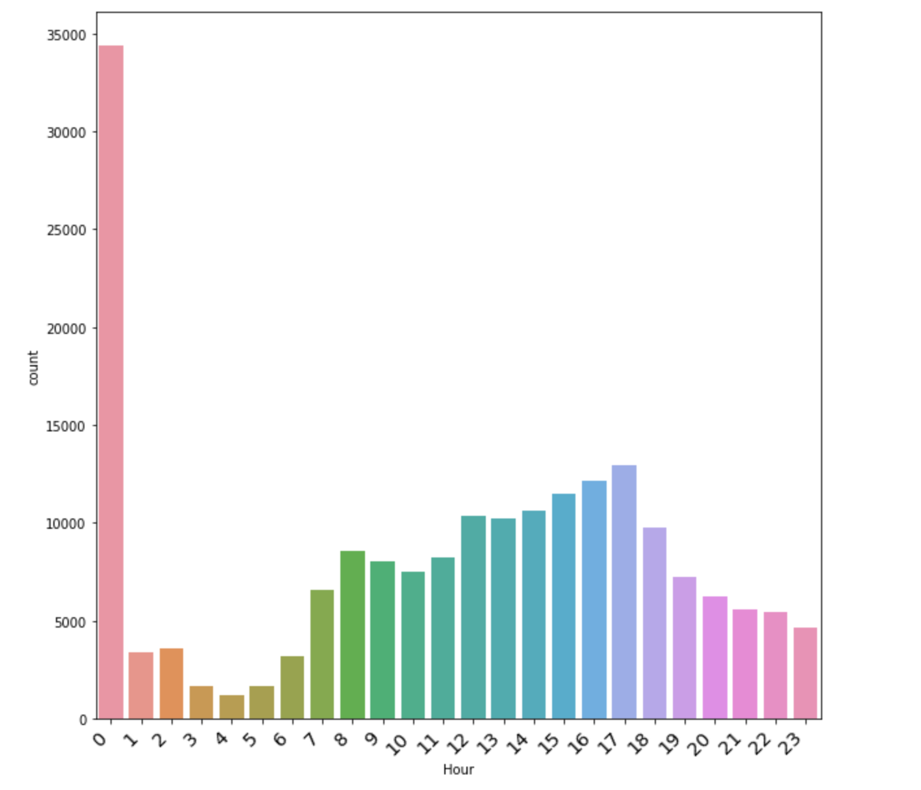
Data analysis
These are the year, month, day, and hour of the car accidents.

Slide 7
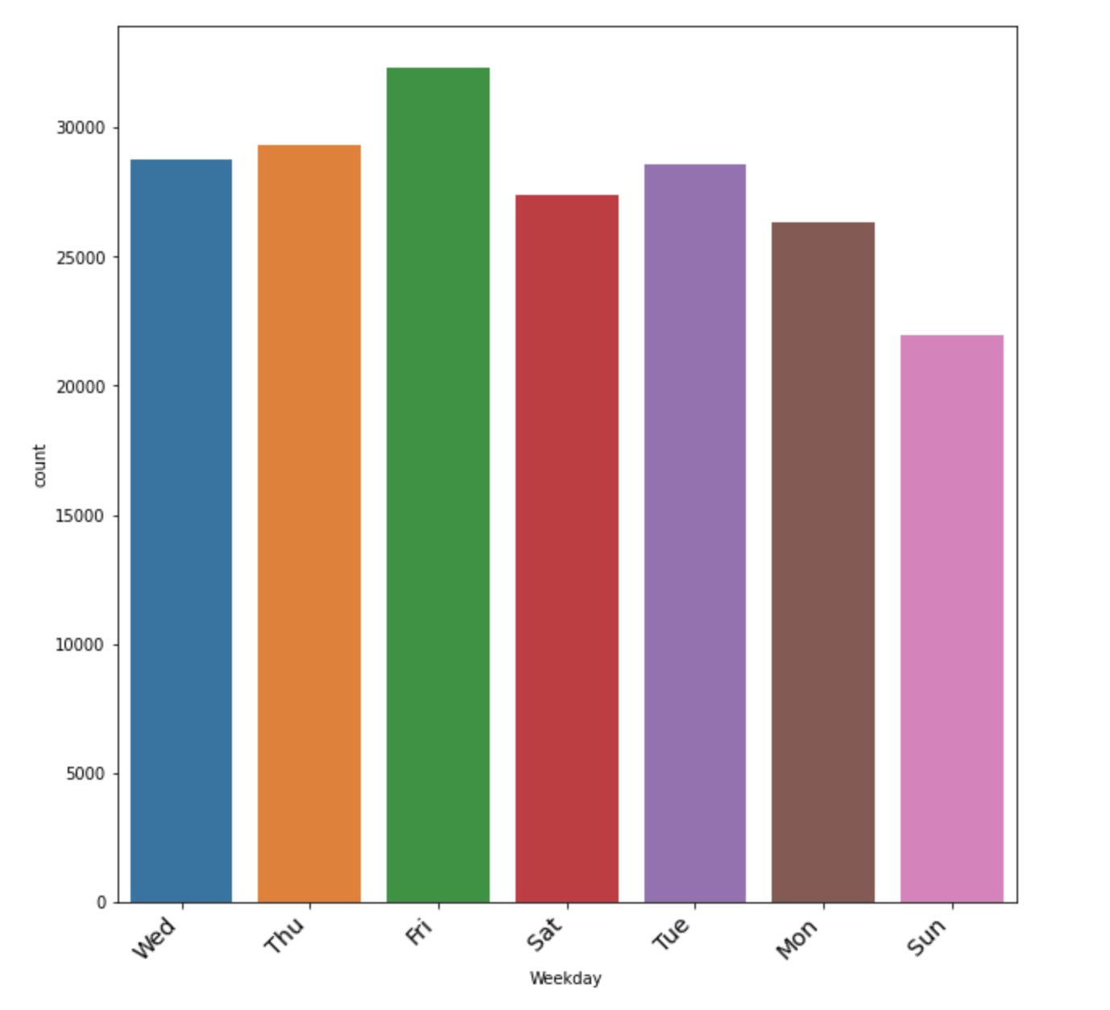
Data analysis
These figure shows the weekday of car accidents.

Slide 8
Modeling
In this part, we split the dataset into training and testing with 70% as training and 30% testing
We build Logistic Regression, Decision Tree and Random Forest models.

Slide 9
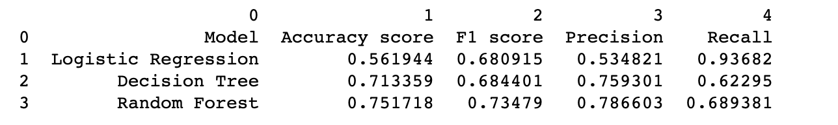
Evaluation
In this section, we introduce accuracy, F1 score, precision and recall to evaluate the models.
From the figure above, we can see Random Forest model performed best.

Slide 10
Conclusion
In our minds, there is tight correlation between weather conditions, road conditions, light conditions, junction types and severity of vehicles collisions. In reality there are so many attributes that affect the outcome of a crash so that the contribution of a specific one is too hard to be evaluated.
It remains the human influence the most significant factor for the result of an accident. The level of watchfulness, the driving experience and even the driving habits are difficult to be measured and to be part of a model.

