Slide 1

Costa Rican Household Poverty Level Prediction
Chang Liu, Ji Lyu, Jian Shen
2019.11.16

Slide 2
Outline
1. Introduction
2. Exploratory Data Analysis (EDA)
3. Feature engineering
4. Compare several baseline models
5. LightGBM optimize example
6. Final Model (90%+ accuracy)
Notes:
Multi-class classification
Supervised
Data is on an individual level, solutions are scored on a household level

Slide 3
Introduction
Our topic is to use living condition data to predict poverty level in Costa Rica.
Our project will help many social programs to distribute financial aids reasonably. Also, through this project, we can find out the most relevant features to poverty, so that other organizations can apply these features to their own aiding programs.

Slide 4
2 EDA
No. of records in the dataset: 9557 (training) / 23857 (testing) (individual level)
140+ features
Target (Categorical (int64)): Poverty Level (family level)
1 = extreme poverty
2 = moderate poverty
3 = vulnerable households
4 = non-vulnerable households
Level 1 = 755; Level 2 = 1597; Level 3 = 1209; Level 4 = 5996
Missing Values
Families without Household
Labels are incorrect
Features with mixed data types
Unbalance
Notes:
(individuals in the same household have a different poverty level)
Level 1 = 755; Level 2 = 1597; Level 3 = 1209; Level 4 = 5996

Slide 5
3 Feature Engineering
Aggregate features
by household & by geography
Add / Del features
Feature importance ranking system
Voting Classifier of 3 xgboost
Recursive Feature Elimination with Random Forest

Slide 6
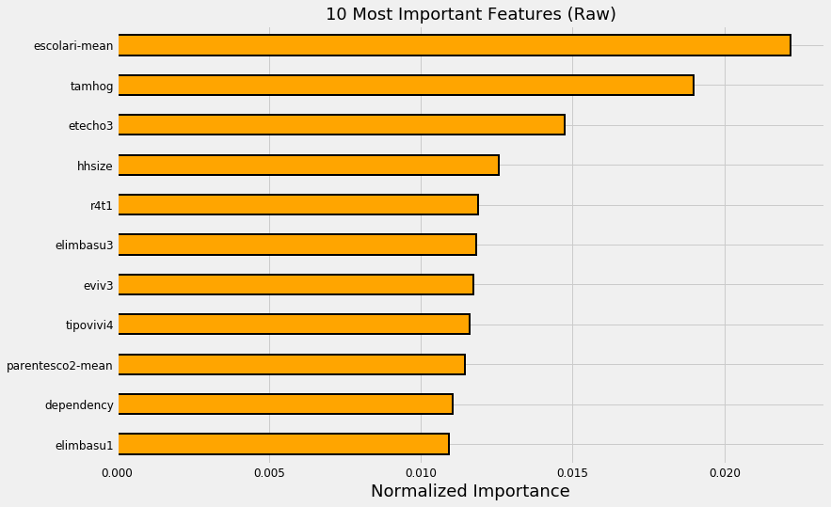
3 Feature Engineering
Feature importance ranking system
Voting Classifier of 3 xgboost

Slide 7
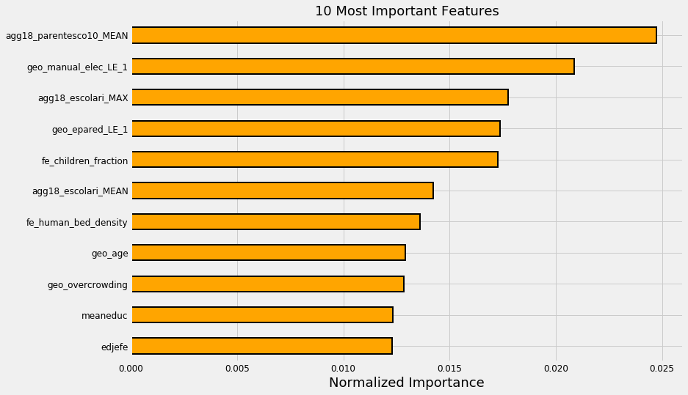
3 Feature Engineering
Feature importance ranking system
Voting Classifier of 3 xgboost

Slide 8
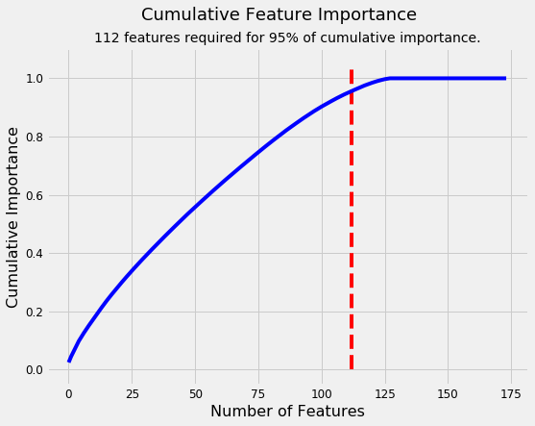
3 Feature Engineering
Feature importance ranking system
Voting Classifier of 3 xgboost

Slide 9
4 Data Split
Split data
K-Fold
Modify K-Fold
Pseudo Labeling (semi-supervised learning)

Slide 10
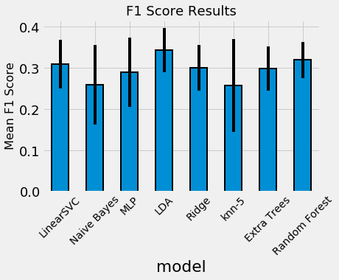
4. Baseline Models

Slide 11

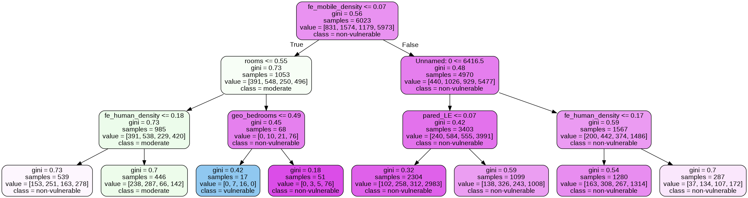
4. RF Visualization

Slide 12
5. LightGBM optimize example
Boosting compare
- lighgbm
- xgboost
Parameter Optimization
- Hyper Parameter search
Tree early stopping
- Decaying learning rate
- Accuracy
Dimension Reduction (Not work)

Slide 13
6. Final Model
Classifier
[1] Voting Classifier of 3*xgboost
- soft
- hard
[2] Voting Classifier of 3*Random Forest Classifier
- soft
- hard
[3] Combine [1] and [2]

Slide 14
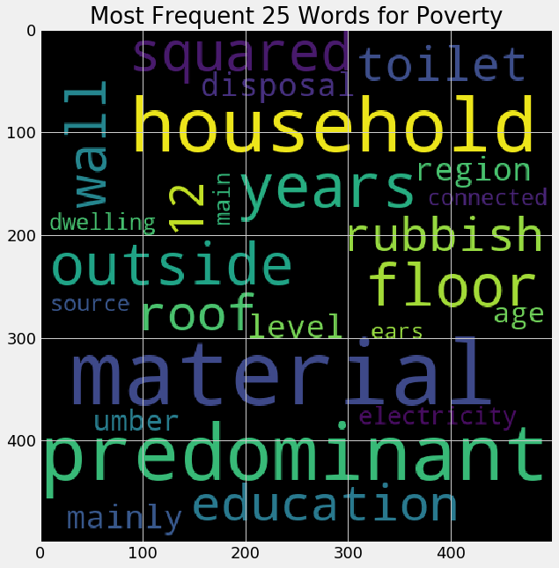
Expected Result & Conclusions
Word Cloud of Most frequency words used in data description

Slide 15

Thank You

