Slide 1
A Labeling Framework for Street
Scene Images
Big Data Science Practical -- Summer term 2018
Team SIJACO
12. 07. 2018
Advisors:
Felix Borutta & Dr. Tobias Emrich
Supervisor:
Prof. Dr. Thomas Seidl

Slide 2
Agenda
Motivation & Goals
Functionalities (Demo)
Pipeline Workflow
Active Learning Metrics
Experiment Results
Conclusions & Future Work
Notes:
Motivation and Goals (Ira)
Functionalities (Demo) (Chris & Sinksar)
Pipeline Workflow (Johannes)
Active Learning (Andrea)
Experiments (Otto)
Conclusions & Future Work (Otto)

Slide 3
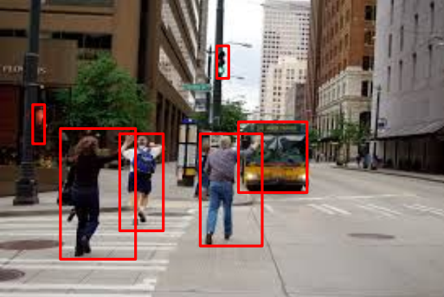
Motivation
Labeling images by humans is expensive
Build an Active Learning tool for automatic Object Detection & Labeling in images
Difficult images should be manually labeled & used for tool training
Motivation | Functionalities | Pipeline Workflow | Metrics |Experiments | Conclusion

Slide 4
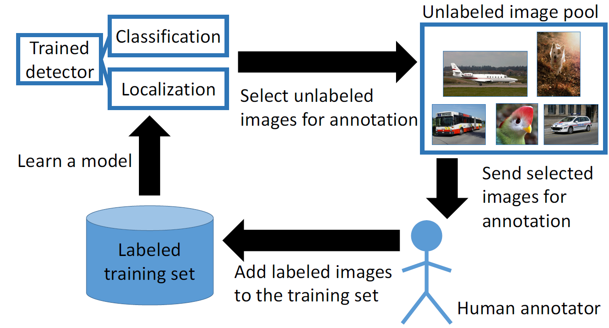
Active Learning for Object Detection
Prelabeled image pool
Select prelabeled
Images for annotation
Motivation | Functionalities | Pipeline Workflow | Metrics |Experiments | Conclusion

Slide 5
Goals
Active Learning based labeling tool
    Web UI
    Backend
Evaluation of Active Learning algorithms: Experiments
Motivation | Functionalities | Pipeline Workflow | Metrics |Experiments | Conclusion
Notes:
Change label | Adjust box | Delete box |New box → get proposal for label

Slide 6
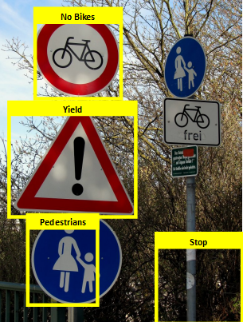
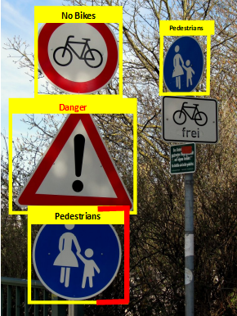

Goals
tool
user
Motivation | Functionalities | Pipeline Workflow | Metrics |Experiments | Conclusion

Slide 7
Functionalities
DEMO
To-Do’s:
  Functionalities Liste erstellen
  Testen
  In der Präsentation integrieren (bspw. Link)
Motivation | Functionalities | Pipeline Workflow | Metrics |Experiments | Conclusion

Slide 8
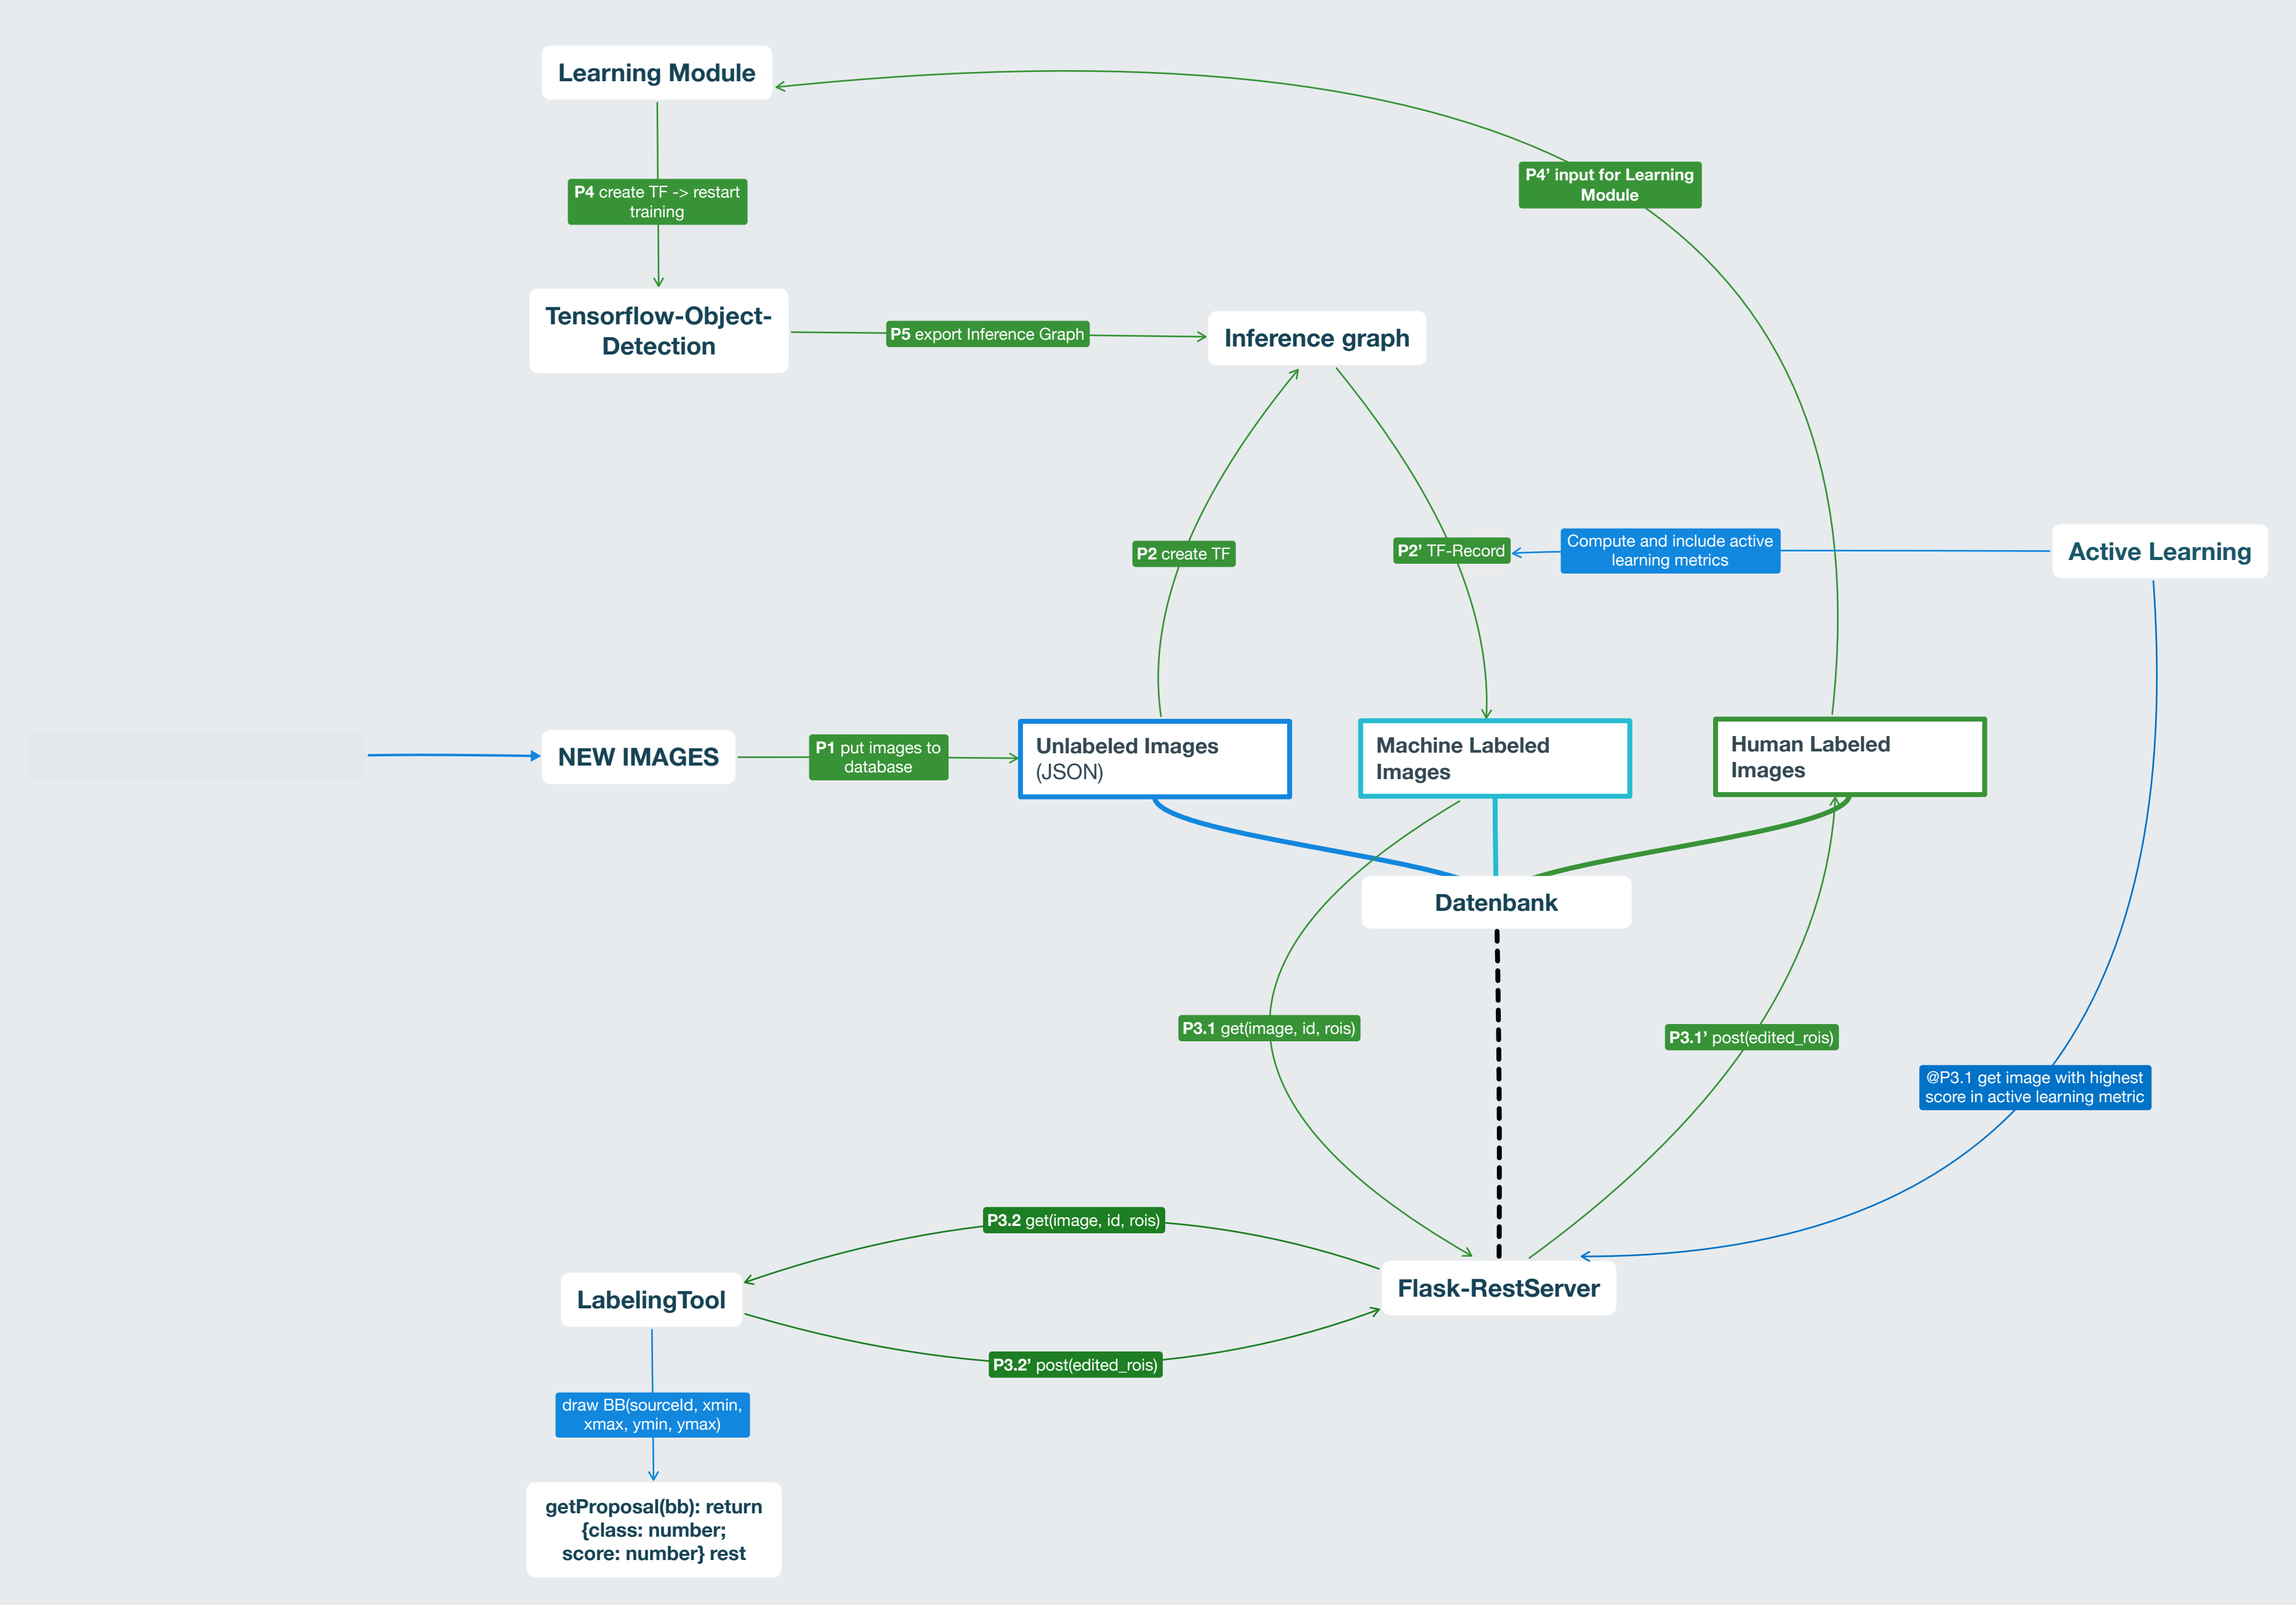
Motivation | Functionalities | Pipeline Workflow | Metrics |Experiments | Conclusion

Slide 9
Active Learning Metrics
Metrics:
  Random
  LS+C (Local Stability + Classifier)
  Classifier
Evaluation Metrics:
  Mean Average Precision (mAP)
Motivation | Functionalities | Pipeline Workflow | Metrics |Experiments | Conclusion

Slide 10
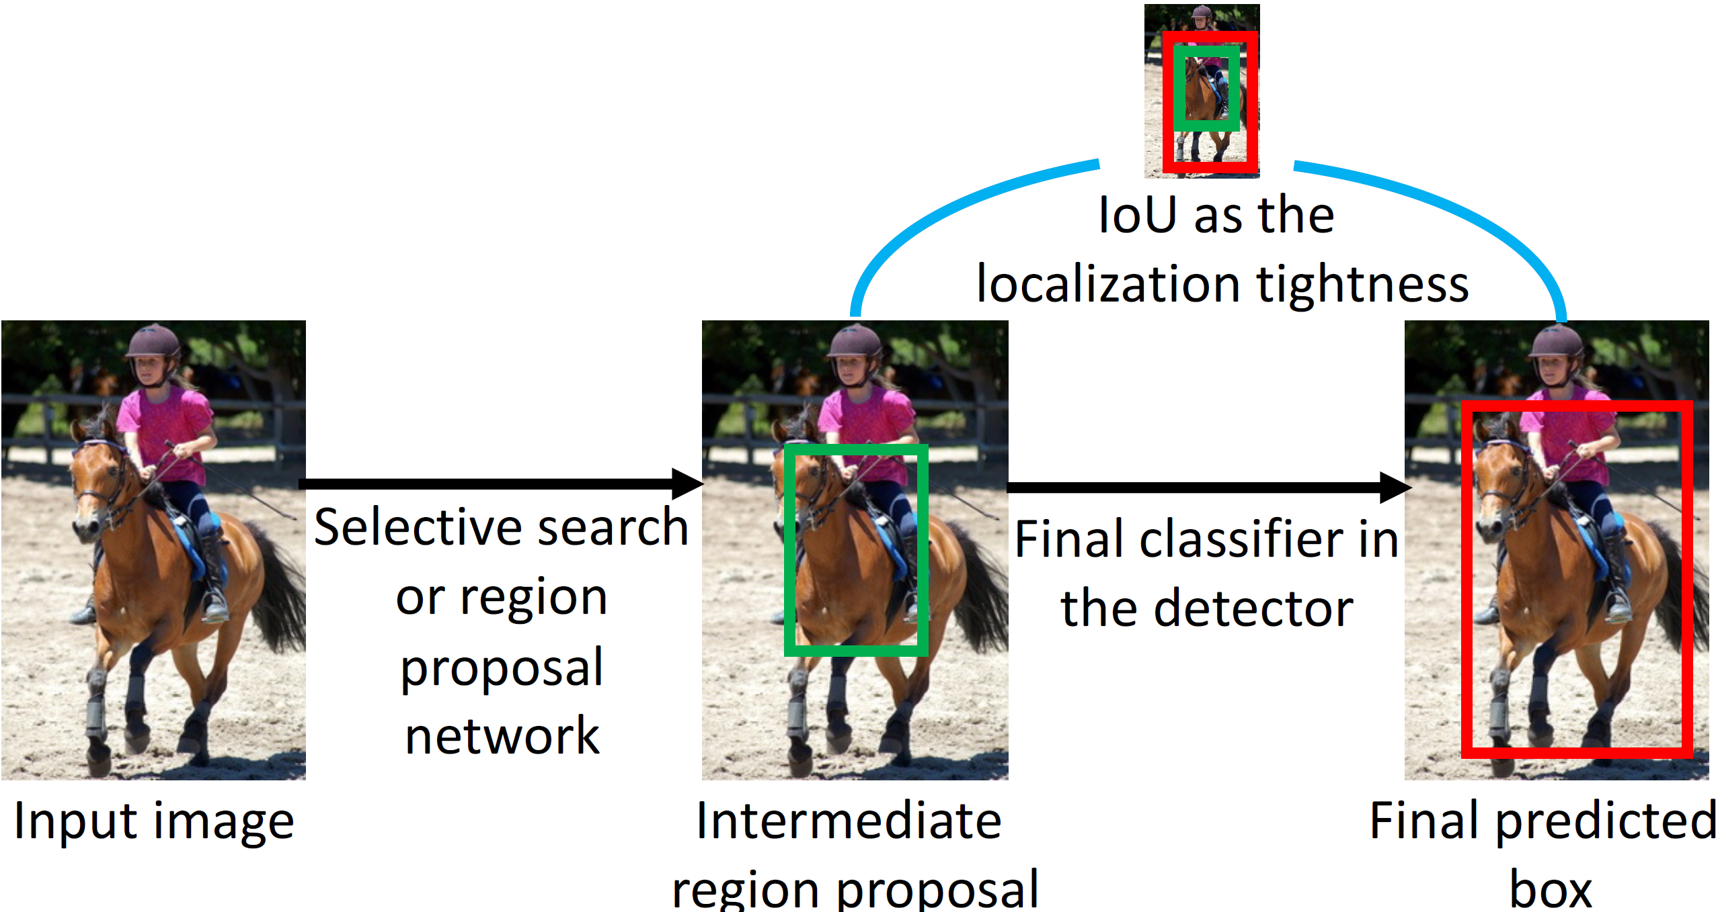
Localization Tightness
Motivation | Functionalities | Pipeline Workflow | Metrics |Experiments | Conclusion

Slide 11
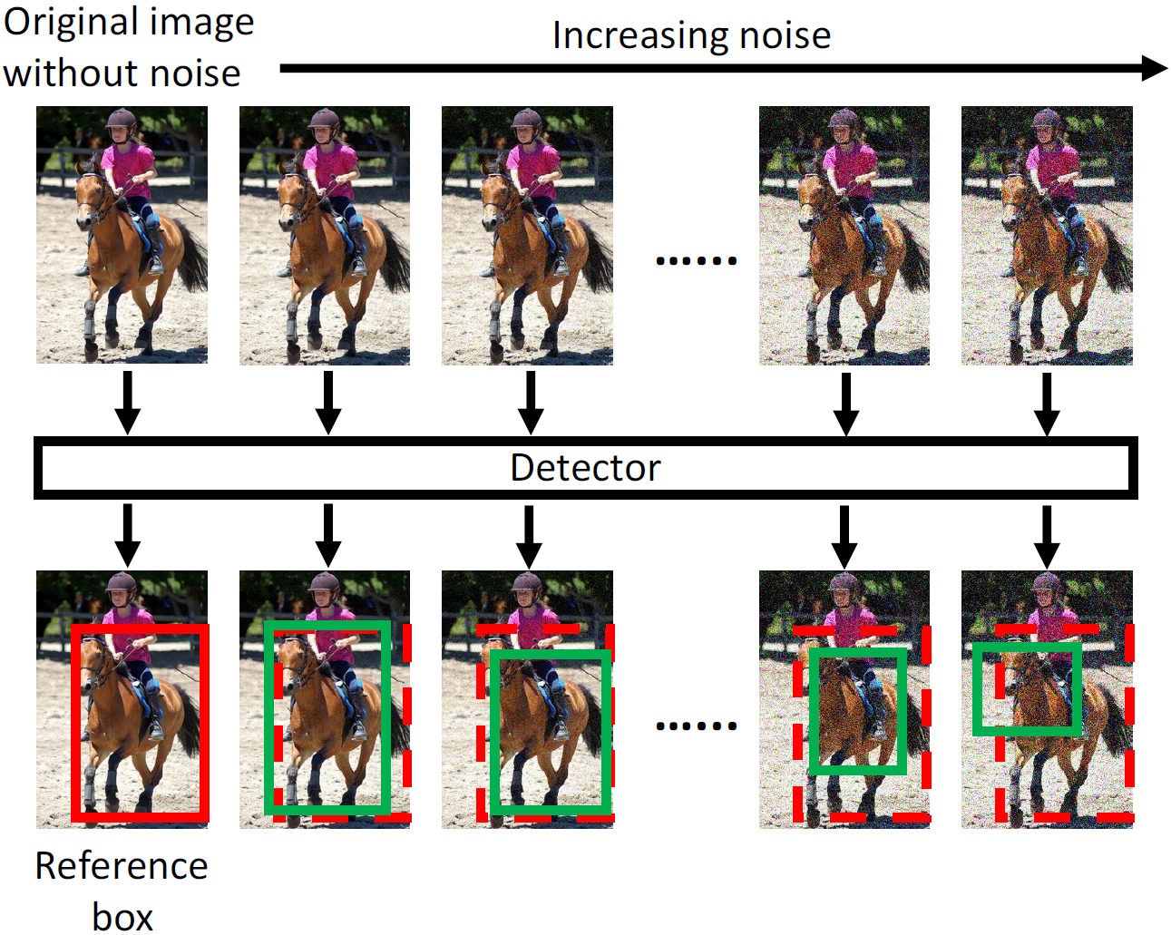
Localization Stability
Motivation | Functionalities | Pipeline Workflow | Metrics |Experiments | Conclusion

Slide 12
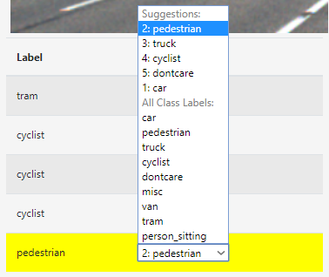
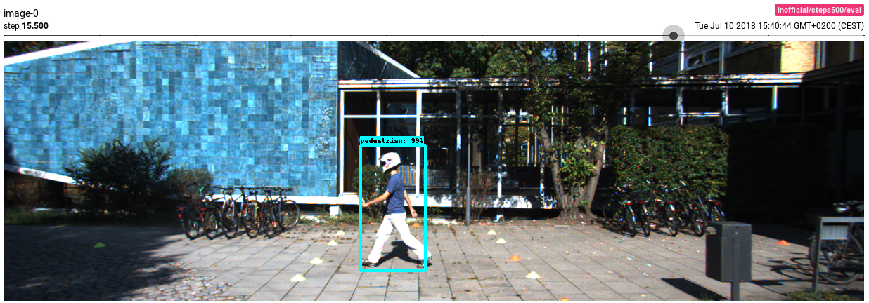
Classification Uncertainty
P_{max}(B) highest probability out of all classes for this box
Motivation | Functionalities | Pipeline Workflow | Metrics |Experiments | Conclusion

Slide 13
Mean Average Precision (mAP)
COCO AP: average over
IoU. AP@[0.5:0.95]
step size of 0.05. AP
“Mean” in (mAP) averages over all class categories
Motivation | Functionalities | Pipeline Workflow | Metrics |Experiments | Conclusion

Slide 14
Experiment Results 1
(Visualization)
(Explain the thoughts about why we got these results)
Motivation | Functionalities | Pipeline Workflow | Metrics |Experiments | Conclusion

Slide 15
Experiment Results ...
(Visualization)
(Explain the thoughts about why we got these results)
Motivation | Functionalities | Pipeline Workflow | Metrics |Experiments | Conclusion

Slide 16
Experiment Results n
(Visualization)
(Explain the thoughts about why we got these results)
Motivation | Functionalities | Pipeline Workflow | Metrics |Experiments | Conclusion

Slide 17
Conclusions & Future Work
To-Do’s:
  Conclusions:
    Product for Harman
    Everything works but still potential, see future work ;)
    Team work
      Cons:
        Zeitkoordination
        Kein fester Arbeitsort
        IT config
        Wenig Erfahrung vorher mit solchen Projekten
        Umfang des Projektes zu groß, viel Einarbeitungszeit nötig
        Keine einsteigerfreundliche Docu für tensorflow da, viel eigenes Austesten nötig
        Besser: mehr über Active Learning lernen
        Zu viele branches in git
        Häufig wechselnde Aufgaben
        Zu viel Zeit für UI, statt für tensorflow verbraucht?
      Pros:
        Firmenkooperation gut
        Viel gelernt
        Praktische Erfahrungen
        Motivation, Kooperation im team
        State of the art, aktuelles Thema
  Future Work:
    Thoughts about what future functionalities could look like
    Localization Tightness Experiments
    Automatized adaptation of number of iterations and images for training
Motivation | Functionalities | Pipeline Workflow | Metrics |Experiments | Conclusion

Slide 18
References
[1] mean Average Precision for Object Detection, Hui Jonathanhttps://medium.com/@jonathan_hui/map-mean-average-precision-for-object-detection-45c121a31173
[2] Presentation “A Labeling Framework for Street Scene Images”, 19.04.2018, Felix Borutta & Dr. Tobias Emrich
[3] Localization-Aware Active Learning for Object Detection,
Chieh-Chi Kao, Teng-Yok Lee, Pradeep Sen, Ming-Yu Liu, 16.01.2018
Motivation | Functionalities | Pipeline Workflow | Metrics |Experiments | Conclusion

