Slide 1
INTANGIBLE CAPITAL
& PRODUCTIVITY
DIVERGENCE
Denmark vs Italy · ICT Sector (NACE J) · 1996–2019
Group 6 | Internet and Network Economics | LUISS 2025

Slide 2
THE PRODUCTIVITY PUZZLE
Europe's productivity slowdown
Research Question
High-income economies, especially in Europe, have experienced underwhelming productivity growth since the 1990s. Digital technologies were expected to reverse this trend — yet their impact has been highly uneven across countries.
"To what extent do differences in the contribution of intangible capital services explain divergence in labour productivity growth between Denmark and Italy over the period 1995–2019?"
Why does this matter?
Slower productivity growth means less income to redistribute, weaker living standards improvements, and growing divergence between EU member states. Understanding where the gap comes from is a prerequisite for effective digital policy.
Why Denmark and Italy?
Both are high-income EU economies with comparable GDP, yet their ICT sector productivity trajectories have diverged markedly since 1996. Denmark consistently ranks among the EU's top digital economies; Italy consistently lags.
Internet and Network Economics — Prof. R. Urbani
Group 6 | Internet and Network Economics | LUISS 2025

Slide 3
GROWTH ACCOUNTING FRAMEWORK
Labour productivity growth (LP1_G) = Σ Capital contributions + TFP
Δ Intangible
Capital
Δ Tangible
ICT
Δ Total Factor
Productivity
LP
Growth
+
+
=
LP1ConIntang
LP1ConTangICT
LP1ConTFP
LP1_G
Assumptions & derivation
Under competitive markets, constant returns to scale and Cobb-Douglas technology, income shares equal output elasticities (Solow, 1957). Labour productivity growth equals the weighted sum of capital deepening contributions — broken down by asset type — plus the Solow residual (TFP). This decomposition is pre-computed in EUKLEMS & INTANProd using endogenous rates of return and asset-specific depreciation rates (Jorgenson & Griliches, 1967; Bontadini et al., 2023).
Capital deepening vs TFP
Why intangibles matter
Capital deepening captures more capital per worker. TFP captures efficiency gains not explained by capital — including organisational innovation, management quality, and mismeasurement.
EUKLEMS extends national accounts to include non-NA intangibles: organisational capital (I_OrgCap), software & databases (I_Soft_DB), R&D, training, brand. These are the assets most directly linked to digitalisation.
Group 6 | Internet and Network Economics | LUISS 2025

Slide 4
DATA & METHODOLOGY
Dataset
Variables (7)
Scope & filters
EUKLEMS & INTANProd
2024 release
Two sub-databases:
— Growth Accounts Extended
— Intangibles Analytical
Source: Bontadini et al. (2023)
Luiss University / EU-funded
LP1_G — LP growth rate ★
LP1ConIntang — intangible contribution ★
LP1ConTFP — TFP contribution
LP1ConTangICT — tangible ICT
I_Intang — total intangible investment
I_OrgCap — organisational capital
I_Soft_DB — software & databases
Countries: Denmark · Italy
Sector: J (ICT) — primary
TOT_IND — economy benchmark
C, M — supporting comparison
Period: 1996–2019
(2020–2021 excluded: COVID)
Panel: 192 obs · 0 missing values
★ Primary variables for the research question. Panel constructed by merging Growth Accounts Extended (LP variables) and Intangibles Analytical (I_ variables), filtered to 1996–2019, format converted from wide to long.
Group 6 | Internet and Network Economics | LUISS 2025

Slide 5
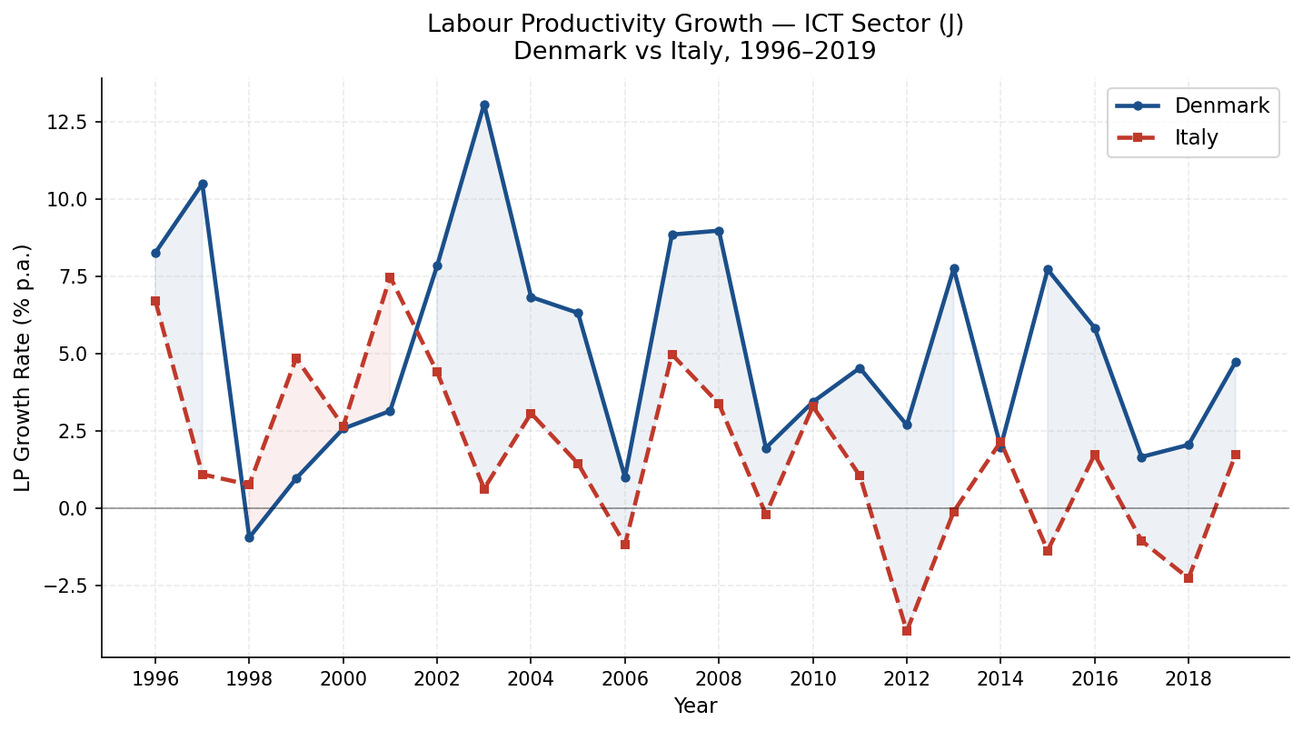
THE DIVERGENCE — ICT SECTOR LABOUR PRODUCTIVITY GROWTH
+3.35
avg. pp gap per year
(DK − IT, sector J)
24
[INSERT Chart 1: LP1_G line chart, sector J, DK vs IT, 1996–2019]
consecutive years
of divergence
2012
inflection point
Italy goes negative
The gap is persistent,
not cyclical
Group 6 | Internet and Network Economics | LUISS 2025

Slide 6
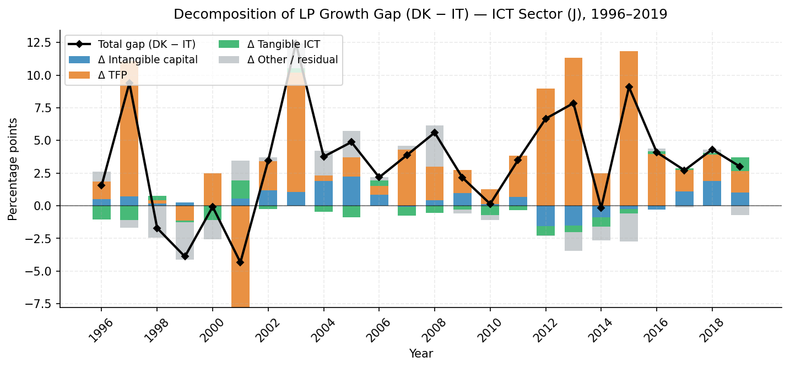
DECOMPOSING THE GAP — WHAT DRIVES DENMARK'S ADVANTAGE?
Key insight
TFP is the dominant driver of the gap, explaining ~95% on average.
However, intangibles contribute systematically and consistently — never zero — throughout the full 1996–2019 period.
Tangible ICT (hardware) contributes negatively on average — hardware alone does not explain the divergence.
[INSERT Chart 2: Stacked bar gap decomposition, sector J, annual]
~3.2 pp
~0.5 pp
−0.2 pp
TFP contribution
(avg. annual gap)
Intangible contribution
(avg. annual gap)
Tangible ICT contribution
(avg. annual gap)
Group 6 | Internet and Network Economics | LUISS 2025

Slide 7
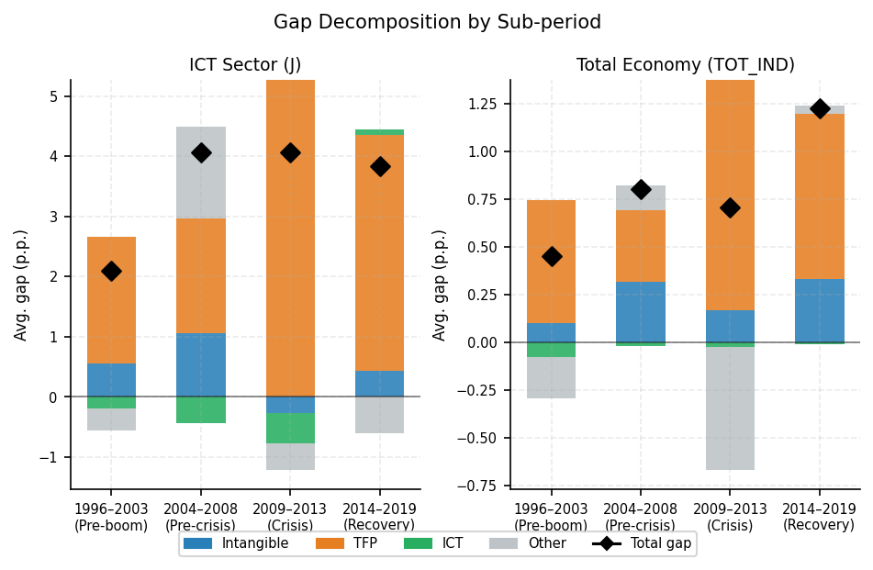
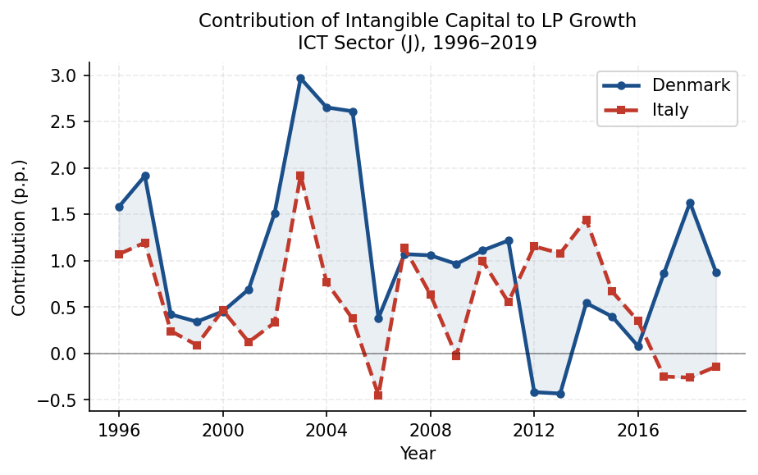
THE INTANGIBLE CHANNEL — EVOLUTION ACROSS SUB-PERIODS
[INSERT Chart 6: Sub-period gap decomposition, J vs TOT_IND]
[INSERT Chart 3: LP1ConIntang over time, DK vs IT, sector J]
1996–2003
2004–2011
2012–2019
Total gap: 2.10 pp | Intangibles: 0.56 pp (27% of gap)
Total gap: 3.26 pp | Intangibles: 0.88 pp (27% of gap)
Total gap: 4.70 pp | Intangibles: −0.06 pp (neg. of gap)
★ Original finding: After 2011, Italy's intangible capital contribution turns negative (−0.06 pp avg.) while Denmark's remains positive — a structural deterioration within the ICT sector that compounds the TFP gap.
Group 6 | Internet and Network Economics | LUISS 2025

Slide 8
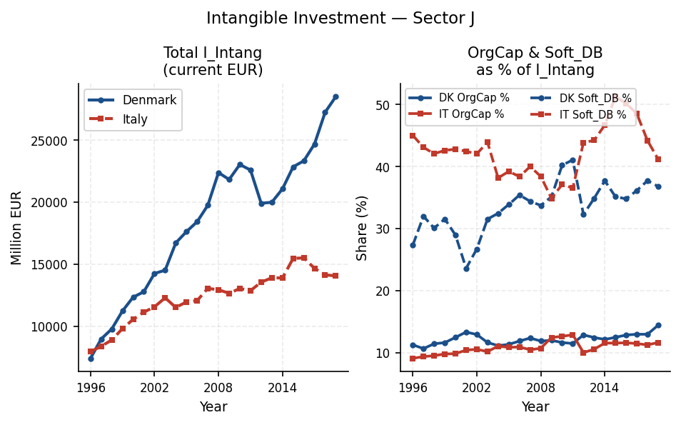
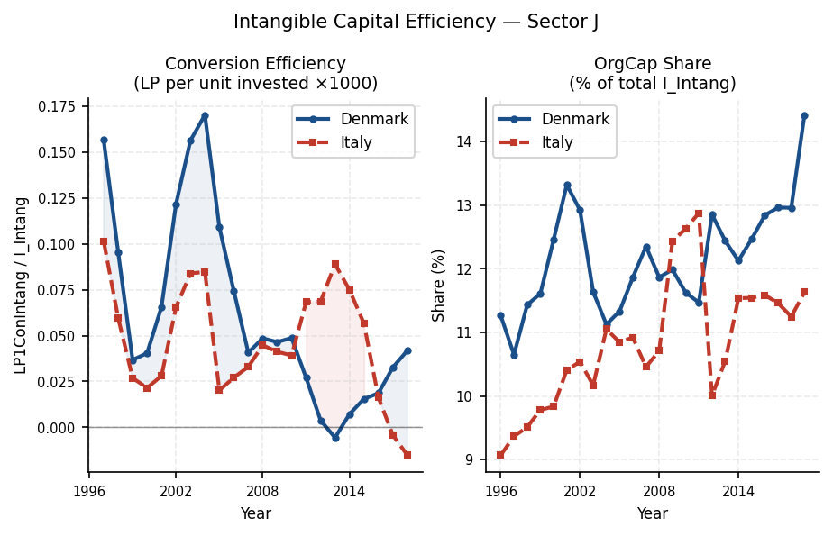
UPSTREAM: INVESTMENT SCALE AND CONVERSION EFFICIENCY
[INSERT Chart 4: I_Intang levels + OrgCap & Soft_DB composition, sector J]
[INSERT Chart 7: Conversion efficiency LP1ConIntang/I_Intang, 3yr rolling, sector J]
Investment scale
Conversion efficiency
Denmark's intangible investment (I_Intang) grew from ~€7.4bn to ~€28.5bn in sector J. Italy's grew more slowly and plateaued after 2014 (~€14bn). The gap is about scale, not composition alone.
Denmark consistently generates more LP growth per unit of intangible investment throughout 1996–2012. Post-2012 the gap narrows — a nuance we acknowledge. Metric: LP1ConIntang / I_Intang × 1000, 3-year rolling avg.
Group 6 | Internet and Network Economics | LUISS 2025

Slide 9
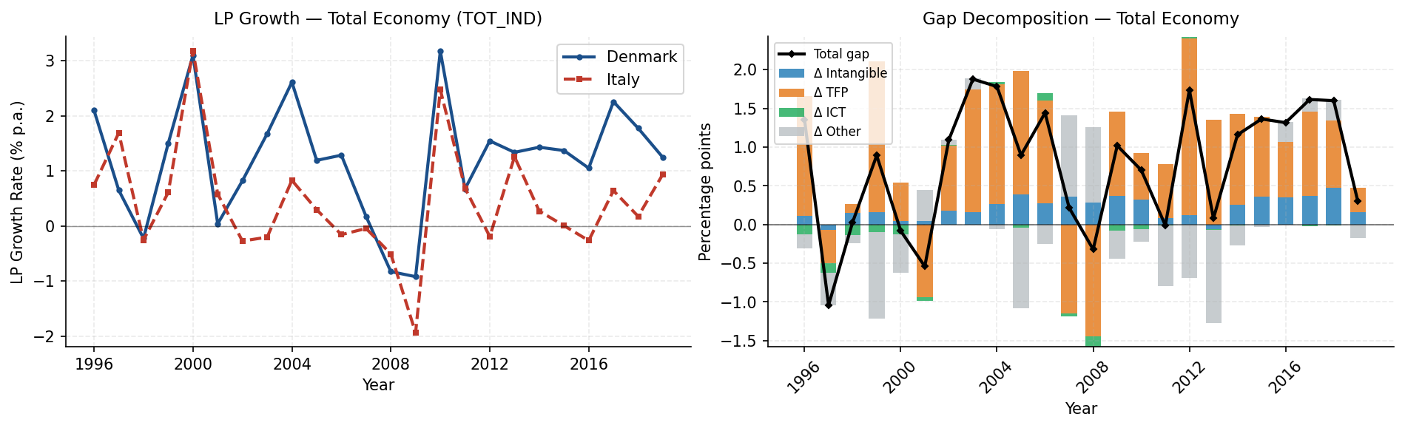
BENCHMARK — IS THIS AN ICT-SPECIFIC PHENOMENON?
[INSERT Chart 5: TOT_IND LP1_G line chart (left) + gap decomposition (right)]
 | ICT Sector (J) | Total Economy (TOT_IND)
Avg. LP gap (DK − IT) | +3.35 pp/year | +0.91 pp/year
Intangible contribution to gap | ~0.46 pp (14%) | ~0.21 pp (23%)
TFP contribution to gap | ~3.18 pp (95%) | ~0.76 pp (83%)
The divergence exists at all levels, but it is significantly larger and more structural in the ICT sector — confirming it is not a general macroeconomic phenomenon.
Group 6 | Internet and Network Economics | LUISS 2025

Slide 10
INSTITUTIONAL CONTEXT — WHY DENMARK CONVERTS BETTER
Indicator | 🇩🇰 Denmark | 🇮🇹 Italy | Source
Number of enterprises, Sector J (2019) | 18,961 | 104,879 | Eurostat SBS (sbs_na_sca_r2)
Avg. persons employed per enterprise, Sector J (2019) | 6.5 | 5.6 | Eurostat SBS (calculated)
EPL Index — regular contracts, Version 1 (2019) | 1.53 | 2.56 | OECD EPL Database (2019)
Flexicurity model (Denmark)
Fragmented firm structure (Italy)
Denmark's EPL of 1.53 vs Italy's 2.56 means significantly lower cost of organisational restructuring. Under the flexicurity model, firms can redeploy labour to implement digital technologies without prohibitive legal risk — a prerequisite for effective organisational capital investment. This is consistent with Denmark's higher and rising OrgCap share.
Italy's ICT sector has nearly 6× more enterprises than Denmark (105K vs 19K), reflecting a fabric of micro-firms. Small firms face structural barriers to OrgCap investment: insufficient management layers, limited balance sheet capacity, and no scale to benefit from organisational innovations. This is consistent with Italy's lower and more volatile intangible contribution.
Causality note: institutional factors are interpreted as consistent with observed data patterns. No formal causal identification is established — this analysis is descriptive and interpretive.
Group 6 | Internet and Network Economics | LUISS 2025

Slide 11
ANSWER TO THE RESEARCH QUESTION
"To what extent do differences in the contribution of intangible capital services explain divergence in labour productivity growth between Denmark and Italy over the period 1995–2019?"
Intangible capital explains approximately 14% of the annual LP growth gap in the ICT sector (≈0.46 of 3.35 pp). TFP remains the dominant driver across all sub-periods.
However, the intangible channel is not static. It is positive and growing in the pre-crisis era (1996–2011), then turns negative for Italy (−0.06 pp avg.) while remaining positive for Denmark in 2012–2019. This structural divergence within the divergence — a widening intangible gap on top of the TFP gap — is the most original finding of this analysis.
This pattern is consistent with institutional differences: Denmark's flexicurity model lowers restructuring costs; Italy's fragmented firm structure limits investment at scale. We argue this explains why Denmark converts each euro of intangible investment into more productivity growth.
Limitations: analysis is descriptive and based on aggregate sector-level data. No formal causal identification is established. Other determinants (R&D policy, digital infrastructure, education) are not captured.
Group 6 | Internet and Network Economics | LUISS 2025

Slide 12
CONCLUSIONS & LIMITATIONS
Conclusions
Limitations
Persistent divergence
1. Aggregate sector-level data: no firm-level identification possible.
1
Denmark's ICT sector LP advantage over Italy averages +3.35 pp per year across 1996–2019. The gap is structural, not cyclical.
2. No formal causal identification: institutional links are interpretive, not econometrically established.
Intangibles: systematic but partial
3. Other determinants not captured: R&D policy, digital infrastructure, education systems, public investment.
2
Intangible capital explains ~14% of the gap directly. More importantly, Italy's intangible contribution turns negative post-2011 — a deterioration that amplifies the TFP gap.
4. Post-2012 efficiency gap narrows for reasons not fully explained by the model.
Efficiency over volume
3
Data sources
The most original finding: Denmark does not just invest more — it converts each euro of intangible investment into productivity more efficiently, consistently throughout 1996–2012.
EUKLEMS & INTANProd (2024)
Bontadini et al. (2023)
Eurostat SBS — sbs_na_sca_r2
OECD EPL Database (2019)
Thank you — we welcome your questions
Group 6 | Internet and Network Economics | LUISS 2025

